Slide 1
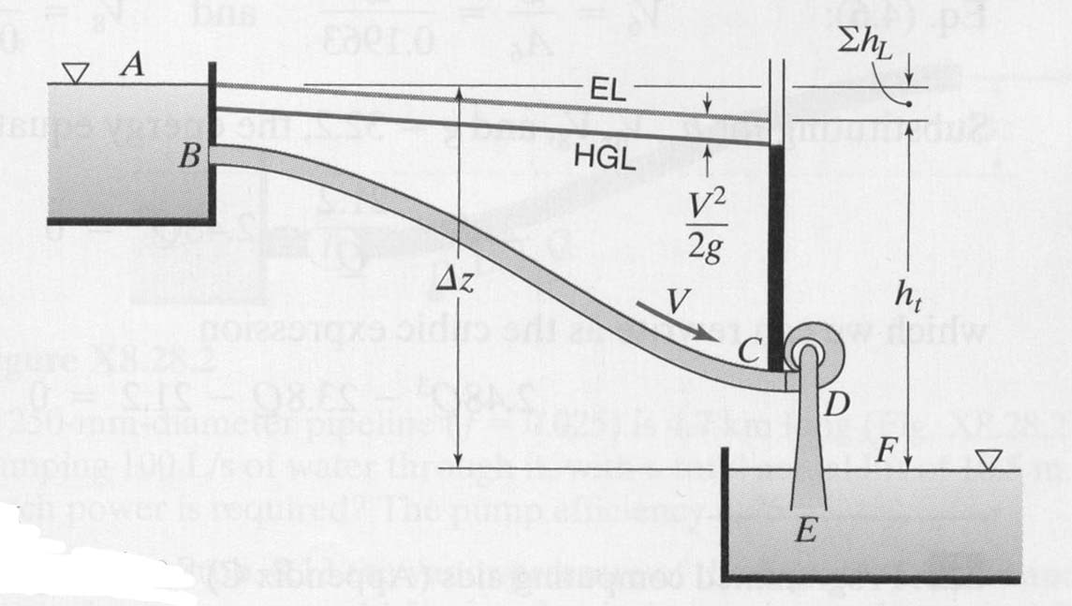
Example
Pipe between B and E has l = 200 ft, D = 12 in., f = 0.021;
Vertical distance between surfaces of two reservoirs is 120 ft.
Pipe is flush with wall at B.
(a) What head is supplied to the turbine when Q = 8 ft³/s?
(b) What power does the turbine deliver if η_{turb} is 75%?

Slide 2
(a) What head is supplied to the turbine when Q = 8 ft³/s?

Slide 4
(b) What power does the turbine deliver if η_{turb} is 75%?

Slide 5
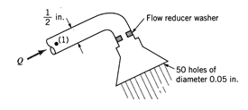
Example
To conserve water and energy, a “flow reducer” is installed in the shower head shown at the right. If the pressure at point (1) remains constant and all losses except for that in the flow reducer are neglected, determine the value of the loss coefficient (based on the velocity in the pipe) of the flow reducer, if it’s presence is to reduce the flow rate by a factor of two. Assume that the elevation difference between point (1) and the outlet is negligible.
Write the energy equation before and after installation of the flow reducer, and solve for p₁ in each case.

Slide 6
Before:
Simplifications:
By continuity:

Slide 7
After:
Simplifications:
Again, by continuity:

Slide 8
Given:
Given:

Slide 9
