Slide 1
Analysis of Hydrokinetic Turbines in Open Channel Flow
Arshiya Hoseyni Chime
Advisor: Professor Phil Malte
UW –NNMREC
04 November 2012

Slide 2
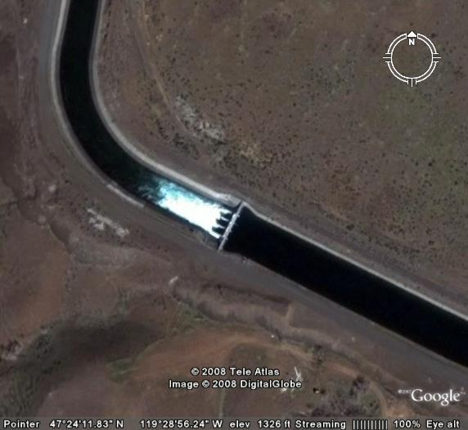
Irrigation Canals
Traditional: Sluice gates for flow control
Opportunity: Hydrokinetic turbines for flow control and power generation
Approximately 1 MW power loss

Slide 3
Approach
1-D modeling using conservation of mass, linear momentum and energy equations
3-D CFD modeling
Volume of Fluid model
Open Channel Flow Boundary Conditions
Turbines
Actuator Disc Model
Virtual Blade Model
Power generation vs flow control

Slide 4
1-D Theory
Turbine
Drawing courtesy of Dr. Polagye

Slide 5
Effect of Channel Constriction on Water Depth
Decrease in channel width to increase blockage ratio and velocity
Subcritical and supercritical solutions

Slide 6
Effect of Channel Constriction on Power Generation
Stream Conditions
Flow rate= 130 m³/s
Upstream energy=5.08 m
3 Turbines, each with 4 m diameter
Froude number=0.18-0.24

Slide 7
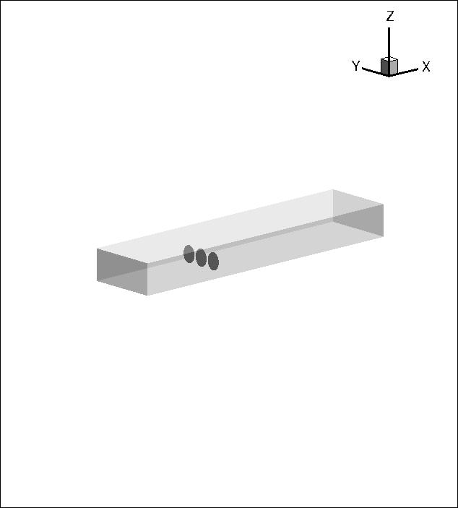
CFD-Actuator Disc Model
Fluent14.0
Volume of Fluid Model
Coupled Pseudo-Transient Solver
turbulence model
Porous Media Model to define resistance across the turbine (ΔP based on 1D theory)
No slip at walls

Slide 8
Boundary Conditions
Mass flow inlet
Pressure outlet
50 kg/s
2.5 m
air
water
132,800 kg/s
D=4 m
t= 0.2 m
5 m
2.5 m
30 m
60 m

Slide 9
Free Surface Elevation
Both 1D theory and 3D CFD show a 2% drop in water depth for the 21m case, and a 4% drop for the 16 m case.

Slide 10
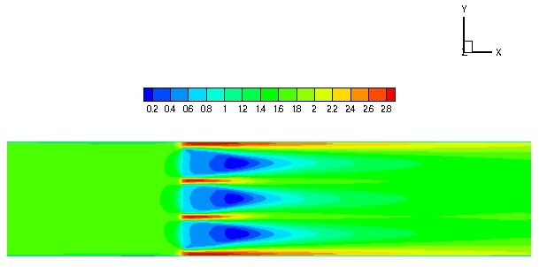
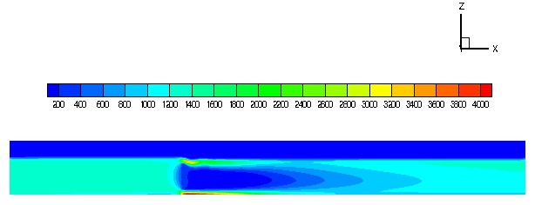
Velocity and Dynamic Pressure Profiles (16m)
Velocity Magnitude [m/s]
Dynamic Pressure [Pa]

Slide 11
To do …
Supercritical Cases with ADM
Virtual Blade Model in Fluent

Slide 12
Acknowledgement
Professor Malte
Professor Riley
Dr. Novosselov
Ms. Megan Karalus
Northwest National Marine Renewable Energy Center
Department of Energy

