Slide 1
Exam 3 Review
Psych 101B: Spring 2013

Slide 2
Memory
The mental capacity to encode information, store information over time, and retrieve the information at a later time
Three major memory states:
Sensory: Limited only by capacity of sensory system, & lasts ~½ second (Sperling’s experiments)
Short Term: 7 ± 2 “chunks” of info, & lasts for a few minutes without rehearsal (phone numbers)
Long Term: Finite, but immense! Not known what the limit is (The case of ”S”)
Notes:
Sperling: flashed letter matrix for 1/20th of a second! Subjects had to recall letters, consistently recalled ~4 letters

Slide 3
Types of Long Term Memories
Declarative: Memories you can talk about
Episodic: specific events
Semantic: meanings of objects, words, etc.
Procedural: Memories you can’t talk about (e.g. Tower of Hanoi puzzle, riding a bike, driving, etc.)
Amnesiacs lose mostly episodic memories
Semantic dementia patients lose mostly semantic memories
Alzheimer’s patients lose both episodic & semantic

Slide 4
How it Works and When it Doesn’t
Initial encoding depends on hippocampus & related structures
Long term storage depends on cortex
Consolidation: process of going from initial encoding to long term storage
Seems to happen during sleep
Retrograde amnesia: Can’t remember things before brain damage
Anterograde amnesia: Can’t remember things after brain damage

Slide 5
Amnesia: Adrift in the Abyss
Clive Wearing: lost memory due to viral encephalitis, which typically damages temporal lobe & hippocampus, as well as parts of cortex
Result: profound retrograde & anterograde amnesia
H.M.: Suffered from seizures and underwent bilateral medial temporal lobe removal, including hippocampus
Result: mild retrograde amnesia & anterograde amnesia
Other causes: ECT, Korsakoff’s syndrome, dementia, head trauma

Slide 6
Long Term Memory Permanence
Brain Stimulation: Penfield stimulated temporal lobe, sometimes leading to remembering long “forgotten” memory
Hypnosis: Under hypnosis people sometimes have access to memories they would not otherwise recall (e.g. Boston Strangler)
Spontaneous Recovery: People sometimes seem to recover memories that they had “forgotten” (e.g. childhood sexual abuse)

Slide 7
Are Long Term Memories Permanent & Accurate?
Loftus, Lost in the Mall: Students wrote a letter to a younger sibling that included 4 real events in the sibling’s past, and 1 fake
Some siblings accepted fake event as real, and even wrote full, detailed descriptions of it
Important implications for eyewitness testimony
Subsequent information introduced by another witness, a police officer, a prosecutor, or a defense lawyer can alter the recollection of a memory
Study showing auto accident to subjects
Notes:
Loftus study: When siblings were told that one of the events was not real and were asked to pick which one it was, they often selected an actually occurring event as the “fake” event
Subjects viewed a slide showing a car accident. Some subjects were later asked how fast the cars were traveling when they "hit" each other, others were asked how fast the cars were traveling when they "smashed" into each other. Those subjects questioned using the word "smashed" were more likely to report having seen broken glass in the original slide. The introduction of false cues altered participants’ memories.

Slide 8
Motivation
Eating, sex, drugs, pleasure

Slide 9
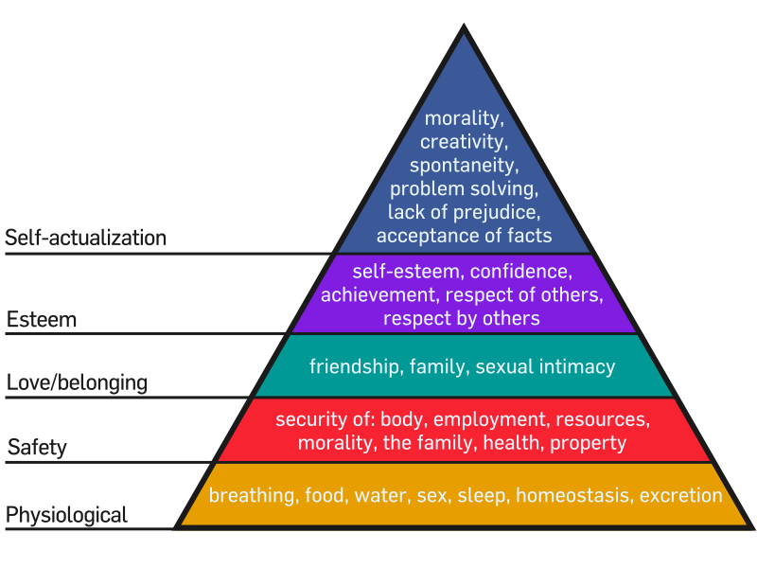
Maslow’s hierarchy of needs

Slide 10
Eating – Maintenance of body weight
Set point: Weight body is aiming for (hunger & metabolic rate change if weight is above/below)
Lateral hypothalamus:
Damage: reduce food intake
Stimulate: increase food intake/desire to eat
Ventromedial hypothalamus:
Damage: increase food intake
Stimulate: feel full, reduce food intake
Appetite hormones:
Ghrelin: causes feelings of hunger, secreted by stomach
Leptin, PYY: decrease hunger
Orexin: triggers hunger

Slide 11
Anorexia: prolonged avoidance of eating
1% of women in teens/early 20’s, uncommon outside of Europe, North America, Australia
Weight loss, excessive activity, disrupted circadian rhythms (lack of menstruation, decreased sleep, fluctuating body temperature), avoidance of sexual activity
Causes
Not malfunctioning hypothalamus, not clearly hormone levels
Psychological emotional: societal messages that “thin is better”, feelings of worthlessness, focus on perfection, conflict with parents obsession with weight, fear of adult world/sexual relationships

Slide 12
Bulimia nervosa
Binge eating, later purging food (vomiting or use of laxatives)
More common in women than men
Weight fluctuates
Effects: dehydration, electrolyte imbalance (can cause cardiac arrhythmia, cardiac arrest, death), damage to the esophagus, dental erosion

Slide 13
Obesity
Energy intake vs. energy output
Intake affected by
External causes: food availability, palatability
Emotional causes: responses to anxiety, depression
Energy output affected by: genetic/physiological causes

Slide 14
Genetics/physiology of weight and obesity
Genetics
Twin studies: high correlation between weight and biological parents, low correlation between weight and adoptive parents
Inherited weight maintenance factors:
Levels of thermogenesis (low = heavier weight)
# fat cells born with
Lipoprotein lipase (LPL) (more LPL = heavier weight)

Slide 15
Sex
Why do we have sex?
To reproduce, keep our species/genes going
Pleasurable → activates brain’s reward circuit

Slide 16
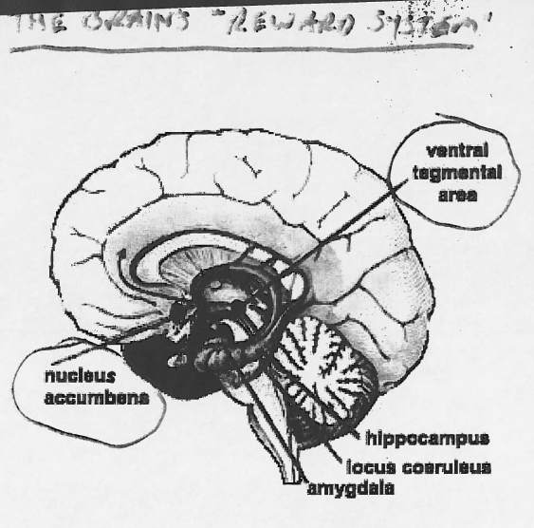

Slide 17
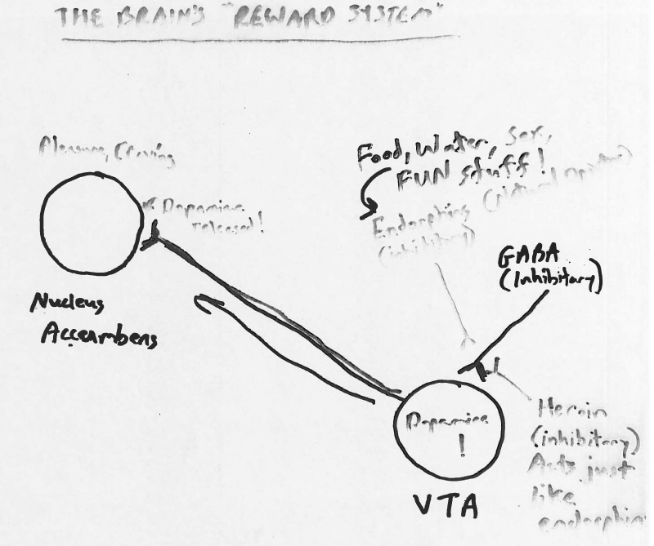

Slide 18
Sex hormones
Androgens (e.g., testosterone), produced by testes (primary male sex hormone)
Estrogens (e.g., estradiol), produced by ovaries (primary female sex hormone)

Slide 19
Sex hormones and rats
Male rat
Castrate (remove testicles): no sexual behavior
Castrate AND inject testosterone: normal male sexual behavior
Castrate AND inject estrogen: almost normal female sexual behavior
Female rat
Remove ovaries: no sexual behavior
Remove ovaries AND inject estrogen: normal female sexual behavior
Remove ovaries AND inject testosterone: almost normal male sexual behavior
In rat, sexual behavior is largely driven by hormones

Slide 20
Sex hormones and humans
Males: castration
Gradual decline in sexual desire and the ability to engage in sexual behavior
Females: removal of ovaries
No reduction in sexual desire or ability to engage in sexual behavior
Hormones play a less important role in sexual behavior in humans than in rats
Also important: psychological and emotional factors

Slide 21
Drugs
Is drug addition voluntary?
No: addiction is a biological need, like hunger or thirst
Some people are more susceptible to addition than others (genetics likely involved)
80% of drug addicts will relapse

Slide 22
Physiological effects (at the synapse) of common drugs
Caffeine (stimulant): keeps postsynaptic ion channels open longer when a NT binds
Amphetamines (stimulant): more NT released each time a signal is sent
Cocaine (stimulant): inhibits reuptake of NT after release – so NT affects postsynaptic neuron longer
LSD: binds to serotonin receptors, causes hallucinations
Heroin: binds to endorphin receptors

Slide 23
Stress!
The physiological and psychological response to an event that threatens or challenges us (a stressor).
Psychological Appraisal: Threat?

Slide 24
Types of stressors
Microstressors – daily hassles
Major life events – e.g. marriage
Catastrophic events – e.g. earthquake
Chronic stress – e.g. divorce
PTSD

Slide 25
Stress response: fight or flight
Increased: breathing, heartbeat, sweating
Decreased: appetite
Sympathetic nervous system
Epinephrine and norepinephrine
Cerebral Cortex
Hypothalamus and pituitary gland
Release cortisol

Slide 26
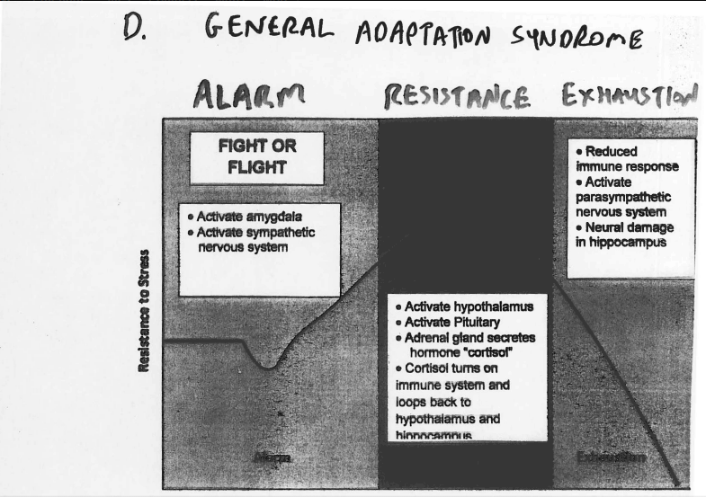
General adaptation syndrome

Slide 27
Coping with stress
Physical strategies (relaxation, exercise)
Problem Oriented Strategies
Problem focused coping
Cognitive strategies (reappraisal, humor)
Social support

Slide 28
personality

Slide 29
What is personality?
A person’s characteristic pattern of thinking, feeling and acting.
Approaches:
Psychoanalytic / Conflict driven
Humanistic / self fulfillment

Slide 30
Measuring personality
Trait measures:
Cattell’s 16 PF
Minnesota Multiphasic Personality Inventory (MMPI)
Eysenck’s Personality Questionnaire
- All self report are subject to dishonesty
Projective tests
Rorschach Inkblot Test
Thematic Apperception Test
Subjective evaluation by clinician/difficult to develop norms

Slide 31
Freud – Things to remember
Personality Structure:
Id, Ego, Superego
Personality Development
Psychosexual stages: Oral, anal, phallic, latency, genital
Oedipus complex
Defense Mechanisms
Repression, regression, rationalization
Denial, displacement
Projection

Slide 32
Humanistic Theories
Abraham Maslow:
Self Actualization
Carl Rogers:
We all have innate potentialities
Shaped by environment
We can either be striving for self fulfillment or maladjusted

Slide 33
Trait theories
Gordon Allport
Eysenck
2 trait factors: 1. stability/neuroticism
2. Extroversion/introversion
Big Five factors of personality
Openness to experience
Conscientiousness
Extroversion
Agreeableness
Neuroticism

Slide 34
Behavioral genetics
These traits are inherited as well as determined by environment
About 50% contribution comes from each

