Slide 1


Axion Particle Dark Matter
April Meeting of the APS
April 16, 2013
Leslie J Rosenberg
University of Washington

Slide 2
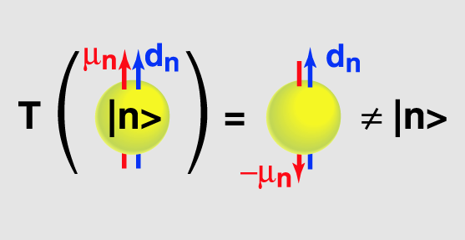
What’s an axion? (1) The “QCD Axion”
There’s something disturbing about the Standard Model:
The Standard Model violates P and CP, we expect QCD to violate P and CP, yet QCD does not.
For instance, Why doesn’t the neutron have an electric dipole moment?
This leads to the “Strong CP Problem”: Where did QCD CP violation go?
1977: Peccei and Quinn: Apply Higgs-like physics to the problem:
Posit a hidden broken U(1) symmetry ⇒
1) A new Goldstone boson (the axion);
2) Remnant axion VEV nulls QCD CP violation.
Peccei & Quinn receive 2013 Sakurai Prize for this elegant idea.
θ_{QCD} < 10⁻⁹

Slide 3
What’s an axion? (2)
A. Nelson

Slide 4
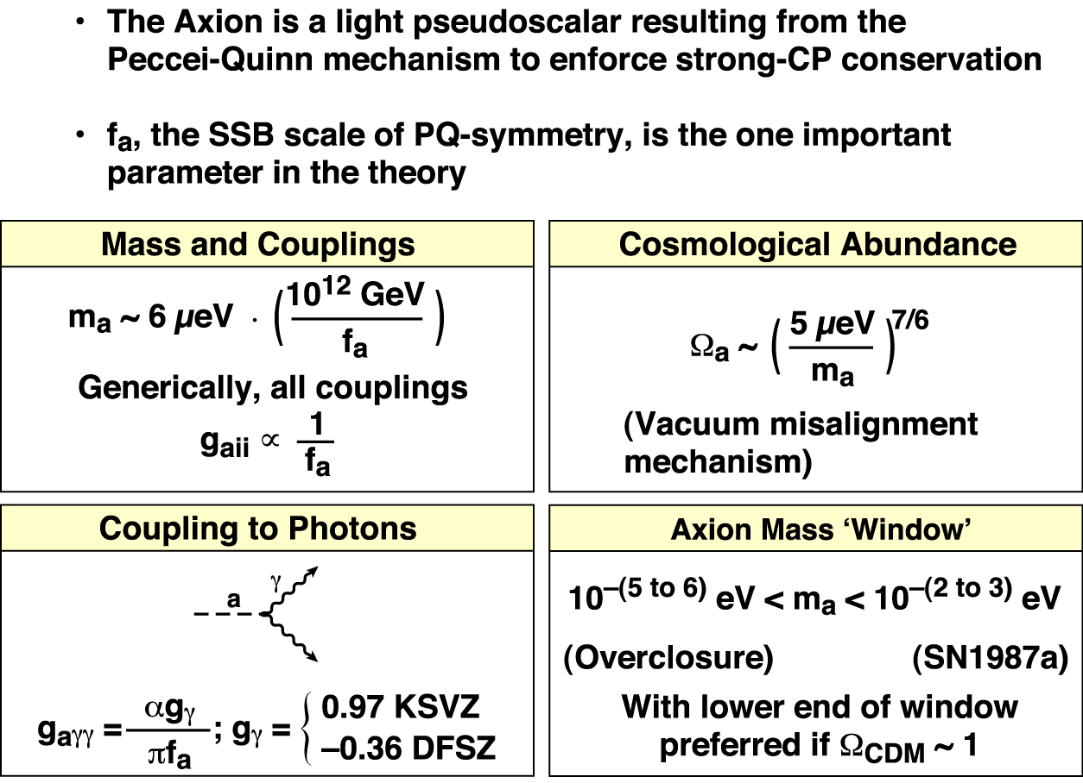
What’s an axion? (3) Summary properties

Slide 5
Recap: Axions and dark matter
Key properties of “vanilla” dark matter:
Feeble interactions with normal matter and radiation (“dark…”);
Gravitational interactions (“…matter”);
Long-lived (around today);
Cold (slow-moving in the early universe);
Low mass axions are an ideal dark matter candidate:
Long-lived: WIMP via conserved quantum number, axion is very light.
Cold: WIMP massive, axions produced non-thermally.
No solid observational evidence for one scenario over the other: choice is a bias.
Plus…
The axion mass is constrained to 1 or 2 orders-of-magnitude;
Some axion couplings are constrained to 1 order-of-magnitude;
The axion is doubly-well motivated…it solves 2 big problems
(a sharp Occam’s razor).

Slide 6
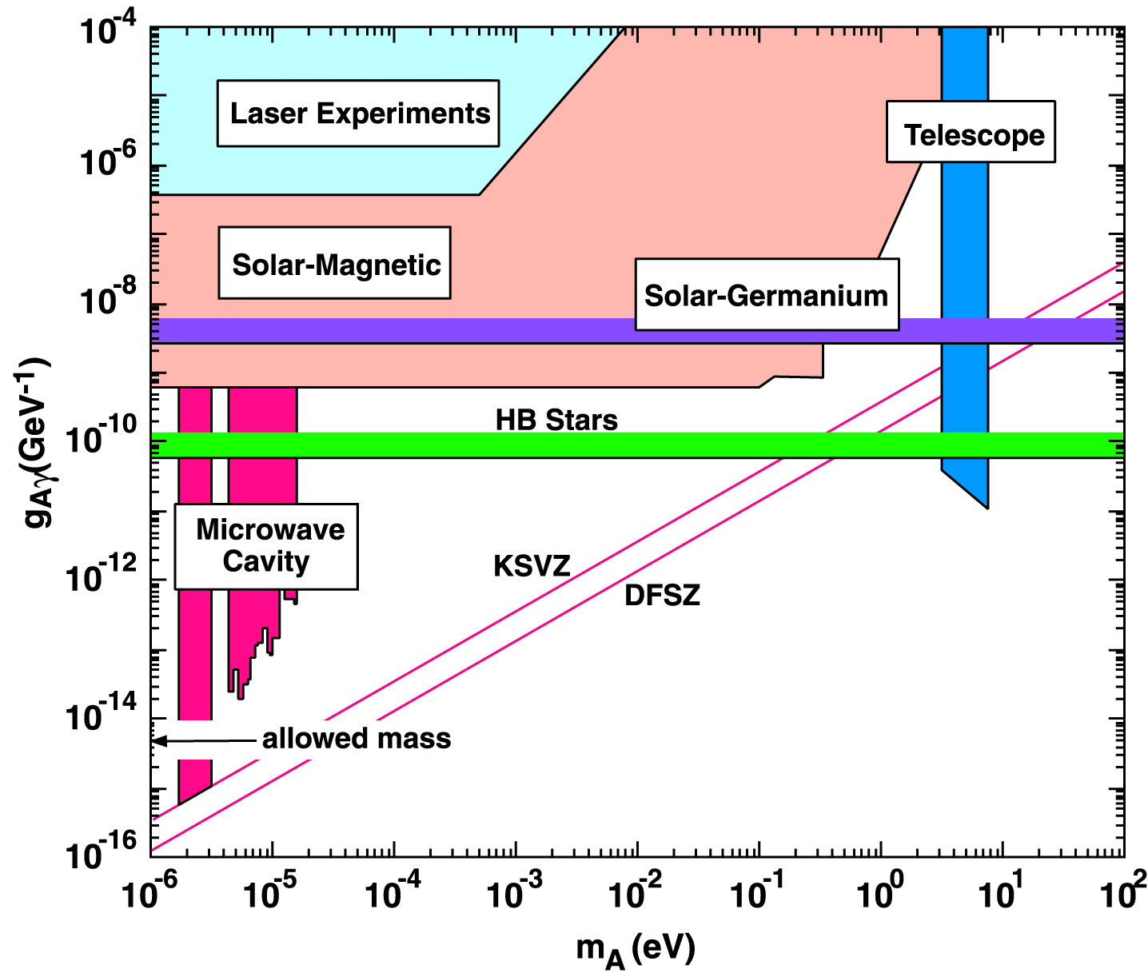
Selected limits on dark-matter axion masses and couplings
SN1987A
Focus on:
RF-cavity
Solar
Laser

Slide 7
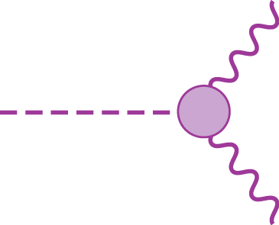
RF-cavity experiments.
RF-cavity experiments exploit the axion’s 2-photon coupling
The axion couples (very weakly, indeed) to normal particles.
(μeV-mass axions would live around 10⁵⁰ seconds.)
I happens that the axion’s 2γ coupling has relatively little axion-model dependence
g_{aγγ}
Axions constituting our local galactic halo would have huge number density ~10¹⁴ cm⁻³

Slide 8
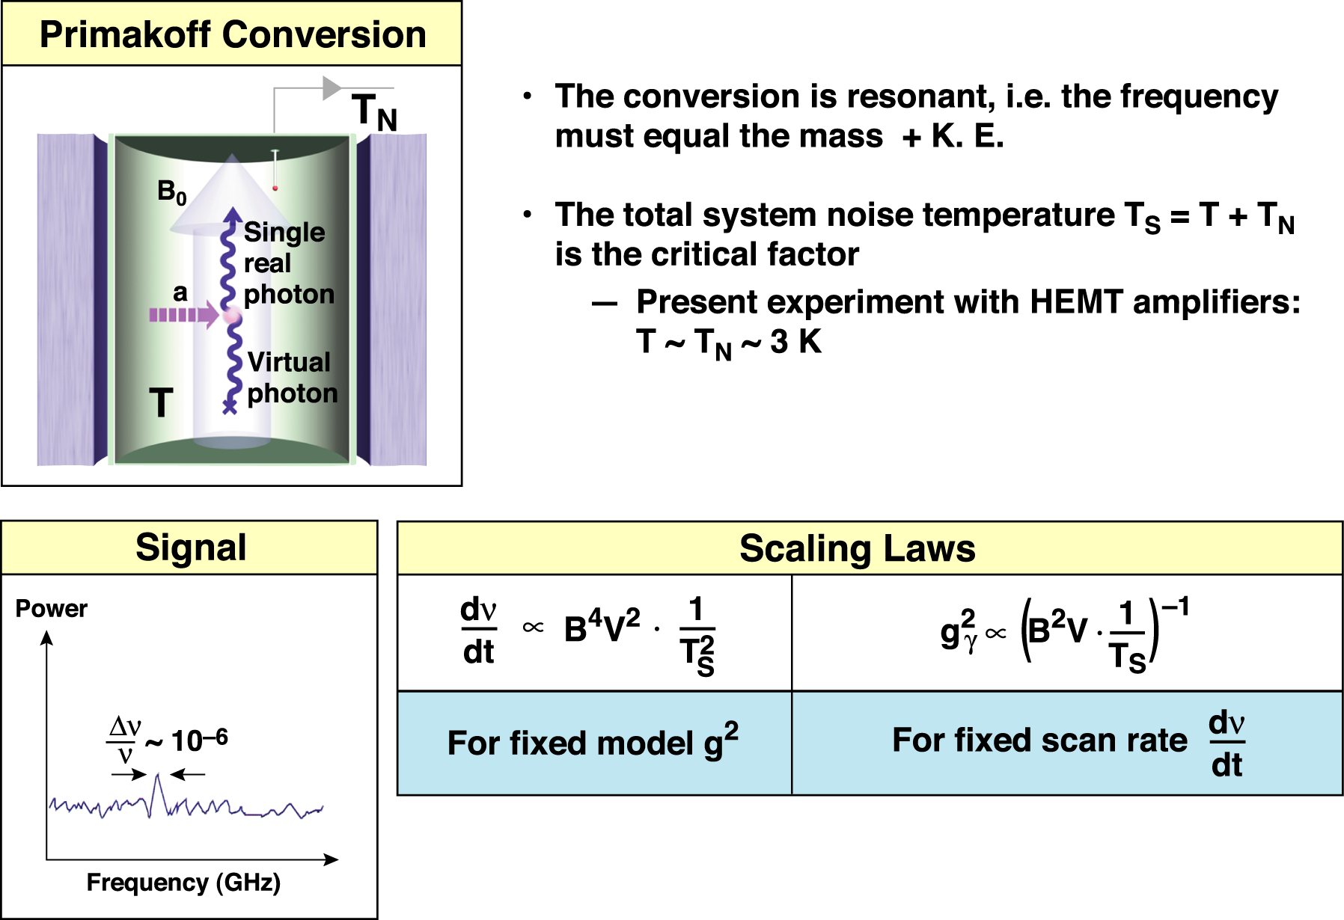
RF-cavity axion search: Dark-matter axions and electromagnetic fields exchange energy
The search speed is
quadratic in 1/Ts

Slide 9
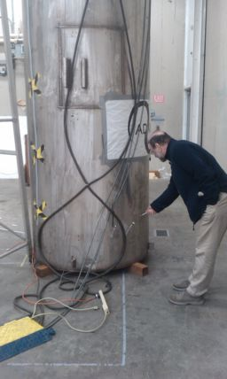
ADMX: Axion Dark-Matter eXperiment
U. of Washington, LLNL, U. of Florida, U.C. Berkeley,
National Radio Astronomy Observatory,
U. of Virginia, Sheffield U., Yale U.
Magnet with insert
Magnet cryostat

Slide 10
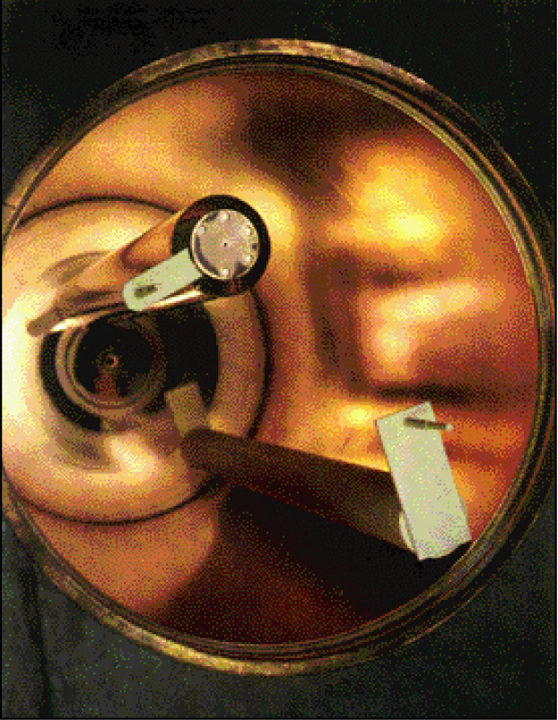
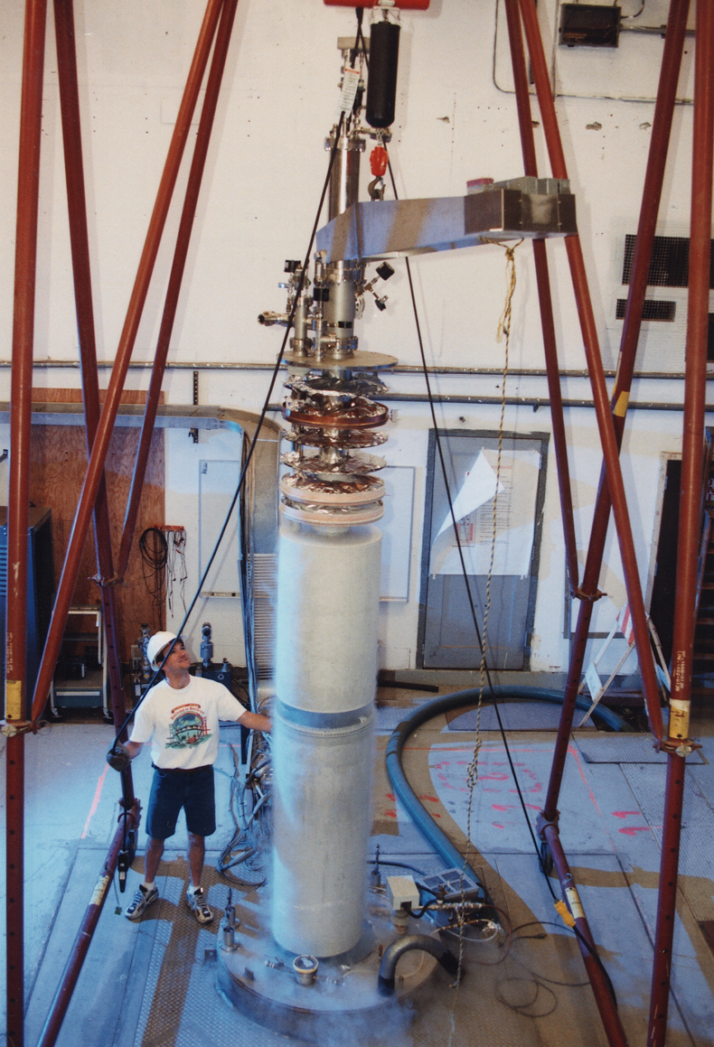
ADMX hardware
High-Q microwave cavity
Experiment insert

Slide 11
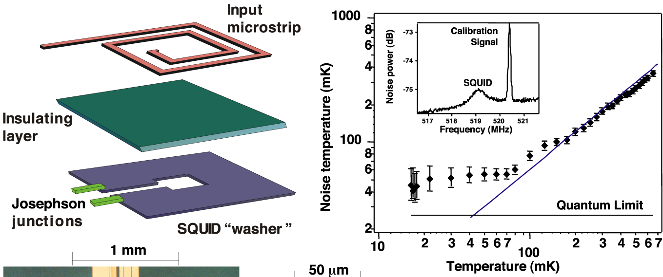
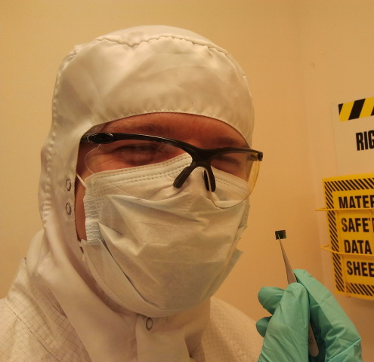
Breakthrough:
Quantum-limited SQUID-based microwave amplification
SQUIDs have been measured with T_{N} ~ 50 mK
Near quantum– limited noise
This provides the enormous increase in ADMX sensitivity

Slide 12
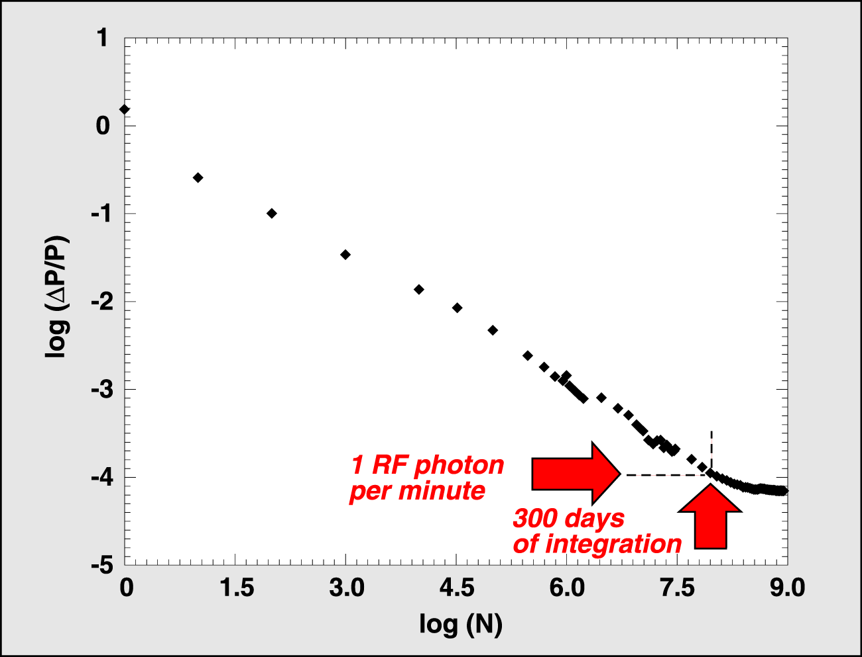
Converted microwave photons are detected by the world’s quietest radio receiver
Systematics-limited for signals of <10⁻²⁶ W
~10⁻³ of “DFSZ” axion power (<1/100 yoctoWatt).

Slide 13
What would an axion signal look like in ADMX?

Slide 14
Expected ADMX sensitivity with dilution-refrigerator cooling
Dilution-refrigerator cooled detectors allow scanning at or below DFSZ sensitivity at fractional dark-matter halo density.
This defines a “definitive” QCD dark-matter axion search

Slide 15
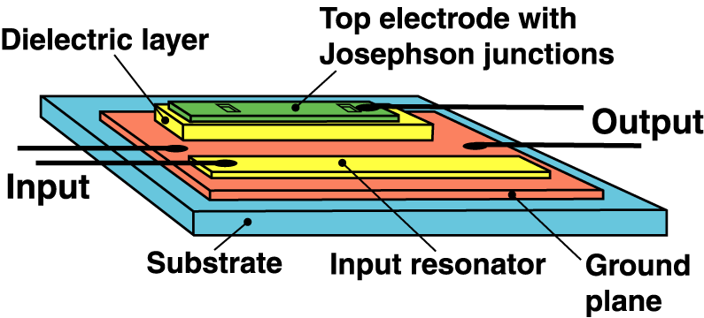
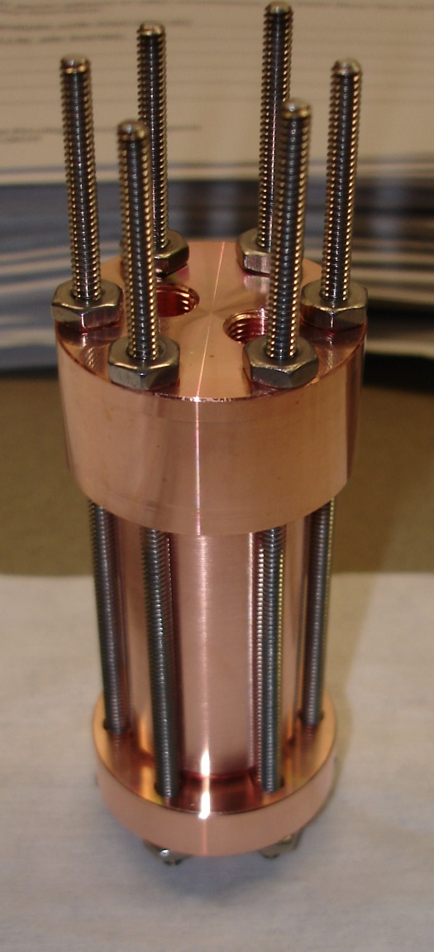
Can the RF-cavity experiments do better?
Higher frequencies, higher Q, squeezed states?
Active R&D paths.
higher-frequency
quantum-limited SQUIDs
“hybrid” superconducting
cavities (Yale group)
new amplifier technologies

Slide 16
ADMX “Gen 3”: Higher frequency

Slide 17
ADMX “Gen 3”: Lower frequency
16Apr13 LJR 17

Slide 18
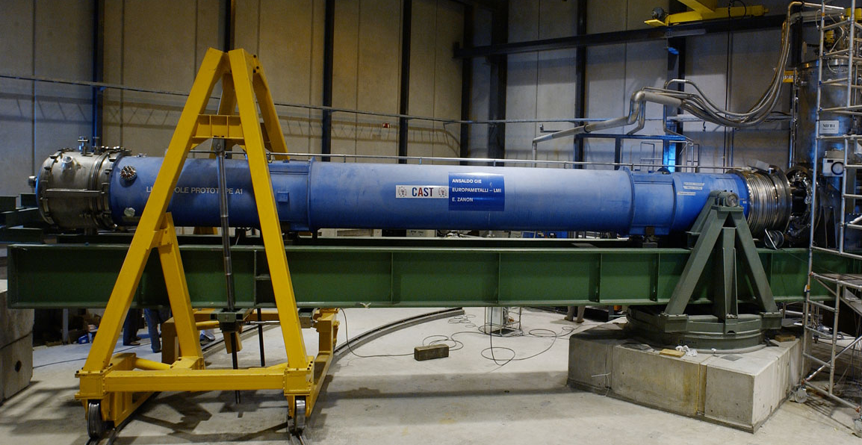
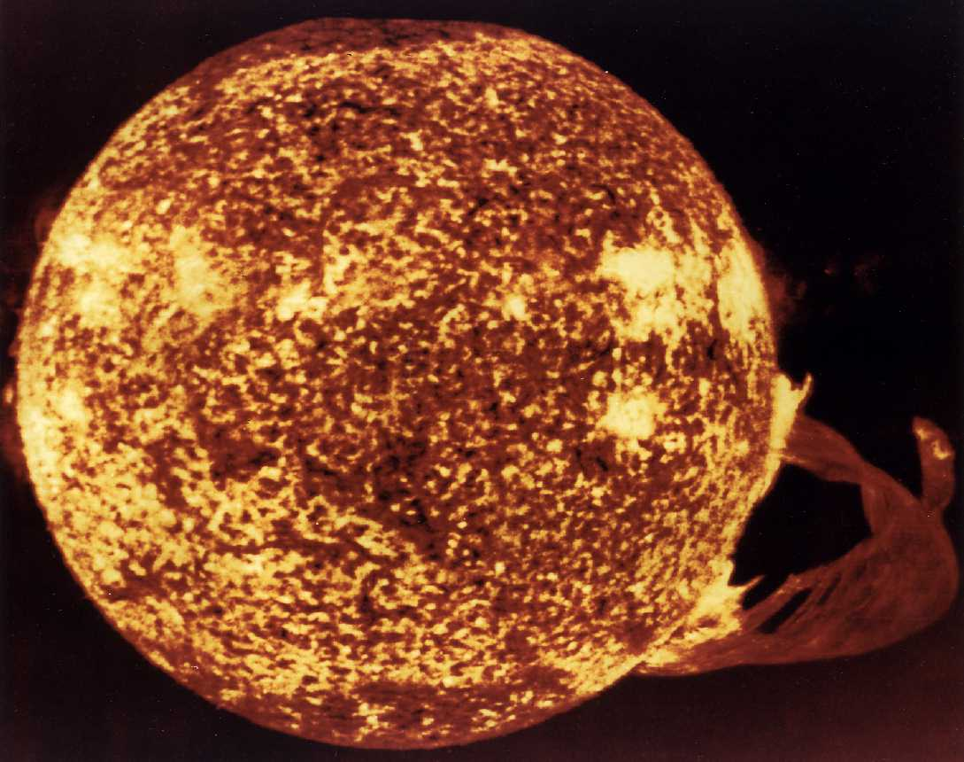
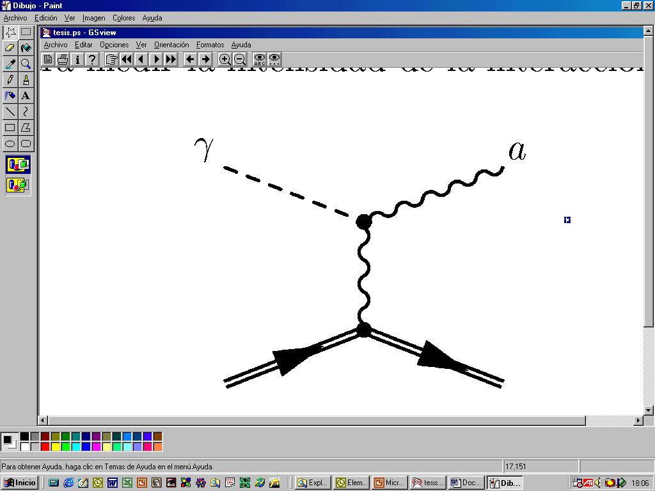
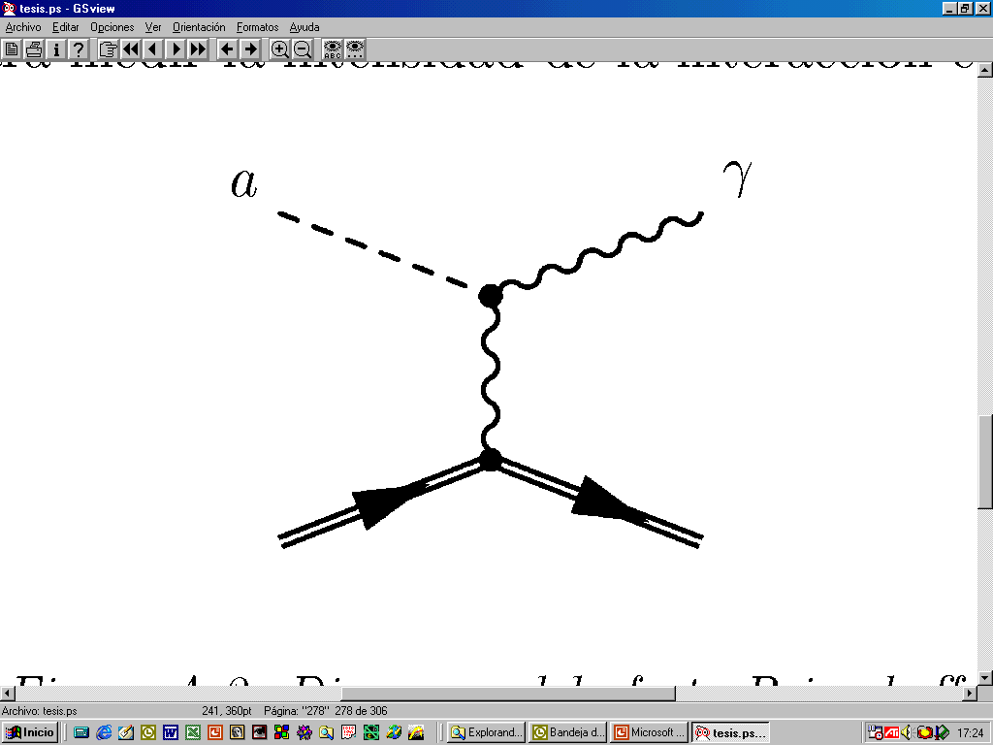
CAST: CERN Axion Solar Telescope.
Searching for axions produced in the Sun.
8
×
14
Axions from the sun become x-rays inside a
spare LHC dipole magnet
10
1
V
-
6
×
14
e
10
k
1
-
c
e
4
×
14
2
s
10
m
-
c
2
×
14
10
0
0
2
4
6
8
10
E
(keV)
16Apr13 LJR 18

Slide 19
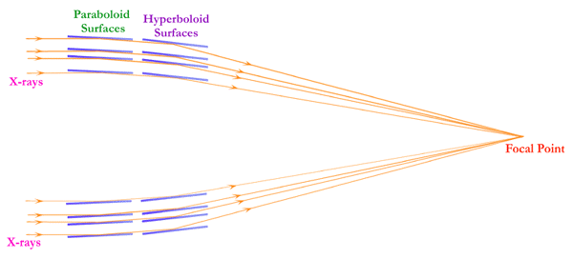
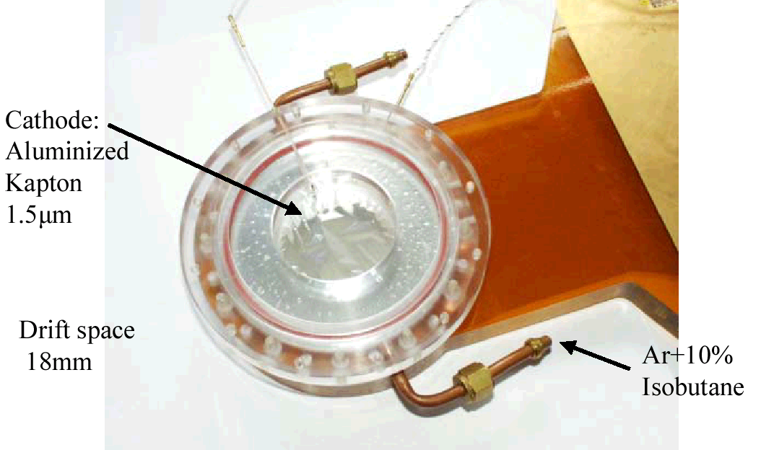
CAST Technology
State-of-the-art x-ray detection borrowed from astrophysics
Grazing-incidence
x-ray optics
Micromegas
x-ray camera

Slide 20
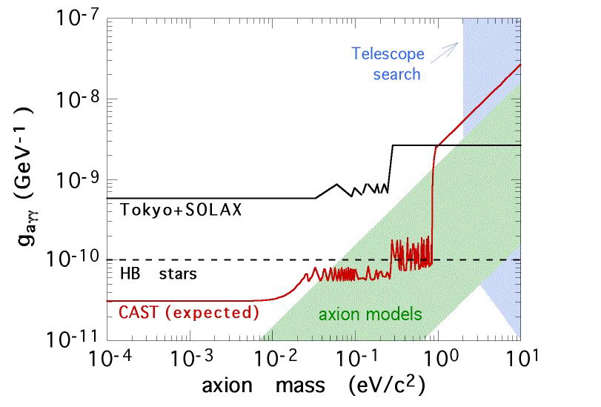
CAST Search Range
They are conceptualizing IAXO: a next-generation helioscope.
Larger magnetic field volume
Better x-ray optics.
Lower backgrounds.

Slide 21
Helioscope Futurism

Slide 22
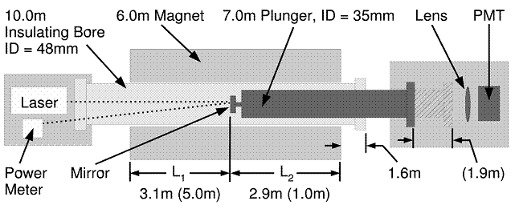
Laser Axion Searches
e.g., GammeV at FNAL

Slide 23
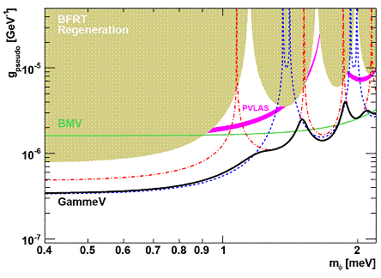
Laser Axion Searches: Sensitivity
GammeV at FNAL

Slide 24
Laser axion search: future experiments
Add pair of phase-locked, high finesse optical cavities
Sensitivity would be about that from astrophysical
bounds (red giant, white dwarf, solar)

Slide 25
Laser futurism (1): REAPR at FNAL

Slide 26
Laser futurism (2): ALPS-II at DESY

Slide 27
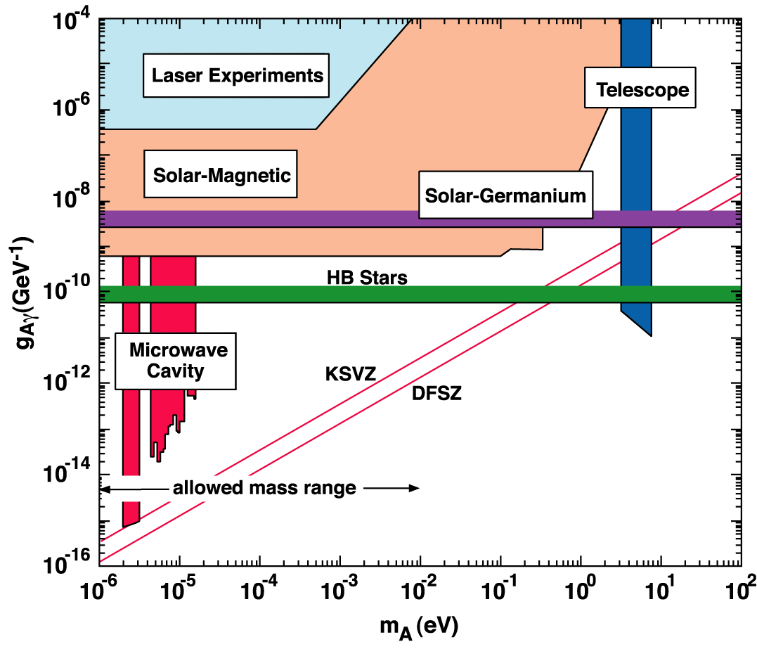
An Experimental Scenario:
Focus on Three Key Technologies
Laser: current
helioscope: current
Laser: locked FP
helioscope: 10-year
cavity: next year
cavity: 3-year
cavity: challenging

Slide 28
Theory challenges going forward (1) include
e.g, White dwarfs:
Can we better understand their cooling?
Isern et al., 2012

Slide 29
Theory challenges going forward (2) include
Gamma ray propagation:
e.g., Can we better understand gamma-ray absorption?

Slide 30
Theory challenges going forward (3) include
Axion Bose-condensates & structure
Is the dark matter a Bose condensate? Does it matter?
E.g.,
look where a ring would be
in our galaxy
Skyview virtual observatory
Isern et al., 2010
Nararajan & Sikivie, 2005

Slide 31
Conclusions (1)
Listen to Nature:
We’re keeping our eye on the LHC and WIMP detectors.
The jury is certainly still out, but if SUSY-WIMPs remain
undetected, you might want to look harder at axions.

Slide 32
Conclusions (2)
On the other hand, some say, LHC finding
SUSY may strongly suggest axion dark matter.
H. Baer

Slide 33
Overall Conclusions
Axions: A very compelling dark-matter candidate.
The QCD dark-matter axion is well bounded in mass and couplings.
The dark-matter axion focus is 1-100 μeV axion masses.
There are many search techniques, but the RF-cavity one is most sensitive.
ADMX is largest and most mature; several others are on the horizon.
The next several years will either see a discovery or reject the QCD
dark-matter axion hypothesis.
The space of variant axion (non “QCD”) models is wide open.
Major efforts are underway for solar axions and laser experiments.
And ideas are out there for searching for very low-mass axions
(inspired by string theory and anthropic arguments).
Quite starkly: These experiments have the sensitivity and mass reach to
either detect or rule out QCD dark-matter axions at high confidence.

