Slide 1
Challenges in Dialog & Dialog Systems
Ling575
Discourse and Dialog
April 27, 2011

Slide 2
Roadmap
Issues in Dialog & Dialog Systems
Dialog vs General Discourse
Linguistics of Conversation
Turn-taking
Grounding
Implicature
Dialog Systems
Architecture
Components
Evaluation

Slide 3
Dialogue vs General Discourse
Key contrast: Two or more speakers
Primary focus on speech

Slide 4
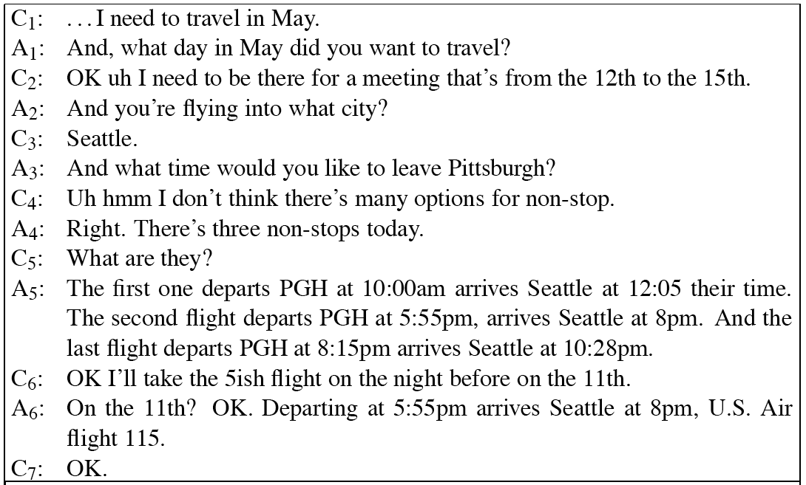
Dialog Example

Slide 5
Dialogue vs General Discourse
Key contrast: Two or more speakers
Primary focus on speech
Issues in multi-party spoken dialogue
Turn-taking – who speaks next, when?
Collaboration – clarification, feedback,…
Disfluencies
Adjacency pairs, dialogue acts

Slide 6
Conversations and Conversational Agents
Conversation:
First and often most common form of language use
Context of language learning and use

Slide 7
Conversations and Conversational Agents
Conversation:
First and often most common form of language use
Context of language learning and use
Goal:
Describe, characterize spoken interaction
Enable automatic recognition, understanding

Slide 8
Conversations and Conversational Agents
Conversation:
First and often most common form of language use
Context of language learning and use
Goal:
Describe, characterize spoken interaction
Enable automatic recognition, understanding
Conversational agents:
Spoken dialog systems, spoken language systems

Slide 9
Conversations and Conversational Agents
Conversation:
First and often most common form of language use
Context of language learning and use
Goal:
Describe, characterize spoken interaction
Enable automatic recognition, understanding
Conversational agents:
Spoken dialog systems, spoken language systems
Interact with users through speech
Tasks: travel arrangements, call routing, planning

Slide 10
Human-Human Example

Slide 11
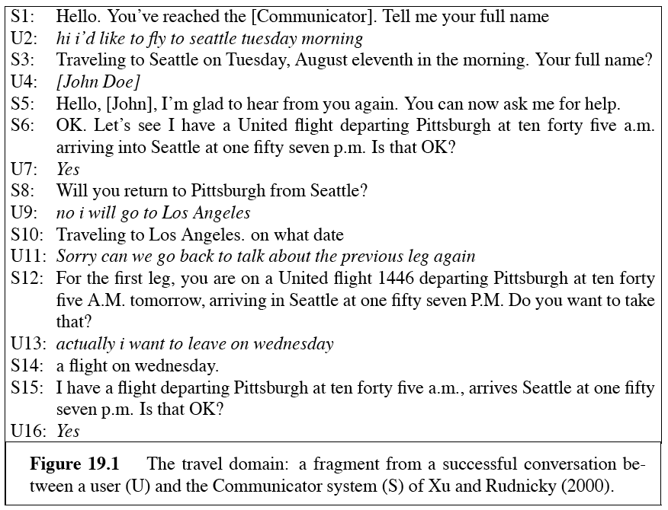
Travel Planning

Slide 12
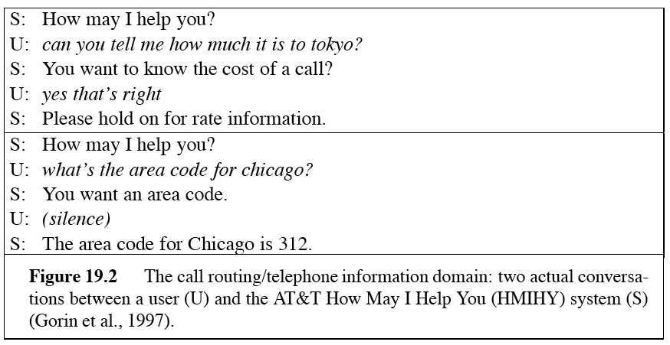
AT&T’s How May I Help You?

Slide 13
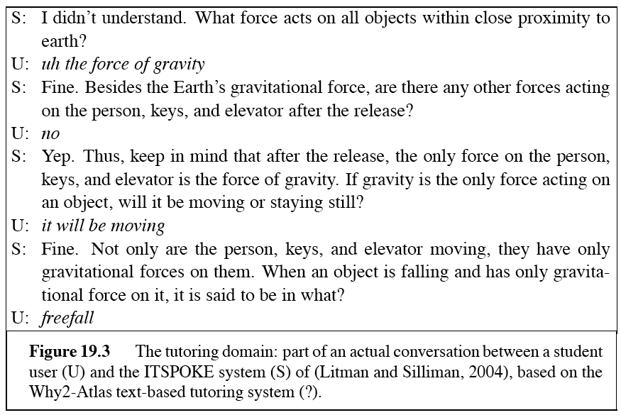
ItSpoke Tutoring System

Slide 14
Conversation
Intricate, joint activity
Constructed from consecutive turns
Joint activity between speakers, hearer
Involves inferences about intended meaning
SDS: simpler, but hopefully consistent

Slide 15
Turn-Taking
Multi-party discourse
Need to trade off speaker/hearer roles
Interpret reference from sequential utterances
When?

Slide 16
Turn-Taking
Multi-party discourse
Need to trade off speaker/hearer roles
Interpret reference from sequential utterances
When?
End of sentence?

Slide 17
Turn-Taking
Multi-party discourse
Need to trade off speaker/hearer roles
Interpret reference from sequential utterances
When?
End of sentence?
No: multi-utterance turns
Silence?

Slide 18
Turn-Taking
Multi-party discourse
Need to trade off speaker/hearer roles
Interpret reference from sequential utterances
When?
End of sentence?
No: multi-utterance turns
Silence?
No: little silence in smooth dialogue:< 250ms
Gaps less than actual sentence planning time - anticipate
When other starts speaking?

Slide 19
Turn-Taking
Multi-party discourse
Need to trade off speaker/hearer roles
Interpret reference from sequential utterances
When?
End of sentence?
No: multi-utterance turns
Silence?
No: little silence in smooth dialogue:< 250ms
Gaps less than actual sentence planning time - anticipate
When other starts speaking?
No: relatively little overlap face-to-face: ~5%

Slide 20
Turn-taking
Rule-governed behavior
Possibly multiple legal turn change times
Aka transition-relevance places (TRP)

Slide 21
Turn-taking
Rule-governed behavior
Possibly multiple legal turn change times
Aka transition-relevance places (TRP)
Generally at utterance boundaries
Utterance not necessarily sentence
In fact, utterance/sentence boundaries not obvious in speech
Don’t necessarily pause between sentences

Slide 22
Turn-taking
Rule-governed behavior
Possibly multiple legal turn change times
Aka transition-relevance places (TRP)
Generally at utterance boundaries
Utterance not necessarily sentence
In fact, utterance/sentence boundaries not obvious in speech
Don’t necessarily pause between sentences
Automatic utterance boundary detection
Cue words (okay, so,..); POS sequences; prosody

Slide 23
Turn-taking: Who & How
At each TRP in each turn (Sacks 1974)
If speaker has selected A to speak, A must take floor
If speaker has selected no one to speak, anyone can
If no one else takes the turn, the speaker can

Slide 24
Turn-taking: Who & How
At each TRP in each turn (Sacks 1974)
If speaker has selected A to speak, A must take floor
If speaker has selected no one to speak, anyone can
If no one else takes the turn, the speaker can
Selecting speaker A:
By explicit/implicit mention: What about it, Bob?
By gaze, function

Slide 25
Turn-taking: Who & How
At each TRP in each turn (Sacks 1974)
If speaker has selected A to speak, A must take floor
If speaker has selected no one to speak, anyone can
If no one else takes the turn, the speaker can
Selecting speaker A:
By explicit/implicit mention: What about it, Bob?
By gaze, function
Selecting others: questions, greetings, closing
(Traum et al., 2003)

Slide 26
Turns and Structure
Some utterances select others:

Slide 27
Turns and Structure
Some utterances select others:
Adjacency pairs:
Greeting – Greeting, Question – Answer,
Compliment – Downplayer

Slide 28
Turns and Structure
Some utterances select others:
Adjacency pairs:
Greeting – Greeting, Question – Answer,
Compliment – Downplayer
Linkage ‘disprefers’ silences within adjacency pair
More acceptable between

Slide 29
Turn-taking in HCI
Human turn end:

Slide 30
Turn-taking in HCI
Human turn end:
Detected by 250ms (or longer) silence
System turn end:

Slide 31
Turn-taking in HCI
Human turn end:
Detected by 250ms (or longer) silence
System turn end:
Signaled by end of speech
Indicated by any human sound
Barge-in
Continued attention:

Slide 32
Turn-taking in HCI
Human turn end:
Detected by 250ms (or longer) silence
System turn end:
Signaled by end of speech
Indicated by any human sound
Barge-in
Continued attention:
No signal
Design problems create ambiguous silences

Slide 33
Turn-taking in HCI
Human turn end:
Detected by 250ms (or longer) silence
System turn end:
Signaled by end of speech
Indicated by any human sound
Barge-in
Continued attention:
No signal
Design problems create ambiguous silences
Problematic for SDS users
(Stifelman et al., 1993), (Yankelovich et al, 1995)

Slide 34
Speech Acts
Utterance:
Action performed by the speaker (Austin, 1962)
Performatives: name, second
I name this ship the Titanic.
I second that motion.
Extend to all utterances

Slide 35
Utterances as 3 Act Types
Locutionary act:
utterance with some meaning
“You can’t do that!”

Slide 36
Utterances as 3 Act Types
Locutionary act:
utterance with some meaning
“You can’t do that!”
Illocutionary act:
Act of asking, promising, answering, in utterance
Protesting

Slide 37
Utterances as 3 Act Types
Locutionary act:
utterance with some meaning
“You can’t do that!”
Illocutionary act:
Act of asking, promising, answering, in utterance
Protesting
Perlocutionary act:
Production of effects on feeling, beliefs of addressee
Intend to prevent doing some action

Slide 38
Utterances as 3 Act Types
Locutionary act:
utterance with some meaning
“You can’t do that!”
Illocutionary act:
Act of asking, promising, answering, in utterance
Protesting
Perlocutionary act:
Production of effects on feeling, beliefs of addressee
Intend to prevent doing some action
Types: assertives, directives, commissives, expressives, declarations

Slide 39
The 3 levels of act revisited
 | Locutionary Force | Illocutionary Force | Perlocutionary Force
Can I have the rest of your sandwich? | Question | Request | Intent: You give me sandwich
I want the rest of your sandwich | Declarative | Request | Intent: You give me sandwich
Give me your sandwich! | Imperative | Request | Intent: You give me sandwich

Slide 40
Dialogue Acts
(aka Conversational moves)
Enriched set of speech acts
Capture full range of conversational functions

Slide 41
Dialogue Acts
(aka Conversational moves)
Enriched set of speech acts
Capture full range of conversational functions
Adjacency pairs: Many two-part structures
E.g. Question-Answer, Greeting-Greeting, Request-Grant, etc…

Slide 42
Dialogue Acts
(aka Conversational moves)
Enriched set of speech acts
Capture full range of conversational functions
Adjacency pairs: Many two-part structures
E.g. Question-Answer, Greeting-Greeting, Request-Grant, etc…
Paired for speaker-hearer dyads
Contrast with rhetorical relations in monologue

Slide 43
DAMSL
Dialogue Act Tagging framework
Builds on Adjacency pairs

Slide 44
DAMSL
Dialogue Act Tagging framework
Builds on Adjacency pairs
Forward looking functions
Statement, info-request, commit, closing, etc

Slide 45
DAMSL
Dialogue Act Tagging framework
Builds on Adjacency pairs
Forward looking functions
Statement, info-request, commit, closing, etc
Backward looking functions
Focus on link to prior speaker utterance
Agreement, answer, accept, etc..

Slide 46
[assert] C1: . . . I need to travel in May.
[inforeq,ack] A1: And, what day in May did you want to travel?
[assert,answer] C2: OK uh I need to be there for a meeting that’s from the 12th to the 15th.
[inforeq,ack] A2: And you’re flying into what city?
[assert,answer]C3: Seattle.
[inforeq,ack] A3: And what time would you like to leave Pittsburgh?
[check,hold] C4: Uh hmm I dont think theres many options for nonstop.
[accept,ack] A4: Right.
[assert] There’s three non-stops today.
[info-req] C5: What are they?
[assert,open-option] A5: The first one departs PGH at…

Slide 47
Dialogue Act Recognition
Goal: Identify dialogue act tag(s) from surface form

Slide 48
Dialogue Act Recognition
Goal: Identify dialogue act tag(s) from surface form
Challenge: Surface form can be ambiguous
“Can you X?” – yes/no question, or info-request
“Flying on the 11t^{h}, at what time?” – check, statement

Slide 49
Dialogue Act Recognition
Goal: Identify dialogue act tag(s) from surface form
Challenge: Surface form can be ambiguous
“Can you X?” – yes/no question, or info-request
“Flying on the 11t^{h}, at what time?” – check, statement
Requires interpretation by hearer
Strategies: cue recognition

Slide 50
Cue-based Interpretation
Employs sets of features to identify
Words and collocations: Please -> request
Prosody: Rising pitch -> yes/no question
Conversational structure: prior act

Slide 51
Cue-based Interpretation
Employs sets of features to identify
Words and collocations: Please -> request
Prosody: Rising pitch -> yes/no question
Conversational structure: prior act
Example: Check:
Syntax: tag question “,right?”
Syntax + prosody: Fragment with rise
N-gram: argmax d P(d)P(W|d)
So you, sounds like, etc
Details later ….

