Slide 1
Discourse Segmentation
Ling575
Discourse and Dialogue
April 20, 2011

Slide 2
Roadmap
Project updates and milestones
Automatic Discourse Segmentation
Linear Segmentation
Unsupervised techniques
Supervised techniques
Segmentation evaluation
Discourse Parsing
Discourse Relation Extraction
D-LTAG

Slide 3
Project Presentations
Spread over April 27, May 4
Literature review
At least 3 papers
Identify 1 as primary
Everyone should read
Relation to project, project plan

Slide 4
Recognizing Discourse Structure
Decompose text into subunits

Slide 5
Recognizing Discourse Structure
Decompose text into subunits
Questions:
What type of structure is derived?

Slide 6
Recognizing Discourse Structure
Decompose text into subunits
Questions:
What type of structure is derived?
Sequential spans, hierarchical trees, arbitrary graphs
What is the granularity of the subunits?

Slide 7
Recognizing Discourse Structure
Decompose text into subunits
Questions:
What type of structure is derived?
Sequential spans, hierarchical trees, arbitrary graphs
What is the granularity of the subunits?
Clauses? Sentences? Paragraphs?
What information guides segmentation?

Slide 8
Recognizing Discourse Structure
Decompose text into subunits
Questions:
What type of structure is derived?
Sequential spans, hierarchical trees, arbitrary graphs
What is the granularity of the subunits?
Clauses? Sentences? Paragraphs?
What information guides segmentation?
Local cue phrases?

Slide 9
Recognizing Discourse Structure
Decompose text into subunits
Questions:
What type of structure is derived?
Sequential spans, hierarchical trees, arbitrary graphs
What is the granularity of the subunits?
Clauses? Sentences? Paragraphs?
What information guides segmentation?
Local cue phrases? Lexical cohesion?

Slide 10
Recognizing Discourse Structure
Decompose text into subunits
Questions:
What type of structure is derived?
Sequential spans, hierarchical trees, arbitrary graphs
What is the granularity of the subunits?
Clauses? Sentences? Paragraphs?
What information guides segmentation?
Local cue phrases? Lexical cohesion?
How is the information modeled? Learned?

Slide 11
Recognizing Discourse Structure
Decompose text into subunits
Questions:
What type of structure is derived?
Sequential spans, hierarchical trees, arbitrary graphs
What is the granularity of the subunits?
Clauses? Sentences? Paragraphs?
What information guides segmentation?
Local cue phrases? Lexical cohesion?
How is the information modeled? Learned?
How do we evaluate the results?

Slide 12
Discourse Topic Segmentation
Separate news broadcast into component stories
On "World News Tonight" this Thursday, another bad day on stock
markets, all over the world global economic anxiety. ||
Another massacre in Kosovo, the U.S. and its allies prepare to do
something about it. Very slowly. ||
And the millennium bug, Lubbock Texas prepares for catastrophe, Bangalore in
India sees only profit.||

Slide 13
Coherence Analysis
S1: John went to the bank to deposit his paycheck.
S2: He then took a train to Bill’s car dealership.
S3: He needed to buy a car.
S4: The company he works now isn’t near any public transportation.
S5: He also wanted to talk to Bill about their softball league.

Slide 14
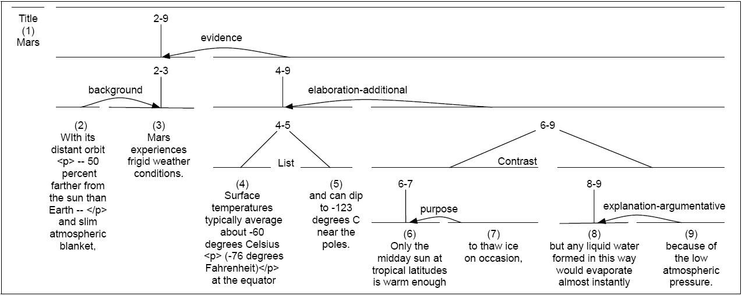

Slide 15
TextTiling
Structure:
Linear segmentation
Units:
‘Sections’ from sentences, paragraphs
Information:
Lexical cohesions, word-level
Evaluation:
Accuracy, WindowDiff

Slide 16
TextTiling (Hearst ‘97)
Lexical cohesion-based segmentation
Boundaries at dips in cohesion score
Tokenization, Lexical cohesion score, Boundary ID

Slide 17
TextTiling (Hearst ‘97)
Lexical cohesion-based segmentation
Boundaries at dips in cohesion score
Tokenization, Lexical cohesion score, Boundary ID
Tokenization
Units?

Slide 18
TextTiling (Hearst ‘97)
Lexical cohesion-based segmentation
Boundaries at dips in cohesion score
Tokenization, Lexical cohesion score, Boundary ID
Tokenization
Units?
White-space delimited words
Stopped
Stemmed
20 words = 1 pseudo sentence

Slide 19
Lexical Cohesion Score
Similarity between spans of text
b = ‘Block’ of 10 pseudo-sentences before gap
a = ‘Block’ of 10 pseudo-sentences after gap
How do we compute similarity?

Slide 20
Lexical Cohesion Score
Similarity between spans of text
b = ‘Block’ of 10 pseudo-sentences before gap
a = ‘Block’ of 10 pseudo-sentences after gap
How do we compute similarity?
Vectors and cosine similarity (again!)

Slide 21
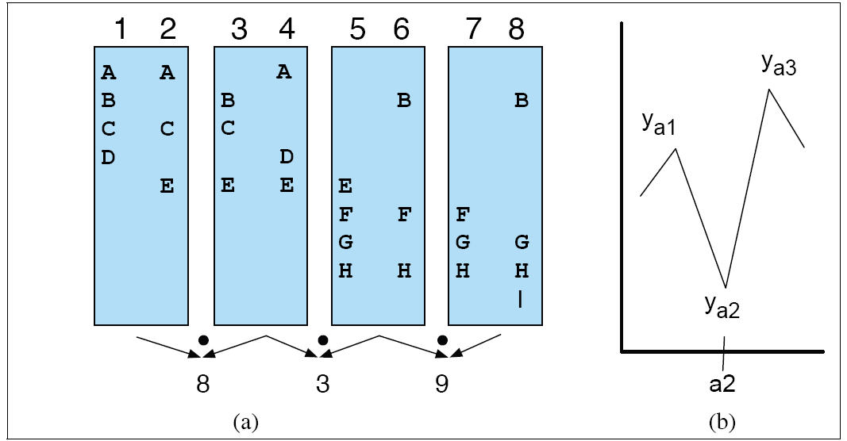
Segmentation
Depth score:
Difference between position and adjacent peaks
E.g., (y_{a1}-y_{a2})+(y_{a3}-y_{a2})

Slide 22
Evaluation

Slide 23
Evaluation
Contrast with reader judgments
Alternatively with author or task-based
7 readers, 13 articles: “Mark topic change”
If 3 agree, considered a boundary

Slide 24
Evaluation
Contrast with reader judgments
Alternatively with author or task-based
7 readers, 13 articles: “Mark topic change”
If 3 agree, considered a boundary
Run algorithm – align with nearest paragraph
Contrast with random assignment at frequency

Slide 25
Evaluation
Contrast with reader judgments
Alternatively with author or task-based
7 readers, 13 articles: “Mark topic change”
If 3 agree, considered a boundary
Run algorithm – align with nearest paragraph
Contrast with random assignment at frequency
Auto: 0.66, 0.61; Human:0.81, 0.71
Random: 0.44, 0.42

Slide 26
Discussion
Overall: Auto much better than random
Often “near miss” – within one paragraph
0.83,0.78
Issues

Slide 27
Discussion
Overall: Auto much better than random
Often “near miss” – within one paragraph
0.83,0.78
Issues: Summary material
Often not similar to adjacent paras
Similarity measures

Slide 28
Discussion
Overall: Auto much better than random
Often “near miss” – within one paragraph
0.83,0.78
Issues: Summary material
Often not similar to adjacent paras
Similarity measures
Is raw tf the best we can do?
Other cues??
Other experiments with TextTiling perform less well – Why?

Slide 29
Improving TextTiling
Basic technique: Weighted word overlap

Slide 30
Improving TextTiling
Basic technique: Weighted word overlap
Issue?
Restricted to exact word match
Synonyms? Hyper/hyponyms?
Related words?

Slide 31
Improving TextTiling
Basic technique: Weighted word overlap
Issue?
Restricted to exact word match
Synonyms? Hyper/hyponyms?
Related words?
How can we generalize?
Automatically create pseudo-words that capture
Latent Semantic Analysis (and related techniques)

Slide 32
Latent Semantic Analysis
Represents words by their document occurrence patt.
Create term x document matrix

Slide 33
Latent Semantic Analysis
Represents words by their document occurrence patt.
Create term x document matrix
Perform dimensionality reduction
E.g. Singular Value Decomposition on matrix
Create best rank k approximation of original matrix

Slide 34
Latent Semantic Analysis
Represents words by their document occurrence patt.
Create term x document matrix
Perform dimensionality reduction
E.g. Singular Value Decomposition on matrix
Create best rank k approximation of original matrix
Yields representation of terms/documents in new space of latent semantic concepts
Can improve retrieval, semantic distance calculation

Slide 35
Latent Semantic Analysis
Represents words by their document occurrence patt.
Create term x document matrix
Perform dimensionality reduction
E.g. Singular Value Decomposition on matrix
Create best rank k approximation of original matrix
Yields representation of terms/documents in new space of latent semantic concepts
Can improve retrieval, semantic distance calculation
Many dimensionality reduction variants (e.g. GLSA)

Slide 36
Latent Semantic Analysis

Slide 37
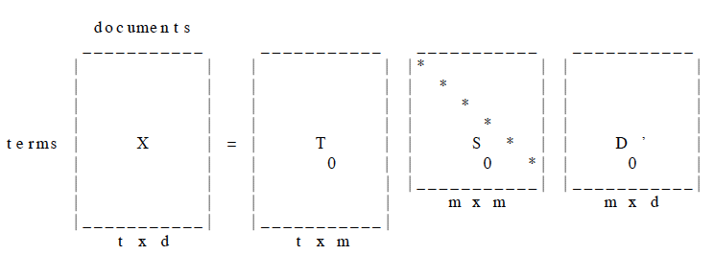
LSA
SVD

Slide 38
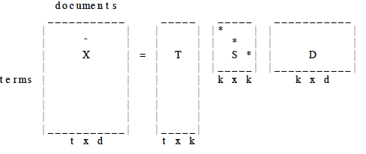
LSA: Rank k Approximation
Reduced rank:

Slide 39
LSA Text Segmentation
Replace basic word based cosine similarity
Instead use similarity based on new representation
Reduced effect of lexical variation

Slide 40
LSA Text Segmentation
Replace basic word based cosine similarity
Instead use similarity based on new representation
Reduced effect of lexical variation
Compute average block similarity
Perform peak-picking, assign boundaries at dips
Improves significantly over raw TextTiling

Slide 41
LSA Text Segmentation
Replace basic word based cosine similarity
Instead use similarity based on new representation
Reduced effect of lexical variation
Compute average block similarity
Perform peak-picking, assign boundaries at dips
Improves significantly over raw TextTiling
Choi2001, Bergsten 2006, Malioutov et al, 2007; Matveeva & Levow 2007; Eisenstein 2008

Slide 42
Supervised Segmentation
Structure:
Linear segmentation
Units:
Stories from sentences
Information:
Lexical cohesion, word-level
Cues
Evaluation:
WindowDiff

Slide 43
Supervised Segmentation
Unsupervised techniques rely on block similarity
Wide windows of topical similarity

Slide 44
Supervised Segmentation
Unsupervised techniques rely on block similarity
Wide windows of topical similarity
Other sources of information?
Local indicators
Cue phrases:

Slide 45
Supervised Segmentation
Unsupervised techniques rely on block similarity
Wide windows of topical similarity
Other sources of information?
Local indicators
Cue phrases: Often domain specific
News: ‘Christiane Amanpour, reporting’
‘This is CNN’, ‘Incorporated’
Trigram models
(Beeferman et al, 1999; Galley et al, 2003)

Slide 46
Supervised Segmentation
Combines
Local context tri-gram language models

Slide 47
Supervised Segmentation
Combines
Local context tri-gram language models
Trigger pairs:
Pairs of words where occurrence of 1st boosts that of 2nd

Slide 48
Supervised Segmentation
Combines
Local context tri-gram language models
Trigger pairs:
Pairs of words where occurrence of 1st boosts that of 2nd
Appearance w/in 500 words greater than prior
E.g. Picket, Scab; Pulitzer, Prizewinning
Implemented in a log-linear model
Integrated as product of log-linear and trigram models

Slide 49
Segmentation Features
Topicality features:
Idea:
Local tri-gram model more predictive than long-range

Slide 50
Segmentation Features
Topicality features:
Idea:
Local tri-gram model more predictive than long-range
Implementation:
Compute log of ratio of trigger model to tri-gram model

Slide 51
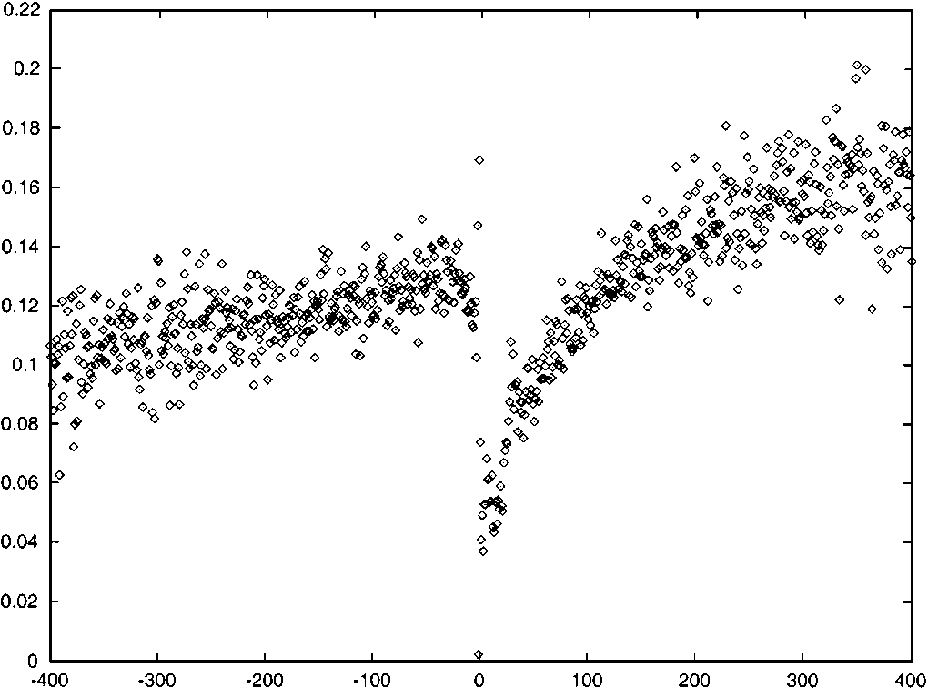
Segmentation Features
Topicality features:
Idea:
Local tri-gram model more predictive than long-range
Implementation:
Compute log of ratio of trigger model to tri-gram model

Slide 52
Segmentation Features II
Word in some relative position:
I.e. Word X appears in next/previous Y words/sentences

Slide 53
Segmentation Features II
Word in some relative position:
I.e. Word X appears in next/previous Y words/sentences
Generates enormous numbers of possible features
300K-500K
Filtered by feature selection process

Slide 54
Segmentation Features II
Word in some relative position:
I.e. Word X appears in next/previous Y words/sentences
Generates enormous numbers of possible features
300K-500K
Filtered by feature selection process
Why is selection/filtering necessary?

Slide 55
Segmentation Features II
Word in some relative position:
I.e. Word X appears in next/previous Y words/sentences
Generates enormous numbers of possible features
300K-500K
Filtered by feature selection process
Why is selection/filtering necessary?
Domain-specificity:
Broadcast news: ‘C.’ or ‘N.’ within some number of words
WSJ: ‘Incorporated’ or ‘Corporation’ within some window

Slide 56
Segmentation Evaluation
Standard NLP evaluation measures:
Accuracy, F-measures
Problems?

Slide 57
Segmentation Evaluation
Standard NLP evaluation measures:
Accuracy, F-measures
Problems?
Near-misses
Intuitively better if close to ‘true’ boundary
Fuzziness of boundaries

Slide 58
Segmentation Evaluation
Standard NLP evaluation measures:
Accuracy, F-measures
Problems?
Near-misses
Intuitively better if close to ‘true’ boundary
Fuzziness of boundaries
Alternatives:
Give credit for near-miss

Slide 59
WindowDiff
Pevzner & Hearst 2002
Compares automatic to reference segmentation

Slide 60
WindowDiff
Pevzner & Hearst 2002
Compares automatic to reference segmentation
Slides window of length k across segmentation
Compares # hypothesis boundaries to # of reference
Penalize window where h_{i} <> r_{i;} k= ½ average seg length

Slide 61
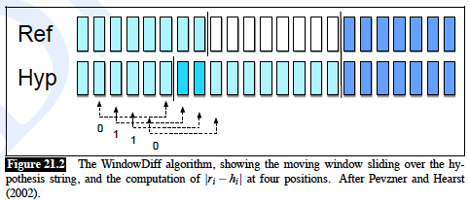
WindowDiff
Pevzner & Hearst 2002
Compares automatic to reference segmentation
Slides window of length k across segmentation
Compares # hypothesis boundaries to # of reference
Penalize window where h_{i} <> r_{i;} k= ½ average seg length

Slide 62
Other Systems
Shriberg et al.
HMM’s over topic models, language models, and prosodic cues
Contrasts in pitch, loudness; silence
Galley et al, 2003:
LCSeg:
Lexical chains, cues from words, silence, overlap
Multi-party dialogue
Multi-lingual:
English, Chinese, Dutch, Arabic,…

Slide 63
RST Parsing
Structure:
Discourse structure (RST) tree, Relations
Units:
Spans over clauses
Information:
Lexical cohesion, word-level
Evaluation:
Accuracy

Slide 64
RST Parsing (Marcu 1999)
Learn and apply classifiers for
Segmentation and parsing of discourse

Slide 65
RST Parsing (Marcu 1999)
Learn and apply classifiers for
Segmentation and parsing of discourse
Assign coherence relations between spans

Slide 66
RST Parsing (Marcu 1999)
Learn and apply classifiers for
Segmentation and parsing of discourse
Assign coherence relations between spans
Create a representation over whole text => parse
Discourse structure
RST trees
Fine-grained, hierarchical structure
Clause-based units

Slide 67
Corpus-based Approach
Training & testing on 90 RST trees
Texts from MUC, Brown (science), WSJ (news)
Annotations:

Slide 68
Corpus-based Approach
Training & testing on 90 RST trees
Texts from MUC, Brown (science), WSJ (news)
Annotations:
Identify “edu”s – elementary discourse units
Clause-like units – key relation
Parentheticals – could delete with no effect

Slide 69
Corpus-based Approach
Training & testing on 90 RST trees
Texts from MUC, Brown (science), WSJ (news)
Annotations:
Identify “edu”s – elementary discourse units
Clause-like units – key relation
Parentheticals – could delete with no effect
Identify nucleus-satellite status

Slide 70
Corpus-based Approach
Training & testing on 90 RST trees
Texts from MUC, Brown (science), WSJ (news)
Annotations:
Identify “edu”s – elementary discourse units
Clause-like units – key relation
Parentheticals – could delete with no effect
Identify nucleus-satellite status
Identify relation that holds – I.e. elab, contrast…

Slide 71
Identifying Segments & Relations
Key source of information:
Cue phrases
Aka discourse markers, cue words, clue words
Typically connectives
E.g. conjunctions, adverbs
Clue to relations, boundaries
Although, but, for example, however, yet, with, and….
John hid Bill’s keys because he was drunk.

Slide 72
Cue Phrases
Issues:
Ambiguous:
Insufficient:
Not all relations marked by cue phrases
Only 15-25% of relations marked by cues

Slide 73
Learning Discourse Parsing
Train classifiers for:
EDU segmentation
Coherence relation assignment
Discourse structure assignment
Shift-reduce parser transitions
Use range of features:
Cue phrases
Lexical/punctuation in context
Syntactic parses

Slide 74
RST Parsing Model
Shift-reduce parser
Assumes segmented into edus
Edu -> Edt – minimal discourse tree unit, undefined

Slide 75
RST Parsing Model
Shift-reduce parser
Assumes segmented into edus
Edu -> Edt – minimal discourse tree unit, undefined
Shift: Add next input edt to stack

Slide 76
RST Parsing Model
Shift-reduce parser
Assumes segmented into edus
Edu -> Edt – minimal discourse tree unit, undefined
Shift: Add next input edt to stack
Reduce: pop top 2 edts, combine in new tree
Update: status, relation
Push new tree on stack

Slide 77
RST Parsing Model
Shift-reduce parser
Assumes segmented into edus
Edu -> Edt – minimal discourse tree unit, undefined
Shift: Add next input edt to stack
Reduce: pop top 2 edts, combine in new tree
Update: status, relation
Push new tree on stack
Requires 1 shift op and 6 reduce
Reduce ops: ns, sn, nn -> binary; below ops: non-binary

Slide 78
RST Parsing Model
Shift-reduce parser
Assumes segmented into edus
Edu -> Edt – minimal discourse tree unit, undefined
Shift: Add next input edt to stack
Reduce: pop top 2 edts, combine in new tree
Update: status, relation
Push new tree on stack
Requires 1 shift op and 6 reduce
Reduce ops: ns, sn, nn -> binary; below ops: non-binary
Learn: relation+ops: 17*6 + 1

Slide 79
Learning Segmentation
Per-word: Sentence, edu, or parenthetical bnd
Features:

Slide 80
Learning Segmentation
Per-word: Sentence, edu, or parenthetical bnd
Features:
Context: 5 word window, POS: 2 before, after
Discourse marker present?
Abbreviations?

Slide 81
Learning Segmentation
Per-word: Sentence, edu, or parenthetical bnd
Features:
Context: 5 word window, POS: 2 before, after
Discourse marker present?
Abbreviations?
Global context:
Discourse markers, commas & dashes, verbs present
2417 binary features/example

Slide 82
Segmentation Results
Good news: Overall:~97% accuracy
Contrast: Majority (none): ~92%
Contrast: “DOT”= bnd: 93%
Comparable to alternative approaches
Bad news:
Problem cases: Start of parenthetical, edu

Slide 83
Learning Shift-Reduce
Construct sequence of actions from tree
For a configuration:
3 top trees on stack, next edt in input
Features: # of trees on stack, in input
Tree characteristics: size, branching, relations
Words and POS of 1st and last 2 lexemes in spans
Presence and position of any discourse markers
Previous 5 parser actions
Hearst-style semantic similarity across trees
Similarity of WordNet measures

Slide 84
Classifying Shift-Reduce
C4.5 classifier
Overall: 61%
Majority: 50%, Random: 27%

Slide 85
Classifying Shift-Reduce
C4.5 classifier
Overall: 61%
Majority: 50%, Random: 27%
End-to-end evaluation:
Good on spans and N/S status
Poor on relations

Slide 86
Discussion
Noise in segmentation degrades parsing
Poor segmentation -> poor parsing

Slide 87
Discussion
Noise in segmentation degrades parsing
Poor segmentation -> poor parsing
Need sufficient training data
Subset (27) texts insufficient
More variable data better than less but similar data

Slide 88
Discussion
Noise in segmentation degrades parsing
Poor segmentation -> poor parsing
Need sufficient training data
Subset (27) texts insufficient
More variable data better than less but similar data
Constituency and N/S status good
Relation far below human

Slide 89
Evaluation
Segmentation:
Good: 96%
Better than frequency or punctuation baseline

Slide 90
Evaluation
Segmentation:
Good: 96%
Better than frequency or punctuation baseline
Discourse structure:
Okay: 61% span, relation structure

Slide 91
Evaluation
Segmentation:
Good: 96%
Better than frequency or punctuation baseline
Discourse structure:
Okay: 61% span, relation structure
Relation identification: poor

Slide 92
Issues
Goal: Single tree-shaped analysis of all text
Difficult to achieve

Slide 93
Issues
Goal: Single tree-shaped analysis of all text
Difficult to achieve
Significant ambiguity
Significant disagreement among labelers

Slide 94
Issues
Goal: Single tree-shaped analysis of all text
Difficult to achieve
Significant ambiguity
Significant disagreement among labelers
Relation recognition is difficult
Some clear “signals”, I.e. although
Not mandatory, only 25%

Slide 95
D-LTAG
Webber, Joshi, et al

Slide 96
D-LTAG
Structure:
Tree structure, relations
Units:
Clauses in local coherence relations
Information:
Word pairs, word n-grams, polarity
Evaluation:
F-measure on relations

Slide 97
D-LTAG
Discourse – handles discourse relations
Lexicalized – builds on rules associated with words
Tree Adjoining Grammar
Grammar model – mildly context-sensitive
Basic units are trees
Trees are combined by
Substitution
Adjunction

Slide 98
Tree Adjoining Grammars
Mildly context-sensitive (Joshi, 1979)
Motivation:
Enables representation of crossing dependencies
Operations for rewriting
“Substitution” and “Adjunction”
X
X
A
A
A
A
A
A

Slide 99
L-TAG Example
NP
S
NP
VP
N
NP
VP
N
VP
Ad
V
NP
Maria
pasta
quickly
eats
S
NP
VP
N
VP
VP
Ad
Maria
NP
V
quickly
N
eats
pasta

Slide 100
Dimensions of D-LTAG
Discourse relations:
‘Semantic classifications’ of lexical connectives (or implicit)
Discourse structures:
Trees: predominantly binary (for discourse part)
Discourse units:
Usually clauses, sequences
Exceptionally, VP coord, nominalization of discourse, anaphor, answer
Discourse Segments:
Non-overlapping
Discourse Relation Triggers:
Lexical elements and Structure

Slide 101
Lexicalization of Discourse
D-LTAG associates discourse tree elements with words
What words? Cue words (often)

Slide 102
Lexicalization of Discourse
D-LTAG associates discourse tree elements with words
What words? Cue words (often)
Specifically, discourse connectives:
Coordinating conjunctions
And, or, but

Slide 103
Lexicalization of Discourse
D-LTAG associates discourse tree elements with words
What words? Cue words (often)
Specifically, discourse connectives:
Coordinating conjunctions
And, or, but
Subordinating conjunctions
Although, because, however, etc, or null (implicit)

Slide 104
Lexicalization of Discourse
D-LTAG associates discourse tree elements with words
What words? Cue words (often)
Specifically, discourse connectives:
Coordinating conjunctions
And, or, but
Subordinating conjunctions
Although, because, however, etc, or null (implicit)
Parallel constructions
not only, but also

Slide 105
Lexicalization of Discourse
D-LTAG associates discourse tree elements with words
What words? Cue words (often)
Specifically, discourse connectives:
Coordinating conjunctions
And, or, but
Subordinating conjunctions
Although, because, however, etc, or null (implicit)
Parallel constructions
not only, but also
Discourse adverbials
Then, instead, …

Slide 106
Connectives & Arguments
Connectives viewed as predicate of 2 arguments
(from Webber 2006)
John loves Barolo.
So he ordered three cases of the ‘97.
But he had to cancel the order
Because he then discovered he was broke.

Slide 107
Connectives & Arguments
Connectives viewed as predicate of 2 arguments
(from Webber 2006)
John loves Barolo.
So he ordered three cases of the ‘97.
But he had to cancel the order
Because he then discovered he was broke.
Conjunctions (So, But, Because)
Arg2 – current clause; arg1 – previous clause

Slide 108
Connectives & Arguments
Connectives viewed as predicate of 2 arguments
(from Webber 2006)
John loves Barolo.
So he ordered three cases of the ‘97.
But he had to cancel the order
Because he then discovered he was broke.
Conjunctions (So, But, Because)
Arg2 – current clause; arg1 – previous clause
Discourse adverbial ‘then’
Arg2 – current clause; arg1 -????

Slide 109
Connectives & Arguments
Connectives viewed as predicate of 2 arguments
(from Webber 2006)
John loves Barolo.
So he ordered three cases of the ‘97.
But he had to cancel the order
Because he then discovered he was broke.
Conjunctions (So, But, Because)
Arg2 – current clause; arg1 – previous clause
Discourse adverbial ‘then’
Arg2 – current clause; arg1 -????
Implicit anaphor – some prior clause or discourse element

Slide 110
Example: Structural Arguments to Conjunctions
John likes Mary because she walks Fido.

Slide 111
Penn Discourse Treebank
Explicit connectives:
In Washington, House aides said Mr. Phelan told congressmen that the collar, which banned program trades through the Big Board's computer when the Dow Jones Industrial Average moved 50 points, didn't work well.
A Chemical spokeswoman said the second-quarter charge was "not material" and that no personnel changes were made as a result.

Slide 112
Penn Discourse Treebank
Explicit connectives:
In Washington, House aides said Mr. Phelan told congressmen that the collar, which banned program trades through the Big Board's computer when the Dow Jones Industrial Average moved 50 points, didn't work well.
A Chemical spokeswoman said the second-quarter charge was "not material" and that no personnel changes were made as a result.
Implicit connectives:
Some have raised their cash positions to record levels. Implicit=because (causal) High cash positions help buffer a fund when the market falls.
The projects already under construction will increase Las Vegas's supply of hotel rooms by 11,795, or nearly 20%, to 75,500. Implicit=so (consequence) By a rule of thumb of 1.5 new jobs for each new hotel room, Clark County will have nearly 18,000 new jobs.

Slide 113
Annotation
Applied as extension to Penn Treebank
Wall Street Journal
Have trained D-LTAG parsers
Available as Penn Discourse Treebank from LDC
PDTB 2.0

Slide 114
Recognizing Implicit Relations
Discourse parsing requires relation identification
Cue words/phrases very helpful
Relations disambiguatable at 93% by connective

Slide 115
Recognizing Implicit Relations
Discourse parsing requires relation identification
Cue words/phrases very helpful
Relations disambiguatable at 93% by connective
But..
Only account for 25-30% of cases

Slide 116
Recognizing Implicit Relations
Discourse parsing requires relation identification
Cue words/phrases very helpful
Relations disambiguatable at 93% by connective
But..
Only account for 25-30% of cases
Relations are overwhelming ‘implicit’
However, identifiable by people
Annotated in PDTB

Slide 117
Implicit Relations
The 101-year-old magazine has never had to woo advertisers with quite so much fervor before.
It largely rested on its hard-to-fault demographics.

Slide 118
Implicit Relations
The 101-year-old magazine has never had to woo advertisers with quite so much fervor before.
[because] It largely rested on its hard-to-fault demographics.

Slide 119
Implicit Relations
The 101-year-old magazine has never had to woo advertisers with quite so much fervor before.
[because] It largely rested on its hard-to-fault demographics.
Previous results had used synthetic implicits:
Delete existing connectives and classify
Accuracy not bad, but overestimates true implicits

Slide 120
PDTB Implicits
Relations annotated between all adjacent sentences
Hierarchy of relations:
Top-level: Comparison, Contigency, Expansion, Temporal
Relation holds between 2 spans (args)
1st sentence: Arg1; 2nd sentence: Arg2

Slide 121
Relation Features
Narrowly focused funds grew wildly popular. They faded info oblivion after the crash.
What relation?

Slide 122
Relation Features
Narrowly focused funds grew wildly popular. They faded info oblivion after the crash.
What relation? But/contrast
What words?

Slide 123
Relation Features
Narrowly focused funds grew wildly popular. They faded info oblivion after the crash.
What relation? But/contrast
What words? Popular/Oblivion
Antonyms -> contrast

Slide 124
Relation Features
Narrowly focused funds grew wildly popular. They faded info oblivion after the crash.
What relation? But/contrast
What words? Popular/Oblivion
Antonyms -> contrast
Word-pair features frequently used
Problem:

Slide 125
Relation Features
Narrowly focused funds grew wildly popular. They faded info oblivion after the crash.
What relation? But/contrast
What words? Popular/Oblivion
Antonyms -> contrast
Word-pair features frequently used
Problem: too many pairs – lots of possible features
Approach: Filtering
Stem; Use only most frequent stems – largely fn wds

Slide 126
Word-pair Analysis
Sentence pairs from English Gigaword Corpus
Explicit relations with connectives removed

Slide 127
Word-pair Analysis
Sentence pairs from English Gigaword Corpus
Explicit relations with connectives removed
Contrast vs Other:
5000 contrast, 2500 Causal, 2500 No-rel

Slide 128
Word-pair Analysis
Sentence pairs from English Gigaword Corpus
Explicit relations with connectives removed
Contrast vs Other:
5000 contrast, 2500 Causal, 2500 No-rel
No-rel: sentences at least 3 sentences aparts
Extract all word-pairs
Remove those with < 5 occurrences
Rank by information gain in MALLET

Slide 129
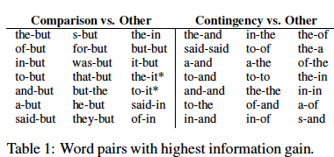
Word-Pairs
Highest information gain: (Pitler et al, 2009)
What do we see?

Slide 130
Word-Pairs
Highest information gain: (Pitler et al, 2009)
What do we see?
Lots of cue words!! Didn’t they get deleted??
Only inter-sentence ones, not within sentence

Slide 131
Word-Pairs
Highest information gain: (Pitler et al, 2009)
What do we see?
Lots of cue words!! Didn’t they get deleted??
Only inter-sentence ones, not within sentence
Function words: ‘the-it’

Slide 132
Word-Pairs
Highest information gain: (Pitler et al, 2009)
What do we see?
Lots of cue words!! Didn’t they get deleted??
Only inter-sentence ones, not within sentence
Function words: ‘the-it’

Slide 133
New Features
Intuition: popular/oblivion
Contrast in lexical semantics – antonymy
Also contrast in polarity: positive vs negative
Might help Comparison

Slide 134
New Features
Intuition: popular/oblivion
Contrast in lexical semantics – antonymy
Also contrast in polarity: positive vs negative
Might help Comparison
Polarity tags:
Each sentiment word (and negation) gets MPQA tag

Slide 135
New Features
Intuition: popular/oblivion
Contrast in lexical semantics – antonymy
Also contrast in polarity: positive vs negative
Might help Comparison
Polarity tags:
Each sentiment word (and negation) gets MPQA tag
Inquirer tags:
General Inquirer lexicon classes: (verbs only)
Polarity, Comparison, Rise/Fall, Pain/Pleasure
Categories have fewer sparseness problems than words

Slide 136
More Features
Money/Percent/Num:
Counts of each; combination in each pair
Why?

Slide 137
More Features
Money/Percent/Num:
Counts of each; combination in each pair
Why? Domain-dependent? WSJ!
WSJ-LM: Rank of relation for uni/bigram in PDTB

Slide 138
More Features
Money/Percent/Num:
Counts of each; combination in each pair
Why? Domain-dependent? WSJ!
WSJ-LM: Rank of relation for uni/bigram in PDTB
Expl-LM: Rank from EG corpus

Slide 139
More Features
Money/Percent/Num:
Counts of each; combination in each pair
Why? Domain-dependent? WSJ!
WSJ-LM: Rank of relation for uni/bigram in PDTB
Expl-LM: Rank from EG corpus
Verbs:
# of verbs in same Levin class
Average VP length
Main verb POS tag

Slide 140
And More Features
First/Last Words: First/List 1-3 words in each Arg

Slide 141
And More Features
First/Last Words: First/List 1-3 words in each Arg
Modality: presence of modals; specific types

Slide 142
And More Features
First/Last Words: First/List 1-3 words in each Arg
Modality: presence of modals; specific types
Context: previous/following explicit relation

Slide 143
And More Features
First/Last Words: First/List 1-3 words in each Arg
Modality: presence of modals; specific types
Context: previous/following explicit relation
Word-pairs:
Derived from EG corpus
Derived from Implicit spans in PDTB
Only PDTB implicit word pairs with information gain> 0
Derived from Explicit spans in PDTB

Slide 144
Experiments
Classifiers:
MALLET: Naïve Bayes, MaxEnt, AdaBoost
Train balanced 1-vs-all classifiers for 4 classes
Test on natural distribution

Slide 145
Discussion
Overall:
First/Last words generally among best features
Context features also help

Slide 146
Discussion
Overall:
First/Last words generally among best features
Context features also help
Surprises:
Polarity features some of worst for contrast
Polarity pairs as common in non-contrast as contrast

Slide 147
Discussion
Overall:
First/Last words generally among best features
Context features also help
Surprises:
Polarity features some of worst for contrast
Polarity pairs as common in non-contrast as contrast
Word-pairs:
Best features: From implicit pairs, w/info gain

Slide 148
Discussion
Overall:
First/Last words generally among best features
Context features also help
Surprises:
Polarity features some of worst for contrast
Polarity pairs as common in non-contrast as contrast
Word-pairs:
Best features: From implicit pairs, w/info gain
Combining features improves 6-16% absolute
However, overall accuracy still not great

