Slide 1
Question-Answering: Overview
Ling573
Systems & Applications
March 31, 2011

Slide 2
Quick Schedule Notes
No Treehouse this week!
CS Seminar: Retrieval from Microblogs (Metzler)
April 8, 3:30pm; CSE 609

Slide 3
Roadmap
Dimensions of the problem
A (very) brief history
Architecture of a QA system
QA and resources
Evaluation
Challenges
Logistics Check-in

Slide 4
Dimensions of QA
Basic structure:
Question analysis
Answer search
Answer selection and presentation

Slide 5
Dimensions of QA
Basic structure:
Question analysis
Answer search
Answer selection and presentation
Rich problem domain: Tasks vary on
Applications
Users
Question types
Answer types
Evaluation
Presentation

Slide 6
Applications
Applications vary by:
Answer sources
Structured: e.g., database fields
Semi-structured: e.g., database with comments
Free text

Slide 7
Applications
Applications vary by:
Answer sources
Structured: e.g., database fields
Semi-structured: e.g., database with comments
Free text
Web
Fixed document collection (Typical TREC QA)

Slide 8
Applications
Applications vary by:
Answer sources
Structured: e.g., database fields
Semi-structured: e.g., database with comments
Free text
Web
Fixed document collection (Typical TREC QA)

Slide 9
Applications
Applications vary by:
Answer sources
Structured: e.g., database fields
Semi-structured: e.g., database with comments
Free text
Web
Fixed document collection (Typical TREC QA)
Book or encyclopedia
Specific passage/article (reading comprehension)

Slide 10
Applications
Applications vary by:
Answer sources
Structured: e.g., database fields
Semi-structured: e.g., database with comments
Free text
Web
Fixed document collection (Typical TREC QA)
Book or encyclopedia
Specific passage/article (reading comprehension)
Media and modality:
Within or cross-language; video/images/speech

Slide 11
Users
Novice
Understand capabilities/limitations of system

Slide 12
Users
Novice
Understand capabilities/limitations of system
Expert
Assume familiar with capabilties
Wants efficient information access
Maybe desirable/willing to set up profile

Slide 13
Question Types
Could be factual vs opinion vs summary

Slide 14
Question Types
Could be factual vs opinion vs summary
Factual questions:
Yes/no; wh-questions

Slide 15
Question Types
Could be factual vs opinion vs summary
Factual questions:
Yes/no; wh-questions
Vary dramatically in difficulty
Factoid, List

Slide 16
Question Types
Could be factual vs opinion vs summary
Factual questions:
Yes/no; wh-questions
Vary dramatically in difficulty
Factoid, List
Definitions
Why/how..

Slide 17
Question Types
Could be factual vs opinion vs summary
Factual questions:
Yes/no; wh-questions
Vary dramatically in difficulty
Factoid, List
Definitions
Why/how..
Open ended: ‘What happened?’

Slide 18
Question Types
Could be factual vs opinion vs summary
Factual questions:
Yes/no; wh-questions
Vary dramatically in difficulty
Factoid, List
Definitions
Why/how..
Open ended: ‘What happened?’
Affected by form
Who was the first president?

Slide 19
Question Types
Could be factual vs opinion vs summary
Factual questions:
Yes/no; wh-questions
Vary dramatically in difficulty
Factoid, List
Definitions
Why/how..
Open ended: ‘What happened?’
Affected by form
Who was the first president? Vs Name the first president

Slide 20
Answers
Like tests!

Slide 21
Answers
Like tests!
Form:
Short answer
Long answer
Narrative

Slide 22
Answers
Like tests!
Form:
Short answer
Long answer
Narrative
Processing:
Extractive vs generated vs synthetic

Slide 23
Answers
Like tests!
Form:
Short answer
Long answer
Narrative
Processing:
Extractive vs generated vs synthetic
In the limit -> summarization
What is the book about?

Slide 24
Evaluation & Presentation
What makes an answer good?

Slide 25
Evaluation & Presentation
What makes an answer good?
Bare answer

Slide 26
Evaluation & Presentation
What makes an answer good?
Bare answer
Longer with justification

Slide 27
Evaluation & Presentation
What makes an answer good?
Bare answer
Longer with justification
Implementation vs Usability
QA interfaces still rudimentary
Ideally should be

Slide 28
Evaluation & Presentation
What makes an answer good?
Bare answer
Longer with justification
Implementation vs Usability
QA interfaces still rudimentary
Ideally should be
Interactive, support refinement, dialogic

Slide 29
(Very) Brief History
Earliest systems: NL queries to databases (60-s-70s)
BASEBALL, LUNAR

Slide 30
(Very) Brief History
Earliest systems: NL queries to databases (60-s-70s)
BASEBALL, LUNAR
Linguistically sophisticated:
Syntax, semantics, quantification, ,,,

Slide 31
(Very) Brief History
Earliest systems: NL queries to databases (60-s-70s)
BASEBALL, LUNAR
Linguistically sophisticated:
Syntax, semantics, quantification, ,,,
Restricted domain!

Slide 32
(Very) Brief History
Earliest systems: NL queries to databases (60-s-70s)
BASEBALL, LUNAR
Linguistically sophisticated:
Syntax, semantics, quantification, ,,,
Restricted domain!
Spoken dialogue systems (Turing!, 70s-current)
SHRDLU (blocks world), MIT’s Jupiter , lots more

Slide 33
(Very) Brief History
Earliest systems: NL queries to databases (60-s-70s)
BASEBALL, LUNAR
Linguistically sophisticated:
Syntax, semantics, quantification, ,,,
Restricted domain!
Spoken dialogue systems (Turing!, 70s-current)
SHRDLU (blocks world), MIT’s Jupiter , lots more
Reading comprehension: (~2000)

Slide 34
(Very) Brief History
Earliest systems: NL queries to databases (60-s-70s)
BASEBALL, LUNAR
Linguistically sophisticated:
Syntax, semantics, quantification, ,,,
Restricted domain!
Spoken dialogue systems (Turing!, 70s-current)
SHRDLU (blocks world), MIT’s Jupiter , lots more
Reading comprehension: (~2000)
Information retrieval (TREC); Information extraction (MUC)

Slide 35
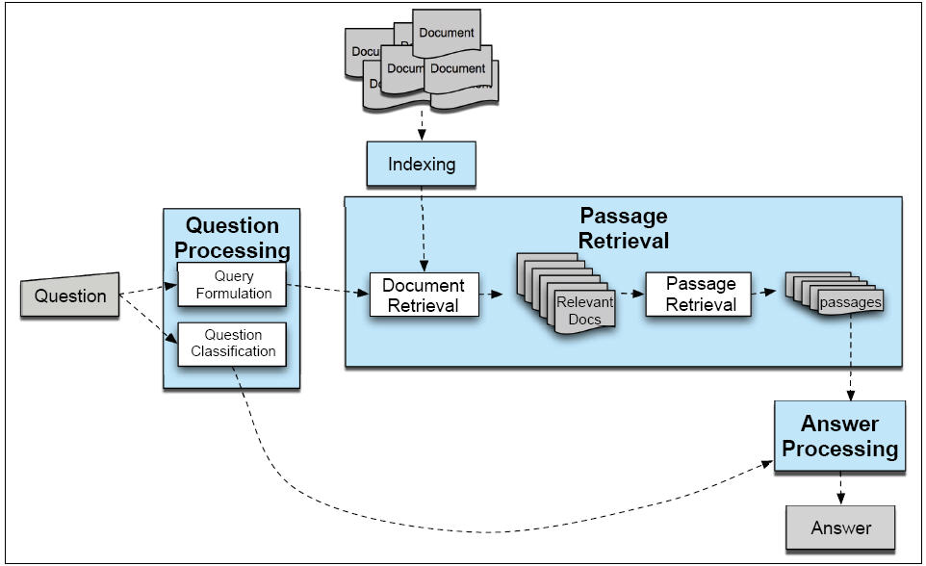
General Architecture

Slide 36
Basic Strategy
Given a document collection and a query:

Slide 37
Basic Strategy
Given a document collection and a query:
Execute the following steps:

Slide 38
Basic Strategy
Given a document collection and a query:
Execute the following steps:
Question processing
Document collection processing
Passage retrieval
Answer processing and presentation
Evaluation

Slide 39
Basic Strategy
Given a document collection and a query:
Execute the following steps:
Question processing
Document collection processing
Passage retrieval
Answer processing and presentation
Evaluation
Systems vary in detailed structure, and complexity

Slide 40
AskMSR
Shallow Processing for QA
1
2
3
5
4

Slide 41
Deep Processing Technique for QA
LCC (Moldovan, Harabagiu, et al)

Slide 42
Query Formulation
Convert question suitable form for IR
Strategy depends on document collection
Web (or similar large collection):

Slide 43
Query Formulation
Convert question suitable form for IR
Strategy depends on document collection
Web (or similar large collection):
‘stop structure’ removal:
Delete function words, q-words, even low content verbs
Corporate sites (or similar smaller collection):

Slide 44
Query Formulation
Convert question suitable form for IR
Strategy depends on document collection
Web (or similar large collection):
‘stop structure’ removal:
Delete function words, q-words, even low content verbs
Corporate sites (or similar smaller collection):
Query expansion
Can’t count on document diversity to recover word variation

Slide 45
Query Formulation
Convert question suitable form for IR
Strategy depends on document collection
Web (or similar large collection):
‘stop structure’ removal:
Delete function words, q-words, even low content verbs
Corporate sites (or similar smaller collection):
Query expansion
Can’t count on document diversity to recover word variation
Add morphological variants, WordNet as thesaurus

Slide 46
Query Formulation
Convert question suitable form for IR
Strategy depends on document collection
Web (or similar large collection):
‘stop structure’ removal:
Delete function words, q-words, even low content verbs
Corporate sites (or similar smaller collection):
Query expansion
Can’t count on document diversity to recover word variation
Add morphological variants, WordNet as thesaurus
Reformulate as declarative: rule-based
Where is X located -> X is located in

Slide 47
Question Classification
Answer type recognition
Who

Slide 48
Question Classification
Answer type recognition
Who -> Person
What Canadian city ->

Slide 49
Question Classification
Answer type recognition
Who -> Person
What Canadian city -> City
What is surf music -> Definition
Identifies type of entity (e.g. Named Entity) or form (biography, definition) to return as answer

Slide 50
Question Classification
Answer type recognition
Who -> Person
What Canadian city -> City
What is surf music -> Definition
Identifies type of entity (e.g. Named Entity) or form (biography, definition) to return as answer
Build ontology of answer types (by hand)
Train classifiers to recognize

Slide 51
Question Classification
Answer type recognition
Who -> Person
What Canadian city -> City
What is surf music -> Definition
Identifies type of entity (e.g. Named Entity) or form (biography, definition) to return as answer
Build ontology of answer types (by hand)
Train classifiers to recognize
Using POS, NE, words

Slide 52
Question Classification
Answer type recognition
Who -> Person
What Canadian city -> City
What is surf music -> Definition
Identifies type of entity (e.g. Named Entity) or form (biography, definition) to return as answer
Build ontology of answer types (by hand)
Train classifiers to recognize
Using POS, NE, words
Synsets, hyper/hypo-nyms

Slide 53
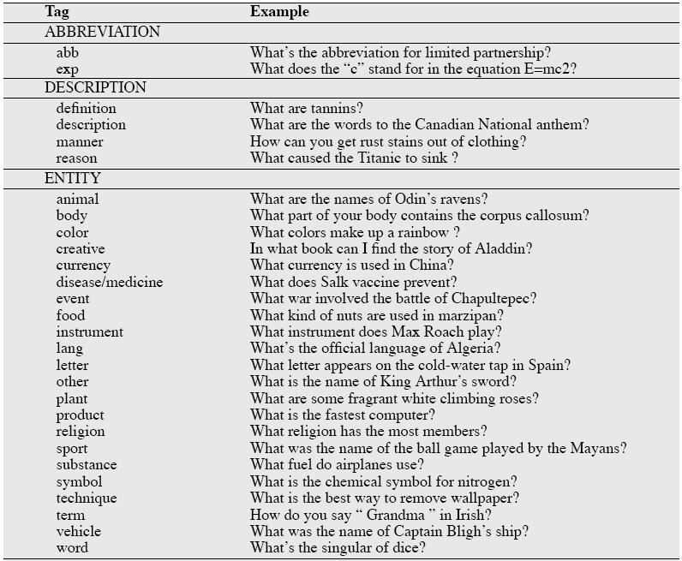

Slide 54
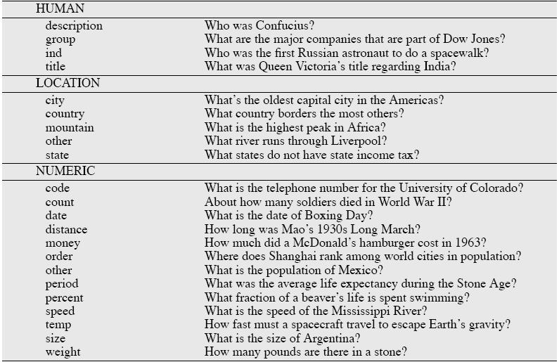

Slide 55
Passage Retrieval
Why not just perform general information retrieval?

Slide 56
Passage Retrieval
Why not just perform general information retrieval?
Documents too big, non-specific for answers
Identify shorter, focused spans (e.g., sentences)

Slide 57
Passage Retrieval
Why not just perform general information retrieval?
Documents too big, non-specific for answers
Identify shorter, focused spans (e.g., sentences)
Filter for correct type: answer type classification
Rank passages based on a trained classifier
Features:
Question keywords, Named Entities
Longest overlapping sequence,
Shortest keyword-covering span
N-gram overlap b/t question and passage

Slide 58
Passage Retrieval
Why not just perform general information retrieval?
Documents too big, non-specific for answers
Identify shorter, focused spans (e.g., sentences)
Filter for correct type: answer type classification
Rank passages based on a trained classifier
Features:
Question keywords, Named Entities
Longest overlapping sequence,
Shortest keyword-covering span
N-gram overlap b/t question and passage
For web search, use result snippets

Slide 59
Answer Processing
Find the specific answer in the passage

Slide 60
Answer Processing
Find the specific answer in the passage
Pattern extraction-based:
Include answer types, regular expressions
Similar to relation extraction:
Learn relation b/t answer type and aspect of question

Slide 61
Answer Processing
Find the specific answer in the passage
Pattern extraction-based:
Include answer types, regular expressions
Similar to relation extraction:
Learn relation b/t answer type and aspect of question
E.g. date-of-birth/person name; term/definition
Can use bootstrap strategy for contexts, like Yarowsky
<NAME> (<BD>-<DD>) or <NAME> was born on <BD>

Slide 62
Answer Processing
Find the specific answer in the passage
Pattern extraction-based:
Include answer types, regular expressions
Similar to relation extraction:
Learn relation b/t answer type and aspect of question
E.g. date-of-birth/person name; term/definition
Can use bootstrap strategy for contexts
<NAME> (<BD>-<DD>) or <NAME> was born on <BD>

Slide 63
Resources
System development requires resources
Especially true of data-driven machine learning

Slide 64
Resources
System development requires resources
Especially true of data-driven machine learning
QA resources:
Sets of questions with answers for development/test

Slide 65
Resources
System development requires resources
Especially true of data-driven machine learning
QA resources:
Sets of questions with answers for development/test
Specifically manually constructed/manually annotated

Slide 66
Resources
System development requires resources
Especially true of data-driven machine learning
QA resources:
Sets of questions with answers for development/test
Specifically manually constructed/manually annotated
‘Found data’

Slide 67
Resources
System development requires resources
Especially true of data-driven machine learning
QA resources:
Sets of questions with answers for development/test
Specifically manually constructed/manually annotated
‘Found data’
Trivia games!!!, FAQs, Answer Sites, etc

Slide 68
Resources
System development requires resources
Especially true of data-driven machine learning
QA resources:
Sets of questions with answers for development/test
Specifically manually constructed/manually annotated
‘Found data’
Trivia games!!!, FAQs, Answer Sites, etc
Multiple choice tests (IP???)

Slide 69
Resources
System development requires resources
Especially true of data-driven machine learning
QA resources:
Sets of questions with answers for development/test
Specifically manually constructed/manually annotated
‘Found data’
Trivia games!!!, FAQs, Answer Sites, etc
Multiple choice tests (IP???)
Partial data: Web logs – queries and click-throughs

Slide 70
Information Resources
Proxies for world knowledge:
WordNet: Synonymy; IS-A hierarchy

Slide 71
Information Resources
Proxies for world knowledge:
WordNet: Synonymy; IS-A hierarchy
Wikipedia

Slide 72
Information Resources
Proxies for world knowledge:
WordNet: Synonymy; IS-A hierarchy
Wikipedia
Web itself
….
Term management:
Acronym lists
Gazetteers
….

Slide 73
Software Resources
General: Machine learning tools

Slide 74
Software Resources
General: Machine learning tools
Passage/Document retrieval:
Information retrieval engine:
Lucene, Indri/lemur, MG
Sentence breaking, etc..

Slide 75
Software Resources
General: Machine learning tools
Passage/Document retrieval:
Information retrieval engine:
Lucene, Indri/lemur, MG
Sentence breaking, etc..
Query processing:
Named entity extraction
Synonymy expansion
Parsing?

Slide 76
Software Resources
General: Machine learning tools
Passage/Document retrieval:
Information retrieval engine:
Lucene, Indri/lemur, MG
Sentence breaking, etc..
Query processing:
Named entity extraction
Synonymy expansion
Parsing?
Answer extraction:
NER, IE (patterns)

Slide 77
Evaluation
Candidate criteria:
Relevance
Correctness
Conciseness:
No extra information
Completeness:
Penalize partial answers
Coherence:
Easily readable
Justification
Tension among criteria

Slide 78
Evaluation
Consistency/repeatability:
Are answers scored reliability

Slide 79
Evaluation
Consistency/repeatability:
Are answers scored reliability?
Automation:
Can answers be scored automatically?
Required for machine learning tune/test

Slide 80
Evaluation
Consistency/repeatability:
Are answers scored reliability?
Automation:
Can answers be scored automatically?
Required for machine learning tune/test
Short answer answer keys
Litkowski’s patterns

Slide 81
Evaluation
Classical:
Return ranked list of answer candidates

Slide 82
Evaluation
Classical:
Return ranked list of answer candidates
Idea: Correct answer higher in list => higher score
Measure: Mean Reciprocal Rank (MRR)

Slide 83
Evaluation
Classical:
Return ranked list of answer candidates
Idea: Correct answer higher in list => higher score
Measure: Mean Reciprocal Rank (MRR)
For each question,
Get reciprocal of rank of first correct answer
E.g. correct answer is 4 => ¼
None correct => 0
Average over all questions

Slide 84
Dimensions of TREC QA
Applications

Slide 85
Dimensions of TREC QA
Applications
Open-domain free text search
Fixed collections
News, blogs

Slide 86
Dimensions of TREC QA
Applications
Open-domain free text search
Fixed collections
News, blogs
Users
Novice
Question types

Slide 87
Dimensions of TREC QA
Applications
Open-domain free text search
Fixed collections
News, blogs
Users
Novice
Question types
Factoid -> List, relation, etc
Answer types

Slide 88
Dimensions of TREC QA
Applications
Open-domain free text search
Fixed collections
News, blogs
Users
Novice
Question types
Factoid -> List, relation, etc
Answer types
Predominantly extractive, short answer in context
Evaluation:

Slide 89
Dimensions of TREC QA
Applications
Open-domain free text search
Fixed collections
News, blogs
Users
Novice
Question types
Factoid -> List, relation, etc
Answer types
Predominantly extractive, short answer in context
Evaluation:
Official: human; proxy: patterns
Presentation: One interactive track

