Slide 1
Answer Extraction: Redundancy & Semantics
Ling573
NLP Systems and Applications
May 24, 2011

Slide 2
Roadmap
Integrating Redundancy-based Answer Extraction
Answer projection
Answer reweighting
Structure-based extraction
Semantic structure-based extraction
FrameNet (Shen et al).

Slide 3
Redundancy-Based Approaches & TREC
Redundancy-based approaches:
Exploit redundancy and large scale of web to
Identify ‘easy’ contexts for answer extraction
Identify statistical relations b/t answers and questions

Slide 4
Redundancy-Based Approaches & TREC
Redundancy-based approaches:
Exploit redundancy and large scale of web to
Identify ‘easy’ contexts for answer extraction
Identify statistical relations b/t answers and questions
Frequently effective:
More effective using Web as collection than TREC
Issue:
How integrate with TREC QA model?

Slide 5
Redundancy-Based Approaches & TREC
Redundancy-based approaches:
Exploit redundancy and large scale of web to
Identify ‘easy’ contexts for answer extraction
Identify statistical relations b/t answers and questions
Frequently effective:
More effective using Web as collection than TREC
Issue:
How integrate with TREC QA model?
Requires answer string AND supporting TREC document

Slide 6
Answer Projection
Idea:
Project Web-based answer onto some TREC doc
Find best supporting document in AQUAINT

Slide 7
Answer Projection
Idea:
Project Web-based answer onto some TREC doc
Find best supporting document in AQUAINT
Baseline approach: (Concordia, 2007)
Run query on Lucene index of TREC docs

Slide 8
Answer Projection
Idea:
Project Web-based answer onto some TREC doc
Find best supporting document in AQUAINT
Baseline approach: (Concordia, 2007)
Run query on Lucene index of TREC docs
Identify documents where top-ranked answer appears

Slide 9
Answer Projection
Idea:
Project Web-based answer onto some TREC doc
Find best supporting document in AQUAINT
Baseline approach: (Concordia, 2007)
Run query on Lucene index of TREC docs
Identify documents where top-ranked answer appears
Select one with highest retrieval score

Slide 10
Answer Projection
Modifications:
Not just retrieval status value

Slide 11
Answer Projection
Modifications:
Not just retrieval status value
Tf-idf of question terms
No information from answer term
E.g. answer term frequency (baseline: binary)

Slide 12
Answer Projection
Modifications:
Not just retrieval status value
Tf-idf of question terms
No information from answer term
E.g. answer term frequency (baseline: binary)
Approximate match of answer term
New weighting:
Retrieval score x (frequency of answer + freq. of target)

Slide 13
Answer Projection
Modifications:
Not just retrieval status value
Tf-idf of question terms
No information from answer term
E.g. answer term frequency (baseline: binary)
Approximate match of answer term
New weighting:
Retrieval score x (frequency of answer + freq. of target)
No major improvement:
Selects correct document for 60% of correct answers

Slide 14
Answer Projection as Search
Insight: (Mishne & De Rijk, 2005)
Redundancy-based approach provides answer
Why not search TREC collection after Web retrieval?

Slide 15
Answer Projection as Search
Insight: (Mishne & De Rijk, 2005)
Redundancy-based approach provides answer
Why not search TREC collection after Web retrieval?
Use web-based answer to improve query
Alternative query formulations: Combinations

Slide 16
Answer Projection as Search
Insight: (Mishne & De Rijk, 2005)
Redundancy-based approach provides answer
Why not search TREC collection after Web retrieval?
Use web-based answer to improve query
Alternative query formulations: Combinations
Baseline: All words from Q & A

Slide 17
Answer Projection as Search
Insight: (Mishne & De Rijk, 2005)
Redundancy-based approach provides answer
Why not search TREC collection after Web retrieval?
Use web-based answer to improve query
Alternative query formulations: Combinations
Baseline: All words from Q & A
Boost-Answer-N: All words, but weight Answer wds by N

Slide 18
Answer Projection as Search
Insight: (Mishne & De Rijk, 2005)
Redundancy-based approach provides answer
Why not search TREC collection after Web retrieval?
Use web-based answer to improve query
Alternative query formulations: Combinations
Baseline: All words from Q & A
Boost-Answer-N: All words, but weight Answer wds by N
Boolean-Answer: All words, but answer must appear

Slide 19
Answer Projection as Search
Insight: (Mishne & De Rijk, 2005)
Redundancy-based approach provides answer
Why not search TREC collection after Web retrieval?
Use web-based answer to improve query
Alternative query formulations: Combinations
Baseline: All words from Q & A
Boost-Answer-N: All words, but weight Answer wds by N
Boolean-Answer: All words, but answer must appear
Phrases: All words, but group ‘phrases’ by shallow proc

Slide 20
Answer Projection as Search
Insight: (Mishne & De Rijk, 2005)
Redundancy-based approach provides answer
Why not search TREC collection after Web retrieval?
Use web-based answer to improve query
Alternative query formulations: Combinations
Baseline: All words from Q & A
Boost-Answer-N: All words, but weight Answer wds by N
Boolean-Answer: All words, but answer must appear
Phrases: All words, but group ‘phrases’ by shallow proc
Phrase-Answer: All words, Answer words as phrase

Slide 21
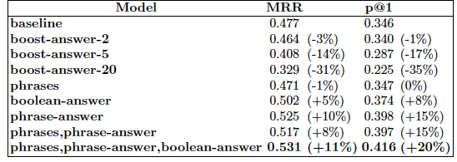
Results

Slide 22
Results
Boost-Answer-N hurts!

Slide 23
Results
Boost-Answer-N hurts!
Topic drift to answer away from question
Require answer as phrase, without weighting improves

Slide 24
Web-Based Boosting
Harabagiu et al 2005
Create search engine queries from question
Extract most redundant answers from search
Augment Deep NLP approach

Slide 25
Web-Based Boosting
Harabagiu et al 2005
Create search engine queries from question
Extract most redundant answers from search
Augment Deep NLP approach
Increase weight on TREC candidates that match

Slide 26
Web-Based Boosting
Harabagiu et al 2005
Create search engine queries from question
Extract most redundant answers from search
Augment Deep NLP approach
Increase weight on TREC candidates that match
Higher weight if higher frequency
Intuition:
QA answer search too focused on query terms
Deep QA bias to matching NE type, syntactic class

Slide 27
Web-Based Boosting
Create search engine queries from question
Extract most redundant answers from search
Augment Deep NLP approach
Increase weight on TREC candidates that match
Higher weight if higher frequency
Intuition:
QA answer search too focused on query terms
Deep QA bias to matching NE type, syntactic class
Reweighting improves
Web-boosting improves significantly: 20%

Slide 28
Semantic Structure-based Answer Extraction
Shen and Lapata, 2007
Intuition:
Surface forms obscure Q&A patterns
Q: What year did the U.S. buy Alaska?
S_{A}:…before Russia sold Alaska to the United States in 1867

Slide 29
Semantic Structure-based Answer Extraction
Shen and Lapata, 2007
Intuition:
Surface forms obscure Q&A patterns
Q: What year did the U.S. buy Alaska?
S_{A}:…before Russia sold Alaska to the United States in 1867
Learn surface text patterns?

Slide 30
Semantic Structure-based Answer Extraction
Shen and Lapata, 2007
Intuition:
Surface forms obscure Q&A patterns
Q: What year did the U.S. buy Alaska?
S_{A}:…before Russia sold Alaska to the United States in 1867
Learn surface text patterns?
Long distance relations, require huge # of patterns to find
Learn syntactic patterns?

Slide 31
Semantic Structure-based Answer Extraction
Shen and Lapata, 2007
Intuition:
Surface forms obscure Q&A patterns
Q: What year did the U.S. buy Alaska?
S_{A}:…before Russia sold Alaska to the United States in 1867
Learn surface text patterns?
Long distance relations, require huge # of patterns to find
Learn syntactic patterns?
Different lexical choice, different dependency structure
Learn predicate-argument structure?

Slide 32
Semantic Structure-based Answer Extraction
Shen and Lapata, 2007
Intuition:
Surface forms obscure Q&A patterns
Q: What year did the U.S. buy Alaska?
S_{A}:…before Russia sold Alaska to the United States in 1867
Learn surface text patterns?
Long distance relations, require huge # of patterns to find
Learn syntactic patterns?
Different lexical choice, different dependency structure
Learn predicate-argument structure?
Different argument structure: Agent vs recipient, etc

Slide 33
Semantic Similarity
Semantic relations:
Basic semantic domain:
Buying and selling

Slide 34
Semantic Similarity
Semantic relations:
Basic semantic domain:
Buying and selling
Semantic roles:
Buyer, Goods, Seller

Slide 35
Semantic Similarity
Semantic relations:
Basic semantic domain:
Buying and selling
Semantic roles:
Buyer, Goods, Seller
Examples of surface forms:
[Lee]Seller sold a textbook [to Abby]Buyer
[Kim]Seller sold [the sweater]Goods
[Abby]Seller sold [the car]Goods [for cash]Means.

Slide 36
Semantic Roles & QA
Approach:
Perform semantic role labeling
FrameNet
Perform structural and semantic role matching
Use role matching to select answer

Slide 37
Semantic Roles & QA
Approach:
Perform semantic role labeling
FrameNet
Perform structural and semantic role matching
Use role matching to select answer
Comparison:
Contrast with syntax or shallow SRL approach

Slide 38
Frames
Semantic roles specific to Frame
Frame:
Schematic representation of situation

Slide 39
Frames
Semantic roles specific to Frame
Frame:
Schematic representation of situation
Evokation:
Predicates with similar semantics evoke same frame

Slide 40
Frames
Semantic roles specific to Frame
Frame:
Schematic representation of situation
Evokation:
Predicates with similar semantics evoke same frame
Frame elements:
Semantic roles
Defined per frame
Correspond to salient entities in the evoked situation

Slide 41
FrameNet
Database includes:
Surface syntactic realizations of semantic roles
Sentences (BNC) annotated with frame/role info
Frame example: Commerce_Sell

Slide 42
FrameNet
Database includes:
Surface syntactic realizations of semantic roles
Sentences (BNC) annotated with frame/role info
Frame example: Commerce_Sell
Evoked by:

Slide 43
FrameNet
Database includes:
Surface syntactic realizations of semantic roles
Sentences (BNC) annotated with frame/role info
Frame example: Commerce_Sell
Evoked by: sell, vend, retail; also: sale, vendor
Frame elements:

Slide 44
FrameNet
Database includes:
Surface syntactic realizations of semantic roles
Sentences (BNC) annotated with frame/role info
Frame example: Commerce_Sell
Evoked by: sell, vend, retail; also: sale, vendor
Frame elements:
Core semantic roles:

Slide 45
FrameNet
Database includes:
Surface syntactic realizations of semantic roles
Sentences (BNC) annotated with frame/role info
Frame example: Commerce_Sell
Evoked by: sell, vend, retail; also: sale, vendor
Frame elements:
Core semantic roles: Buyer, Seller, Goods
Non-core (peripheral) semantic roles:

Slide 46
FrameNet
Database includes:
Surface syntactic realizations of semantic roles
Sentences (BNC) annotated with frame/role info
Frame example: Commerce_Sell
Evoked by: sell, vend, retail; also: sale, vendor
Frame elements:
Core semantic roles: Buyer, Seller, Goods
Non-core (peripheral) semantic roles:
Means, Manner
Not specific to frame

Slide 47
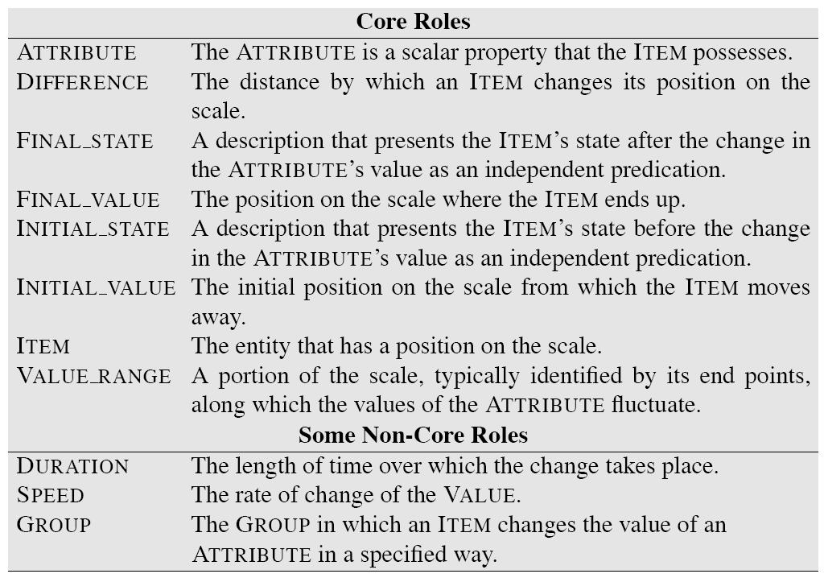

Slide 48
Bridging Surface Gaps in QA
Semantics: WordNet
Query expansion
Extended WordNet chains for inference
WordNet classes for answer filtering

Slide 49
Bridging Surface Gaps in QA
Semantics: WordNet
Query expansion
Extended WordNet chains for inference
WordNet classes for answer filtering
Syntax:
Structure matching and alignment
Cui et al, 2005; Aktolga et al, 2011

Slide 50
Semantic Roles in QA
Narayanan and Harabagiu, 2004
Inference over predicate-argument structure
Derived PropBank and FrameNet

Slide 51
Semantic Roles in QA
Narayanan and Harabagiu, 2004
Inference over predicate-argument structure
Derived PropBank and FrameNet
Sun et al, 2005
ASSERT Shallow semantic parser based on PropBank
Compare pred-arg structure b/t Q & A
No improvement due to inadequate coverage

Slide 52
Semantic Roles in QA
Narayanan and Harabagiu, 2004
Inference over predicate-argument structure
Derived PropBank and FrameNet
Sun et al, 2005
ASSERT Shallow semantic parser based on PropBank
Compare pred-arg structure b/t Q & A
No improvement due to inadequate coverage
Kaisser et al, 2006
Question paraphrasing based on FrameNet
Reformulations sent to Google for search
Coverage problems due to strict matching

Slide 53
Approach
Standard processing:
Question processing:
Answer type classification

Slide 54
Approach
Standard processing:
Question processing:
Answer type classification
Similar to Li and Roth
Question reformulation

Slide 55
Approach
Standard processing:
Question processing:
Answer type classification
Similar to Li and Roth
Question reformulation
Similar to AskMSR/Aranea

Slide 56
Approach (cont’d)
Passage retrieval:
Top 50 sentences from Lemur
Add gold standard sentences from TREC

Slide 57
Approach (cont’d)
Passage retrieval:
Top 50 sentences from Lemur
Add gold standard sentences from TREC
Select sentences which match pattern
Also with >= 1 question key word

Slide 58
Approach (cont’d)
Passage retrieval:
Top 50 sentences from Lemur
Add gold standard sentences from TREC
Select sentences which match pattern
Also with >= 1 question key word
NE tagged:
If matching Answer type, keep those NPs
Otherwise keep all NPs

Slide 59
Semantic Matching
Derive semantic structures from sentences
P: predicate
Word or phrase evoking FrameNet frame

Slide 60
Semantic Matching
Derive semantic structures from sentences
P: predicate
Word or phrase evoking FrameNet frame
Set(SRA): set of semantic role assignments
<w,SR,s>:
w: frame element; SR: semantic role; s: score

Slide 61
Semantic Matching
Derive semantic structures from sentences
P: predicate
Word or phrase evoking FrameNet frame
Set(SRA): set of semantic role assignments
<w,SR,s>:
w: frame element; SR: semantic role; s: score
Perform for questions and answer candidates
Expected Answer Phrases (EAPs) are Qwords
Who, what, where
Must be frame elements
Compare resulting semantic structures
Select highest ranked

Slide 62
Semantic Structure Generation Basis
Exploits annotated sentences from FrameNet
Augmented with dependency parse output
Key assumption:

Slide 63
Semantic Structure Generation Basis
Exploits annotated sentences from FrameNet
Augmented with dependency parse output
Key assumption:
Sentences that share dependency relations will also share semantic roles, if evoked same frames

Slide 64
Semantic Structure Generation Basis
Exploits annotated sentences from FrameNet
Augmented with dependency parse output
Key assumption:
Sentences that share dependency relations will also share semantic roles, if evoked same frames
Lexical semantics argues:
Argument structure determined largely by word meaning

Slide 65
Predicate Identification
Identify predicate candidates by lookup
Match POS-tagged tokens to FrameNet entries

Slide 66
Predicate Identification
Identify predicate candidates by lookup
Match POS-tagged tokens to FrameNet entries
For efficiency, assume single predicate/question:
Heuristics:

Slide 67
Predicate Identification
Identify predicate candidates by lookup
Match POS-tagged tokens to FrameNet entries
For efficiency, assume single predicate/question:
Heuristics:
Prefer verbs
If multiple verbs,

Slide 68
Predicate Identification
Identify predicate candidates by lookup
Match POS-tagged tokens to FrameNet entries
For efficiency, assume single predicate/question:
Heuristics:
Prefer verbs
If multiple verbs, prefer least embedded
If no verbs,

Slide 69
Predicate Identification
Identify predicate candidates by lookup
Match POS-tagged tokens to FrameNet entries
For efficiency, assume single predicate/question:
Heuristics:
Prefer verbs
If multiple verbs, prefer least embedded
If no verbs, select noun
Lookup predicate in FrameNet:
Keep all matching frames: Why?

Slide 70
Predicate Identification
Identify predicate candidates by lookup
Match POS-tagged tokens to FrameNet entries
For efficiency, assume single predicate/question:
Heuristics:
Prefer verbs
If multiple verbs, prefer least embedded
If no verbs, select noun
Lookup predicate in FrameNet:
Keep all matching frames: Why?
Avoid hard decisions

Slide 71
Predicate ID Example
Q: Who beat Floyd Patterson to take the title away?
Candidates:

Slide 72
Predicate ID Example
Q: Who beat Floyd Patterson to take the title away?
Candidates:
Beat, take away, title

Slide 73
Predicate ID Example
Q: Who beat Floyd Patterson to take the title away?
Candidates:
Beat, take away, title
Select: Beat
Frame lookup: Cause_harm
Require that answer predicate ‘match’ question

Slide 74
Semantic Role Assignment
Assume dependency path R=<r₁,r₂,…,r_{L}>
Mark each edge with direction of traversal: U/D
R = <subj_{U},obj_{D}>

Slide 75
Semantic Role Assignment
Assume dependency path R=<r₁,r₂,…,r_{L}>
Mark each edge with direction of traversal: U/D
R = <subj_{U},obj_{D}>
Assume words (or phrases) w with path to p are FE
Represent frame element by path

Slide 76
Semantic Role Assignment
Assume dependency path R=<r₁,r₂,…,r_{L}>
Mark each edge with direction of traversal: U/D
R = <subj_{U},obj_{D}>
Assume words (or phrases) w with path to p are FE
Represent frame element by path
In FrameNet:
Extract all dependency paths b/t w & p
Label according to annotated semantic role

Slide 77
Computing Path Compatibility
M: Set of dep paths for role SR in FrameNet

Slide 78
Computing Path Compatibility
M: Set of dep paths for role SR in FrameNet
P(R_{SR}): Relative frequency of role in FrameNet

Slide 79
Computing Path Compatibility
M: Set of dep paths for role SR in FrameNet
P(R_{SR}): Relative frequency of role in FrameNet
Sim(R1,R2): Path similarity

Slide 80
Computing Path Compatibility
M: Set of dep paths for role SR in FrameNet
P(R_{SR}): Relative frequency of role in FrameNet
Sim(R1,R2): Path similarity
Adapt string kernel
Weighted sum of common subsequences

Slide 81
Computing Path Compatibility
M: Set of dep paths for role SR in FrameNet
P(R_{SR}): Relative frequency of role in FrameNet
Sim(R1,R2): Path similarity
Adapt string kernel
Weighted sum of common subsequences
Unigram and bigram sequences
Weight: tf-idf like: association b/t role and dep. relation

Slide 82
Assigning Semantic Roles
Generate set of semantic role assignments
Represent as complete bipartite graph
Connect frame element to all SRs licensed by predicate
Weight as above

Slide 83
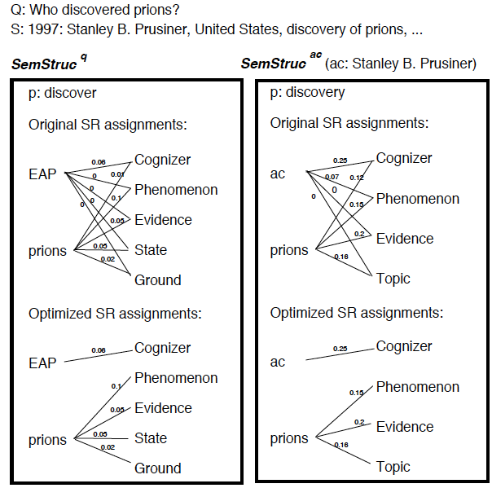

Slide 84
Assigning Semantic Roles
Generate set of semantic role assignments
Represent as complete bipartite graph
Connect frame element to all SRs licensed by predicate
Weight as above
How can we pick mapping of words to roles?

Slide 85
Assigning Semantic Roles
Generate set of semantic role assignments
Represent as complete bipartite graph
Connect frame element to all SRs licensed by predicate
Weight as above
How can we pick mapping of words to roles?
Pick highest scoring SR?

Slide 86
Assigning Semantic Roles
Generate set of semantic role assignments
Represent as complete bipartite graph
Connect frame element to all SRs licensed by predicate
Weight as above
How can we pick mapping of words to roles?
Pick highest scoring SR?
‘Local’: could assign multiple words to the same role!
Need global solution:

Slide 87
Assigning Semantic Roles
Generate set of semantic role assignments
Represent as complete bipartite graph
Connect frame element to all SRs licensed by predicate
Weight as above
How can we pick mapping of words to roles?
Pick highest scoring SR?
‘Local’: could assign multiple words to the same role!
Need global solution:
Minimum weight bipartite edge cover problem
Assign semantic role to each frame element
FE can have multiple roles (soft labeling)

Slide 89
Semantic Structure Matching
Measure similarity b/t question and answers
Two factors:

Slide 90
Semantic Structure Matching
Measure similarity b/t question and answers
Two factors:
Predicate matching

Slide 91
Semantic Structure Matching
Measure similarity b/t question and answers
Two factors:
Predicate matching:
Match if evoke same frame

Slide 92
Semantic Structure Matching
Measure similarity b/t question and answers
Two factors:
Predicate matching:
Match if evoke same frame
Match if evoke frames in hypernym/hyponym relation
Frame: inherits_from or is_inherited_by

Slide 93
Semantic Structure Matching
Measure similarity b/t question and answers
Two factors:
Predicate matching:
Match if evoke same frame
Match if evoke frames in hypernym/hyponym relation
Frame: inherits_from or is_inherited_by
SR assignment match (only if preds match)
Sum of similarities of subgraphs
Subgraph is FE w and all connected SRs

Slide 94
Comparisons
Syntax only baseline:
Identify verbs, noun phrases, and expected answers
Compute dependency paths b/t phrases
Compare key phrase to expected answer phrase to
Same key phrase and answer candidate
Based on dynamic time warping approach

Slide 95
Comparisons
Syntax only baseline:
Identify verbs, noun phrases, and expected answers
Compute dependency paths b/t phrases
Compare key phrase to expected answer phrase to
Same key phrase and answer candidate
Based on dynamic time warping approach
Shallow semantics baseline:
Use Shalmaneser to parse questions and answer cand
Assigns semantic roles, trained on FrameNet
If frames match, check phrases with same role as EAP
Rank by word overlap

Slide 96
Evaluation
Q1: How does incompleteness of FrameNet affect utility for QA systems?
Are there questions for which there is no frame or no annotated sentence data?

Slide 97
Evaluation
Q1: How does incompleteness of FrameNet affect utility for QA systems?
Are there questions for which there is no frame or no annotated sentence data?
Q2: Are questions amenable to FrameNet analysis?
Do questions and their answers evoke the same frame? The same roles?

Slide 98
FrameNet Applicability
Analysis:
NoFrame: No frame for predicate: sponsor, sink

Slide 99
FrameNet Applicability
Analysis:
NoFrame: No frame for predicate: sponsor, sink
NoAnnot: No sentences annotated for pred: win, hit

Slide 100
FrameNet Applicability
Analysis:
NoFrame: No frame for predicate: sponsor, sink
NoAnnot: No sentences annotated for pred: win, hit
NoMatch: Frame mismatch b/t Q & A

Slide 101
FrameNet Utility
Analysis on Q&A pairs with frames, annotation, match
Good results, but

Slide 102
FrameNet Utility
Analysis on Q&A pairs with frames, annotation, match
Good results, but
Over-optimistic
SemParse still has coverage problems

Slide 103
FrameNet Utility (II)
Q3: Does semantic soft matching improve?
Approach:
Use FrameNet semantic match

Slide 104
FrameNet Utility (II)
Q3: Does semantic soft matching improve?
Approach:
Use FrameNet semantic match
If no answer found

Slide 105
FrameNet Utility (II)
Q3: Does semantic soft matching improve?
Approach:
Use FrameNet semantic match
If no answer found, back off to syntax based approach
Soft match best: semantic parsing too brittle, Q

Slide 106
Summary
FrameNet and QA:
FrameNet still limited (coverage/annotations)
Bigger problem is lack of alignment b/t Q & A frames
Even if limited,
Substantially improves where applicable
Useful in conjunction with other QA strategies
Soft role assignment, matching key to effectiveness

Slide 107
Thematic Roles
Describe semantic roles of verbal arguments
Capture commonality across verbs

Slide 108
Thematic Roles
Describe semantic roles of verbal arguments
Capture commonality across verbs
E.g. subject of break, open is AGENT
AGENT: volitional cause
THEME: things affected by action

Slide 109
Thematic Roles
Describe semantic roles of verbal arguments
Capture commonality across verbs
E.g. subject of break, open is AGENT
AGENT: volitional cause
THEME: things affected by action
Enables generalization over surface order of arguments
John_{AGENT} broke the window_{THEME}

Slide 110
Thematic Roles
Describe semantic roles of verbal arguments
Capture commonality across verbs
E.g. subject of break, open is AGENT
AGENT: volitional cause
THEME: things affected by action
Enables generalization over surface order of arguments
John_{AGENT} broke the window_{THEME}
The rock_{INSTRUMENT} broke the window_{THEME}

Slide 111
Thematic Roles
Describe semantic roles of verbal arguments
Capture commonality across verbs
E.g. subject of break, open is AGENT
AGENT: volitional cause
THEME: things affected by action
Enables generalization over surface order of arguments
John_{AGENT} broke the window_{THEME}
The rock_{INSTRUMENT} broke the window_{THEME}
The window_{THEME} was broken by John_{AGENT}

Slide 112
Thematic Roles
Thematic grid, θ-grid, case frame
Set of thematic role arguments of verb

Slide 113
Thematic Roles
Thematic grid, θ-grid, case frame
Set of thematic role arguments of verb
E.g. Subject:AGENT; Object:THEME, or
Subject: INSTR; Object: THEME

Slide 114
Thematic Roles
Thematic grid, θ-grid, case frame
Set of thematic role arguments of verb
E.g. Subject:AGENT; Object:THEME, or
Subject: INSTR; Object: THEME
Verb/Diathesis Alternations
Verbs allow different surface realizations of roles

Slide 115
Thematic Roles
Thematic grid, θ-grid, case frame
Set of thematic role arguments of verb
E.g. Subject:AGENT; Object:THEME, or
Subject: INSTR; Object: THEME
Verb/Diathesis Alternations
Verbs allow different surface realizations of roles
Doris_{AGENT} gave the book_{THEME} to Cary_{GOAL}

Slide 116
Thematic Roles
Thematic grid, θ-grid, case frame
Set of thematic role arguments of verb
E.g. Subject:AGENT; Object:THEME, or
Subject: INSTR; Object: THEME
Verb/Diathesis Alternations
Verbs allow different surface realizations of roles
Doris_{AGENT} gave the book_{THEME} to Cary_{GOAL}
Doris_{AGENT} gave Cary_{GOAL} the book_{THEME}

Slide 117
Thematic Roles
Thematic grid, θ-grid, case frame
Set of thematic role arguments of verb
E.g. Subject:AGENT; Object:THEME, or
Subject: INSTR; Object: THEME
Verb/Diathesis Alternations
Verbs allow different surface realizations of roles
Doris_{AGENT} gave the book_{THEME} to Cary_{GOAL}
Doris_{AGENT} gave Cary_{GOAL} the book_{THEME}
Group verbs into classes based on shared patterns

Slide 118
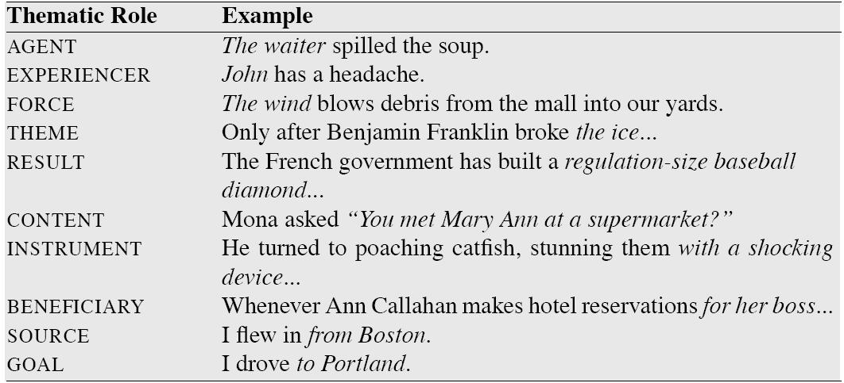
Canonical Roles

Slide 119
Thematic Role Issues
Hard to produce

Slide 120
Thematic Role Issues
Hard to produce
Standard set of roles
Fragmentation: Often need to make more specific
E,g, INSTRUMENTS can be subject or not

Slide 121
Thematic Role Issues
Hard to produce
Standard set of roles
Fragmentation: Often need to make more specific
E,g, INSTRUMENTS can be subject or not
Standard definition of roles
Most AGENTs: animate, volitional, sentient, causal
But not all….
Strategies:
Generalized semantic roles: PROTO-AGENT/PROTO-PATIENT
Defined heuristically: PropBank
Define roles specific to verbs/nouns: FrameNet

Slide 122
Thematic Role Issues
Hard to produce
Standard set of roles
Fragmentation: Often need to make more specific
E,g, INSTRUMENTS can be subject or not
Standard definition of roles
Most AGENTs: animate, volitional, sentient, causal
But not all….

Slide 123
Thematic Role Issues
Hard to produce
Standard set of roles
Fragmentation: Often need to make more specific
E,g, INSTRUMENTS can be subject or not
Standard definition of roles
Most AGENTs: animate, volitional, sentient, causal
But not all….
Strategies:
Generalized semantic roles: PROTO-AGENT/PROTO-PATIENT
Defined heuristically: PropBank

Slide 124
Thematic Role Issues
Hard to produce
Standard set of roles
Fragmentation: Often need to make more specific
E,g, INSTRUMENTS can be subject or not
Standard definition of roles
Most AGENTs: animate, volitional, sentient, causal
But not all….
Strategies:
Generalized semantic roles: PROTO-AGENT/PROTO-PATIENT
Defined heuristically: PropBank
Define roles specific to verbs/nouns: FrameNet

Slide 125
PropBank
Sentences annotated with semantic roles
Penn and Chinese Treebank

Slide 126
PropBank
Sentences annotated with semantic roles
Penn and Chinese Treebank
Roles specific to verb sense
Numbered: Arg0, Arg1, Arg2,…
Arg0: PROTO-AGENT; Arg1: PROTO-PATIENT, etc

Slide 127
PropBank
Sentences annotated with semantic roles
Penn and Chinese Treebank
Roles specific to verb sense
Numbered: Arg0, Arg1, Arg2,…
Arg0: PROTO-AGENT; Arg1: PROTO-PATIENT, etc
E.g. agree.01
Arg0: Agreer

Slide 128
PropBank
Sentences annotated with semantic roles
Penn and Chinese Treebank
Roles specific to verb sense
Numbered: Arg0, Arg1, Arg2,…
Arg0: PROTO-AGENT; Arg1: PROTO-PATIENT, etc
E.g. agree.01
Arg0: Agreer
Arg1: Proposition

Slide 129
PropBank
Sentences annotated with semantic roles
Penn and Chinese Treebank
Roles specific to verb sense
Numbered: Arg0, Arg1, Arg2,…
Arg0: PROTO-AGENT; Arg1: PROTO-PATIENT, etc
E.g. agree.01
Arg0: Agreer
Arg1: Proposition
Arg2: Other entity agreeing

Slide 130
PropBank
Sentences annotated with semantic roles
Penn and Chinese Treebank
Roles specific to verb sense
Numbered: Arg0, Arg1, Arg2,…
Arg0: PROTO-AGENT; Arg1: PROTO-PATIENT, etc
E.g. agree.01
Arg0: Agreer
Arg1: Proposition
Arg2: Other entity agreeing
Ex1: [_{Arg0}The group] agreed [_{Arg1}it wouldn’t make an offer]

