Slide 1
Answer Extraction
Ling573
NLP Systems and Applications
May 19, 2011

Slide 2
Roadmap
Noisy-channel Question-Answering
Answer selection by reranking
Redundancy-based Answer Selection

Slide 3
Noisy Channel QA
Employed for speech, POS tagging, MT, summ, etc
Intuition:
Question is a noisy representation of the answer

Slide 4
Noisy Channel QA
Employed for speech, POS tagging, MT, summ, etc
Intuition:
Question is a noisy representation of the answer
Basic approach:
Given a corpus of (Q,S_{A}) pairs
Train P(Q|S_{A})
Find sentence with answer as
S_{i,Aij} that maximize P(Q|S_{i,Aij})

Slide 5
QA Noisy Channel
A: Presley died of heart disease at Graceland in 1977, and..
Q: When did Elvis Presley die?

Slide 6
QA Noisy Channel
A: Presley died of heart disease at Graceland in 1977, and..
Q: When did Elvis Presley die?
Goal:
Align parts of Ans parse tree to question
Mark candidate answers
Find highest probability answer

Slide 7
Approach
Alignment issue:

Slide 8
Approach
Alignment issue:
Answer sentences longer than questions
Minimize length gap
Represent answer as mix of words/syn/sem/NE units

Slide 9
Approach
Alignment issue:
Answer sentences longer than questions
Minimize length gap
Represent answer as mix of words/syn/sem/NE units
Create ‘cut’ through parse tree
Every word –or an ancestor – in cut
Only one element on path from root to word

Slide 10
Approach
Alignment issue:
Answer sentences longer than questions
Minimize length gap
Represent answer as mix of words/syn/sem/NE units
Create ‘cut’ through parse tree
Every word –or an ancestor – in cut
Only one element on path from root to word
Presley died of heart disease at Graceland in 1977, and..
Presley died PP PP in DATE, and..
When did Elvis Presley die?

Slide 11
Approach (Cont’d)
Assign one element in cut to be ‘Answer’
Issue: Cut STILL may not be same length as Q

Slide 12
Approach (Cont’d)
Assign one element in cut to be ‘Answer’
Issue: Cut STILL may not be same length as Q
Solution: (typical MT)
Assign each element a fertility
0 – delete the word; > 1: repeat word that many times

Slide 13
Approach (Cont’d)
Assign one element in cut to be ‘Answer’
Issue: Cut STILL may not be same length as Q
Solution: (typical MT)
Assign each element a fertility
0 – delete the word; > 1: repeat word that many times
Replace A words with Q words based on alignment
Permute result to match original Question
Everything except cut computed with OTS MT code

Slide 14
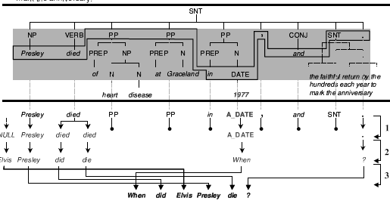
Schematic
Assume cut, answer guess all equally likely

Slide 15
Training Sample Generation
Given question and answer sentences
Parse answer sentence
Create cut s.t.:
Words in both Q & A are preserved
Answer reduced to ‘A_’ syn/sem class label
Nodes with no surface children reduced to syn class
Keep surface form of all other nodes
20K TREC QA pairs; 6.5K web question pairs

Slide 16
Selecting Answers
For any candidate answer sentence:
Do same cut process

Slide 17
Selecting Answers
For any candidate answer sentence:
Do same cut process
Generate all candidate answer nodes:
Syntactic/Semantic nodes in tree

Slide 18
Selecting Answers
For any candidate answer sentence:
Do same cut process
Generate all candidate answer nodes:
Syntactic/Semantic nodes in tree
What’s a bad candidate answer?

Slide 19
Selecting Answers
For any candidate answer sentence:
Do same cut process
Generate all candidate answer nodes:
Syntactic/Semantic nodes in tree
What’s a bad candidate answer?
Stopwords
Question words!
Create cuts with each answer candidate annotated
Select one with highest probability by model

Slide 20
Example Answer Cuts
Q: When did Elvis Presley die?
S_{A1}: Presley died A_PP PP PP, and …
S_{A2}: Presley died PP A_PP PP, and ….
S_{A3}: Presley died PP PP in A_DATE, and …
Results: MRR: 24.8%; 31.2% in top 5

Slide 21
Error Analysis
Component specific errors:
Patterns:
Some question types work better with patterns
Typically specific NE categories (NAM, LOC, ORG..)
Bad if ‘vague’
Stats based:
No restrictions on answer type – frequently ‘it’
Patterns and stats:
‘Blatant’ errors:
Select ‘bad’ strings (esp. pronouns) if fit position/pattern

Slide 22
Error Analysis
Component specific errors:
Patterns:
Some question types work better with patterns
Typically specific NE categories (NAM, LOC, ORG..)
Bad if ‘vague’

Slide 23
Error Analysis
Component specific errors:
Patterns:
Some question types work better with patterns
Typically specific NE categories (NAM, LOC, ORG..)
Bad if ‘vague’
Stats based:
No restrictions on answer type – frequently ‘it’

Slide 24
Error Analysis
Component specific errors:
Patterns:
Some question types work better with patterns
Typically specific NE categories (NAM, LOC, ORG..)
Bad if ‘vague’
Stats based:
No restrictions on answer type – frequently ‘it’
Patterns and stats:
‘Blatant’ errors:
Select ‘bad’ strings (esp. pronouns) if fit position/pattern

Slide 25
Combining Units
Linear sum of weights?

Slide 26
Combining Units
Linear sum of weights?
Problematic:
Misses different strengths/weaknesses

Slide 27
Combining Units
Linear sum of weights?
Problematic:
Misses different strengths/weaknesses
Learning! (of course)
Maxent re-ranking
Linear

Slide 28
Feature Functions
48 in total
Component-specific:
Scores, ranks from different modules
Patterns. Stats, IR, even QA word overlap

Slide 29
Feature Functions
48 in total
Component-specific:
Scores, ranks from different modules
Patterns. Stats, IR, even QA word overlap
Redundancy-specific:
# times candidate answer appears (log, sqrt)

Slide 30
Feature Functions
48 in total
Component-specific:
Scores, ranks from different modules
Patterns. Stats, IR, even QA word overlap
Redundancy-specific:
# times candidate answer appears (log, sqrt)
Qtype-specific:
Some components better for certain types: type+mod

Slide 31
Feature Functions
48 in total
Component-specific:
Scores, ranks from different modules
Patterns. Stats, IR, even QA word overlap
Redundancy-specific:
# times candidate answer appears (log, sqrt)
Qtype-specific:
Some components better for certain types: type+mod
Blatant ‘errors’: no pronouns, when NOT DoW

Slide 32
Experiments
Per-module reranking:
Use redundancy, qtype, blatant, and feature from mod

Slide 33
Experiments
Per-module reranking:
Use redundancy, qtype, blatant, and feature from mod
Combined reranking:
All features (after feature selection to 31)

Slide 34
Experiments
Per-module reranking:
Use redundancy, qtype, blatant, and feature from mod
Combined reranking:
All features (after feature selection to 31)
Patterns: Exact in top 5: 35.6% -> 43.1%
Stats: Exact in top 5: 31.2% -> 41%
Manual/knowledge based: 57%

Slide 35
Redundancy-based QA
AskMSR (2001,2002); Aranea (Lin, 2007)

Slide 36
Redundancy-based QA
Systems exploit statistical regularity to find “easy” answers to factoid questions on the Web

Slide 37
Redundancy-based QA
Systems exploit statistical regularity to find “easy” answers to factoid questions on the Web
—When did Alaska become a state?
(1) Alaska became a state on January 3, 1959.
(2) Alaska was admitted to the Union on January 3, 1959.

Slide 38
Redundancy-based QA
Systems exploit statistical regularity to find “easy” answers to factoid questions on the Web
—When did Alaska become a state?
(1) Alaska became a state on January 3, 1959.
(2) Alaska was admitted to the Union on January 3, 1959.
—Who killed Abraham Lincoln?
(1) John Wilkes Booth killed Abraham Lincoln.
(2) John Wilkes Booth altered history with a bullet. He will forever be known as the man who ended Abraham Lincoln’s life.

Slide 39
Redundancy-based QA
Systems exploit statistical regularity to find “easy” answers to factoid questions on the Web
—When did Alaska become a state?
(1) Alaska became a state on January 3, 1959.
(2) Alaska was admitted to the Union on January 3, 1959.
—Who killed Abraham Lincoln?
(1) John Wilkes Booth killed Abraham Lincoln.
(2) John Wilkes Booth altered history with a bullet. He will forever be known as the man who ended Abraham Lincoln’s life.
Text collection

Slide 40
Redundancy-based QA
Systems exploit statistical regularity to find “easy” answers to factoid questions on the Web
—When did Alaska become a state?
(1) Alaska became a state on January 3, 1959.
(2) Alaska was admitted to the Union on January 3, 1959.
—Who killed Abraham Lincoln?
(1) John Wilkes Booth killed Abraham Lincoln.
(2) John Wilkes Booth altered history with a bullet. He will forever be known as the man who ended Abraham Lincoln’s life.
Text collection may only have (2), but web? anything

Slide 41
Redundancy-based QA
Systems exploit statistical regularity to find “easy” answers to factoid questions on the Web
—When did Alaska become a state?
(1) Alaska became a state on January 3, 1959.
(2) Alaska was admitted to the Union on January 3, 1959.
—Who killed Abraham Lincoln?
(1) John Wilkes Booth killed Abraham Lincoln.
(2) John Wilkes Booth altered history with a bullet. He will forever be known as the man who ended Abraham Lincoln’s life.
Text collection may only have (2), but web?

Slide 42
Redundancy & Answers
How does redundancy help find answers?

Slide 43
Redundancy & Answers
How does redundancy help find answers?
Typical approach:
Answer type matching
E.g. NER, but
Relies on large knowledge-based
Redundancy approach:

Slide 44
Redundancy & Answers
How does redundancy help find answers?
Typical approach:
Answer type matching
E.g. NER, but
Relies on large knowledge-based
Redundancy approach:
Answer should have high correlation w/query terms
Present in many passages
Uses n-gram generation and processing

Slide 45
Redundancy & Answers
How does redundancy help find answers?
Typical approach:
Answer type matching
E.g. NER, but
Relies on large knowledge-based
Redundancy approach:
Answer should have high correlation w/query terms
Present in many passages
Uses n-gram generation and processing
In ‘easy’ passages, simple string match effective

Slide 46
Redundancy Approaches
AskMSR (2001):
Lenient: 0.43; Rank: 6/36; Strict: 0.35; Rank: 9/36

Slide 47
Redundancy Approaches
AskMSR (2001):
Lenient: 0.43; Rank: 6/36; Strict: 0.35; Rank: 9/36
Aranea (2002, 2003):
Lenient: 45%; Rank: 5; Strict: 30%; Rank:6-8

Slide 48
Redundancy Approaches
AskMSR (2001):
Lenient: 0.43; Rank: 6/36; Strict: 0.35; Rank: 9/36
Aranea (2002, 2003):
Lenient: 45%; Rank: 5; Strict: 30%; Rank:6-8
Concordia (2007): Strict: 25%; Rank 5

Slide 49
Redundancy Approaches
AskMSR (2001):
Lenient: 0.43; Rank: 6/36; Strict: 0.35; Rank: 9/36
Aranea (2002, 2003):
Lenient: 45%; Rank: 5; Strict: 30%; Rank:6-8
Concordia (2007): Strict: 25%; Rank 5
Many systems incorporate some redundancy
Answer validation
Answer reranking
LCC: huge knowledge-based system, redundancy improved

Slide 50
Redundancy-based Answer Extraction
Prior processing:
Question formulation (class 6)
Web search
Retrieve snippets – top 100

Slide 51
Redundancy-based Answer Extraction
Prior processing:
Question formulation (class 6)
Web search
Retrieve snippets – top 100
N-grams:
Generation
Voting
Filtering
Combining
Scoring
Reranking

Slide 52
N-gram Generation & Voting
N-gram generation from unique snippets:
Approximate chunking – without syntax
All uni-, bi-, tri-, tetra- grams
Concordia added 5-grams (prior errors)

Slide 53
N-gram Generation & Voting
N-gram generation from unique snippets:
Approximate chunking – without syntax
All uni-, bi-, tri-, tetra- grams
Concordia added 5-grams (prior errors)
Score: based on source query: exact 5x, others 1x
N-gram voting:
Collates n-grams
N-gram gets sum of scores of occurrences
What would be highest ranked ?

Slide 54
N-gram Generation & Voting
N-gram generation from unique snippets:
Approximate chunking – without syntax
All uni-, bi-, tri-, tetra- grams
Concordia added 5-grams (prior errors)
Score: based on source query: exact 5x, others 1x
N-gram voting:
Collates n-grams
N-gram gets sum of scores of occurrences
What would be highest ranked ?
Specific, frequent: Question terms, stopwords

Slide 55
N-gram Filtering
Throws out ‘blatant’ errors
Conservative or aggressive?

Slide 56
N-gram Filtering
Throws out ‘blatant’ errors
Conservative or aggressive?
Conservative: can’t recover error
Question-type-neutral filters:

Slide 57
N-gram Filtering
Throws out ‘blatant’ errors
Conservative or aggressive?
Conservative: can’t recover error
Question-type-neutral filters:
Exclude if begin/end with stopword
Exclude if contain words from question, except
‘Focus words’ : e.g. units
Question-type-specific filters:

Slide 58
N-gram Filtering
Throws out ‘blatant’ errors
Conservative or aggressive?
Conservative: can’t recover error
Question-type-neutral filters:
Exclude if begin/end with stopword
Exclude if contain words from question, except
‘Focus words’ : e.g. units
Question-type-specific filters:
‘how far’, ‘how fast’:

Slide 59
N-gram Filtering
Throws out ‘blatant’ errors
Conservative or aggressive?
Conservative: can’t recover error
Question-type-neutral filters:
Exclude if begin/end with stopword
Exclude if contain words from question, except
‘Focus words’ : e.g. units
Question-type-specific filters:
‘how far’, ‘how fast’: exclude if no numeric
‘who’,’where’: exclude if not NE (first & last caps)

Slide 60
N-gram Filtering
Throws out ‘blatant’ errors
Conservative or aggressive?
Conservative: can’t recover error
Question-type-neutral filters:
Exclude if begin/end with stopword
Exclude if contain words from question, except
‘Focus words’ : e.g. units
Question-type-specific filters:
‘how far’, ‘how fast’: exclude if no numeric
‘who’,’where’:

Slide 61
N-gram Filtering
Closed-class filters:
Exclude if not members of an enumerable list

Slide 62
N-gram Filtering
Closed-class filters:
Exclude if not members of an enumerable list
E.g. ‘what year ‘ -> must be acceptable date year

Slide 63
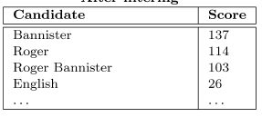
N-gram Filtering
Closed-class filters:
Exclude if not members of an enumerable list
E.g. ‘what year ‘ -> must be acceptable date year
Example after filtering:
Who was the first person to run a sub-four-minute mile?

Slide 64
N-gram Filtering
Impact of different filters:
Highly significant differences when run w/subsets

Slide 65
N-gram Filtering
Impact of different filters:
Highly significant differences when run w/subsets
No filters: drops 70%

Slide 66
N-gram Filtering
Impact of different filters:
Highly significant differences when run w/subsets
No filters: drops 70%
Type-neutral only: drops 15%

Slide 67
N-gram Filtering
Impact of different filters:
Highly significant differences when run w/subsets
No filters: drops 70%
Type-neutral only: drops 15%
Type-neutral & Type-specific: drops 5%

Slide 68
N-gram Combining
Current scoring favors longer or shorter spans?

Slide 69
N-gram Combining
Current scoring favors longer or shorter spans?
E.g. Roger or Bannister or Roger Bannister or Mr…..

Slide 70
N-gram Combining
Current scoring favors longer or shorter spans?
E.g. Roger or Bannister or Roger Bannister or Mr…..
Bannister pry highest – occurs everywhere R.B. +
Generally, good answers longer (up to a point)

Slide 71
N-gram Combining
Current scoring favors longer or shorter spans?
E.g. Roger or Bannister or Roger Bannister or Mr…..
Bannister pry highest – occurs everywhere R.B. +
Generally, good answers longer (up to a point)
Update score: S_{c} += ΣS_{t}, where t is unigram in c
Possible issues:

Slide 72
N-gram Combining
Current scoring favors longer or shorter spans?
E.g. Roger or Bannister or Roger Bannister or Mr…..
Bannister pry highest – occurs everywhere R.B. +
Generally, good answers longer (up to a point)
Update score: S_{c} += ΣS_{t}, where t is unigram in c
Possible issues:
Bad units: Roger Bannister was

Slide 73
N-gram Combining
Current scoring favors longer or shorter spans?
E.g. Roger or Bannister or Roger Bannister or Mr…..
Bannister pry highest – occurs everywhere R.B. +
Generally, good answers longer (up to a point)
Update score: S_{c} += ΣS_{t}, where t is unigram in c
Possible issues:
Bad units: Roger Bannister was – blocked by filters
Also, increments score so long bad spans lower
Improves significantly

Slide 74
N-gram Scoring
Not all terms created equal

Slide 75
N-gram Scoring
Not all terms created equal
Usually answers highly specific
Also disprefer non-units
Solution

Slide 76
N-gram Scoring
Not all terms created equal
Usually answers highly specific
Also disprefer non-units
Solution: IDF-based scoring
S_{c}=S_{c} * average_unigram_idf

Slide 77
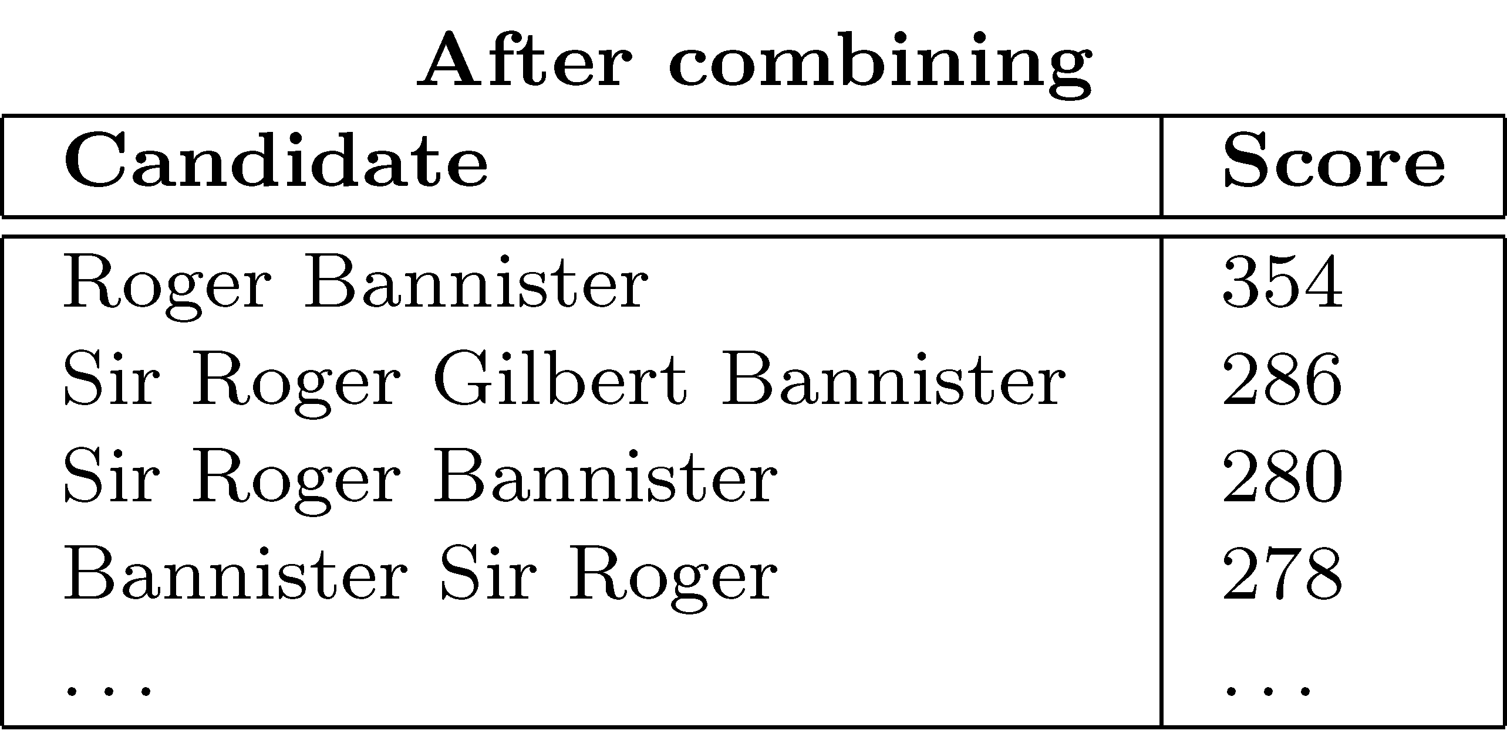
N-gram Scoring
Not all terms created equal
Usually answers highly specific
Also disprefer non-units
Solution: IDF-based scoring
S_{c}=S_{c} * average_unigram_idf

Slide 78
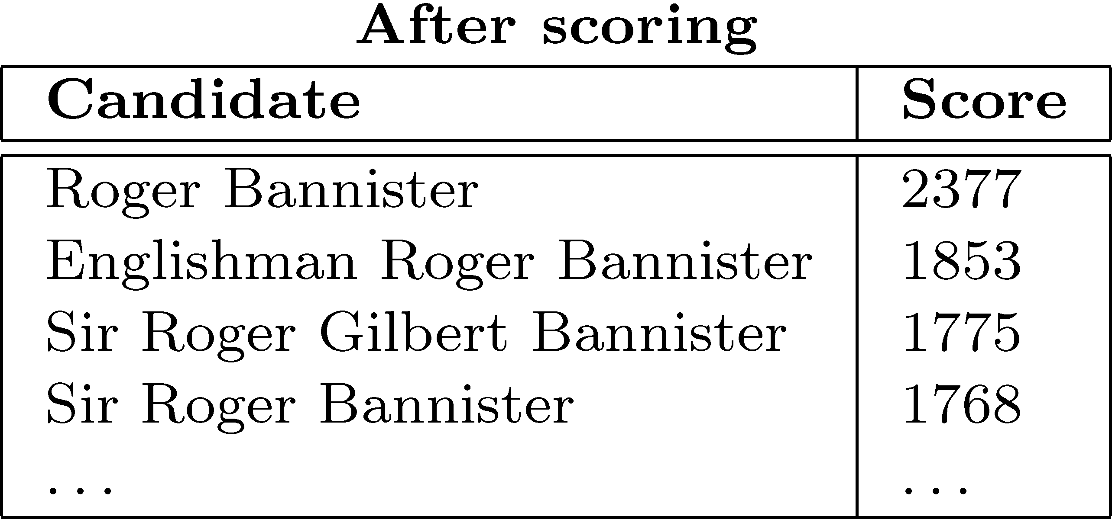
N-gram Scoring
Not all terms created equal
Usually answers highly specific
Also disprefer non-units
Solution: IDF-based scoring
S_{c}=S_{c} * average_unigram_idf

Slide 79
N-gram Reranking
Promote best answer candidates:

Slide 80
N-gram Reranking
Promote best answer candidates:
Filter any answers not in at least two snippets

Slide 81
N-gram Reranking
Promote best answer candidates:
Filter any answers not in at least two snippets
Use answer type specific forms to raise matches
E.g. ‘where’ -> boosts ‘city, state’
Small improvement depending on answer type

Slide 82
Summary
Redundancy-based approaches
Leverage scale of web search
Take advantage of presence of ‘easy’ answers on web
Exploit statistical association of question/answer text

Slide 83
Summary
Redundancy-based approaches
Leverage scale of web search
Take advantage of presence of ‘easy’ answers on web
Exploit statistical association of question/answer text
Increasingly adopted:
Good performers independently for QA
Provide significant improvements in other systems
Esp. for answer filtering

Slide 84
Summary
Redundancy-based approaches
Leverage scale of web search
Take advantage of presence of ‘easy’ answers on web
Exploit statistical association of question/answer text
Increasingly adopted:
Good performers independently for QA
Provide significant improvements in other systems
Esp. for answer filtering
Does require some form of ‘answer projection’
Map web information to TREC document

Slide 85
Summary
Redundancy-based approaches
Leverage scale of web search
Take advantage of presence of ‘easy’ answers on web
Exploit statistical association of question/answer text
Increasingly adopted:
Good performers independently for QA
Provide significant improvements in other systems
Esp. for answer filtering
Does require some form of ‘answer projection’
Map web information to TREC document
Aranea download:
http://www.umiacs.umd.edu/~jimmylin/resources.html

