Slide 1
Passage Retrieval & Re-ranking
Ling573
NLP Systems and Applications
May 5, 2011

Slide 2
Reranking with Deeper Processing
Passage Reranking for Question Answering Using Syntactic Structures and Answer Types
Atkolga et al, 2011
Reranking of retrieved passages
Integrates
Syntactic alignment
Answer type
Named Entity information

Slide 3
Motivation
Issues in shallow passage approaches:
From Tellex et al.

Slide 4
Motivation
Issues in shallow passage approaches:
From Tellex et al.
Retrieval match admits many possible answers
Need answer type to restrict

Slide 5
Motivation
Issues in shallow passage approaches:
From Tellex et al.
Retrieval match admits many possible answers
Need answer type to restrict
Question implies particular relations
Use syntax to ensure

Slide 6
Motivation
Issues in shallow passage approaches:
From Tellex et al.
Retrieval match admits many possible answers
Need answer type to restrict
Question implies particular relations
Use syntax to ensure
Joint strategy required
Checking syntactic parallelism when no answer, useless
Current approach incorporates all (plus NER)

Slide 7
Baseline Retrieval
Bag-of-Words unigram retrieval (BOW)

Slide 8
Baseline Retrieval
Bag-of-Words unigram retrieval (BOW)
Question analysis: QuAn
ngram retrieval, reformulation

Slide 9
Baseline Retrieval
Bag-of-Words unigram retrieval (BOW)
Question analysis: QuAn
ngram retrieval, reformulation
Question analysis + Wordnet: QuAn-Wnet
Adds 10 synonyms of ngrams in QuAn

Slide 10
Baseline Retrieval
Bag-of-Words unigram retrieval (BOW)
Question analysis: QuAn
ngram retrieval, reformulation
Question analysis + Wordnet: QuAn-Wnet
Adds 10 synonyms of ngrams in QuAn
Best performance: QuAn-Wnet (baseline)

Slide 11
Dependency Information
Assume dependency parses of questions, passages
Passage = sentence
Extract undirected dependency paths b/t words

Slide 12
Dependency Information
Assume dependency parses of questions, passages
Passage = sentence
Extract undirected dependency paths b/t words
Find path pairs between words (q_{k},a_{l}),(q_{r},a_{s})
Where q/a words ‘match’
Word match if a) same root or b) synonyms

Slide 13
Dependency Information
Assume dependency parses of questions, passages
Passage = sentence
Extract undirected dependency paths b/t words
Find path pairs between words (q_{k},a_{l}),(q_{r},a_{s})
Where q/a words ‘match’
Word match if a) same root or b) synonyms
Later: require one pair to be question word/Answer term
Train path ‘translation pair’ probabilities

Slide 14
Dependency Information
Assume dependency parses of questions, passages
Passage = sentence
Extract undirected dependency paths b/t words
Find path pairs between words (q_{k},a_{l}),(q_{r},a_{s})
Where q/a words ‘match’
Word match if a) same root or b) synonyms
Later: require one pair to be question word/Answer term
Train path ‘translation pair’ probabilities
Use true Q/A pairs, <path_{q},path_{a}>
GIZA++, IBM model 1
Yields Pr(label_{a},label_{q})

Slide 15
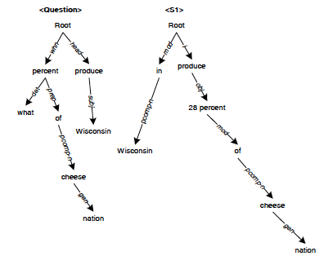
Dependency Path Similarity
From Cui

Slide 16
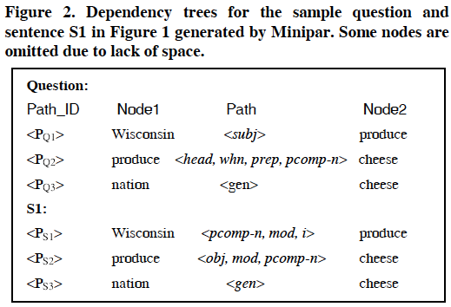
Dependency Path Similarity

Slide 17
Similarity
Dependency path matching

Slide 18
Similarity
Dependency path matching
Some paths match exactly
Many paths have partial overlap or differ due to question/declarative contrasts

Slide 19
Similarity
Dependency path matching
Some paths match exactly
Many paths have partial overlap or differ due to question/declarative contrasts
Approaches have employed
Exact match
Fuzzy match
Both can improve over baseline retrieval, fuzzy more

Slide 20
Dependency Path Similarity
Cui et al scoring
Sum over all possible paths in a QA candidate pair

Slide 21
Dependency Path Similarity
Cui et al scoring
Sum over all possible paths in a QA candidate pair

Slide 22
Dependency Path Similarity
Cui et al scoring
Sum over all possible paths in a QA candidate pair

Slide 23
Dependency Path Similarity
Atype-DP
Restrict first q,a word pair to Qword, ACand
Where Acand has correct answer type by NER

Slide 24
Dependency Path Similarity
Atype-DP
Restrict first q,a word pair to Qword, ACand
Where Acand has correct answer type by NER
Sum over all possible paths in a QA candidate pair
with best answer candidate

Slide 25
Dependency Path Similarity
Atype-DP
Restrict first q,a word pair to Qword, ACand
Where Acand has correct answer type by NER
Sum over all possible paths in a QA candidate pair
with best answer candidate

Slide 26
Comparisons
Atype-DP-IP
Interpolates DP score with original retrieval score

Slide 27
Comparisons
Atype-DP-IP
Interpolates DP score with original retrieval score
QuAn-Elim:
Acts a passage answer-type filter
Excludes any passage w/o correct answer type

Slide 28
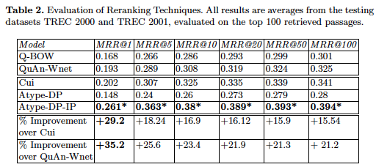
Results
Atype-DP-IP best

Slide 29
Results
Atype-DP-IP best
Raw dependency:‘brittle’; NE failure backs off to IP

Slide 30
Results
Atype-DP-IP best
Raw dependency:‘brittle’; NE failure backs off to IP
QuAn-Elim: NOT significantly worse

Slide 31
Units of Retrieval
Simple is Best: Experiments with Different Document Segmentation Strategies for Passage Retrieval
Tiedemann and Mur, 2008
Comparison of units for retrieval in QA
Documents
Paragraphs
Sentences
Semantically-based units (discourse segments)
Spans

Slide 32
Motivation
Passage units necessary for QA
Focused sources for answers
Typically > 20 passage candidates yield poor QA
Retrieval fundamentally crucial
Re-ranking passages is hard
Tellex et al experiments
Improvements for passage reranking, but
Still dramatically lower than oracle retrieval rates

Slide 33
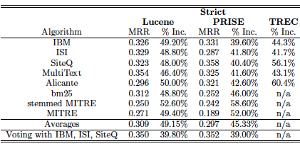
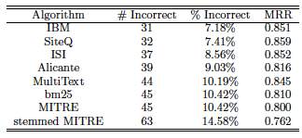

Slide 34
Passages
Some basic advantages for retrieval (vs documents)
Documents vary in
Length,
Topic term density,
Etc
across type
Passages can be less variable
Effectively normalizing for length

Slide 35
What Makes a Passage?
Sources of passage information
Manual:
Existing markup
E.g., Sections, Paragraphs
Issues: ?
Still highly variable:
Wikipedia vs Newswire
Potentially ambiguous:
blank lines separate …..
Not always available

Slide 36
What Makes a Passage?
Automatic:
Semantically motivated document segmentation
Linguistic content
Lexical patterns and relations
Fixed length units:
In words/chars or sentences/paragraphs
Overlapping?
Can be determined empirically
All experiments use Zettair retrieval engine

Slide 37
Coreference Chains
Coreference:
NPs that refer to same entity
Create an equivalence class
Chains of coreference suggest entity-based coherence
Passage:
All sentences spanned by a coreference chain
Can create overlapping passages
Built with cluster-based ranking with own coref. System
System has F-measure of 54.5%

Slide 38
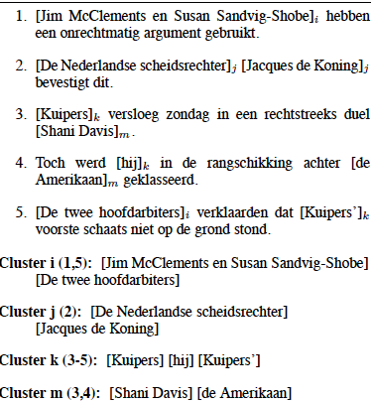

Slide 39
TextTiling (Hearst)
Automatic topic, sub-topic segmentation
Computes similarity between neighboring text blocks
Based on tf-idf weighted cosine similarity
Compares similarity values
Hypothesizes topic shift at dips b/t peaks in similarity
Produces linear topic segmentation
Existing implementations

Slide 40
Window-based Segmentation
Fixed width windows:
Based on words? Characters? Sentences?
Sentences required for downstream deep processing
Overlap? No overlap?
No overlap is simple, but
Not guaranteed to line up with natural boundaries
Including document boundaries
Overlap -> Sliding window

Slide 41
Evaluation
Indexing and retrieval in Zettair system
CLEF Dutch QA track
Computes
Lenient MRR measure
Too few participants to assume pooling exhaustive
Redundancy: Average # relevant passage per query
Coverage: Proportion of Qs w/at least one relpass
MAP
Focus on MRR for prediction of end-to-end QA

Slide 42
Baselines
Existing markup:
Documents, paragraphs, sentences
MRR-IR; MRR-QA (top 5); CLEF: end-to-end score
Surprisingly good sentence results in top-5 and CLEF
Sensitive to exact retrieval weighting

Slide 43
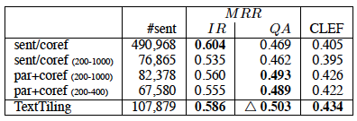
Semantic Passages
Contrast:
Sentence/coref: Sentences in coref. chains -> too long
Bounded length
Paragraphs and coref chains (bounded)
TextTiling (CPAN) – Best : beats baseline

Slide 44
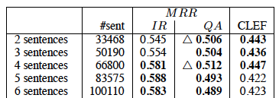
Fixed Size Windows
Different lengths: non-overlapping
2-, 4-sentence units improve over semantic units

Slide 45
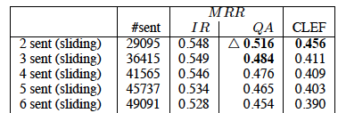
Sliding Windows
Fixed length windows, overlapping
Best MRR-QA values
Small units with overlap
Other settings weaker

Slide 46
Observations
Competing retrieval demands:
IR performance
vs
QA performance
MRR at 5 favors:
Small, fixed width units
Advantageous for downstream processing too
Any benefit of more sophisticated segments
Outweighed by increased processing

