Slide 1
Passage Retrieval and Re-ranking
Ling573
NLP Systems and Applications
May 3, 2011

Slide 2
Upcoming Talks
Edith Law
Friday: 3:30; CSE 303
Human Computation: Core Research Questions and Opportunities
Games with a purpose, MTurk , Captcha verification, etc
Benjamin Grosof: Vulcan Inc., Seattle, WA, USA
Weds 4pm; LIL group, AI lab
SILK's Expressive Semantic Web Rules and Challenges in Natural Language Processing

Slide 3
Roadmap
Passage retrieval and re-ranking
Quantitative analysis of heuristic methods
Tellex et al 2003
Approaches, evaluation, issues
Shallow processing learning approach
Ramakrishnan et al 2004
Syntactic structure and answer types
Aktolga et al 2011
QA dependency alignment, answer type filtering

Slide 4
Passage Ranking
Goal: Select passages most likely to contain answer
Factors in reranking:
Document rank
Want answers!
Answer type matching
Restricted Named Entity Recognition
Question match:
Question term overlap
Span overlap: N-gram, longest common sub-span
Query term density: short spans w/more qterms

Slide 5
Quantitative Evaluation of Passage Retrieval for QA
Tellex et al.
Compare alternative passage ranking approaches
8 different strategies + voting ranker
Assess interaction with document retrieval

Slide 6
Comparative IR Systems
PRISE
Developed at NIST
Vector Space retrieval system
Optimized weighting scheme

Slide 7
Comparative IR Systems
PRISE
Developed at NIST
Vector Space retrieval system
Optimized weighting scheme
Lucene
Boolean + Vector Space retrieval
Results Boolean retrieval RANKED by tf-idf
Little control over hit list

Slide 8
Comparative IR Systems
PRISE
Developed at NIST
Vector Space retrieval system
Optimized weighting scheme
Lucene
Boolean + Vector Space retrieval
Results Boolean retrieval RANKED by tf-idf
Little control over hit list
Oracle: NIST-provided list of relevant documents

Slide 9
Comparing Passage Retrieval
Eight different systems used in QA
Units
Factors

Slide 10
Comparing Passage Retrieval
Eight different systems used in QA
Units
Factors
MITRE:
Simplest reasonable approach: baseline
Unit: sentence
Factor: Term overlap count

Slide 11
Comparing Passage Retrieval
Eight different systems used in QA
Units
Factors
MITRE:
Simplest reasonable approach: baseline
Unit: sentence
Factor: Term overlap count
MITRE+stemming:
Factor: stemmed term overlap

Slide 12
Comparing Passage Retrieval
Okapi bm25
Unit: fixed width sliding window
Factor:
k1=2.0; b=0.75

Slide 13
Comparing Passage Retrieval
Okapi bm25
Unit: fixed width sliding window
Factor:
k1=2.0; b=0.75
MultiText:
Unit: Window starting and ending with query term
Factor:
Sum of IDFs of matching query terms
Length based measure * Number of matching terms

Slide 14
Comparing Passage Retrieval
IBM:
Fixed passage length
Sum of:
Matching words measure: Sum of idfs of overlap terms
Thesaurus match measure:
Sum of idfs of question wds with synonyms in document
Mis-match words measure:
Sum of idfs of questions wds NOT in document
Dispersion measure: # words b/t matching query terms
Cluster word measure: longest common substring

Slide 15
Comparing Passage Retrieval
SiteQ:
Unit: n (=3) sentences
Factor: Match words by literal, stem, or WordNet syn
Sum of
Sum of idfs of matched terms
Density weight score * overlap count, where

Slide 16
Comparing Passage Retrieval
SiteQ:
Unit: n (=3) sentences
Factor: Match words by literal, stem, or WordNet syn
Sum of
Sum of idfs of matched terms
Density weight score * overlap count, where

Slide 17
Comparing Passage Retrieval
Alicante:
Unit: n (= 6) sentences
Factor: non-length normalized cosine similarity

Slide 18
Comparing Passage Retrieval
Alicante:
Unit: n (= 6) sentences
Factor: non-length normalized cosine similarity
ISI:
Unit: sentence
Factors: weighted sum of
Proper name match, query term match, stemmed match

Slide 19
Experiments
Retrieval:
PRISE:
Query: Verbatim question
Lucene:
Query: Conjunctive boolean query (stopped)

Slide 20
Experiments
Retrieval:
PRISE:
Query: Verbatim quesiton
Lucene:
Query: Conjunctive boolean query (stopped)
Passage retrieval: 1000 word passages
Uses top 200 retrieved docs
Find best passage in each doc
Return up to 20 passages
Ignores original doc rank, retrieval score

Slide 21
Pattern Matching
Litkowski pattern files:
Derived from NIST relevance judgments on systems
Format:
Qid answer_pattern doc_list
Passage where answer_pattern matches is correct
If it appears in one of the documents in the list

Slide 22
Pattern Matching
Litkowski pattern files:
Derived from NIST relevance judgments on systems
Format:
Qid answer_pattern doc_list
Passage where answer_pattern matches is correct
If it appears in one of the documents in the list
MRR scoring
Strict: Matching pattern in official document
Lenient: Matching pattern

Slide 23
Examples
Example
Patterns
1894 (190|249|416|440)(\s|\-)million(\s|\-)miles? APW19980705.0043 NYT19990923.0315 NYT19990923.0365 NYT20000131.0402 NYT19981212.0029
1894 700-million-kilometer APW19980705.0043
1894 416 - million - mile NYT19981211.0308
Ranked list of answer passages
1894 0 APW19980601.0000 the casta way weas
1894 0 APW19980601.0000 440 million miles
1894 0 APW19980705.0043 440 million miles

Slide 24
Evaluation
MRR
Strict and lenient
Percentage of questions with NO correct answers

Slide 25
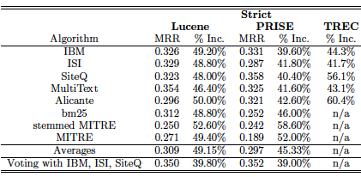
Evaluation
MRR
Strict: Matching pattern in official document
Lenient: Matching pattern
Percentage of questions with NO correct answers

Slide 26
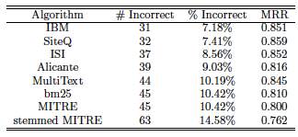
Evaluation on Oracle Docs

Slide 27
Overall
PRISE:
Higher recall, more correct answers

Slide 28
Overall
PRISE:
Higher recall, more correct answers
Lucene:
Higher precision, fewer correct, but higher MRR

Slide 29
Overall
PRISE:
Higher recall, more correct answers
Lucene:
Higher precision, fewer correct, but higher MRR
Best systems:
IBM, ISI, SiteQ
Relatively insensitive to retrieval engine

Slide 30
Analysis
Retrieval:
Boolean systems (e.g. Lucene) competitive, good MRR
Boolean systems usually worse on ad-hoc

Slide 31
Analysis
Retrieval:
Boolean systems (e.g. Lucene) competitive, good MRR
Boolean systems usually worse on ad-hoc
Passage retrieval:
Significant differences for PRISE, Oracle
Not significant for Lucene -> boost recall

Slide 32
Analysis
Retrieval:
Boolean systems (e.g. Lucene) competitive, good MRR
Boolean systems usually worse on ad-hoc
Passage retrieval:
Significant differences for PRISE, Oracle
Not significant for Lucene -> boost recall
Techniques: Density-based scoring improves
Variants: proper name exact, cluster, density score

Slide 33
Error Analysis
‘What is an ulcer?’

Slide 34
Error Analysis
‘What is an ulcer?’
After stopping -> ‘ulcer’
Match doesn’t help

Slide 35
Error Analysis
‘What is an ulcer?’
After stopping -> ‘ulcer’
Match doesn’t help
Need question type!!
Missing relations
‘What is the highest dam?’
Passages match ‘highest’ and ‘dam’ – but not together
Include syntax?

Slide 36
Learning Passage Ranking
Alternative to heuristic similarity measures
Identify candidate features
Allow learning algorithm to select

Slide 37
Learning Passage Ranking
Alternative to heuristic similarity measures
Identify candidate features
Allow learning algorithm to select
Learning and ranking:
Employ general classifiers
Use score to rank (e.g., SVM, Logistic Regression)

Slide 38
Learning Passage Ranking
Alternative to heuristic similarity measures
Identify candidate features
Allow learning algorithm to select
Learning and ranking:
Employ general classifiers
Use score to rank (e.g., SVM, Logistic Regression)
Employ explicit rank learner
E.g. RankBoost

Slide 39
Shallow Features & Ranking
Is Question Answering an Acquired Skill?
Ramakrishnan et al, 2004
Full QA system described
Shallow processing techniques
Integration of Off-the-shelf components
Focus on rule-learning vs hand-crafting
Perspective: questions as noisy SQL queries

Slide 40
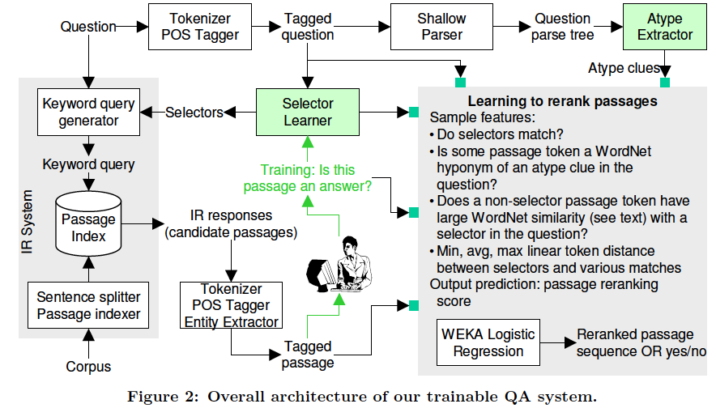
Architecture

Slide 41
Basic Processing
Initial retrieval results:
IR ‘documents’:
3 sentence windows (Tellex et al)
Indexed in Lucene
Retrieved based on reformulated query

Slide 42
Basic Processing
Initial retrieval results:
IR ‘documents’:
3 sentence windows (Tellex et al)
Indexed in Lucene
Retrieved based on reformulated query
Question-type classification
Based on shallow parsing
Synsets or surface patterns

Slide 43
Selectors
Intuition:
‘Where’ clause in an SQL query – selectors

Slide 44
Selectors
Intuition:
‘Where’ clause in an SQL query – selectors
Portion(s) of query highly likely to appear in answer
Train system to recognize these terms
Best keywords for query
Tokyo is the capital of which country?
Answer probably includes…..

Slide 45
Selectors
Intuition:
‘Where’ clause in an SQL query – selectors
Portion(s) of query highly likely to appear in answer
Train system to recognize these terms
Best keywords for query
Tokyo is the capital of which country?
Answer probably includes…..
Tokyo+++
Capital+
Country?

Slide 46
Selector Recognition
Local features from query:
POS of word
POS of previous/following word(s), in window
Capitalized?

Slide 47
Selector Recognition
Local features from query:
POS of word
POS of previous/following word(s), in window
Capitalized?
Global features of word:
Stopword?
IDF of word
Number of word senses
Average number of words per sense

Slide 48
Selector Recognition
Local features from query:
POS of word
POS of previous/following word(s), in window
Capitalized?
Global features of word:
Stopword?
IDF of word
Number of word senses
Average number of words per sense
Measures of word specificity/ambiguity

Slide 49
Selector Recognition
Local features from query:
POS of word
POS of previous/following word(s), in window
Capitalized?
Global features of word:
Stopword?
IDF of word
Number of word senses
Average number of words per sense
Measures of word specificity/ambiguity
Train Decision Tree classifier on gold answers: +/-S

Slide 50
Passage Ranking
For question q and passage r, in a good passage:

Slide 51
Passage Ranking
For question q and passage r, in a good passage:
All selectors in q appear in r

Slide 52
Passage Ranking
For question q and passage r, in a good passage:
All selectors in q appear in r
r has answer zone A w/o selectors

Slide 53
Passage Ranking
For question q and passage r, in a good passage:
All selectors in q appear in r
r has answer zone A w/o selectors
Distances b/t selectors and answer zone A are small

Slide 54
Passage Ranking
For question q and passage r, in a good passage:
All selectors in q appear in r
r has answer zone A w/o selectors
Distances b/t selectors and answer zone A are small
A has high similarity with question type

Slide 55
Passage Ranking
For question q and passage r, in a good passage:
All selectors in q appear in r
r has answer zone A w/o selectors
Distances b/t selectors and answer zone A are small
A has high similarity with question type
Relationship b/t Qtype, A’s POS and NE tag (if any)

Slide 56
Passage Ranking Features
Find candidate answer zone A* as follows for (q.r)
Remove all matching q selectors in r
For each word (or compound in r) A
Compute Hyperpath distance b/t Qtype & A
Where HD is Jaccard overlap between hypernyms of Qtype & A

Slide 57
Passage Ranking Features
Find candidate answer zone A* as follows for (q.r)
Remove all matching q selectors in r
For each word (or compound in r) A
Compute Hyperpath distance b/t Qtype & A
Where HD is Jaccard overlap between hypernyms of Qtype & A
Compute L as set of distances from selectors to A*
Feature vector:

Slide 58
Passage Ranking Features
Find candidate answer zone A* as follows for (q.r)
Remove all matching q selectors in r
For each word (or compound in r) A
Compute Hyperpath distance b/t Qtype & A
Where HD is Jaccard overlap between hypernyms of Qtype & A
Compute L as set of distances from selectors to A*
Feature vector:
IR passage rank; HD score; max, mean, min of L

Slide 59
Passage Ranking Features
Find candidate answer zone A* as follows for (q.r)
Remove all matching q selectors in r
For each word (or compound in r) A
Compute Hyperpath distance b/t Qtype & A
Where HD is Jaccard overlap between hypernyms of Qtype & A
Compute L as set of distances from selectors to A*
Feature vector:
IR passage rank; HD score; max, mean, min of L
POS tag of A*; NE tag of A*; Qwords in q

Slide 60
Passage Ranking
Train logistic regression classifier
Positive example:

Slide 61
Passage Ranking
Train logistic regression classifier
Positive example: question + passage with answer
Negative example:

Slide 62
Passage Ranking
Train logistic regression classifier
Positive example: question + passage with answer
Negative example: question w/any other passage
Classification:
Hard decision: 80% accurate, but

Slide 63
Passage Ranking
Train logistic regression classifier
Positive example: question + passage with answer
Negative example: question w/any other passage
Classification:
Hard decision: 80% accurate, but
Skewed, most cases negative: poor recall

Slide 64
Passage Ranking
Train logistic regression classifier
Positive example: question + passage with answer
Negative example: question w/any other passage
Classification:
Hard decision: 80% accurate, but
Skewed, most cases negative: poor recall
Use regression scores directly to rank

Slide 65
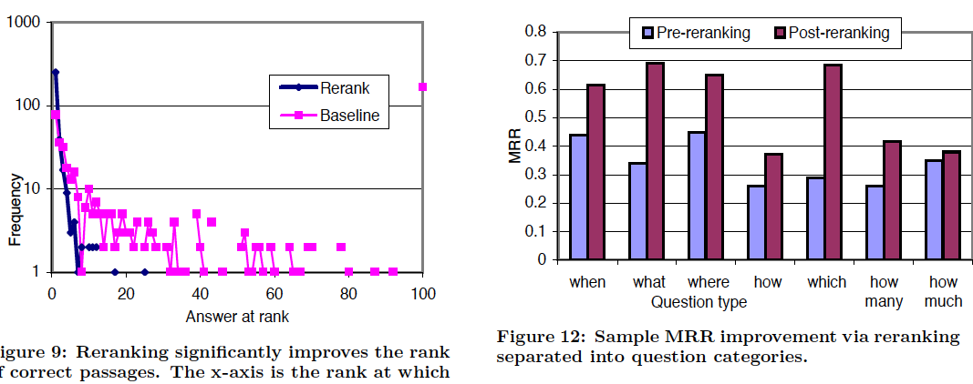
Passage Ranking

Slide 66
Reranking with Deeper Processing
Passage Reranking for Question Answering Using Syntactic Structures and Answer Types
Atkolga et al, 2011
Reranking of retrieved passages
Integrates
Syntactic alignment
Answer type
Named Entity information

Slide 67
Motivation
Issues in shallow passage approaches:
From Tellex et al.

Slide 68
Motivation
Issues in shallow passage approaches:
From Tellex et al.
Retrieval match admits many possible answers
Need answer type to restrict

Slide 69
Motivation
Issues in shallow passage approaches:
From Tellex et al.
Retrieval match admits many possible answers
Need answer type to restrict
Question implies particular relations
Use syntax to ensure

Slide 70
Motivation
Issues in shallow passage approaches:
From Tellex et al.
Retrieval match admits many possible answers
Need answer type to restrict
Question implies particular relations
Use syntax to ensure
Joint strategy required
Checking syntactic parallelism when no answer, useless
Current approach incorporates all (plus NER)

Slide 71
Baseline Retrieval
Bag-of-Words unigram retrieval (BOW)

Slide 72
Baseline Retrieval
Bag-of-Words unigram retrieval (BOW)
Question analysis: QuAn
ngram retrieval, reformulation

Slide 73
Baseline Retrieval
Bag-of-Words unigram retrieval (BOW)
Question analysis: QuAn
ngram retrieval, reformulation
Question analysis + Wordnet: QuAn-Wnet
Adds 10 synonyms of ngrams in QuAn

Slide 74
Baseline Retrieval
Bag-of-Words unigram retrieval (BOW)
Question analysis: QuAn
ngram retrieval, reformulation
Question analysis + Wordnet: QuAn-Wnet
Adds 10 synonyms of ngrams in QuAn
Best performance: QuAn-Wnet (baseline)

Slide 75
Dependency Information
Assume dependency parses of questions, passages
Passage = sentence
Extract undirected dependency paths b/t words

Slide 76
Dependency Information
Assume dependency parses of questions, passages
Passage = sentence
Extract undirected dependency paths b/t words
Find path pairs between words (q_{k},a_{l}),(q_{r},a_{s})
Where q/a words ‘match’
Word match if a) same root or b) synonyms

Slide 77
Dependency Information
Assume dependency parses of questions, passages
Passage = sentence
Extract undirected dependency paths b/t words
Find path pairs between words (q_{k},a_{l}),(q_{r},a_{s})
Where q/a words ‘match’
Word match if a) same root or b) synonyms
Later: require one pair to be question word/Answer term
Train path ‘translation pair’ probabilities

Slide 78
Dependency Information
Assume dependency parses of questions, passages
Passage = sentence
Extract undirected dependency paths b/t words
Find path pairs between words (q_{k},a_{l}),(q_{r},a_{s})
Where q/a words ‘match’
Word match if a) same root or b) synonyms
Later: require one pair to be question word/Answer term
Train path ‘translation pair’ probabilities
Use true Q/A pairs, <path_{q},path_{a}>
GIZA++, IBM model 1
Yields Pr(label_{a},label_{q})

Slide 79
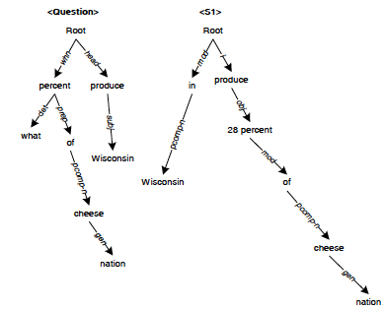
Dependency Path Similarity
From Cui

Slide 80
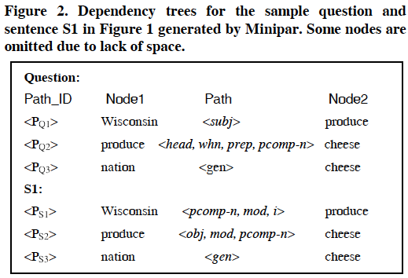
Dependency Path Similarity

Slide 81
Similarity
Dependency path matching

Slide 82
Similarity
Dependency path matching
Some paths match exactly
Many paths have partial overlap or differ due to question/declarative contrasts

Slide 83
Similarity
Dependency path matching
Some paths match exactly
Many paths have partial overlap or differ due to question/declarative contrasts
Approaches have employed
Exact match
Fuzzy match
Both can improve over baseline retrieval, fuzzy more

Slide 84
Dependency Path Similarity
Cui et al scoring
Sum over all possible paths in a QA candidate pair

Slide 85
Dependency Path Similarity
Cui et al scoring
Sum over all possible paths in a QA candidate pair

Slide 86
Dependency Path Similarity
Cui et al scoring
Sum over all possible paths in a QA candidate pair

Slide 87
Dependency Path Similarity
Atype-DP
Restrict first q,a word pair to Qword, ACand
Where Acand has correct answer type by NER

Slide 88
Dependency Path Similarity
Atype-DP
Restrict first q,a word pair to Qword, ACand
Where Acand has correct answer type by NER
Sum over all possible paths in a QA candidate pair
with best answer candidate

Slide 89
Dependency Path Similarity
Atype-DP
Restrict first q,a word pair to Qword, ACand
Where Acand has correct answer type by NER
Sum over all possible paths in a QA candidate pair
with best answer candidate

Slide 90
Comparisons
Atype-DP-IP
Interpolates DP score with original retrieval score

Slide 91
Comparisons
Atype-DP-IP
Interpolates DP score with original retrieval score
QuAn-Elim:
Acts a passage answer-type filter
Excludes any passage w/o correct answer type

Slide 92
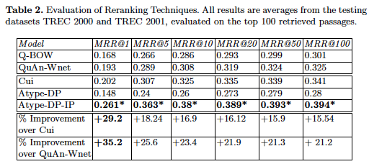
Results
Atype-DP-IP best

Slide 93
Results
Atype-DP-IP best
Raw dependency:‘brittle’; NE failure backs off to IP

Slide 94
Results
Atype-DP-IP best
Raw dependency:‘brittle’; NE failure backs off to IP
QuAn-Elim: NOT significantly worse

