Slide 1
LING 573 D4: The Final D
Elliot Holt
Kelly Peterson

Slide 2
D4 – Smells Like D3
Primary Goal – improve D3 MAP with lessons learned
After many experiments:
TREC 2004 MAP = 0.300 -> 0.321 (+7%)
Global MRR++
Help came from:
Custom Lucene Analyzer
Porter stem the index
NLTK stop the index
Added <HEADLINE> to index
(NOTE: not helpful for QA)

Slide 3
Answer Extraction?
Not yet… Still improving the input pipes
Spillover splitting/scoring
SiteQ PR System MRR Improvements
3sent window = 0.329
1000 start = 0.403350241221
1000 baseline = 0.41155987459
1000 final = 0.424

Slide 4
Answer Extraction?
Hahaha. No.
Enhanced Query Expansion - IT WORKS!
IT:
using improved Rocchio/expanded term weights
using expanded query terms for scoring initial documents
researching for better documents
WORKS:
Significant MRR improvements
2004:
[1] 100: 0.227 -> 0.232 (+2.2%)
[0-3] 1000: 0.398 -> 0.424 (+6.5%)
2005
[1-2] 1000: 0.392 -> 0.398 (+1.5%)

Slide 5
Answer Extraction?
Well, kinda…
Development Efforts:
Hand-built Pattern matching reranking boost
(Soubbotin 2001)
NE boosting with Q_Class associations
(Echihabi et al, 2005)
Needed accuracy evaluation method
Create a corrected TREC 2004 Q_Class label file…manually
Extract information from compute_mrr.py results
TREC 2004 data, 100 char, average MRR
Miss = question with 0.0 MRR
HitAccuracy = Average MRR of non-miss questions

Slide 6
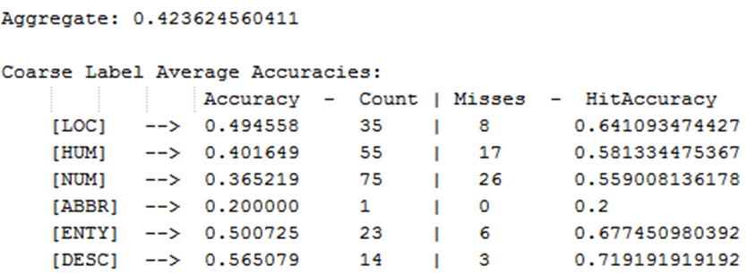
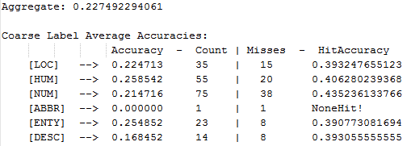
By-Label Accuracy
1000 char: (lenient)
100 char: (lenient)

Slide 7
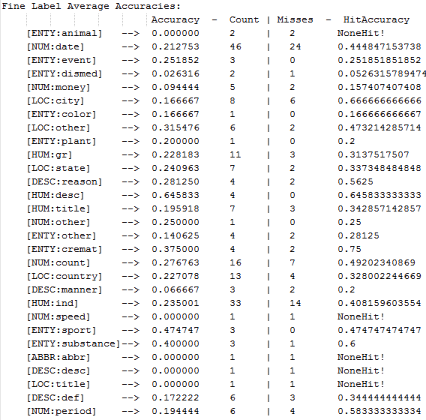

Slide 8
Answer Extraction Results
Similar or better results without
The systems are implemented internally, but untuned
Worst performers (that could have been helped):
by Misses:
NUM:date
HUM:indiv
By HitAccuracy:
NUM:money
LOC
More patterns & NE associations needed

Slide 9
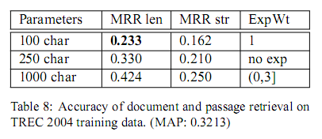
TREC 2004 tuning results

Slide 10
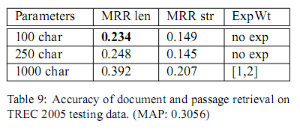
TREC 2005 testing results

Slide 11
Further work
Apply new pattern and NE boosting to disaster areas.
Gloat about getting query expansion to improve both document and passage retrieval.
Restart.

