Slide 1
D4: Final QA System
Group 3
Chad Mills
Esad Suskic
Wee Teck Tan

Slide 2
Outline
Pre-D4 Recap
General Improvements
Short-Passage Improvements
Results
Conclusion

Slide 3
Pre-D4 Recap
Question Classification: not used
Document Retrieval: Indri
Passage Retrieval: Indri
Passage Retrieval Features:
Remove non-alphanumeric characters
Replace pronoun or append target
Remove stop words
Stemming

Slide 4
Entering D4
Best MRR (2004): 0.537
Baseline:
Same methodology
New passage sizes
Passage Size | MRR
1000 | 0.537
250 | 0.281
100 | 0.184

Slide 5
General Improvements
Best so far:
0.537
0.281
0.184
Trimming Improvements:
Remove <P>, </P> tags
Chop off beginnings like:
___ (Xinhua) –
___ (AP) –
Results:
Passage Size | MRR
1000 | 0.545
250 | 0.288
100 | 0.186

Slide 6
General Improvements
Best so far:
0.545
0.288
0.186
Aranea
Query Aranea
Question-neutral filtering:
Edge stopword
Question terms
First Aranea answer matching a passage:
Move first matching passage to top
“Match:” ≥ 60%, by token

Slide 7
General Improvements
Best so far:
0.545
0.288
0.186
Results:
Passage Size | Question Only
1000 | 0.546
250 | 0.340
100 | 0.191

Slide 8
General Improvements
Best so far:
0.545
0.288
0.186
Results:
Passage Size | Question Only | Question + Target
1000 | 0.546 | 0.604
250 | 0.340 | 0.399
100 | 0.191 | 0.238

Slide 9
General Improvements
Best so far:
0.545
0.288
0.186
Results:
Passage Size | Question Only | Question + Target | Indri Input
1000 | 0.546 | 0.604 | 0.603
250 | 0.340 | 0.399 | 0.382
100 | 0.191 | 0.238 | 0.243
Improvement: 11-25% (relative)

Slide 10
General Improvements
Best so far:
0.604
0.399
0.243
Aranea Re-query:
Ignore recent improvements
Add Aranea answers to query
Integrate if useful
For 100-char passages:
Lots of Problems
Many Qs: no results
Add top 5+
Didn’t combine with non-Aranea output
Conditions | MRR
Before Aranea | 0.186
Top 5 terms | 0.169
Top 7 terms | 0.143
Top 10 terms | 0.125

Slide 11
Focus Shift
Best so far:
0.604
0.399
0.243
1000-character MRR “good enough”
100-character MRR needs help
New Focus: short passages only

Slide 12
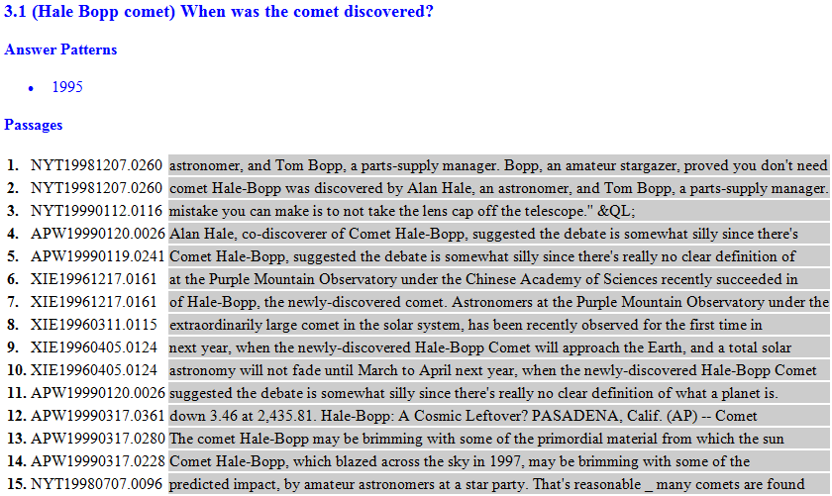
Short-Passage Improvements
Best so far:
0.604
0.399
0.243
What’s going wrong?
Short Passage: no answer at all

Slide 13
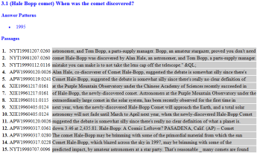
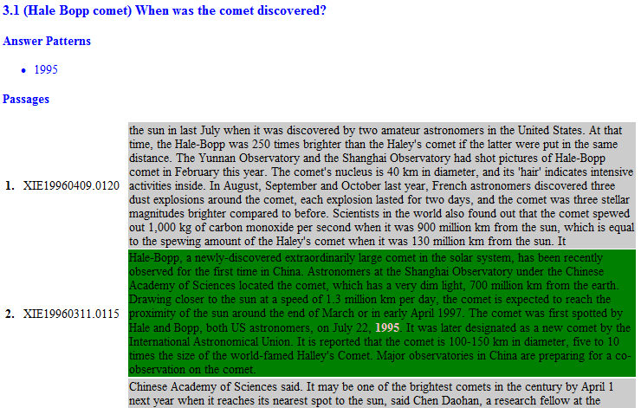
Short-Passage Improvements
Best so far:
0.604
0.399
0.243
What’s going wrong?
Short Passage
Long Passages: answer in 2nd passage

Slide 14
Short-Passage Improvements
Best so far:
0.604
0.399
0.243
What’s going wrong?
16 word passages: too short for Indri
Approach for Short Passages
82% of questions: answers in long passages
Shorten long passages
Don’t rely directly on Indri as much
Needed: a way to shorten them

Slide 15
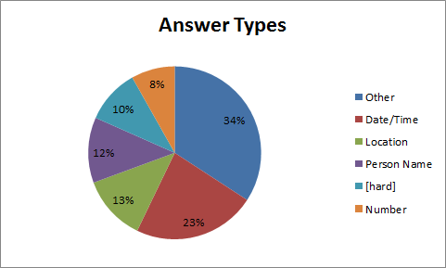
Short-Passage Improvements
Best so far:
0.604
0.399
0.243
36% of questions: date or location
56%: date, location, name, number

Slide 16
Short-Passage Improvements
Best so far:
0.604
0.399
0.243
Putting these together:
Answers do exist in the longer passages
A few categories: large % of answer types
Solution Approach:
Named Entity Recognition
OpenNLP (C# port of java library)
Handles date, time, location, people, percentage, …

Slide 17
Short-Passage Improvements
Best so far:
0.604
0.399
0.243
“When” questions:
Go through long passages w/NER for dates
Require a year (filter out “last week” types)
Center passage at NE, add surrounding tokens up to 100 characters
Put these on top of short passage list
MRR: 0.293 (21% improvement)

Slide 18
Short-Passage Improvements
Best so far:
0.604
0.399
0.293
Before

Slide 19
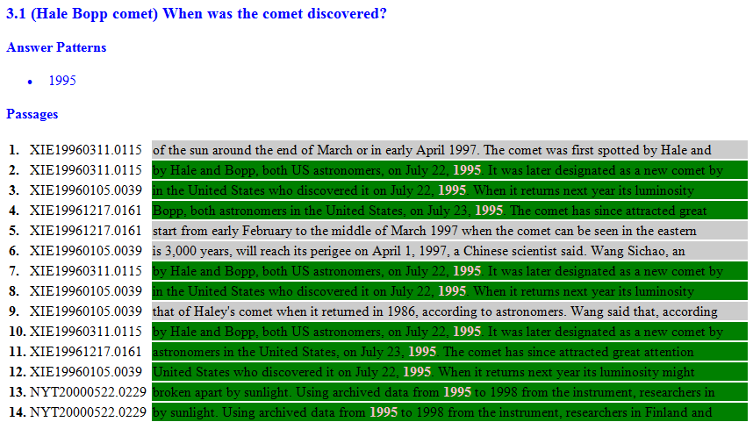
Short-Passage Improvements
Best so far:
0.604
0.399
0.293
Before
After

Slide 20
Short-Passage Improvements
Best so far:
0.604
0.399
0.293
“When” questions (cont’d):
Find dates in top 5 Aranea outputs
“July 3, 1995” ← not recognized as date
“blah blah blah July 3, 1995 blah blah blah” is
Take Aranea+NER dates, then NER dates
Passage matches date if year matches
MRR: 0.300

Slide 21
Short-Passage Improvements
Best so far:
0.604
0.399
0.300
“Where” questions:
Basically the same as “When”
Use “location” instead of “date” NER
Location matches passage if:
>50% of NE chars are in exact token matches
MRR: 0.285
Ick!

Slide 22
Short-Passage Improvements
Best so far:
0.604
0.399
0.300
Trying to fix “Where” logic:
“…blah location blah…” trick doesn’t work well
Lots of news stories starting with locations:
Examples:
REFUGEE. OXFORD, England _
ARGENTAN, France (AP) _
William J. Broad. RELIGION-COLUMN (Undated) _ The weekly religion column. By Gustav Niebuhr.
1100 words. &UR; COMMENTARY (k) &LR; NYHAN-COLUMN (Chappaqua, N.Y.) -- The wife of the outgo
Filter these if: _ or – has a “)” or 5+ caps in 15 chars to left
Remove duplicate passages
“Jacksonville” and “Florida” both match “Jacksonville, Florida”
If short passages have locations, put those first
MRR: 0.303

Slide 23
Short-Passage Improvements
Best so far:
0.604
0.399
0.303
Trying to fix “Where” logic:
Don’t put all short passage locations over long passage locations
Only if in the top 5 short passages
MRR: 0.309

Slide 24
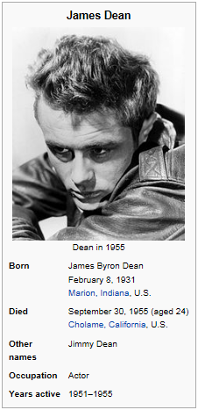
Short-Passage Improvements
Best so far:
0.604
0.399
0.309
Wikipedia
Bing query for question targets only
site://wikipedia.org restriction
Parse factbox as key/value pairs
Match question terms, factbox keys
Levenshtein Distance
poor man’s stemmer
NER for dates only (“When” Qs)
MRR: 0.321

Slide 25
Short-Passage Improvements
Best so far:
0.604
0.399
0.321
Revisiting Aranea output
Before:
Now that 100-character passages are doing better, try Question+Target again
MRR: 0.330
Passage Size | Question Only | Question + Target | Indri Input
1000 | 0.546 | 0.604 | 0.603
250 | 0.340 | 0.399 | 0.382
100 | 0.191 | 0.238 | 0.243

Slide 26
Final Results
Passage Size | 2004 | 2005
1000 | 0.599 | 0.531
250 | 0.403 | 0.369
100 | 0.330 | 0.289
2004 Baseline vs. Final
Initial | Final | Improvement
0.537 | 0.599 | 12%
0.281 | 0.403 | 43%
0.184 | 0.330 | 79%

Slide 27
Future Work
Get re-querying w/Aranea to work
Improve location parsing
Add person, organization NER
Expand Wikipedia beyond dates

Slide 28
Conclusions
Indri: good on long, not on short
Aranea was very useful
NER on dates was similarly effective
Location NER was difficult but workable
Overall NER was the best
Even with many more places to use NER left
Looking at the data is essential
Plenty to do – prioritization is important

Slide 29
Questions?

