Slide 1
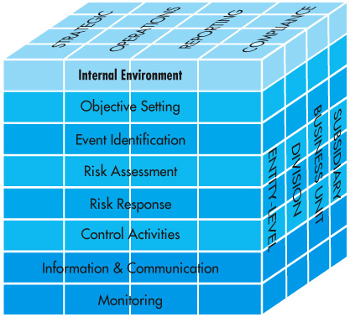
Chapter 6
Control & AISs
Fig. 6-1
COSO’s ERMM

Slide 2
Overview
Questions to be addressed in this chapter:
What are the basic internal control concepts, and why are computer control and security important?
What is the difference between the COBIT, COSO, and ERM control frameworks?
What are the major elements in the internal environment of a company?
What are the four types of control objectives that companies need to set?
What events affect uncertainty, and how can they be identified?
How is the Enterprise Risk Management model used to assess and respond to risk?
What control activities are commonly used in companies?
How do organizations communicate information and monitor control processes?

Slide 3
Introduction
AIS threats are increasing, why?
Control risks have increased in the last few years because:
There are computers and servers everywhere.
Distributed computer networks make data available to many users.
Wide area networks (WANs) are giving customers and suppliers access to each other’s systems and data.
Inadequate Protection:
Threats are underestimated, controls are not well understood.
Productivity pressures, cost reduction pressures.
Companies have not always understood the threats.
Cost pressures mean that mgr.s skip time-consuming control proc.

Slide 4
Introduction
Control and security are important
Companies are now recognizing the problems and taking positive steps to achieve better control, including:
Devoting full-time staff to security and control concerns.
Educating employees about control measures.
Establishing and enforcing formal information security policies.
Making controls a part of the applications development process.
Moving sensitive data to more secure environments.

Slide 5
Introduction
Control objectives are the same regardless of the data processing method, but a computer-based AIS requires different internal control policies and procedures because:
Computer processing may reduce clerical errors but increase risks of unauthorized access or modification of data files.
Segregation of duties must be achieved differently in an AIS.
Computers provide opportunities for enhancement of some internal controls.

Slide 6
Control Concepts
Internal control is the process implemented by the board of directors, management, and those under their direction to provide reasonable assurance that the following control objectives are achieved:
Assets (including data) are safeguarded.
Records are maintained in sufficient detail to accurately and fairly reflect company assets.
Accurate and reliable information is provided.
There is reasonable assurance that financial reports are prepared in accordance with GAAP.
Operational efficiency is promoted and improved.
Adherence to prescribed managerial policies is encouraged.
The organization complies with applicable laws and regulations.

Slide 7
Control Concepts
Internal control is a process because:
It permeates an organization’s operating activities.
It is an integral part of basic management activities.
Internal control provides reasonable, rather than absolute, assurance, because complete assurance is difficult or impossible to achieve and prohibitively expensive.
Internal control systems have inherent limitations, including:
They are susceptible to errors and poor decisions.
They can be overridden by management or by collusion of two or more employees.
Internal control objectives are often at odds with each other.
EXAMPLE: Controls to safeguard assets may also reduce operational efficiency.

Slide 8
Control Concepts
Internal controls perform three important functions:
Preventive controls (deter problems before)
Detective controls (discover problems after they arise.)
Corrective controls (correct and modify system.)

Slide 9
Control Concepts
Internal controls are often classified as:
General controls
Those designed to make sure an organization’s control environment is stable and well managed.
They apply to all sizes and types of systems.
Examples: Security management controls.
Application controls
Prevent, detect, and correct transaction errors and fraud.
Concerned with accuracy, completeness, validity, and authorization of the data captured, entered into the system, processed, stored, transmitted to other systems, and reported.

Slide 10
Sarbanes-Oxley (SOX)
In 1977, Congress passed the Foreign Corrupt Practices Act. This act incorporated language from an AICPA pronouncement.
The primary purpose of the act was to prevent the bribery of foreign officials to obtain business.
A significant effect was to require that corporations maintain good systems of internal accounting control.
Generated significant interest among management, accountants, and auditors in designing and evaluating internal control systems.
However, the resulting internal control improvements weren’t sufficient.

Slide 11
SOX
In the late 1990s and early 2000s, a series of multi-million-dollar accounting frauds made headlines (e.g., ENRON, WorldCom…)
The impact on financial markets was substantial, and Congress responded with passage of the Sarbanes-Oxley Act of 2002 (aka, SOX).
Applies to publicly held companies and their auditors.

Slide 12
SOX
The intent of SOX is to:
Prevent financial statement fraud
Make financial reports more transparent
Protect investors
Strengthen internal controls in publicly-held companies
Punish executives who perpetrate fraud
SOX has had a material impact on the way boards of directors, management, and accountants operate.

Slide 13
SOX
Important aspects of SOX include:
Creation of the Public Company Accounting Oversight Board (PCAOB) to oversee the auditing profession.
The SEC appoints five members to oversee the auditing profession. Three cannot be CPA’s. They enforce auditing, quality control, ethics, and independence.
New rules for auditors
Rotation rules. Prohibit certain activities (bookkeeping, systems, internal audit) for auditors.
New rules for audit committees
All must be independent, and one must be a financial expert.
New rules for management
The CEO/CFO certify findings, responsible for internal controls and certify auditors were told about all material control weaknesses and examples of fraud.
New internal control requirements
Publicly held companies must issue a report accompanying the financial statements that states management is responsible for the internal control structure. They also have to report on the adequacy of the internal control structure.

Slide 14
SOX
After the passage of SOX, the SEC further mandated that:
Management must base its evaluation on a recognized control framework, developed using a due-process procedure that allows for public comment. The most likely framework is the COSO model discussed later.
The report must contain a statement identifying the framework used.
Management must disclose any and all material internal control weaknesses.
Management cannot conclude that the company has effective internal control if there are any material weaknesses.

Slide 15
Control Frameworks
A number of frameworks have been developed to help companies develop good internal control systems. Three of the most important are:
The COBIT framework
The COSO internal control framework
COSO’s Enterprise Risk Management framework (ERM)

Slide 16
COBIT
Also know as the Control Objectives for Information and related Technology framework.
Developed by the Information Systems Audit and Control Foundation (ISACF).
A framework of generally applicable information systems security and control practices for IT control.

Slide 17
COBIT
The COBIT framework allows:
Management to benchmark security and control practices of IT environments.
Users of IT services to be assured that adequate security and control exists.
Auditors to substantiate their opinions on internal control and advise on IT security and control matters.

Slide 18
COBIT
COBIT consolidates standards from 36 different sources into a single framework.
It is having a big impact on the IS profession.
Helps managers to learn how to balance risk and control investment in an IS environment.
Provides users with greater assurance that security and IT controls provided by internal and third parties are adequate.
Guides auditors as they substantiate their opinions and provide advice to management on internal controls.

Slide 19
COSO framework
COSO’s internal control framework
The Committee of Sponsoring Organizations (COSO) is a private sector group consisting of:
The American Accounting Association
The AICPA
The Institute of Internal Auditors
The Institute of Management Accountants
The Financial Executives Institute

Slide 20
COSO
In 1992, COSO issued the Internal Control Integrated Framework:
Defines internal controls.
Provides guidance for evaluating and enhancing internal control systems.
Widely accepted as the authority on internal controls.
Incorporated into policies, rules, and regulations used to control business activities.
(10 years later it issued its expanded Enterprise Risk Management [ERM] model.)

Slide 21
COSO Frameworks
Elements: | I. C. Framework | ERM
Internal environment | X | X
Objective setting |  | X
Event identification |  | X
Risk assessment | X | X
Risk response |  | X
Control activities | X | X
Information and communication | X | X
Monitoring | X | X

Slide 22
ERM
Basic principles behind ERM:
Companies are formed to create value for owners.
Management must decide how much uncertainty they will accept.
Uncertainty can result in:
Risk
Opportunity
The framework should help management manage uncertainty and its associated risk to build and preserve value.
To maximize value, a company must balance its growth and return objectives and risks with efficient and effective use of company resources.

Slide 23
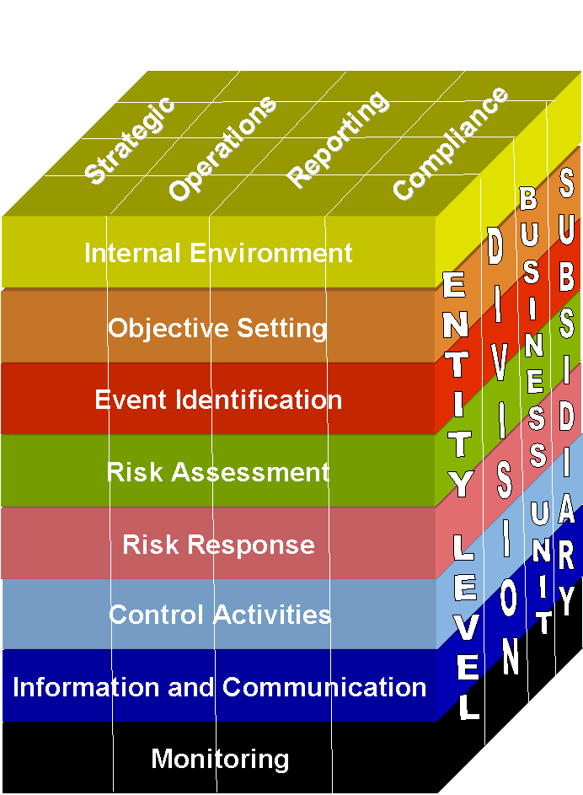
COSO’s ERM model
COSO developed a model to illustrate the elements of ERM.
Columns at the top represent the four types of objectives that management must meet to achieve company goals.
Columns on the right represent the company’s units: Entire company, Division, Business unit, Subsidiary. The horizontal rows are eight related risk and control components.

Slide 24
The eight components of ERM
The Internal Environment
a) Management’s philosophy: management’s philosophy has a huge impact. Risk appetite: different companies have different perspectives on risks. But some companies have excessive focus on achieving results.
b) The Board of Directors:
--Needs to oversee management
--Sarbanes-Oxley audit committee must exist, consisting entirely of outsides directors
--This audit committee needs to work closely with internal and external auditors

Slide 25
The eight components of ERM
The Internal Environment (continued)
c) Commitment to integrity, ethical values, and competence
-- Internal policies
-- Is there a Standards of Business Conduct?
-- Is there an Open Door? Is there protection for people who raise issues concerning company ethics?
-- What is important is what is actually done, not what is actually said.

Slide 26
The eight components of ERM
The Internal Environment (continued)
Organizational structure: Is it overly complex? Statistically, fraud occurs more frequently in organizations with complex structures. Who does finance report to? Who the does internal audit report to? Where does IT report?

Slide 27
The eight components of ERM
Important aspects of organizational structure:
Degree of centralization or decentralization.
Assignment of responsibility for specific tasks.
Direct-reporting relationships or matrix structure.
Organization by industry, product, geographic location, marketing network.
How the responsibility allocation affects management’s information needs.
Organization of accounting and IS functions.
Size and nature of company activities.

Slide 28
The eight components of ERM
(1) The Internal Environment (continued)
(e) Methods of assigning authority and responsibility
Authority and responsibility are assigned through:
Formal job descriptions
Employee training
Operating plans, schedules, and budgets
Codes of conduct that define ethical behavior, acceptable practices, regulatory requirements, and conflicts of interest
Written policies and procedures manuals (a good job reference and job training tool) which covers:
Proper business practices
Knowledge and experience needed by key personnel
Resources provided to carry out duties
Policies and procedures for handling particular transactions
The organization’s chart of accounts
Sample copies of forms and documents

Slide 29
The eight components of ERM
The Internal Environment (continued)
(f) Human Resource Standards
The following policies and procedures are important:
Hiring (background checks)
Compensating (fair)
Training (fraud & ethics awareness, punishment outlined)
Evaluating and promoting
Discharging
Managing disgruntled employees (indentify, help)
Vacations and rotation of duties (mandatory)
Confidentiality insurance and fidelity bonds (signed doc.s)
Prosecute hackers & fraud (most go unprosecuted, why?)

Slide 30
The eight components of ERM
(1) The Internal Environment (continued)
(g) External influences
External influences that affect the control environment include requirements imposed by:
FASB
PCAOB
SEC
Insurance commissions
Regulatory agencies for banks, utilities, etc. (FDIC)

Slide 31
The eight components of ERM
(2) Objective Setting
Objective-setting process proceeds as follows:
First, set strategic objectives, the high-level goals that support the company’s mission and create value for shareholders.
To meet these objectives, identify alternative ways of accomplishing them.
For each alternative, identify and assess risks and implications.
Formulate a corporate strategy.
Then set operations, compliance, and reporting objectives.

Slide 32
The eight components of ERM
(3) Event Identification
Events are:
Incidents or occurrences that emanate from internal or external sources.
That affect implementation of strategy or achievement of objectives.
Impact can be positive, negative, or both.
Events can range from obvious to obscure.
Effects can range from inconsequential to highly significant.
Table 6-2 (pg. 215) Outlines 9 ERM event categories, both external and internal.

Slide 33
The eight components of ERM
(3) Event Identification (continued)
Companies usually use two or more of the following techniques together to identify events:
Use comprehensive lists of potential events
Perform an internal analysis
Monitor leading events and trigger points
Conduct workshops and interviews
Perform data mining and analysis
Analyze business processes

Slide 34
The eight components of ERM
(4 & 5) RISK ASSESSMENT AND RISK RESPONSE
Inherent risk -- before management takes steps to control risk.
Residual risk -- risk that remains after management takes action to control the risk
Four ways to respond to risk:
Reduce (have internal controls)
Accept (no action)
Share (insurance, hedge, outsource)
Avoid (sell division, exit product line)

Slide 35
The eight components of ERM
Risk Assessment Approach to Designing Internal Controls—see Fig. 6-2 pg. 217 of text.
Estimate likelihood and Impact
Identify Controls
Estimate Costs & Benefits
Cost usually easier to measure
Expected loss = Impact * Likelihood
Determine Cost/Benefit Effectiveness
Implement Control or Avoid, Share, or Accept Risk

Slide 36
The eight components of ERM
Example of cost/benefit analysis:
Hobby Hole is trying to decide whether to install a motion detector system in its warehouse to reduce the probability of a catastrophic theft.
A catastrophic theft could result in losses of $800,000.
Local crime statistics suggest that the probability of a catastrophic theft at Hobby Hole is 12%.
Companies with motion detectors only have about a .5% probability of catastrophic theft.
The present value of purchasing and installing a motion detector system and paying future security costs is estimated to be about $43,000.
Should Hobby Hole install the motion detectors?

Slide 37
The eight components of ERM
Expected Loss without control procedure = $800,000 x .12 = $96,000.
Expected loss with control procedure = $800,000 x .005 = $4,000.
Estimated value of control procedure = $96,000 - $4,000 = $92,000.
Estimated cost of control procedure = $43,000 (given).
Benefits exceed costs by $92,000 - $43,000 = $49,000.
In this case, Hobby Hole should probably install the motion detectors.

Slide 38
The eight components of ERM
(6) Control activities: policies, procedures, and rules that provide reasonable assurance that management’s control objectives are met and their risk responses are carried out.
It is critical that controls be in place during the year-end holiday season. A disproportionate amount of computer fraud and security break-ins occur during this time because:
More people are on vacation and fewer around to mind the store.
Students are not tied up with school.
Counterculture hackers may be lonely.

Slide 39
The eight components of ERM
Generally, control procedures fall into one of the following categories:
Proper authorization of transactions and activities (general & specific).
Segregation of duties (our focus)
Project development and acquisition controls
Change management controls
Design and use of documents and records
Safeguard assets, records, and data
Independent checks on performance (top level reviews, analytical reviews, reconciliation of records, independent reviews).

Slide 40
The eight components of ERM
Segregation of duties
Good internal control requires that no single employee be given too much responsibility over business transactions or processes.
An employee should not be in a position to commit and conceal fraud or unintentional errors.
Segregation of duties:
Segregation of accounting duties
Segregation of duties within the systems function

Slide 41
The eight components of ERM
Segregation of accounting duties
Effective segregation of accounting duties is achieved when the following functions are separated:
Authorization—Approving transactions and decisions.
Recording—Preparing source documents; maintaining journals, ledgers, or other files; preparing reconciliations; and preparing performance reports.
Custody—Handling cash, maintaining an inventory storeroom, receiving incoming customer checks, writing checks on the organization’s bank account.
If any two of the preceding functions are the responsibility of one person, then problems can arise. If people collude, then segregation of duties becomes impotent and controls are overridden.

Slide 42
The eight components of ERM
Segregation of Systems Duties--Authority and responsibility must be divided clearly among the following functions:
Systems administration
Network management
Security management
Change management
Users
Systems analysts
Programming
Computer operations
Information systems library
Data control

Slide 43
The eight components of ERM
(7) Information and Communication
The primary purpose of the AIS is to gather, record, process, store, summarize, and communicate information about an organization.
According to the AICPA, an AIS has five primary objectives:
Identify and record all valid transactions.
Properly classify transactions.
Record transactions at their proper monetary value.
Record transactions in the proper accounting period.
Properly present transactions and related disclosures in the financial statements.

Slide 44
The eight components of ERM
(8) Monitoring can be accomplished with a series of ongoing events or by separate evaluations.
Key methods of monitoring performance include:
Perform ERM evaluation
Implement effective supervision
Use responsibility accounting
Monitor system activities
Track purchased software
Conduct periodic audits
Employ a computer security officer, a Chief Compliance Officer, and computer consultants
Engage forensic specialists
Install fraud detection software
Implement a fraud hotline

Slide 45
QUIZ
Multiple Choice 1 (pg. 200)
What type of internal controls finds the problem before it occurs?
A. Detective controls
B. Preventive controls
C. General controls
D. Corrective controls
Multiple Choice 2 (pg. 201)
The Public Company Accounting Oversight Board consists of:
A. 7 members
B. 3 members
C. 5 members
D. 6 members

Slide 46
QUIZ
Multiple Choice 3 (pg. 205)
Which of the following objectives involves parties external to the organization?
A. Strategic objectives
B. Compliance objectives
C. Operation objectives
D. Reporting objectives
Multiple Choice 4 (pg. 206)
Which of the following is not a component of COSO?
A. Event identification
B. External environment
C. Risk identification
D. B and C
E. All of the above are components of COSOW

Slide 47
QUIZ
Multiple Choice 5 (pg. 207)
What is the most important component of the ERM?
Internal environment
Risk assessment
Control activities
Information and communication
Multiple Choice 6 (pg. 209)
Which of the following statements is false?
An internal environment consists of an organizational structure.
Control activities is a component of COSO ERM.
The Sarbanes-Oxley Act requires all public companies to have an audit committee.
Companies endorse integrity as a basic operating principle by actively teaching and reporting it.

Slide 48
QUIZ
Multiple Choice 7 (pg. 205)
What corporate objective is based on a company’s mission statement?
Strategic objectives
Operations objectives
Compliance objectives
Reporting objectives
Multiple Choice 8 (pg. (pg 205)
The third ERM component is:
Objective setting
Risk assessment
Information and Communication
Event identification

Slide 49
QUIZ
Multiple Choice 9 (pg. 219)
The cost of conducting and compiling the end of the month inventory is $10,000 and the risk of an inventory error is 12% without a validation procedure and 3% with the validation procedures. The expected loss to retake and compile the inventory without a validation procedure is $1,200 and with the validation procedure is only $300. The cost of the validation procedure is $650. What is the net expected benefit of validation procedure?
$250
$350
$450
$600

Slide 50
QUIZ
Multiple Choice 10 (pg. 221)
Which of the following does not violate separation of duties?
Approving purchase orders and receiving items ordered.
Approving payment to vendors and completing the monthly bank reconciliation.
Receiving checks in the mail and maintaining the cash receipts journal.
Writing checks and receiving checks in the mail.

