Slide 1
Vagabond
Agnès Varda and Feminist Filmmaking

Slide 2
Topics for Discussion
Varda’s process, inspirations, and style
Narrative structure and effects
Constructing the woman
Alternative gaze structure

Slide 3
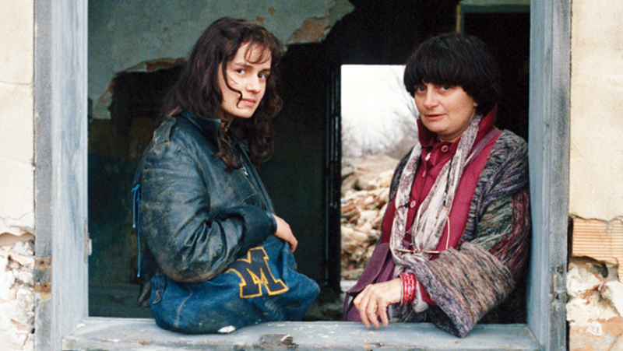
Process
Travel and research as preproduction
Encounters shaping story
Varda and Sandrine Bonnaire on the set of Vagabond. Image source: The Hollywood Interview

Slide 4
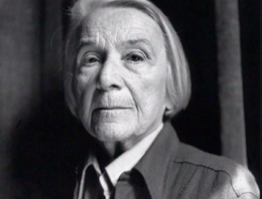
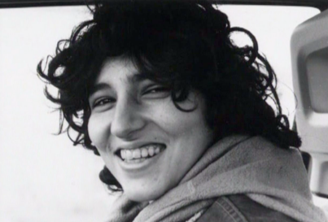
Inspirations
Nathalie Sarraute
Setina

Slide 5
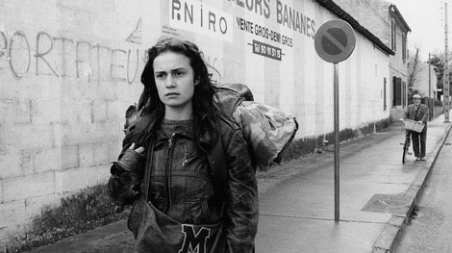
Style
Cinécriture--Film Writing
Left-Bank Group: Concerns with time, memory, narration and a form of cinematic writing that parallels the novel
French New Wave Style
Jump cuts, editing not motivated by narrative
Emphasis on form (demonstrates director’s understanding of film language)
Fragmentation of narrative form
Self-reflexive cinema
Blurring of documentary and fiction line
Mix of realism and mythical, pagan, Judeo-Christian figures
Still from Vagabond (1985).
Image source: British Film Institute

Slide 6
Narrative
What narrative structures does Vagabond use to relate Mona’s encounters and the reflections these encounters inspire?
What is the relationship between the film’s various segments (spatial, chronological, thematic, parallelism, etc.)?
How does the film alter presentation of cause and effect?
What is the effect of the film’s integration of multiple points of view?

Slide 7
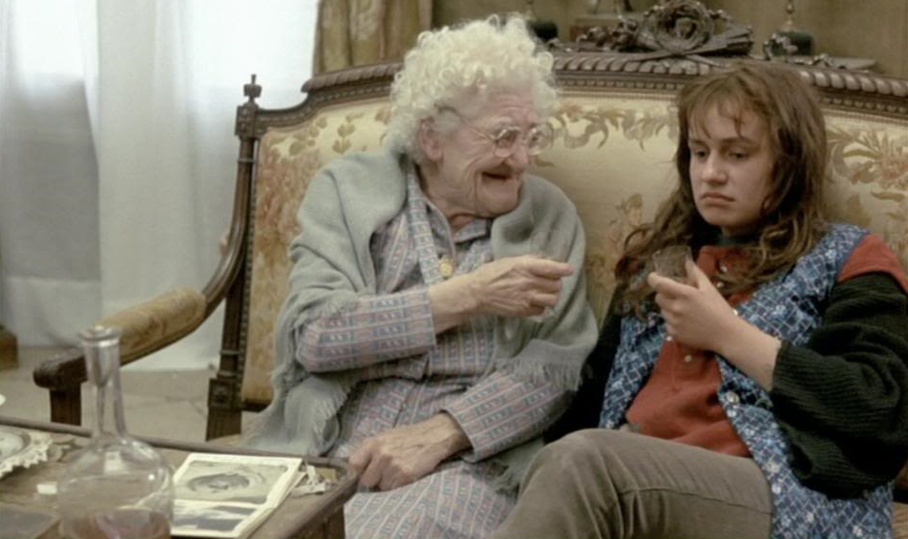
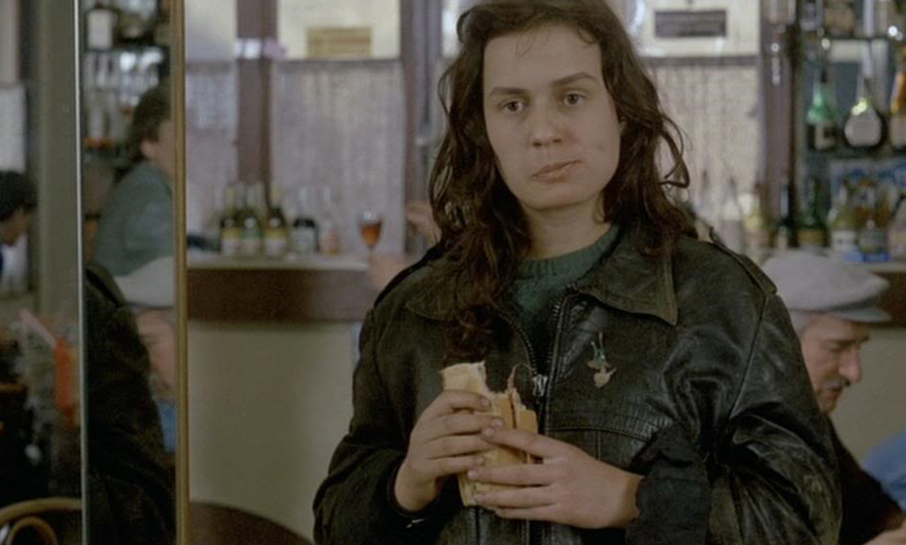
Identity Construction
Stills from Vagabond (1985)
What characteristics do the various witnesses ascribe to Mona?
How are their views informed by particular notions of femininity?
Image source: Slant Magzine

Slide 8
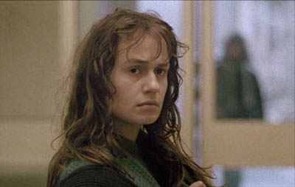
Gaze
How does the film structure gazing?
Still from Vagabond (1985).
Image source: DavidBordwell.net

