Slide 1
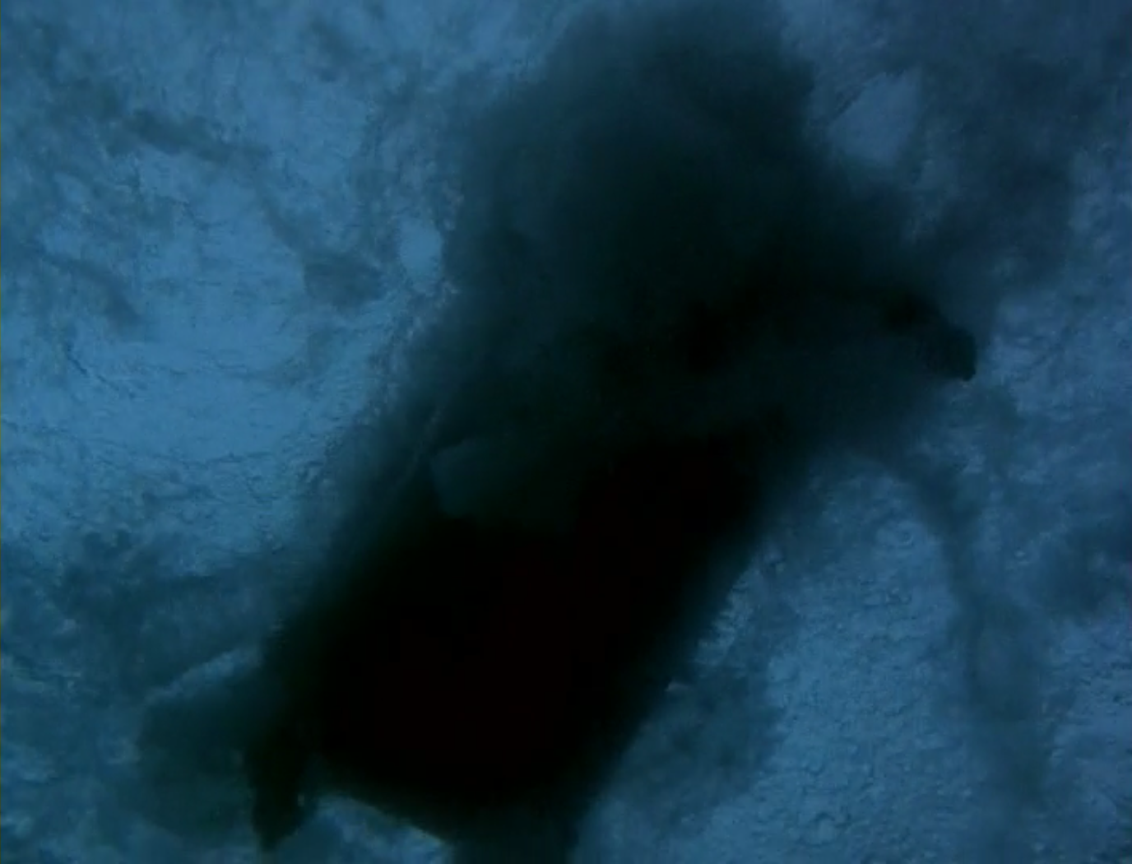
Cinematography in The Piano
Amber Inman, Alex Emry,
and Phil Harty

Slide 2
The Argument
Through Campion’s use of cinematography, the viewer is able to closely follow the mental processes of Ada as she decides to throw her piano overboard and give up the old life associated with it for a new one. The viewer is also able to distinctly see Ada’s plan change to include throwing herself in with the piano, and then her will choosing life.

Slide 3
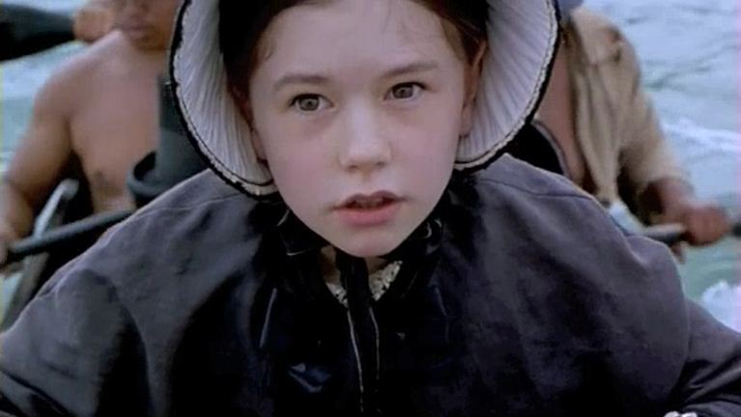

The Clip
[Click image or blue dot to play clip]

Slide 4
The Argument
Through Campion’s use of cinematography, the viewer is able to closely follow the mental processes of Ada as she decides to throw her piano overboard and give up the old life associated with it for a new one. The viewer is also able to distinctly see her plan change to include throwing herself in with the piano, and then her will choosing life.

Slide 5
Tilt Shot
Flora is framed between Ada and Baines
  She, being the middle man in their conversations, is centered between them, and the selective focus brings our attention to this relationship.
Tilt down to close up of hands meeting
  This tilt shows that although Flora interprets for them, there is a nonverbal relationship that exists outside of the need for her translation.
Cut to Ada signing
  This mid-range shot allows the viewer to see Ada’s quick break from Baines’ hand to issue the order to throw the piano overboard. The speed with which Ada breaks away shows that this was a planned event.

Slide 6
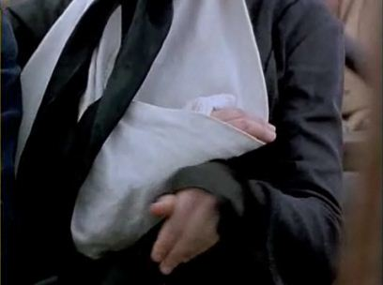
Tilt Shot
[Click image or blue dot to play clip]

Slide 7
Close-up of Oars
Motif
  The oars and accompanying chants serve as a motif within this scene. The chanting and splashing of the oars permeate the first third of the scene, and throughout that time we often see the handles of the oars and elbows of the oarsmen come into frame from offscreen. This exchange between water and human signals the upcoming action.

Slide 8
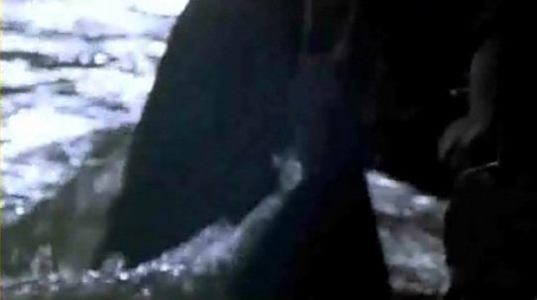
Close-up of Oars
[Click image or blue dot to play clip]

Slide 9
Medium Close-Up of Ada
Depth of Field
  The depth of field here allows the viewer to see in the extreme foreground the action of untying the piano from the boat, but also allows for a clear view of Ada’s face, showing a mixture of disconcertment and resolve. She has steeled herself for what must be done, but is still not wholly ready to let go of the piano.

Slide 10
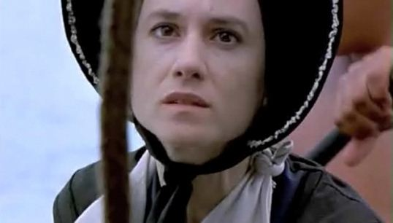
Medium Close-Up of Ada
[Click image or blue dot to play clip]

Slide 11
Close-up of Ada’s hand
Water motif
  This shot provides a different take on the water motif earlier played out by the oars. Here it is a more direct reference to Ada’s future as she is personally making contact with the water.
  From this we can see Ada contemplating going with the piano. The length of this shot and the way she longingly caresses the water are indicative of her decision.

Slide 12
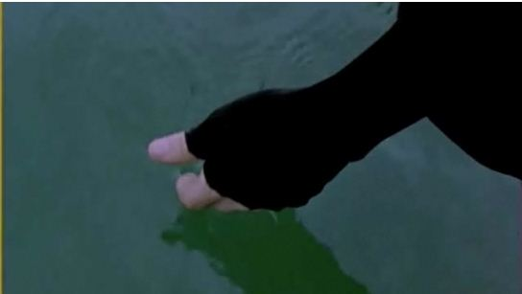
Close-up of Ada’s hand
[Click image or blue dot to play clip]

Slide 13
Close-up of Ada Looking Up
Facial expression
  The beauty of this shot is that it is close enough for us to see the nuances of Ada’s expression. She doesn’t need to say a word through narration or otherwise for us to understand that she finally knows what to do. Her longing look transforms into a look of calculating, rational resolve.

Slide 14
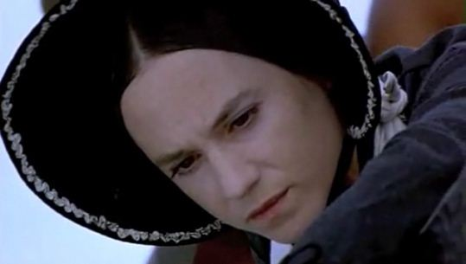
Close-up of Ada Looking Up
[Click image or blue dot to play clip]

Slide 15
Depth of Field
Ropes in front of Ada
  Here we see selective focus showing us a rope sliding in front of Ada’s face. This shot could have easily been done with the rope out of the way, so its involution is intentional.

Slide 16
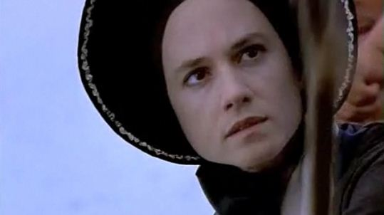
Depth of Field
[Click image or blue dot to play clip]

Slide 17
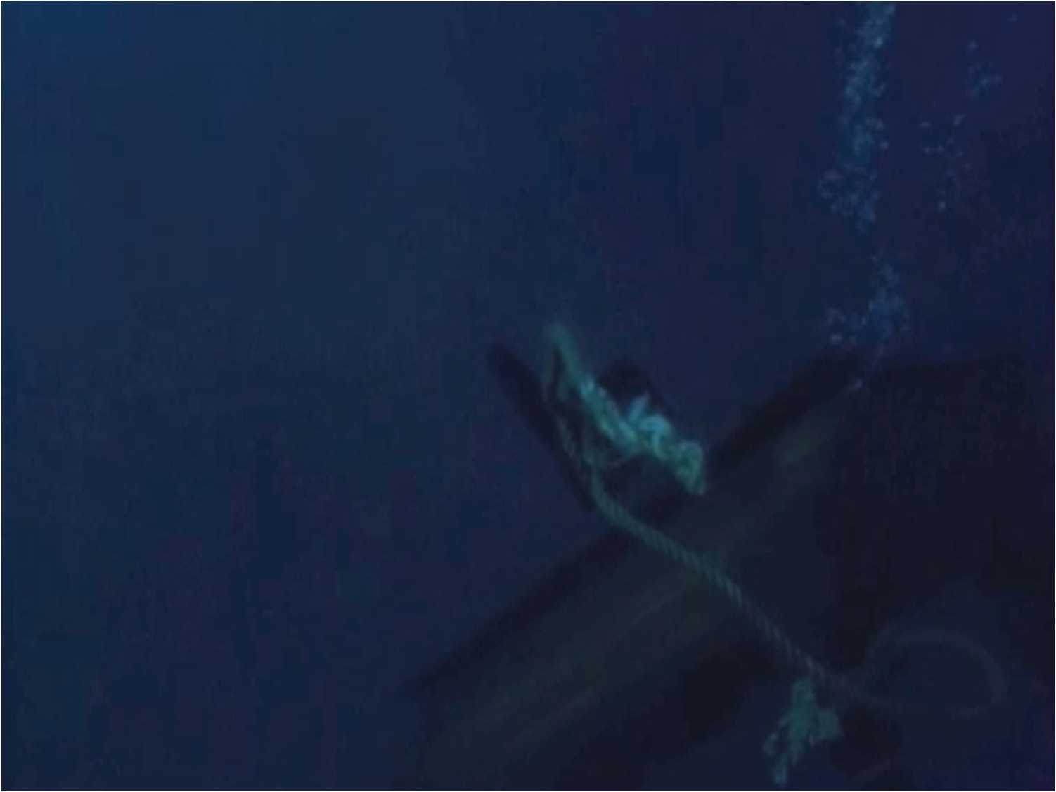
Close-Up of Ada Underwater
Changes in Expression
  Again the close-up format of this shot allows the viewer to observe the subtleties of Ada’s expression. One can see the look of consternation wash over her as she realizes the err in her decision.
Use of slow motion
  The use of slow motion here both heightens the drama of the moment and emphasizes the change in Ada. In slow motion, her life is about to end, but when she realizes her mistake, time comes back up to speed and the struggle begins.

Slide 18
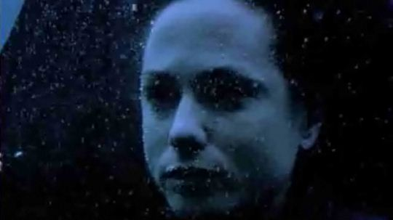
Close-Up of Ada Underwater
[Click image or blue dot to play clip]

Slide 19
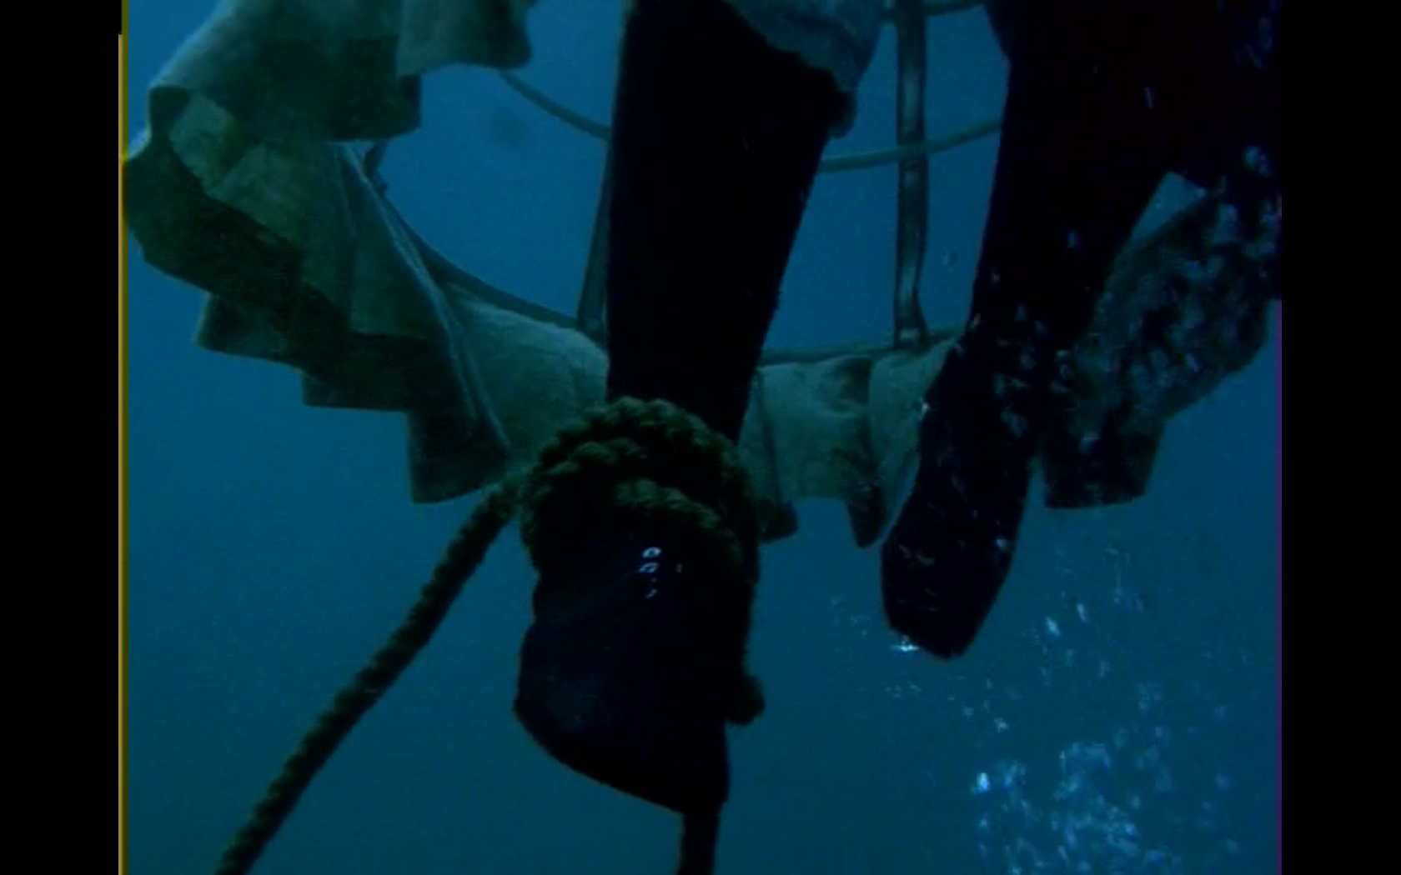
Ada’s Imprisonment
This shot is particularly interesting because the medium close-up of Ada’s bound foot is edged by the bars of her hoop skirt, which in addition to the more obvious rope around her ankle signify the imprisonment that she subjected herself to in going overboard with the piano.

Slide 20
Tilt to Follow Piano
Tilt
  Here the camera follows the piano down, rather than following Ada up. This works well in conjunction with the narration at the end of the scene.
Lighting
  The piano sinks into the void, just as Ada would have had she not escaped.
Focus
  As the piano drifts into said void, it starts to go out of focus.

Slide 21
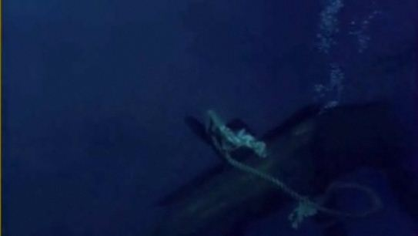
Tilt to Follow Piano
[Click image or blue dot to play clip]

Slide 22
Slow Motion Rise from the Depths
Necessity of Slow Motion
  The fact that this shot is in slow motion really emphasizes the struggle for life and brings to the scene an element of realism.

Slide 23
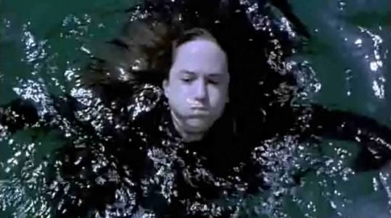
Slow Motion Rise from the Depths
[Click image or blue dot to play clip]

Slide 24
Narration in Slow Motion
Slow Motion
  This shot also being in slow motion continues the drama from the shot just before it. The same sort of realism and single-pointed simplicity serve to sear the scene into the viewer’s mind.
Narration
  Although not directly related to cinematography, it is worth noting that the pace of the narration is slowed to match the pace of the shot and add to the deliberate force of it all.

Slide 25
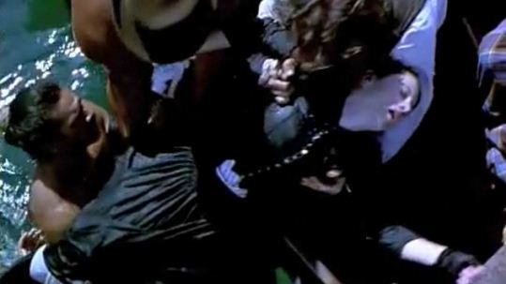
Narration in Slow Motion
[Click image or blue dot to play clip]

Slide 26
Narration
“What a death. What a chance. What a surprise. My will has chosen life. Still, it has had me spooked, and many others besides.”
  Ada attributes her inability to speak on her will as well. She is by no means weak-willed, and perhaps that strength relies on her disseverance from her will. She can’t control it, she can only defer to it.

