Slide 1
Editing in Marianne and Juliane
Jonathan Armoza, Andrew Pritzkau, and Tracey Hale

Slide 2
Argument
Through aspects of editing such as flashbacks, graphic, rhythmic and spatial editing, Von Trotta develops the characters Marianne and Juliane and establishes the dynamics of the personal relationship between the two. Through these techniques the film insists upon Juliane’s experiences more so than the political context of the time.

Slide 3
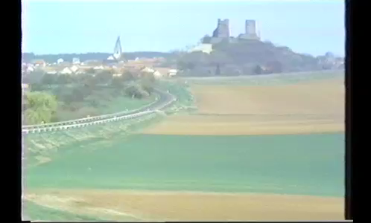
Scene

Slide 4
Graphic and Spatial Editing
“[Graphic editing] may be considered purely as graphic configurations, as patterns of light and dark, line and shape, volumes and depths, movement and stasis – independent of the shots’ relation to the time and space of the story” (Bordell and Thompson, p. 225)
“[Spatial] editing permits the filmmaker to juxtapose any two points in space and thus imply some kind of relationship between them” (Bordwell and Thompson, p. 231)
  Outside vs. inside lighting, wide open vs. confined spaces – proves contrast
  Graphic matches – allows audience to visually connect two images and their meanings
  Each shot juxtaposed with another in order to create the illusion of space – plays a large part in the prison sequences

Slide 5
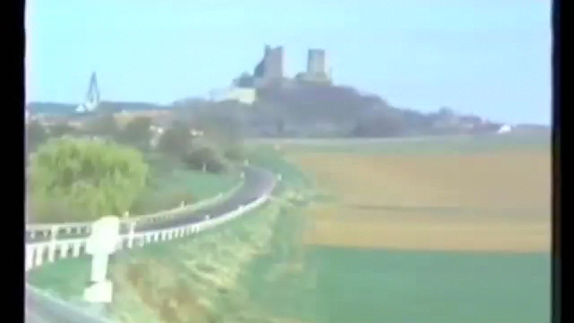
Contrasting Graphic Shots

Slide 6
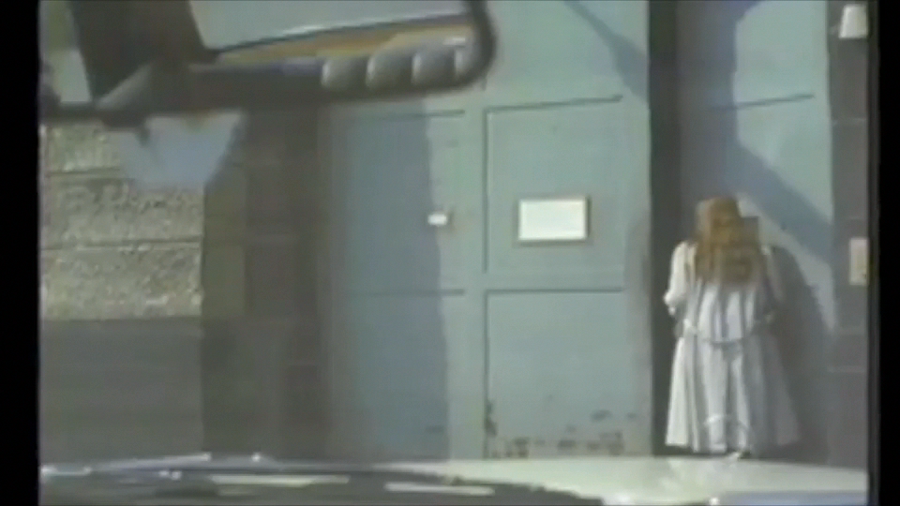
Spatial Constructions

Slide 7
Flashbacks
“Manipulation of events leads to changes in story plot relations. We are most familiar with such manipulations in flashbacks which present one or more shots of their presumed story out of order” (Bordwell and Thompson)
    The entire film is Juliane’s flashback – throughout the film flashbacks focus on Juliane and Marianne’s relationship
    Contrasting present day and past relationships
    Robs the story line of a smooth flow – temporal discontinuity
    Using flashbacks the director is able to compare two different shots in order to make a point

Slide 8
The Strip Search
Rhythmic Editing
  Longer shots of female prison guard searching, quick shots of Juliane’s expression in a close up
    Juliane’s expression is seemingly accustomed though humiliated
    We see this in her sister’s expression as well throughout the film
  The strip search is Juliane’s experience of what Marianne is going through – what they share
  In the rest of the scene any cut made is between long shots – In the search the cuts are quick and the shots are short
  The quick cuts and the emphasis on facial expression call attention to this experience
    We see exactly what Juliane is experiencing and how she feels about it
    This is purposefully done in order to build Juliane as a character and show the audience how invasive the prison is

Slide 9
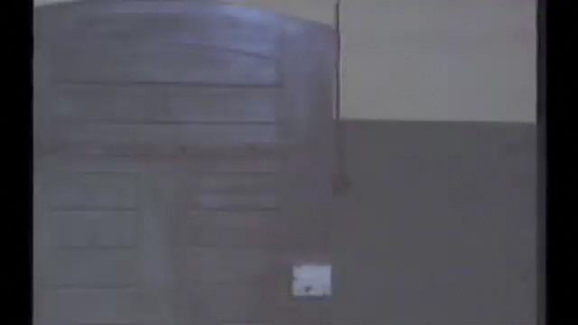
Clip

Slide 10
The Flashback
Fade-in to Juliane’s POV
  Prison courtyard and wall recalls childhood
  The prison reminds Juliane of childhood – the home being a prison
Marianne and Juliane playing
  Inseparable, holding hands, falling down together, etc.
  When film cuts back to present day, Marianne refuses to see Juliane
Walking upstairs
  Lighting is bright
  When film cuts back to present day, prison is dark
Image of Christ
  Cuts to image of Juliane in relatively same position in a dark room
  Connection between two visuals
Abrupt transition back to prison
  Music cuts out

Slide 11
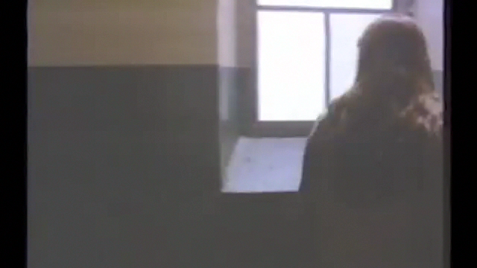
Clip

Slide 12
Conclusion
The editing aspects analyzed in this scene function as a microcosm of the film as a whole
Von Trotta’s insistence on highlighting personal and seemingly mundane moments creates a character study of the two women rather than an event driven plot

Slide 13
Ende

