Slide 1
Looking at Danzón
Gaze, Gender and Genre

Slide 2
Psychoanalytic Models of Development
Mulvey drawing upon Freudian and Lacanian models of psychosexual development, both of which posit the male’s recognition of sexual difference and concomitant identification with the father (Freud) or “Name of the Father” (Lacan) as key stage
Oedipus complex and castration anxiety part of movement away from the mother toward the father or the symbolic order

Slide 3
Cinema and the Pleasures of Scopophilia
Cinema engaging both voyeuristic and narcissistic aspects of looking
Erotically pleasurable looking via “voyeuristic separation” from figures on screen (74/307).
Narcissistic looking via identification with ego-ideal of figure on screen (typically main male performer)

Slide 4
Gendered Looking Relations
Cinematic codes→looking relations structured around gender imbalance
“In a world ordered by sexual imbalance, pleasure in looking has been split between active/male and passive/female” (75/309).
“Traditionally, the woman displayed [on screen] has functioned on two levels: as erotic object for the characters within the screen story, and as erotic object for the spectator within the auditorium . . .” (75/309).
Consequently, male as “narrative,” with actions moving story forward and female as “spectacle,” with body halting narrative

Slide 5
Cinema and the (Un)Pleasure of Scopophilia
However, looking at female image on screen can prove threatening (via raising castration threat) as well as sexually stimulating.
“But, in psychoanalytic terms, the female figure poses a deeper problem. She also connotes something that the look continually circles around but disavows: her lack of a penis, implying a threat of castration and hence unpleasure” (76/311).

Slide 6
Assuaging the Threat
Screen female investigated and demystified
Woman controlled, punished or forgiven
Female figure displaced by or transformed into a fetish object
Sadistic Voyeurism
Fetishitic Scopophilia

Slide 7
Working Outside the Dominant Paradigm
What constitutes the female gaze?
Reversal of terms, with active female looking and passive male body fetishized or punished?
Depiction of actively gazing female without male object?
Subversion or elimination of cinematic techniques typically deployed to objectify the female body?
Depiction of women returning or desiring a male gaze?
Something else?

Slide 8
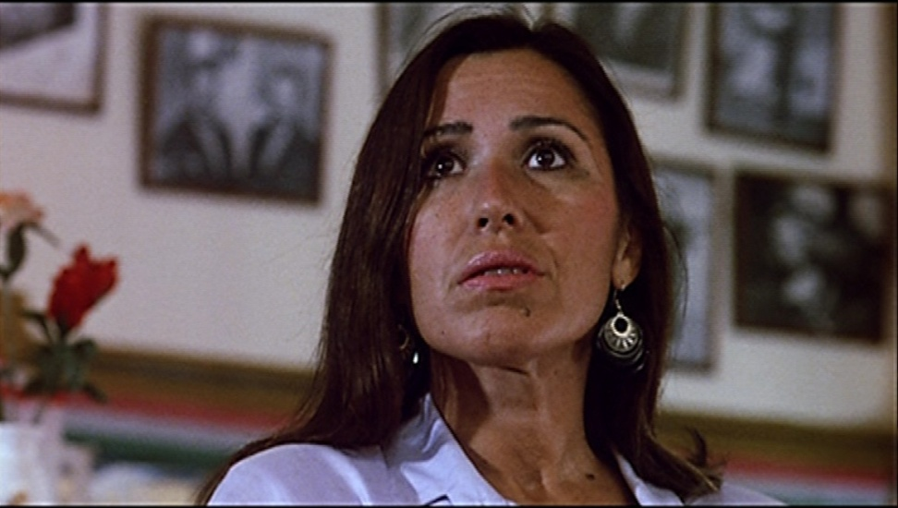
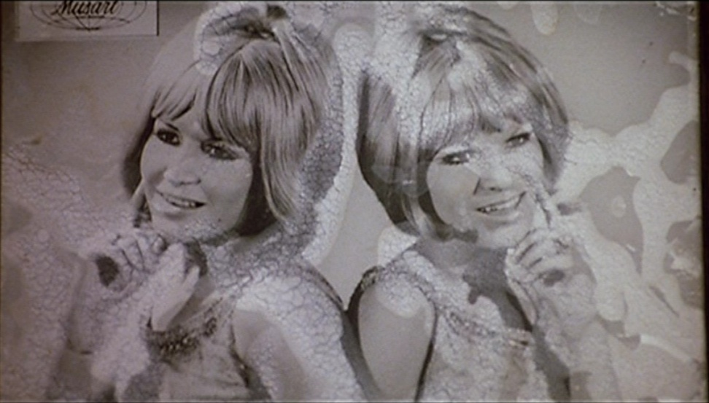
The Gaze in Danzón
Does the film undercut dominant looking relations? How so or why not?
Does Danzón construct a female gaze? How so or why not?
Screen shots from Danzón (1991)

Slide 9
The “Golden Age” of Mexican Cinema: Melodrama and the Female
Early 1930s to 1960s
Included emotive musical performances
Two trends: family melodrama and epic melodrama
Ana López (“Tears and Desire”): “The melodrama always addresses questions of individual (gendered) identity within a patriarchal culture and at the heart of the definition of Mexico as a nation”
Settings: Home and nightclub
Conflicts around shift from old to modern values and resulting gendered identity crises

Slide 10
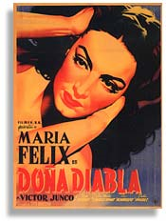
Melodrama Character Types
Saintly, suffering mother whose desire is repressed/channeled into caretaking; rigid father
Independent mala mujer—mistress or bad mother who’s sexual desirous and desiring
Subgenres
Fallen and redeemed mother
Cabaretera (cabaret, nightclub) films with entertainer and prostitute characters
Image source: San Diego Latino Film Festival

Slide 11
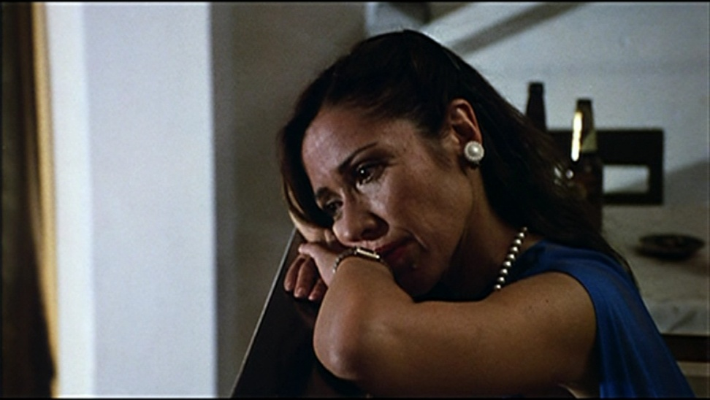
Danzón and Melodrama
What elements does the film borrow from melodrama?
How does it rework the genre?
“While Danzón clearly draws on these classic, woman-centered melodramatic genres, it does so obliquely. . . . Novaro simply captures an atmosphere and a style, discarding the framework of overarching moral conflict” (Rashkin 84/176).

