Slide 1
Introducing Margarethe von Trotta
The Personal is Political

Slide 2
Biography
Born 1942 in Berlin; moved to Dusseldorf at war’s end
Raised by mother, Elisabeth von Trotta, with only occasional visits from father, painter Alfred Roloff, who died when she was ten
Childhood included stint at Protestant boarding school, where von Trotta rebelled against repressiveness of rules, and experiences of being cared for by authoritarian elderly people at boarding houses where mother rented room

Slide 3
Education
Attended commercial school and worked in office before deciding to study art history
Semester at Sorbonne→interest in filmmaking, discovery of French New Wave and other European art cinema (Bergman, Antonioni)
Political awareness also began to develop in Paris
Return to Germany→few job prospects for women filmmakers or art historians; turned to German studies, Romance languages and literature and drama

Slide 4
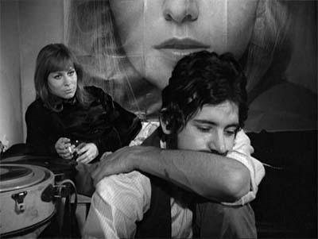
Career as Actor
Began getting stage roles in 1963
Actor with goal of becoming film director
Cast in first movie role in 1968(Schräge Vögel)
Career as actor and director concomitant with rise of social and political protest movements, women’s movement and New German Cinema
Worked in films by Fassbinder, Hauff, Achternbusch and Schlöndorff
Still from Gods of the Plague (Fassbinder, 1970).
Image source: Home Cinema @ The Digital Fix

Slide 5
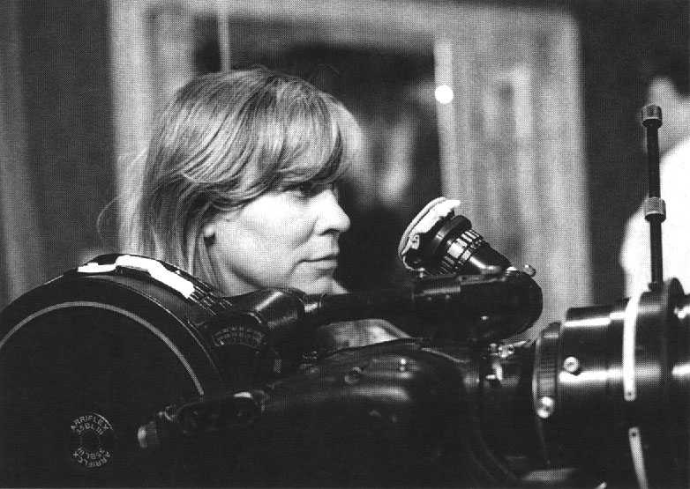
Career as Director
Began working as writer and assistant director for Volker Schlöndorff in 1970 (married him in 1971)
Co-directed The Lost Honor of Katharina Blum (1975)
First solo feature: The Second Awakening of Christa Klages (1978)
Other films include Sisters, or the Balance of Happiness (1979), Marianne and Juliane (1981), Sheer Madness (1983), Rosa Luxemburg (1986), The African Woman (1990), Rosenstrasse (2003)
Films noted for subverting traditional image of woman, motif of doubles/mirror images, theme of role switching, house or public sphere as prison, portrayal of relationship between events and interior state of mind, difficulty of heterosexual couplings
Image source: University of Glasgow Advanced Technology & Information Institute

Slide 6
Protest Movements of 1960s
Post-WWII generation’s disillusionment and suspicion re: their parent’s generation
In 1966, German Chancellor Kurt Georg Kiesinger was former member of Hitler’s National Socialist German Workers Party (NSDAP)
Universities as overwhelmingly conservative, both in terms of faculty and curriculum
Student protest movements in the late 1960s
Anti-Vietnam war and wanting to address conditions in the Third World
Curriculum reformation
Desire for more democratic society
Reduction of biased conservative media influence
Other political activism/issues during period
Focus on repression and inequality that exist even in modern capitalist democratic states (Marxist critiques of class division within capitalist societies)
Implication of media’s role in state’s ideological indoctrination of peoples
Woman’s liberation
Racial freedom
Anti-imperialism
Key protests:
June 1967 protest of Shah’s visit
1968 “Easter Riots” after shooting of student activist leader Rudi Dutschke

Slide 7
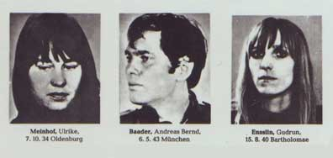
RAF (Red Army Faction, Baader-Meinhof Gang)
Image source: BBC
Formed 1970
Kidnapping of prominent officials, highjackings
Alignment with African and Palestinian groups
Gudrun Ensslin’s (Marianne) participation in Frankfurt department store fires
Arrested April 1968, serves a year before release on appeal
Escapes to France when appeal is denied
Arrested again in 1972 and convicted
Dies by hanging in Stammheim Prison October 18, 1977 (along with 2 other B-M gang members in the same prison, who were shot in their cells)

