Slide 1
Introducing Agnès Varda

Slide 2
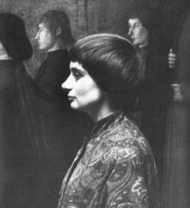
Biography
Born 1928 in Brussels
Studied photography and art history at Ecole du Louvre
Worked as photographer for Théâtre National Populaire
Currently installation artist and photographer as well as filmmaker
Image source: Senses of Cinema

Slide 3
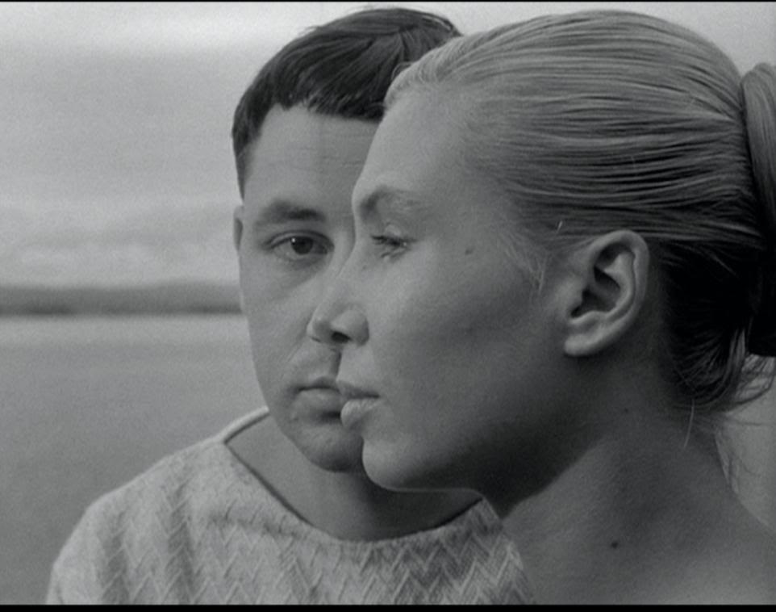
“Mother” of the French New Wave
La Pointe Courte (1954)
Made by Varda’s own production company, Ciné-Tamaris, without Varda undergoing apprenticeship and credentialing process dictated by French film industry
Narrative structure from Faulkner’s The Wild Palms
Focused on neighborhood in city of Sète, in which she had lived as teenager
Viewed as precursor to French New Wave films in blend of documentary and fiction, mixture of neorealist aesthetics and high cultural artifacts, and self-reflexivity
Still from La Pointe Courte (1954).
Image source: Criterion Collection Database

Slide 4
Selected Filmography
Documentary/Autobiography
L'Opera-Mouffe (1958)
The Gleaners and I (2000)
Fiction
Cléo de 5 à 7 (1961)
Le Bonheur (1964)
One Sings, The Other Doesn’t (1976)
Vagabond (1985)
Kung Fu Master (1987)
Experimental
Lion’s Love (1969)
Varda working across (and integrating) multiple cinematic genres

Slide 5
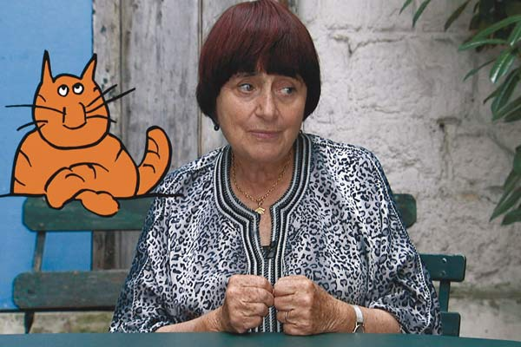
Varda’s Cinécriture
Literally “cinematic writing”
Interest in filmic writing placing Varda within Left Bank group of filmmakers, but her vision distinct
For Varda, cinécriture involves composition of screenplay, cast, location, camera position and movement, editing rhythm, and sound to create specific meanings
Image source: Reverseblog

Slide 6
Varda on Cinécriture
“A well written film is also well filmed, the actors are well chosen, so are the locations. The cutting, the movement, the points-of-view, the rhythm of filming and editing have been felt and considered in the way a writer chooses the depth of meaning of sentences, the type of words, number of adverbs, paragraphs, asides, chapters which advance the story or break its flow, etc. In writing it’s called style. In the cinema style is cinécriture” (qtd. in Alison Smith, Agnès Varda, 14).

