Slide 1
Introducing Kimberly Peirce

Slide 2
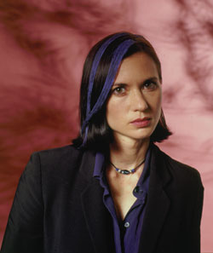
Biography
Born 1967
B.A. in English and Japanese Literature from University of Chicago
Photographer, model and English teacher in Japan and Southeast Asia
M.F.A. Columbia Film School
Image source: MovieMaker Magazine

Slide 3
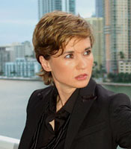
Genesis of Boys Don’t Cry
Originated as Columbia thesis project
Peirce switched from original story of female Civil War spy masquerading as man
Traveled to Falls City with transsexual group and attended murder trials
Made short film at Columbia in 1995
Developed into feature with producer Christine Vachon
Project workshopped at Sundance Filmmakers, Writers and Producers Lab in 1997
Image source: Auburn Moon Agency

Slide 4
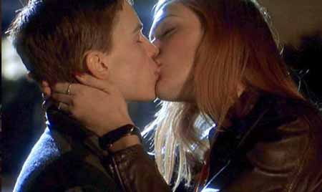
Socially Aware Filmmaking
Peirce on Boys Don’t Cry:
“The last thing I wanted was to duplicate the violence without understanding it. I had to make the violence personal. Once I started understanding the folklore of the society as it was being told to me by the cops and the kids of Falls City, I could get the audience to empathize.”
Still from Boys Don’t Cry (1999).
Image source: Bright Lights Film Journal.

Slide 5
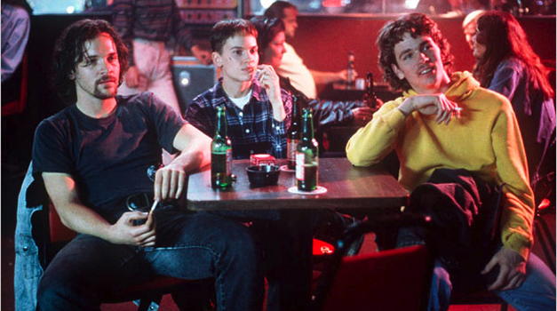
Filmography
The Last Good Breath (1994; experimental short)
Boys Don’t Cry (1999)
Stop-Loss (2008)
Associated Sound-Off website features films made by soldiers with cameras Peirce’s team distributed
Still from Boys Don’t Cry (1999). Image source: SBS

