Slide 1
Introducing María Novaro

Slide 2
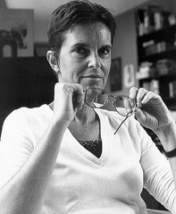
Novaro: Early Career
Born 1951
Studied sociology at National Autonomous University of Mexico in mid 1970s
Involvement with Cine-Mujer (1979-1981) leads to study at Centro Universitario de Estudios Cinematográficos from 1980-1985
Made shorts films while at school
Worked as sound mixer and cinematographer, then assistant director to Alberto Cortés (Love Around the Corner, 1985)
First feature, Lola (1989), focusing on neglectful, street-vendor single mother
Image source: Course Blog for Feminist Film/Media Studies

Slide 3
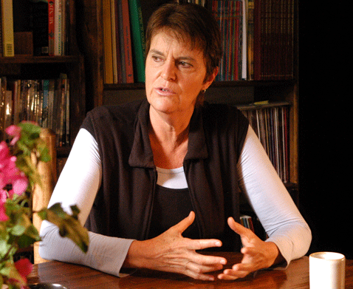
Women in the Mexican Film Industry, 1970s-1980s
Colectivo Cine-Mujer forms in 1975 (disbands 1986)
Two main film schools, Centro Universitario de Estudios Cinematográficos (CUEC) and the Centro de Capacitación Cinematográfica (CCC) receive increased funding, admit more female students and allow independent film production
Film unions, which had restrictive rules regarding female participation, declined in influence as President Luís Echeverría Alvarez (1970-76) restructured film industry
Image source: Juarez

Slide 4
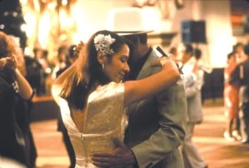
Danzón (1991)
Premiered at Cannes Director’s Fortnight (1991)
Festival awards for film and Novaro
Profitable art-house film distributed internationally
Look for: Elements of mise-en-scène
Image source: Movie Maker

Slide 5
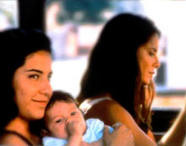
Other Feature Films
El Jardín del Edén (1994)
Sin Dejar Huella (2000)
Las Buenas Yerbas (2010)
Focus on borderlands and women “on the margins”
Still from Sin Dejar Huella (2000). Image source: FilmInc

