Slide 1
Introducing Márta Mészáros
Autobiography,
Film, and Politics

Slide 2
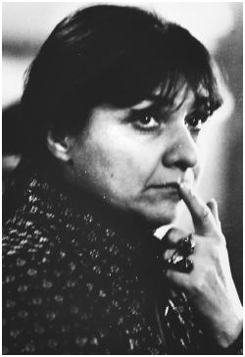
Early Life
Born 1931 in Budapest, Hungary
Emigrated to USSR in 1936 with painter mother and father, sculptor László Mészáros
Father arrested and imprisoned in 1938 purge
Mother died of typhoid
Returned to Hungary in 1946
Studied film at Moscow’s Russian State Institute for Cinematography (VGIK) in mid 1950s, as no woman yet enrolled in Hungarian film school
Image source: Film Reference

Slide 3
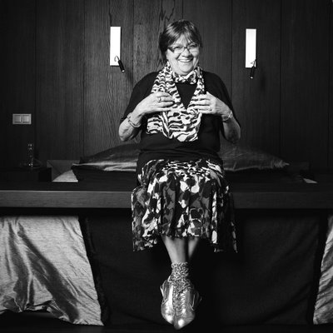
Early Career
Assistant at Studio Budapest, producer of newsreels, 1954
Directed documentaries at studios in both Hungary (1965-1956, 1959-1968) and Romania (1957-1959)
Joined Mafilm 4 Group film unit in 1966
Begins directing fiction feature films in 1968
The Girl (Eltávozott nap,1968) is first feature in Hungarian film history made by woman
Image source: Zobacz Wiecej Foto Enh 2009

Slide 4
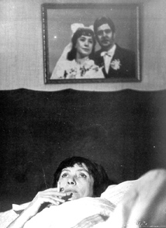
Partial Filmography
Riddance (1973)
Adoption (1975)
Just Like at Home (1978)
Diary for My Children (1982)
Diary for My Loves (1987)
Bye-Bye, Red Riding Hood (1988)
Diary for My Parents (1990)
Little Vilma: The Last Diary (1999)
The Unburied Man (2004)
Still from Adoption. Image source: Senses of Cinema

Slide 5
Tension with Western Feminist Film Theory
Mészáros resisting categorization of “feminist,” despite films’ empathetic focus on female protagonists’ experience and point of view
"I tell banal, commonplace stories, and then in them the leads are women—I portray things from a woman's angle."
“I don’t want to make speeches about women’s emancipation, because I’m not part of that movement, but [filmmaking by women] represents a different kind of sensitivity. If you interpret my films as strictly political, you see that I approach power relations differently from the way they are portrayed by male directors” (Portuges, Screen Memories, 9)
Views political and historical content and focus on individual lived experience as primary

Slide 6
Political Context: Communism in Hungary
1919: Brief communist revolution and Hungarian Soviet Republic under Béla Kun
11/1919: Counterrevolutionary forces under command of Miklós Horthy seize control of government
1920: Horthy becomes Regent and Head of State (until 1944)

Slide 7
Political Context, Cont’d
1945: Provisional government (American/Soviet/British)
11/1945: Elections, with independent Smallholders Party dominating
1947-1948: Hungarian Communist Party gaining control of government (Mátyás Rákosi head of party)
1948: Social Democratic Party merges with Hungarian Communist Party to become Hungarian Worker’s Party

Slide 8
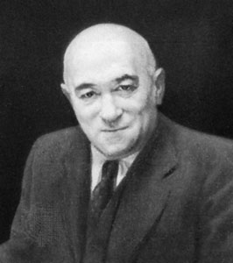
Political Context, Cont’d
Rákosi purging intellectuals and other critics (2,000 executed, 100,000 imprisoned 1948-56)
Rákosi replaced as Prime Minister by Imre Nagy in 1953
Image source: History Learning Site

Slide 9
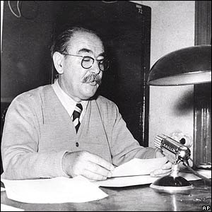
Political Context, Cont’d
Nagy instituting political and cultural reform; removed as Prime Minister in 1955
1956: Nagy reinstated as PM
1956: Uprising against government and Soviet suppression of uprising
1958: Nagy executed on charges of treason
Image source: BBC News

Slide 10
Class Questions: Additional Resources
Communism, Nazism and Fascism
Professor Brad DeLong’s “Alternatives to Capitalism and Democracy” page outlines the major tenets and compares Nazism and Fascism
Josip Broz Tito, leader of Yugoslavia, 1943-1980
Professor Charles Evans provides background on Tito’s break with Stalin and links to articles on the split, like this one from a 1949 issue of TIME
Hungarian political history, post uprising
PBS has a succinct timeline

