Slide 1
Introducing Clara Law

Slide 2
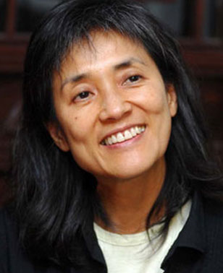
Biography
Born 1957 in Macau
Moved to Hong Kong in 1967
Earned English Literature degree from University of Hong Kong
Took job with Radio Television Hong Kong in 1978
Producing
Screenwriting
Directing
Moved to England 1982-1985 to study directing and writing at National Film and Television School
Emigrated to Australia in 1995
Image source: Asian Media Wiki

Slide 3
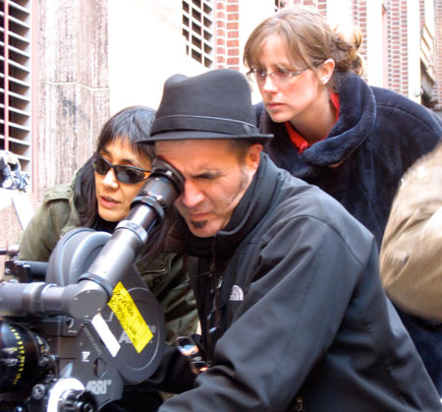
Law and Film Movements
“Second Wave” Hong Kong director (mid 1980s-1990s)
Exploration of contemporary social issues
Awareness of history and its connection to identity
Exploration of Hong Kong’s identity as a place and a people
Aesthetic innovation (lush visuals, quick editing, urban setting)
Law on set of Like a Dream (2009).
Image source: Persona Films

Slide 4
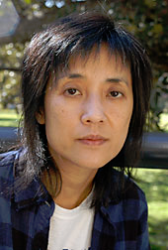
Filmography
Red Earth (2010)
Like a Dream | Ru Meng (2009)
Letters to Ali (2004)
The Goddess of 1967 (2000)
Floating Life (1996)
The Great Emperor’s Concubine | Xi chu bawang (1994)
“Wonton Soup” segment of Erotique (1994)
Temptation of a Monk | You Seng (1993)
Autumn Moon | Qiu yue (1992)
Fruit Punch | Yes! yi zu (1991)
Farewell China | Ai zai bie xiang de ji jie (1990)
The Reincarnation of Golden Lotus | Pan Jin Lian zhi qian shi jin sheng (1989)
The Other ½ & the Other ½ | Wo ai tai kong ren (1988)
They Say the Moon Is Fuller Here (1985)
Image source:
World Socialist Web Site

Slide 5
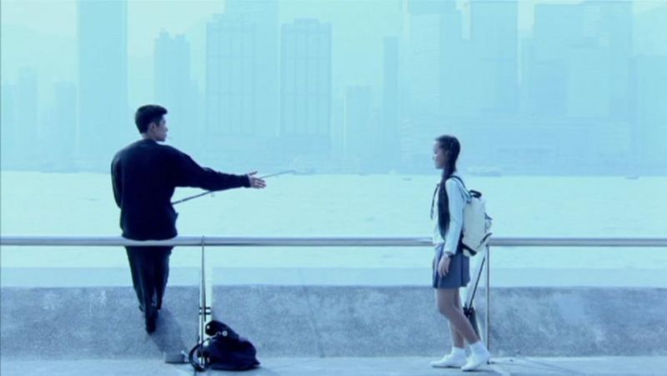
Thematic Concerns
Question of cultural identity
Migration and diaspora
Cross cultural encounters
Relationship between self and other
Status of refugees
Still from Autumn Moon (1992).
Image source: Queensland National Gallery

