Slide 1
Introducing Cheryl Dunye
Exploring the “Dunyementary”

Slide 2
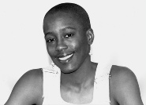
Education
Born in Liberia 1966
Raised in Philadelphia
Introduction to feminist theory in college influenced Dunye’s use of visual media to explore issues of interest
Earned BA from Temple University in 1990
Earned MFA from Rutgers University in 1992
Has taught film and media studies at multiple institutions, including Temple, UCLA, CalArts
Image source: CherylDunye.com

Slide 3
Experimental shorts to Features
Janine (1990)
She Don’t Fade (1991)
Vanilla Sex (1992)
Untitled Portrait (1993)
The Potluck and the Passion (1993)
Greetings From Africa (1994)
The Watermelon Woman (1996)
Stranger Inside (2000)
My Baby’s Daddy (2004)
The Owls (2010)
Still from The Watermelon Woman (1996). Image source: CinemaQueer

Slide 4
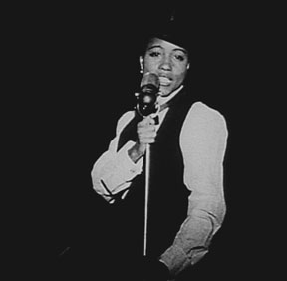
The “Dunyementary”: Elements
Talking-head monologue
Person-on-the street interviews
Confessional scenes
Metanarrative
Archival footage
Mix of real and pseudo-history (photos, texts, posters, other artifacts)
Vignettes
Screen shot of historical photo from
The Watermelon Woman (1996).
Image source: Jump Cut

Slide 5
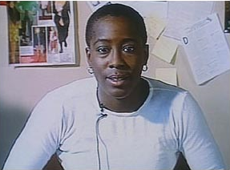
The “Dunyementary”: Purpose
To provide commentary on events/issues depicted in the film
To convey to the audience a character’s point of view
To emphasize the importance of social issues the film addresses
To blur boundaries between art and life, autobiography and documentary, film and genre, self and genre
Dunye as “Cheryl” in The Watermelon Woman (1996).
Image source: University of Michigan, Lesbian History

Slide 6
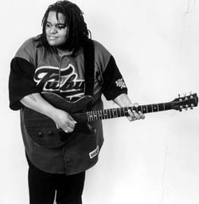
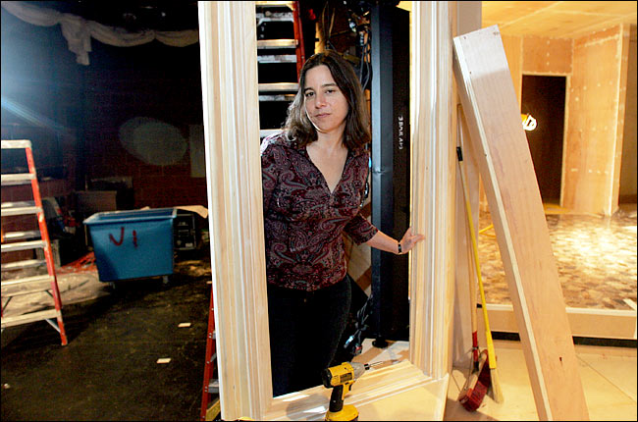
The Watermelon Woman: Selected Cast and Cameos
Toshi Reagon
Role: Street Performer
Lesbian Singer and Songwriter
Image Source: Vancouver Folk Music Festival
Sarah Schulman
Role: C.L.I.T. Archivist
Lesbian Novelist, Playwright and Teacher
Image Source: New York Times

Slide 7
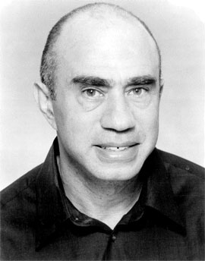
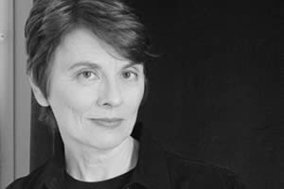
The Watermelon Woman: Selected Cast and Cameos
Brian Freeman
Role: Lee Edwards
Gay Playwright, Poet, Actor, Director and Co-founder of Pomo Afro Homos
Image Source: San Francisco International Arts Festival
Camille Paglia
Role: Herself
Lesbian Author, Teacher and Cultural Critic
Image Source: Bright Lights Film Journal

Slide 8
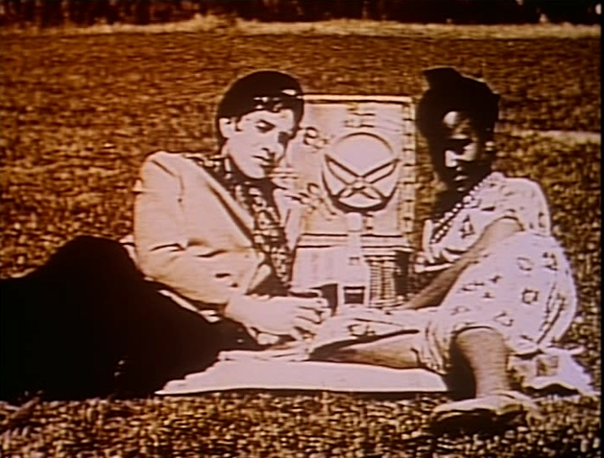
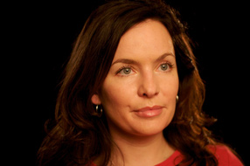
The Watermelon Woman: Selected Cast and Cameos
Alexandra Juhasz
Role: Martha Page
Lesbian Producer, Director, Author and Teacher
Guinevere Turner
Role: Diana
Lesbian Actress, Screenwriter and Producer
Star and Co-writer of Go Fish (1994)
Image Source: IFC

Slide 9
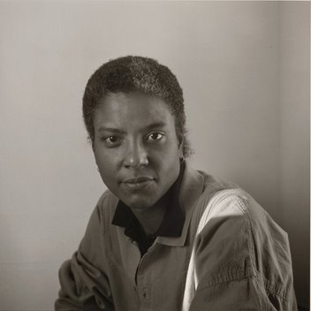
The Watermelon Woman: Selected Cast and Cameos
Cheryl Clarke
Role: June
Lesbian Poet, Non-fiction Author and Teacher
Image Source: Women Among Us

Slide 10
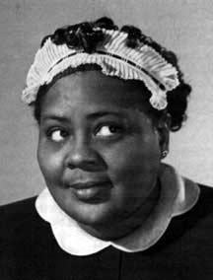
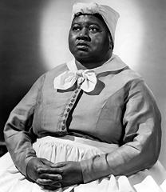
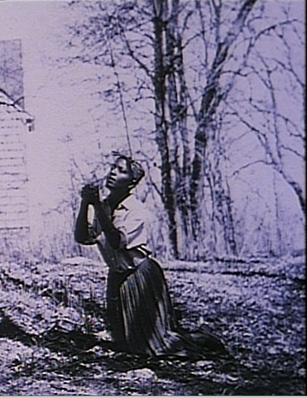
Images: Real and Reel
Louise Beavers
Image Source: Silent Ladies & Gents
Hattie McDaniel
Image Source: University of Georgia Libraries
Screen Shot: The Watermelon Woman

Slide 11
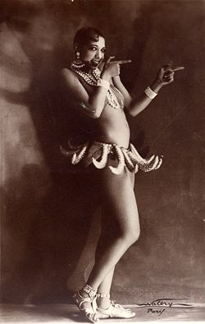
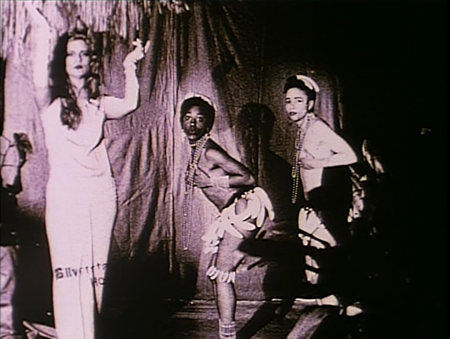
Images: Real and Reel
Josephine Baker
Image Source: Harlem World
Screen Shot: The Watermelon Woman

Slide 12
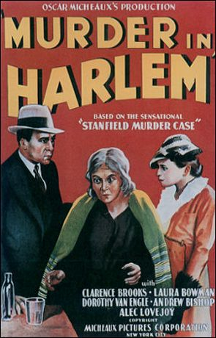
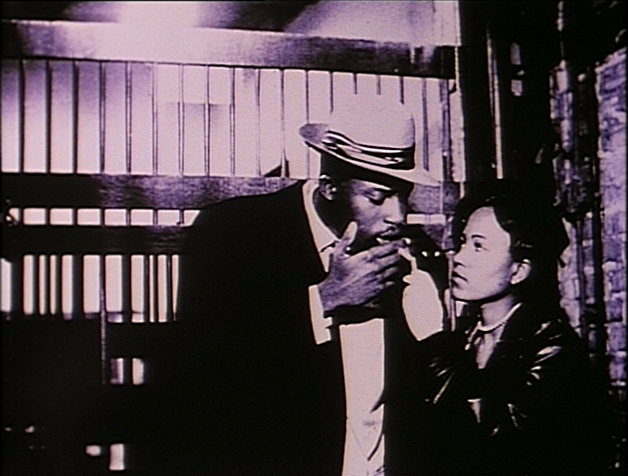
Images: Real and Reel
Poster for Murder in Harlem (Micheaux, 1935)
Image Source: Black Film Center Archives
Screen Shot: The Watermelon Woman

Slide 13
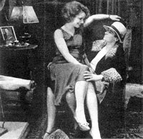
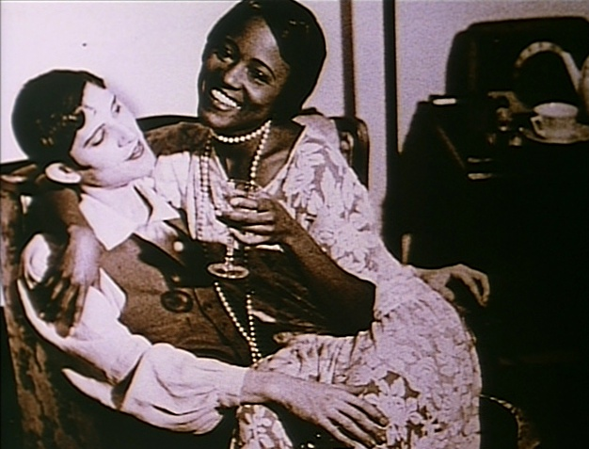
Images: Real and Reel
Dorothy Arzner and Clara Bow on the set of The Wild Party (1929)
Image Source: Photobucket
Screen Shot: The Watermelon Woman

Slide 14
Discussion Questions
K. McHugh writes about The Watermelon Woman as experimental autobiography. Do you agree that the film is an autobiography? Why or why not?
What is the film’s commentary on media, history and identity?
Why does the film interweave video, archival footage, home movies, still photos, and filmed vignettes?
Both Kathleen McHugh and Laura Sullivan argue that The Watermelon Woman avoids essentializing lesbian identity. Do you agree? Why or why not?
What gazes does this film construct and deconstruct?

Slide 15
Additional resources
On Representation of African Americans in Hollywood Film
Donald Bogle: Toms, Coons, Mulattoes, Mammies & Bucks: An Interpretive History of Blacks in American Film (Google Books preview)
Jump Cut: “The Mammy in Hollywood Film”
NPR Podcast: Judging African American Legacy in Film
Marlon Riggs: Ethnic Notions
On African American Filmmakers
FilmReference: African American Cinema
Indiana University Black Film Center/Archive: Race Movies

