Slide 1
Introducing Sofia Coppola

Slide 2
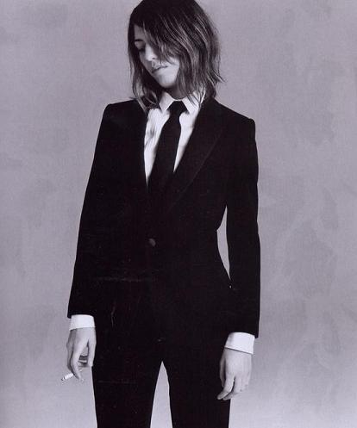
Biography
Born 1971 to director Francis Ford Coppola and designer/artist/documentarian Eleanor Coppola
Appeared in Francis Ford Coppola’s Godfather trilogy (1972/1974/1990), Rumble Fish (1983), The Outsiders (1983), The Cotton Club (1984), and Peggy Sue Got Married (1986), as well as films by other directors (Inside Monkey Zetterland, 1992)
Modeled for Marc Jacobs and interned at Chanel during high school
Image source: Listal

Slide 3
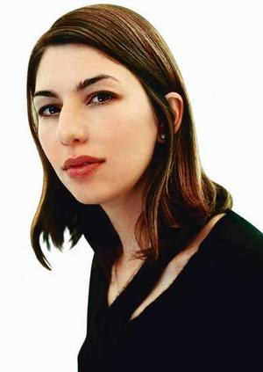
Education and Early Career
Enrolled and dropped out of two colleges, including California Institute of the Arts, where studied painting
Worked as fashion photographer
Designed MilkFed clothing line and sold at own stores, Heaven-27
Image source: Viva Cinema

Slide 4
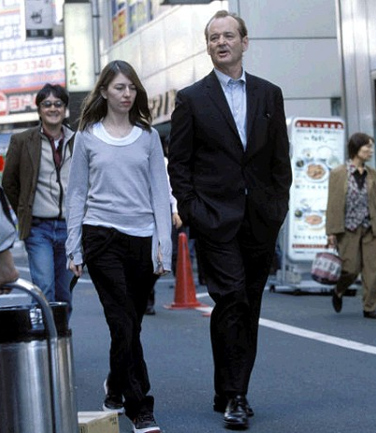
Filmography
Co-writer
Life Without Zoe (1989; Francis Ford Coppola’s segment of New York Stories)
Director and Writer
Lick the Star (1998; short)
The Virgin Suicides (1999)
Lost in Translation (2003)
First American woman nominated for Best Director Academy Award
Marie Antoinette (2006)
Coppola and Bill Murray on set of Lost in Translation (2003). Image source: IGN Movies

Slide 5
Thematic and Stylistic Hallmarks
Thematic
Stylistic
Alienation
Characters in transition
Rites of passage
Social/cultural and personal ritual
Emphasis on visuals over dialogue
Eschewing of traditional narrative arc
Modern soundtrack
Slowly moving camera
Rich mise-en-scene

