Slide 1
Introducing Jane Campion
The Anthropological Meets the Artistic

Slide 2
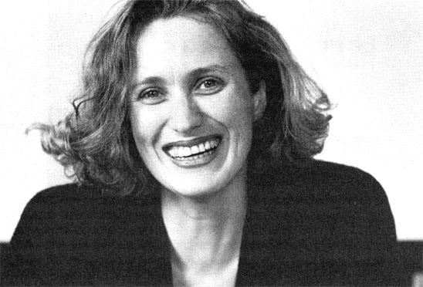
Biography
Born 1954 in Wellington, New Zealand
Parents Richard Campion and Edith Hannah, prominent figures in NZ theater, attempted to build national theater and produce plays that articulated distinctly national aesthetic
Image source: Bombsite

Slide 3
Education
Studied anthropology at Victoria University, graduating with B.A. in 1975
Campion on anthropology:
What interested me about anthropology was to be able to ‘officially’ study what I was curious about anyway: how out thoughts function, their mythic content which has nothing to do with logic, human behaviors. . . . I think that humans believe themselves to be rational beings when they are not, they are governed by something completely different” (Wexman, qtd. in McHugh 5).
Enrolled at Sydney School of the Arts, receiving BA in painting in 1979
Campion viewed SSA program—which emphasized global art—as foundational for filmmaking vision
Created “story paintings,” images annotated with dialogue and text

Slide 4
Artistic Influences
Joseph Beuys, Sculptor (1921-86)
Socially and politically charged art which negotiated physical and psychological trauma through irrational, mythical imagery
Animal Woman (1949, cast 1984)
Image source: Tate Museum

Slide 5
Artistic Influences
Frida Kahlo, Painter (1907-1954)
Surrealistic self portraits
Both Beuys and Kahlo came to art after physical trauma (shot down Luftwaffe pilot, train accident) and used the body to interpret trauma
Both making recognizable elements strange
Kahlo’s powerful gaze and tragic romantic history as inspiration for Ada
The Broken Column (1944). Image source: Tate Museum

Slide 6
Kahlo and Ada
Screen shot from The Piano (1993)
Self-Portrait with Monkey (1940).
Image source: Tate ETC.

Slide 7
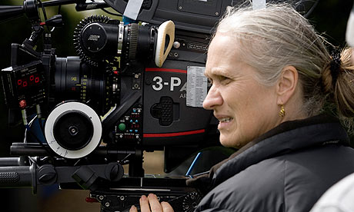
Short Films
Tissues (1981)
Enrolled in graduate school at Australian Film Television and Radio School (AFTRS)
Made four short films while student (1981-1984):
Mishaps: Seduction and Conquest (1981)
Peel: An Exercise in Discipline (1982; won Cannes Palme d’Or in 1986)
Passionless Moments (1983, cowritten and directed with novelist Gerald Lee)
A Girl’s Own Story (1984)
Image source: The Observer at guardian.co.uk

Slide 8
AFTRS and Australian Film Industry
Reduction in Hollywood output in 1960s making national and art cinemas viable alternatives
School inaugurated in 1972 as “part of the Commonwealth Government’s strategy to promote the development of Australia’s Cultural Activity” (McHugh 14) in 1970s and 1980s.
School’s desire to produce filmmakers with distinct, national aesthetic vision, whose work focused on Australian issues
But films had to be commercial enough to be popular at home and abroad
“New Australian Cinema”
Feminism informing endeavors→national cinema
Women’s Film Fund, Sydney Women’s Film Group, The Women’s Programme funded, provided workshops/training, distributed and exhibited women’s films
Campion finding AFTRS nationalist emphasis limiting; her vision dismissed by instructors
However, Campion met filmmaking collaborators at AFTRS
Cinematographer Sally Bongers (Peel, Girl’s Own Story and Sweetie, Campions’s first feature
Editor Veronika Haeussler, who has worked on almost all Campion features

Slide 9
Feature Films
Sweetie (1989)
An Angel at My Table (1990)
The Piano (1993)
The Portrait of a Lady (1996)
Holy Smoke (1999)
In the Cut (2003)
Bright Star (2009)
Television films/miniseries and anthology film segments
Campion on the set of The Piano.
Image source: National Portrait Gallery

Slide 10
Narrative, Thematic, Stylistic Commonalities
“[P]ower, violence and emotional pain in dysfunctional sexual, familial and social relationships” (McHugh 17-18).
Ways in which power and violence affect gender roles
“[C]inematic techniques that represent and blur the differences between objective and subjective narrative states” (McHugh 18).
Heterosexual romance “represented in the context of, and often dwarfed in importance by, relationships between siblings, parents and children, and friends” (McHugh 18).
Strong, reckless passions that can foment disaster or death
“[T]he importance of women’s work, their creative expression, and of sexual desire as a powerful, necessary, and compelling threat to that expression” (McHugh 18).

Slide 11
Campion on Ada
“I always saw her as someone who had very powerfully removed herself from life. . . . There is no sense of her as a handicapped person, however. It’s almost as though she treats the world as if it were handicapped. At the same time, there is a great deal of suffering from this position. It is a retreat from a lot of what the world offers, which I imagine for women at that time would have been very mundane and boring—insufferable, in fact. There is advantage in retreat, but there’s a great disadvantage in it as well” (Wexman 116)
Image source:
The Guardian at guardian.co.uk

