Slide 1
Beau Travail
The Military, Masculinity and Colonialism

Slide 2
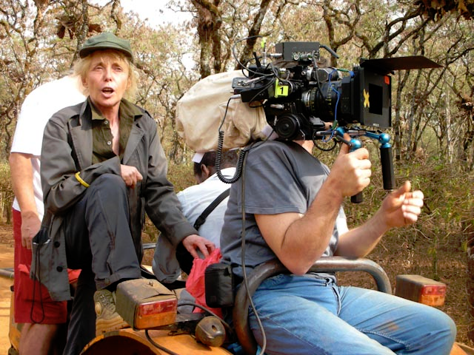
Denis Biography
Born in Paris (1948), but emigrated to Cameroon at 2 months due to father’s work with French Colonial Administration
Lived in Cameroon, Djibouti and Burkina Faso during era of struggle for independence
Returned to France at age 13 when contracted polio
Returned to West Africa at age 17 for schooling (Japanese, history, geography)
Image source:
Belgian Society of Cinematographers

Slide 3
Denis Education & Early Career
Intern at Télé-Niger
Entered Institut des Hautes Etudes Cinématographiques (IDHEC); graduated 1972
Worked way up through filmmaking ranks (intern, production assistant, second assistant director) and served as assistant director for filmmakers such as Jacques Rivette, Wim Wenders, Costa-Gavras and Jim Jarmusch
Experience on Wenders’s Paris, Texas leading her to search for own landscape
Image source: University of Alabama

Slide 4
Denis From AD to Director
First feature: Chocolat (1988)
Combined Denis’s childhood experience in colony, Oyono’s novel Houseboy and history of decolonization in Cameroon
Beginning of long collaboration with co-writer Jean-Pôl Fargeau and cinematographer Agnès Godard
Still from Chocolat (1988).
Image source: Harvard Film Archive

Slide 5
Denis Feature Films
Man No Run (1989)
No Fear, No Die (1990)
Jacques Rivette, Le Veilleur (1990)
I Can’t Sleep (1994)
Nénette and Boni (1996)
Beau Travail (1999)
Trouble Every Day (2001)
Vendredi Soir (2002)
The Intruder (2004)
Vers Mathilde (2005)
35 Shots of Rum (2008)
White Material (2009)
Image source: Paste Magazine

Slide 6
Beau Travail (1999)
Sources
Melville’s Billy Budd, Sailor (1885-91/1924) [Syopsis :: Etext]
Billy Budd, opera (1951)
Le Petit Soldat (Godard 1960/1963)
French Foreign Legion mythology and iconography
Experience of living in Djibouti
Still from Beau Travail (1999).
Image source: Reverse Shot

Slide 7
European Colonialism in Djibouti
Ruled by Sultan of Raheita, Tadjoura and Gobaad in late 19th century
French purchase anchorage of Obock in 1862
French expanded holdings into colony of French Somaliland by 1884
Becomes French Territory of the Afars and the Issas in 1967
1977: Independence for Republic of Djibouti
Image source: Exploring Africa

