Slide 1
Mise-en-Scène and Danzón
A Presentation By:
Miguel, Nina, and Chrissy

Slide 2
Mise-en-Scene
According to Bordwell and Thompson, it can be characterized as signifying “the director’s control over what appears in the film frame”
Includes setting, costume and makeup, lighting, staging and movement, and space and time
The director stages the event of the scene for the camera
Has the power to transcend normal perceptions of reality

Slide 3
Argument
Through the technique of mise-en-scène, the film:
Generates a character in Julia that progresses from a shy and submissive person into a self-confident, bold woman
Promotes feminism by allowing a female main character to move into a dominant role over her male costars
Challenges typical gender roles in film
Empowers women in film

Slide 5
Setting
A boat dock
Women are not often seen here
A man’s place of work
Wind is realistic; creates movement of costume, hair

Slide 6
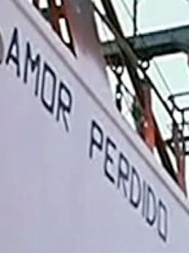
Boat Names
Love Lost
Pure Illusions

Slide 7
Lighting
Natural Sunlight
Naturally illuminates the face and clothing, but not in an unrealistic way
Causes the dress to be transparent

Slide 8
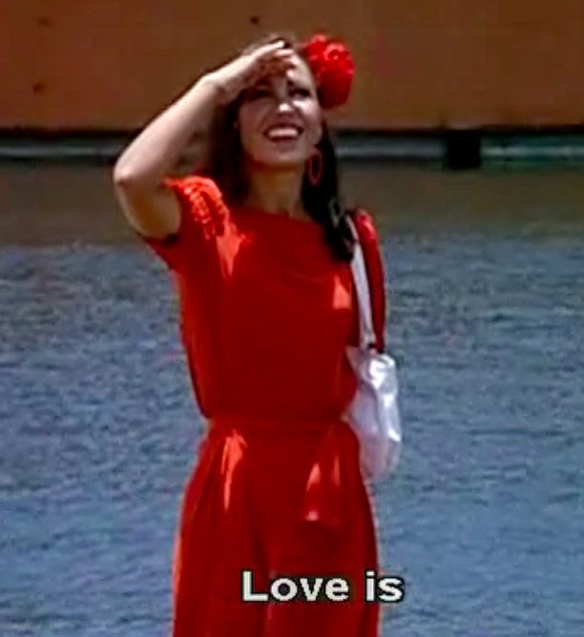
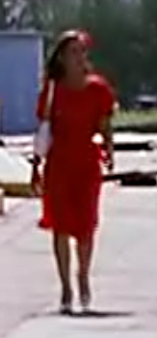
Costume and Makeup
The red dress over the white undergarments: passion covering up purity

Slide 9
Staging and Movement
The men are lined along the side of the shot opposite Julia, who moves towards the center
Reveals attention given to Julia

Slide 10
The Gaze
Julia no longer shies away from the attention shown her by the males in this scene; she even begins to participate in the gazing herself, as a means for seduction and advertising of mutual attraction

Slide 11
Music
Love is anguish
A question
A luminous doubt
Its wanting to know everything
And at the same time
Fearing to find it out
Love is hearing in your breast
The rush of blood and the tide
But love is also
Closing your eyes
Letting dreams flood your body
Like a river of forgetfulness
And sail aimlessly
Love is after all indolence

Slide 12
Progression: Before
white flower
“You know, it’s better to be alone. Like you. I’ll find myself a partner just for dancing and that’s it!”

Slide 13
Progression: Transformation
red flower
red dress

Slide 14
Progression: After
Wearing both red, black, and white (pearls not seen)
Black: maturity, mystery
Red: persistent passion; sign of change
Dancing with another man before Carmelo cuts in
Carmelo still wears white hat and white suit: has not changed
No communication between the two of them: not important
Red flower
Black dress

Slide 15
Conclusion
Pier scene is an important moment of transition for Julia from submission into self-confidence
Has found identity in herself
Progression: dock scene vs opening scene vs ending scene

