Slide 1
Cinema and The New Woman
Comparing Arzner and Guy Blaché

Slide 2
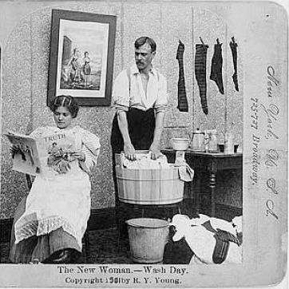
Defining the New Woman
Economic independence, joining workforce
Self-fulfillment, challenging Victorian gender norms
Legal and social equality
Education
Political voice
Sexual independence
Dress freedom
Image source: The National Women’s History Museum

Slide 3
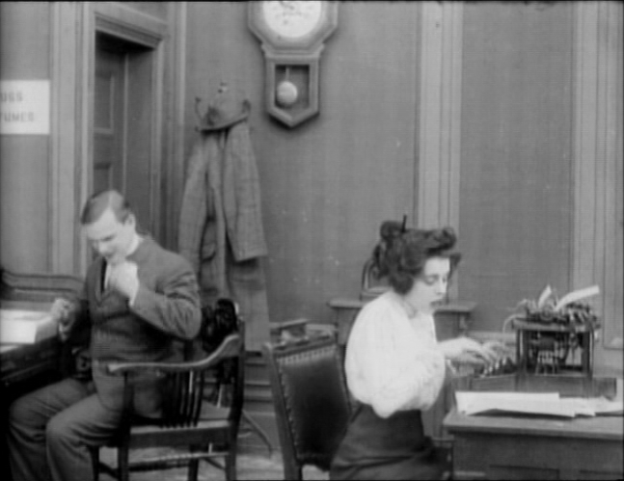
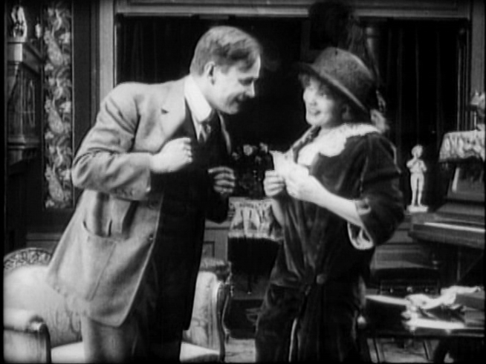
The New Woman in Guy Blaché
Screen shot from A House Divided (1913)
Screen shot from Matrimony’s Speed Limit (1913)

Slide 4
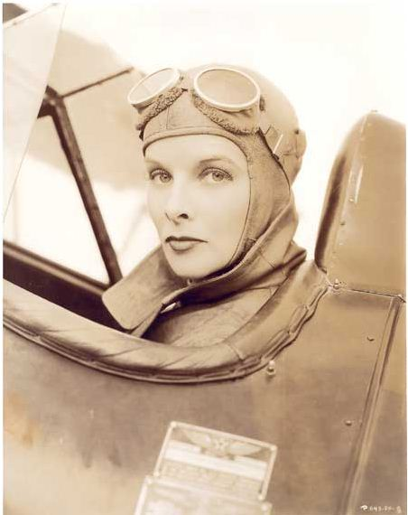
Cynthia as Fulfillment and Containment
Still from Christopher Strong (1933). Image source: One Life: Kate

