Slide 1
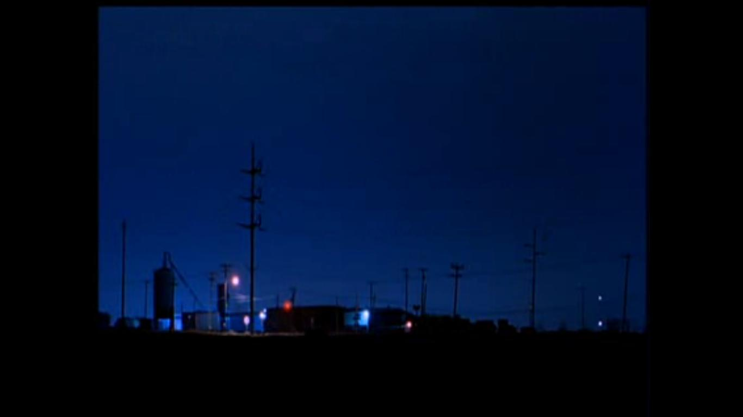
BOYS
Colin Gorenstein
Paul Groff
Sana Hanif
CRY.
DON’T

Slide 2
ARGUMENT
Kimberly Peirce uses “gender as a performance” to deconstruct traditional gender roles in Boys Don’t Cry. She accomplishes this through the application of formal elements such as:
Narrative structure
Costume
Gaze

Slide 3
Defining Gender Through Narrative Forms In Boy's Don't Cry
“A Narrative [is] a chain of events linked by cause and effect and occurring in time and space.” - Bordwell & Thompson

Slide 4
The Scene
Heterosexual Sex
Foreshadowing in the Truck
Lana Becomes The Narrator
Events become Unclear and We no longer trust the Narration
“Then we took off our clothes and went swimming.” - Lana

Slide 5
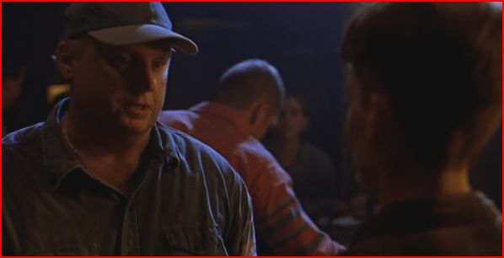
I Challenge You to Fisticuffs!

Slide 6
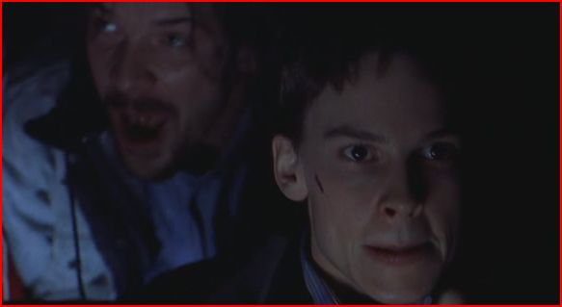
Speed Racer

Slide 7
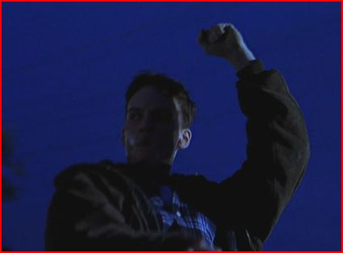
Urban Cowboy

Slide 8
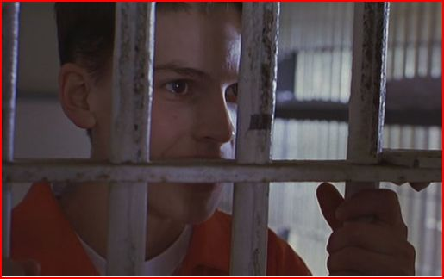
Criminality is Distinctively Male

Slide 9
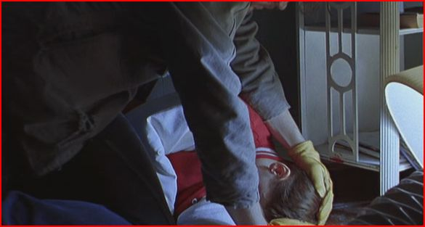
John Holds His “Little Dude”

Slide 10
The Depiction of Lesbian Sex
Undermines the Deconstruction of Gender Roles

Slide 11
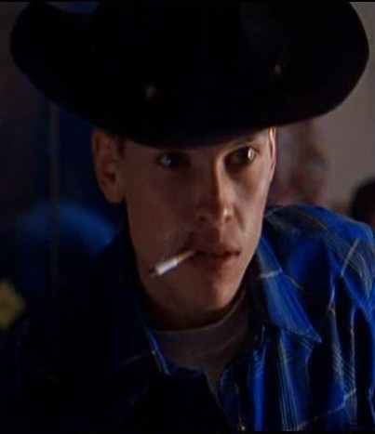
COSTUMES

Slide 12
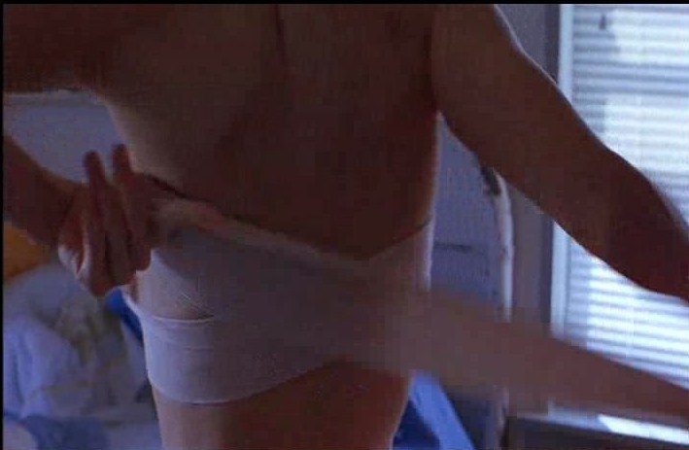
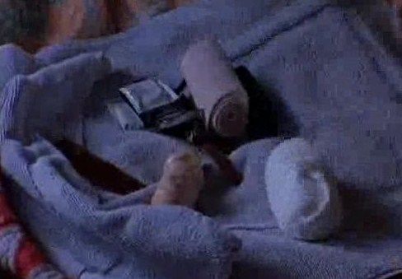
2
4
1
3

Slide 13
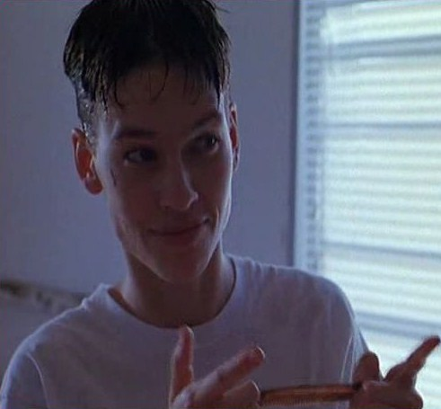

Slide 14
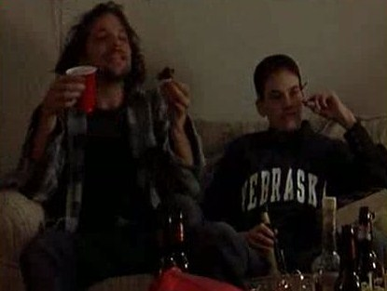
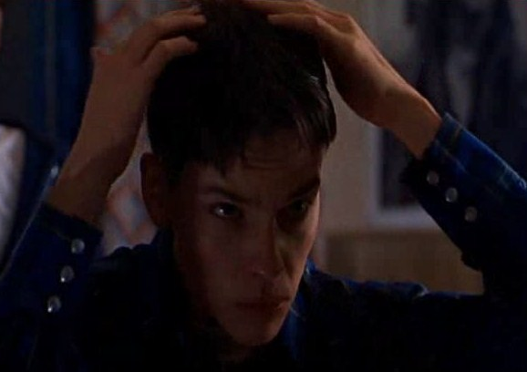
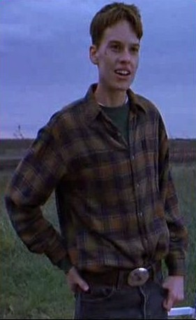
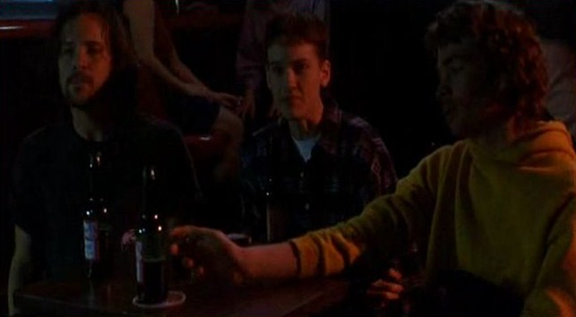

Slide 15
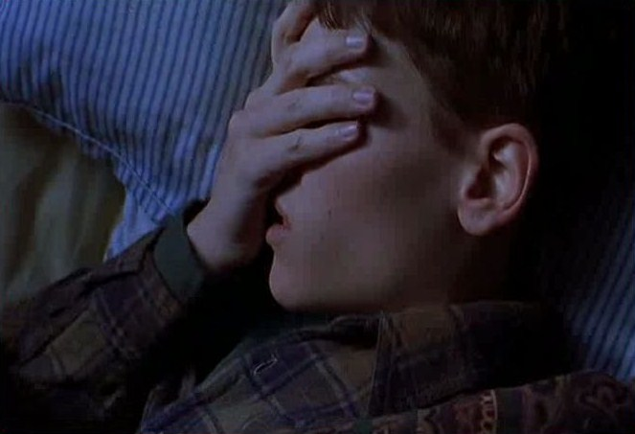

Slide 17
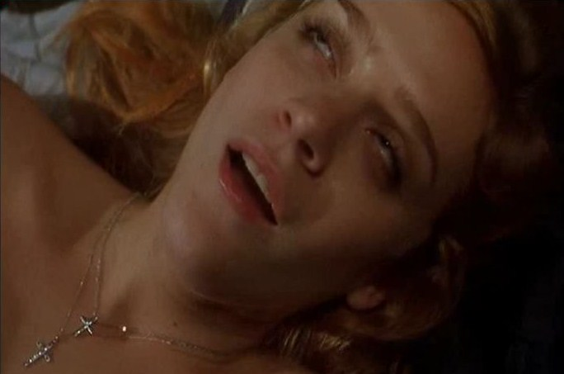

Slide 18
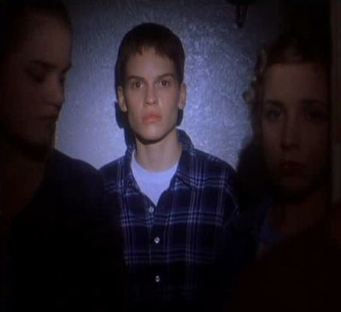
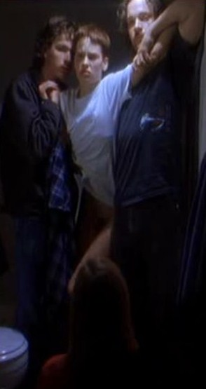

Slide 19
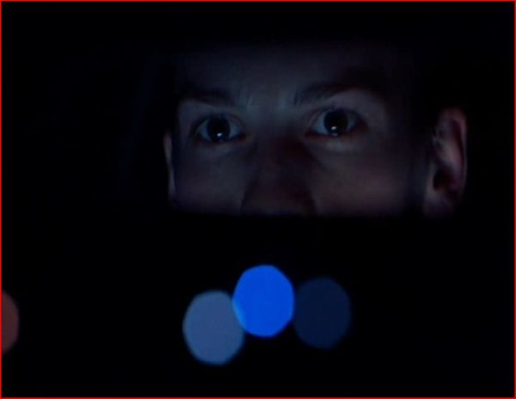
GAZE

Slide 20
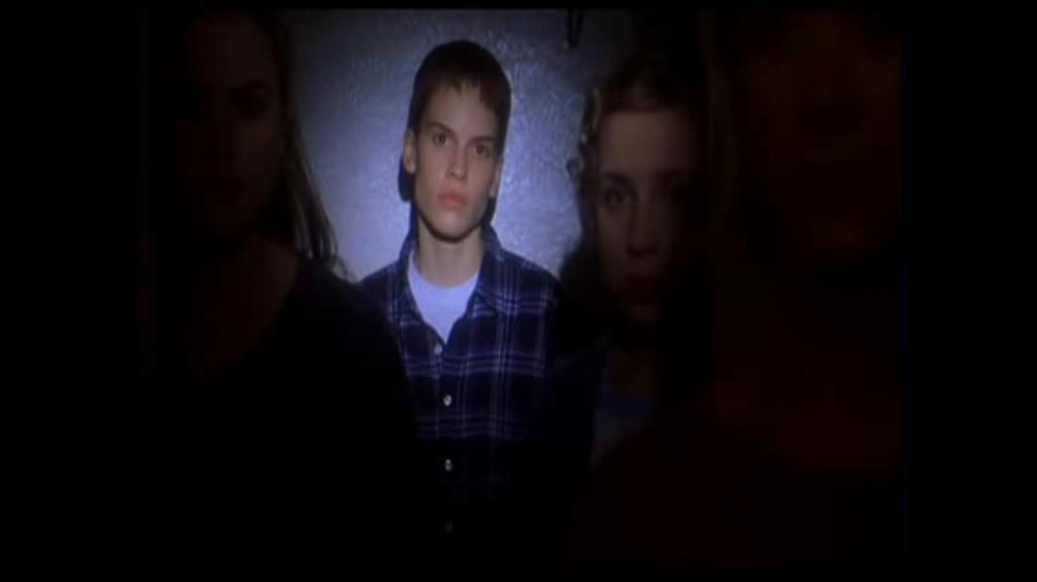
TRANSGENDER GAZE
Slow motion sequence is paired with gaze
“out of body experience”
Vision has a direct link to identity– as Brandon is
revealed, a Brandon fully clothed appears opposite
him
Transgender subject is dependent upon the recognition of the woman
A switch from the typical gaze exchanged between Lana and Brandon

Slide 21
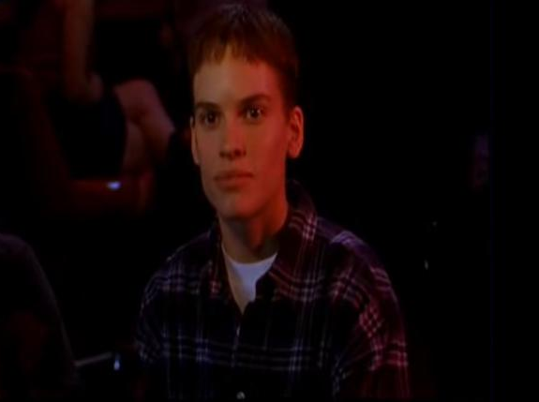
1
2

Slide 22
CONCLUSION
Kimberly Peirce uses “gender as a performance” to deconstruct traditional gender roles in Boys Don’t Cry. She accomplishes this through the application of formal elements. Gender is largely determined by the items visible on the surface.

