Slide 1
Beau Travail: Sound and Cinema

Slide 2
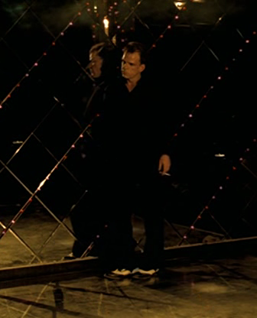
Noise, Music, and Galoup
Sound and image are used to show Galoup’s inability to cope with his expulsion from the French Foreign Legion; his loss of identity leading to his suicide, or apparent suicide. Through voice-over, rhythm (sound-image coordination), and ambiguous diegetic sound, this inner turmoil is made clear.

Slide 3
Clip
Main clip (4:42)

Slide 4
“synchronization of senses”
Noise- bed making, birds chirping
Music- “rhythm of the night”
Rhythm- coordination of sound with image
Voice over- “Serve the Good Cause and Die”

Slide 5
Looking closer
Segment 1 – voiceover/fade in of music:
Galoup’s final voice-over is represented on his chest (tattoo)
Possible significance of coordinating the fade-in of the music with his visible pulse: emphasizes internal/personal aspect of the music, especially if we assume he kills himself.

Slide 6
Functions of noise
For this clip, “noise” precipitates music and dance, adding emphasis and replacing a gunshot with music
Sounds of bed-making, birds chirping, like the ocean and desert noise used in other scenes, preclude particular music, or significant sound (the split-second helicopter explosion for example). For this scene, our expectations of “gun” and fatalistic voice-over are upset by music and the dancing that follows.

Slide 7
Connections to rest of film
Discipline and rhythm- Galoup’s dance
Expectation and possible disunity- “death” represented by ecstatic expressive dance(closely choreographed to follow the music, but in such a way to absolutely contrast the discipline of the various training/exercise scenes throughout the film)
Beau Travail, roughly translated, is “good/nice work” (roughly). For Galoup, death is the fulfillment of his devotion to the Legion. “The perfect legionnaire”

