Slide 1
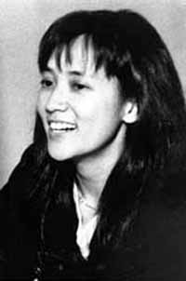
Autumn Moon
Clara Law

Slide 2
Argument
Through the examination of both character movement and patterns of cinematography we can better understand the characters’ struggle to find identity in the cultural hybridity of Hong Kong.

Slide 3
Clip
http://www.viddler.com/explore/english345/videos/105/ingroup/uwenglish345/

Slide 4
Pui-Wai
Physically stationary within the frame
Completely Still Camera
The rigid structure of the setting in the frame dictate her disconnect from her emigrating family and her contemplative nature.
Her movement is very strategic and exemplifies her steady search for her identity before she emigrates to Canada

Slide 5
Limited Movement

Slide 6
Metaphoric Movement
Pui-Wai is heading towards a very important move from her home to a foreign land
Her stationary movement refers to the permanent nature of her move.
She searches for her own identity to be content with herself before this drastic move.
Her search for identity begins very passively, much as her choice to emigrate is not her own.

Slide 7
Tokio
Movement within the frame
Getting out of the car
Filming the plane/city
Chaotic Camera Movement
Indicates the sporadic nature of his identity search
Objectifies the city he is entering
Bizarre images of buildings indicates that the answers are not in the location…they are in the people

Slide 8
Chaotic Buildings

Slide 9
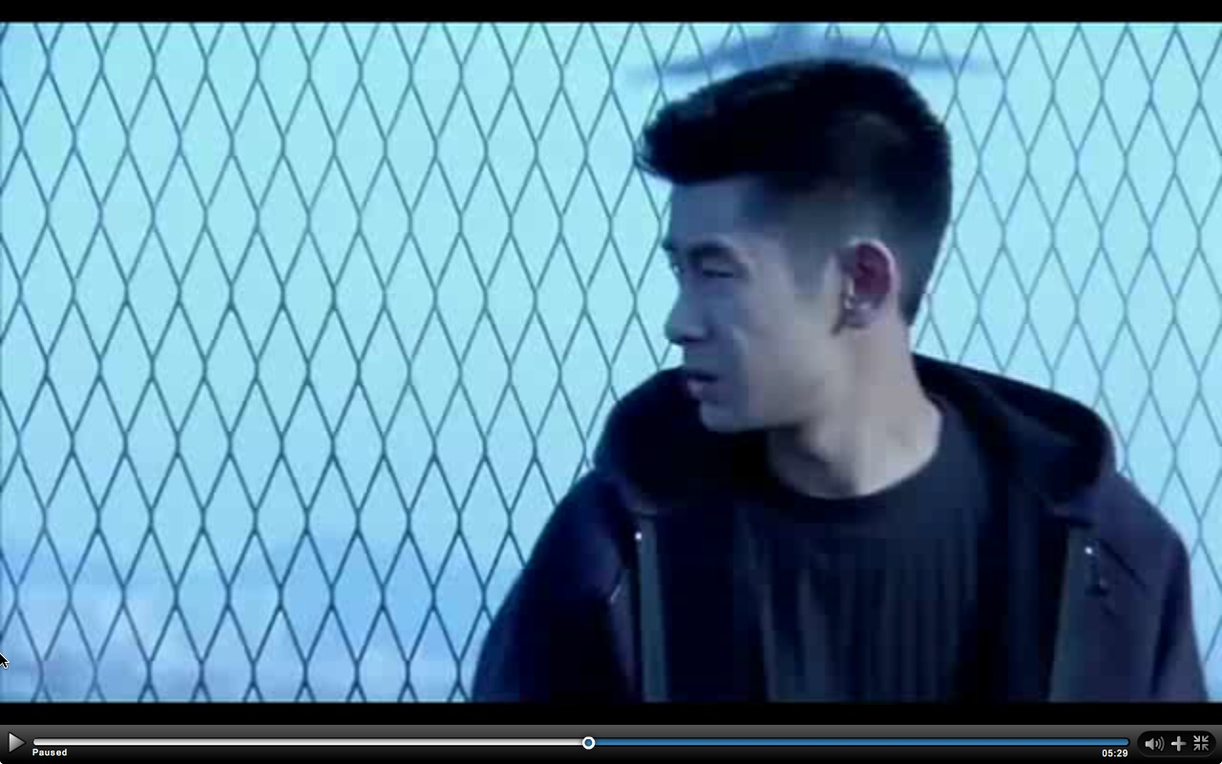
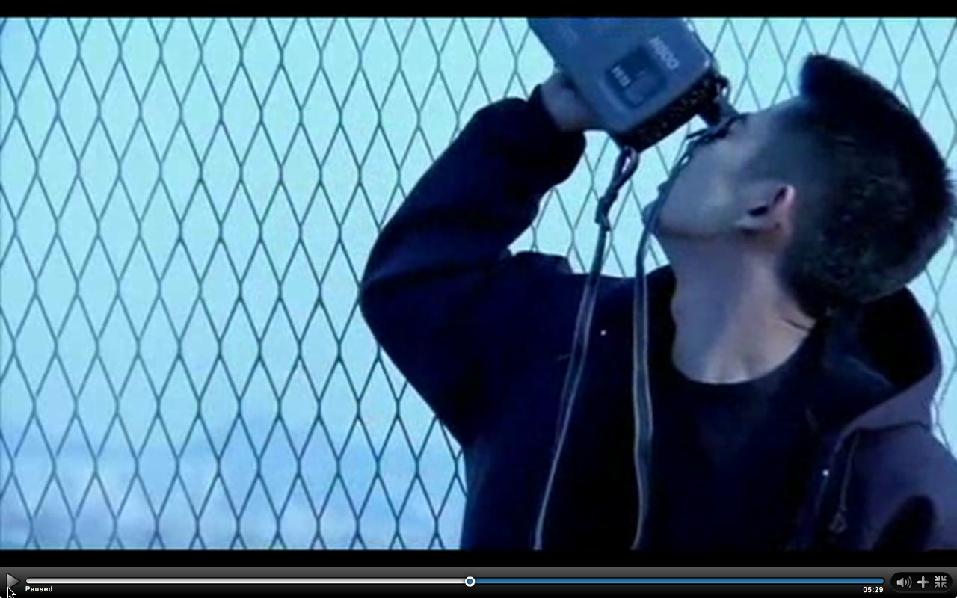
Active Movement

Slide 10
Metaphoric Movement
Tokio has be moving constantly looking for some form of authenticity
His objectivity within his travels is what hinders him from gaining any true personal understanding
He is very much a temporary traveler which relates to the sporadic camera movement in his voiceover
He needs to settle long enough to establish connections with people to truly find what he seeks

Slide 11
Hong Kong’s Cultural Hybridity
Hong Kong is the melting pot of Asia causing a blend of different cultures
This creates a barrier to some forms of authenticity which Tokio and Pui-Wei seek, but inevitably do not exist.
This is why they must combine their two different cultures, bound by the third dimension of the English language, to help each other in their quest for identity.

Slide 12
Conclusion
The hybrid nature of Hong Kong poses as an interesting background on which to examine these characters in their search for personal identity. The use of movement both with the camera and within the frame at the beginning as we meet these characters allows us to understand their differences while recognizing how they will eventually help each other towards greater understanding.

