Slide 1
SPHSC 543 January 22, 2010

Slide 2
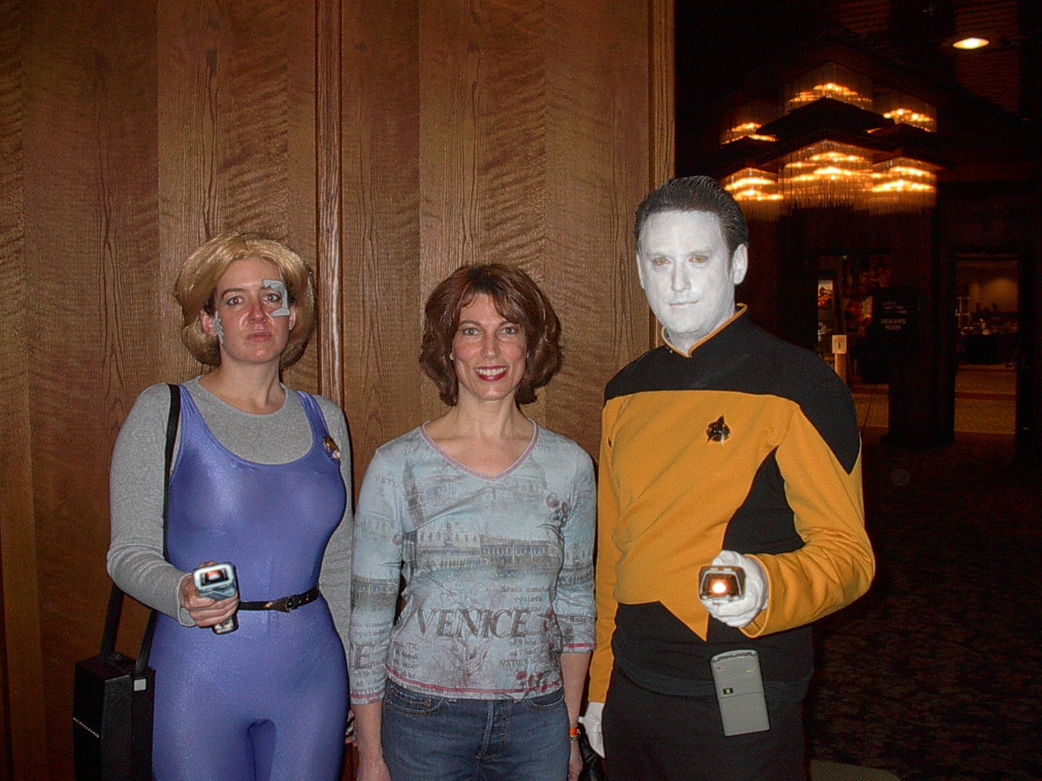

Slide 3
My Dog…and cat…ate my homework

Slide 4
Chiari malformation
“Hindbrain malformation”
Four Types
Type I – often asymptomatic – tonsillar herniation 3-5 mm
Type II – myelomeningocele
Type III – Severe neurological deficits
Type IV – rare – lack of cerebellar development
Removal of lamina of 1st, 2nd, or 3rd cervical vertebrae and part of occipital bone to relieve pressure

Slide 5
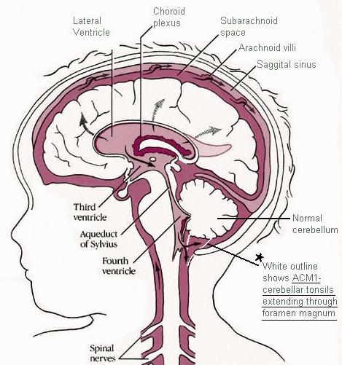

Slide 6
Questions you might expect on tests
What might we expect in an infant born at 24 weeks gestation, 32 weeks, 36 weeks, full-term?
How might respiratory rate impact SSB coordination?
How might increased work of feeding impact SSB coordination?
Why might a 5-month-old infant be referred to you with no prior history of feeding problems?
A child refuses the bottle or breast but readily takes the pacifier. Why?
A child has a history of TEF – what systems might you expect are impacted?
A child who is bottle fed does not exhibit a rooting reflex or a gag reflex. Is this a problem?
A child of 14 months exhibits a phasic bite. Is this a problem?

Slide 7
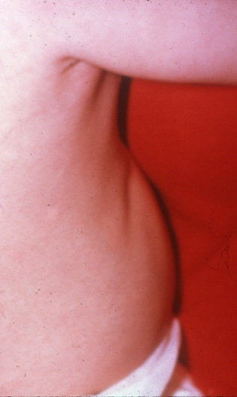
Assessing airway issues
Level of Obstruction
Nose/nasopharynx, mouth/oropharynx, hypopharynx, larynx, tracheobronchial tree
Pulmonary disease or Infection
Cystic Fibrosis, BPD, CDH
Presence of Cough
When during meal
May be ‘silent’
Respiration at rest and with feeding
Look at patterns
Feeding stresses an already marginal airway

Slide 8
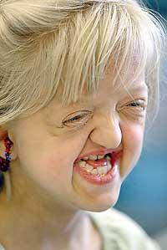
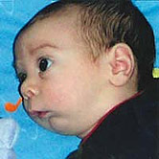
airway issues and treatment
Obstruction
Nasal
Tongue
Mandibular hypoplasia –
Three mechanisms of obstruction
tracheotomy

Slide 9
Airway issues and treatment
Laryngeal anomalies
Feeding difficulties often initial presentation
Obstructive Sleep Apnea
May present as FTT
Older kids -- tonsils
Tracheomalacia
Partial or total collapse
Tracheoesophageal fistula
Triad of cough, choke, cyanosis
Congenital diaphragmatic hernia
Pulmonary hypoplasia and GI issues

Slide 10
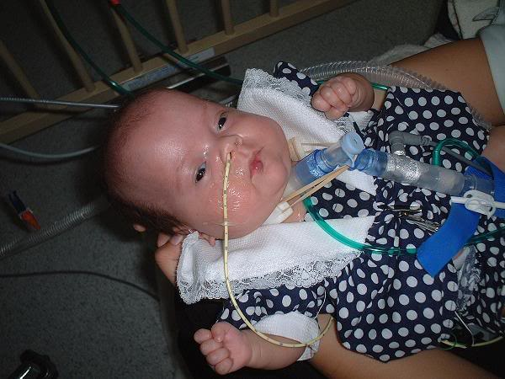
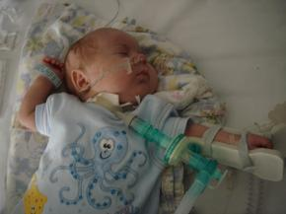
Tracheotomy in Children
Alternate pathway for respiration
Upper airway obstruction, neurologic impairment, chronic pulmonary disease
Pharyngeal phase most affected by trach

Slide 11
Congenital TEF

Slide 12
Congenital TEF
Type D – Proximal esophageal termination on the lower trachea or carina with distal esophagus arising from carina (EA + TEF)
Type E (or Type H) – Variant of type D; if the two segments of esophagus communicate, has a resemblance to the letter ‘H.’ (TEF without EA)

Slide 13
Congenital TEF
Failed fusion of the tracheoesophageal ridges during the third week of embryological development
Unable to feed safely
Prompt surgery is required
May develop feeding difficulties and chest problems post-operatively

Slide 14
Congenital TEF
Clinical presentation
Copious salivation
Choking, coughing, cyanosis with the onset of feeding
Treatment
Resection of fistula and anastomosis of discontinuous segments
Complications
Structure, leak at point of anastomosis, recurrence

Slide 15
Congenital TEF
Some babies with TEF also have other abnormalities
Most commonly associated with VACTERL association

Slide 16
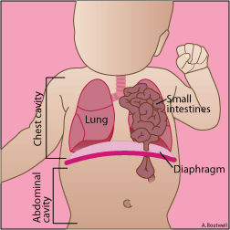
Congenital Diaphragmatic Hernia
CDH
Applied to a variety of congenital birth defects that involve abnormal development of the diaphragm

Slide 17
CDH

Slide 18
CDH
Three major defects:
Failure of diaphragm to close
Herniation of abdominal contents into the chest
Pulmonary hypoplasia (decreased lung volume)
Majority occur on left side, some on right side, small fraction bilateral
Leads to severe, life-threatening respiratory distress
Needs repair in neonatal period. Often on ECMO

Slide 19
A few words about….pneumonia
Community acquired
Viral illness
Nosocomial
Contracted while in institution
Bacterial/staph
Aspiration
Colonized material
bacterial

Slide 20
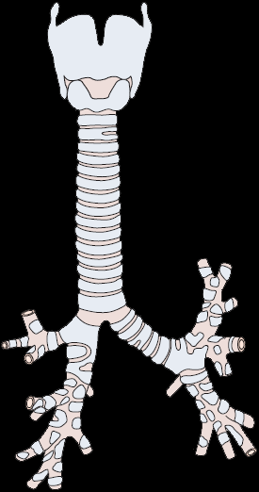

Slide 21
aspiration
Penetration of secretions or any foreign material below the true vocal folds into the tracheobronchial tree
Threatens lower airways
Red flags: Cough, wheeze, gurgling, recurrent, “silent”
Conditions contributing to aspiration pneumonia
Frequency, amount and properties of aspirate
Factors that can contribute to aspiration

Slide 22
Gastrointestinal (GI) Tract
Common when there are feeding/swallowing problems
Causes: Oral sensorimotor problems, GERD, dysmotility, constipation, structural
Effect: poor nutritional intake, growth failure, malnutrition

Slide 23
Dysphagia secondary to GI diseases
Structural abnormalities of the esophagus and stomach
TEF, EA, pyloric stenosis
Dysmotility
Inflammatory diseases
NEC, Crohn’s, Lupus
Constipation
Common in neurologically impaired
Faulty innervation, immobility

Slide 24
malnutrition
Loss of body composition that can be prevented or reversed by nutritional repletion
Multi-factorial
Struggle with feedings
Inadequate volume
Psycho-social problems
Primary and secondary types
Protein energy malnutrition (PEM)
More common with feeding/swallowing difficulties
Organic disease process

Slide 25
Malnutrition
Malabsorption
Inability to absorb nutrients
Systemic infections
Reduction in appetite
Withdrawal of foods (NEC)
Immune system
Infection
Vicious cycle
Malnutrition compounded by not wanting to eat

Slide 26
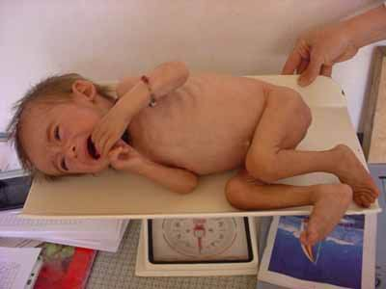
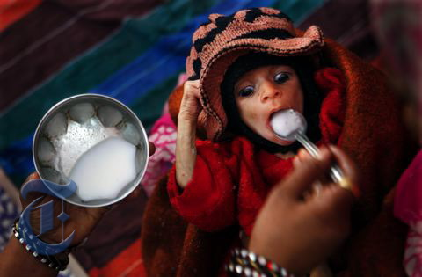

Slide 27
Short bowel (gut) syndrome
Malabsorbtion and subsequent malnutrition that is induced following a massive small intestinal resection
Necrotizing enterocolitis (NEC)
Intestinal malrotation
Gastroschisis/Omphalocele
Multiple intestinal atresias

Slide 28
Necrotizing enterocolitis
NEC
Typically seen in preemies
Timing of onset is generally inversely proportional to gestational age at birth (e.g., the earlier a child is born, the later the signs of NEC are seen)
Portions of the bowel undergo necrosis (tissue death)

Slide 29
NEC

Slide 30
NEC
Treatment includes providing bowel rest by stopping enteral feeds, gastric decompression with intermittent suction, fluid replacement, support for blood pressure, parenteral nutrition, and antibiotic therapy
Emergency surgery resection of necrotic bowel may be required
Colostomy may be required (reversed later)

Slide 31
NEC
Warning –
Picture of resection is next

Slide 32
NEC

Slide 33
NEC
Infection/inflammation of the bowel
Immature bowel sensitive to blood flow changes and oxygen imbalance
Almost never seen before oral feedings are introduced
Formula feeding increases risk of NEC by tenfold compared to infants who are breastfed alone.
Breastmilk (even expressed BM) – antiinfective effect, immunoglobulin agents, rapid digestion
Added stress of food moving through bowel allows bacteria to invade and attack walls of intestine

Slide 34
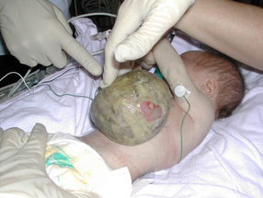
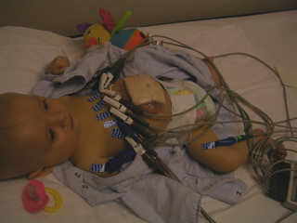

Slide 35
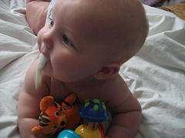
Gastroesophageal reflux
The return of gastric contents, either food alone or mixed with stomach acid, into the esophagus.
Reflux is normal!

Slide 36
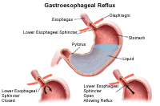

Slide 37
Barriers to reflux
LES – contains gastric contents; pressure differentials
Growth – longer esophagus, more upright, solid foods
Saliva
Acid neutralization
Clears refluxed materials
Polypeptide hormone
Respiratory protective systems
Cough/airway clearance (6 mos +)

Slide 38
GER
Delayed gastric emptying
Strictures
Esophageal spasm leads to odynophagia
Respiratory impact
Increased WOB
Lack of energy = slower digestion
Asthma subgroup
Pressure sensitive
constipation

Slide 39
GER or GERD?
Weight loss or inadequate weight gain (FTT)
Persistent irritability
Food refusal/selectivity
Posture -arching
Coughing/choking
Pain
Apnea
Sleep disturbance
Recurrent pneumonia

Slide 40
Causes of GERD
Food allergies/intolerance
Immature digestive system
Structural
Immature neurological system
Low tone

Slide 41
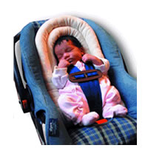
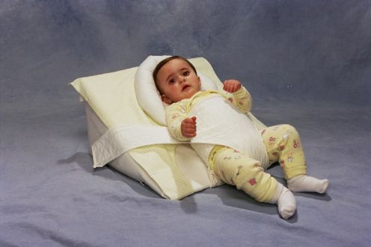
treatment
Non-medical
Thickening
Positioning
Feeding frequency

Slide 42
Treatment
Medication
Improves gastric motility
Metoclopramide
Erythromycin
Lowers gastric acid production
Ranitidine hydrochloride
Proton pump inhibitor
Omeprazole, lansoprazole

Slide 43
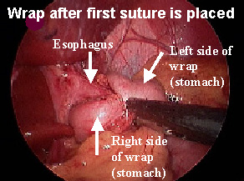
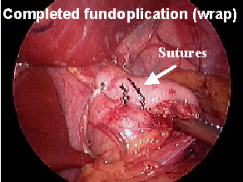
treatment
Surgical
Fundoplication
Percutaneous endoscopic gastrostomy (PEG)
Jejunostomy feedings

Slide 44
treatment
Child/Family
Food as power

Slide 45
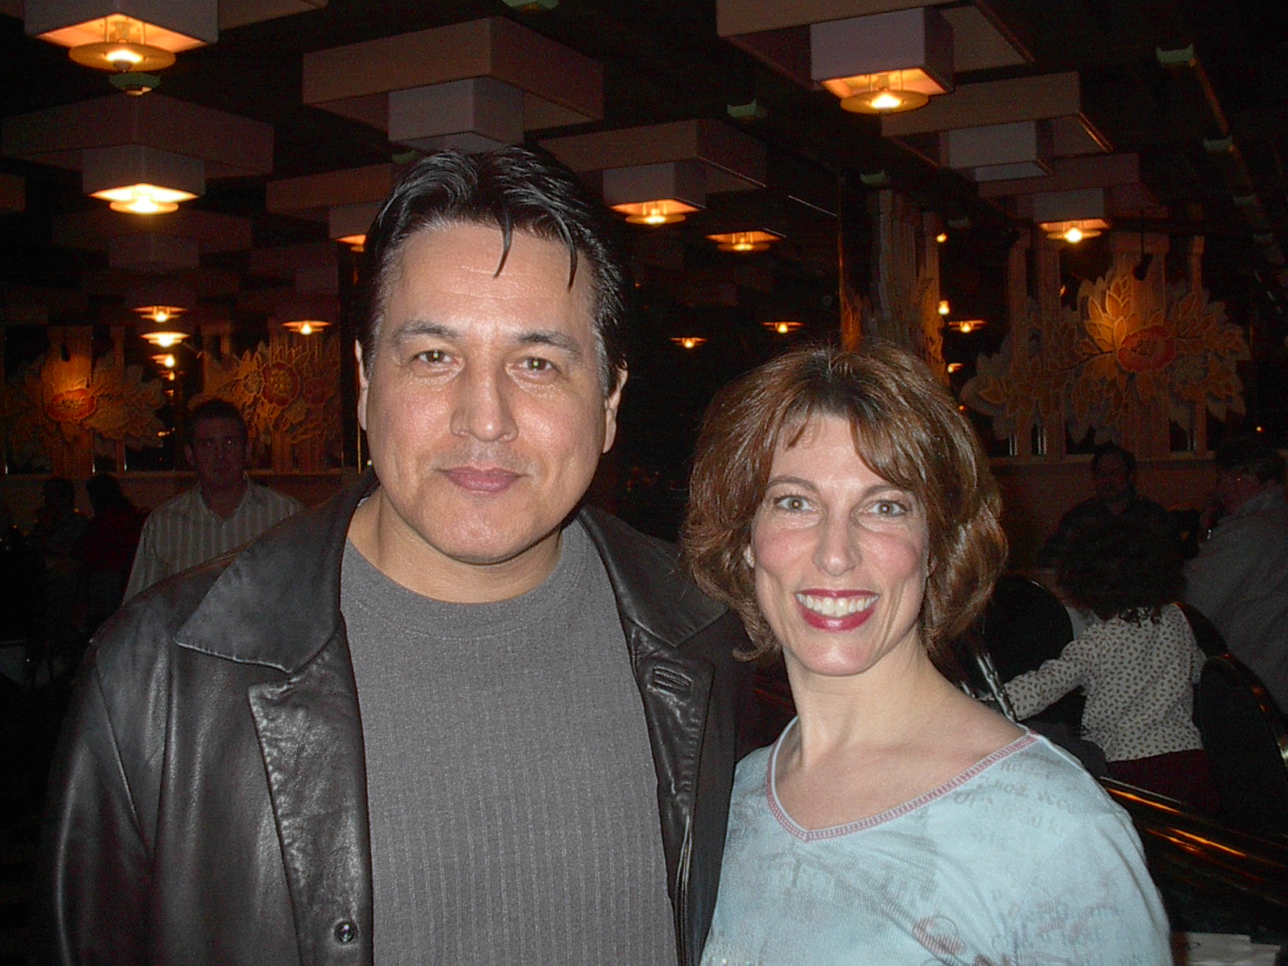

Slide 46
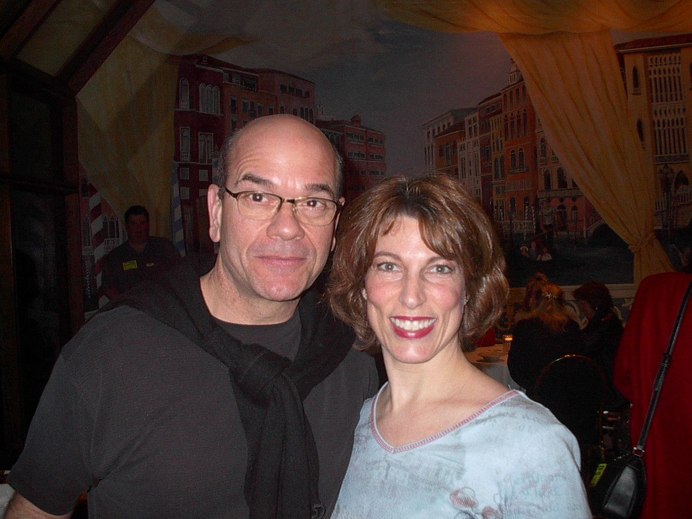

Slide 47
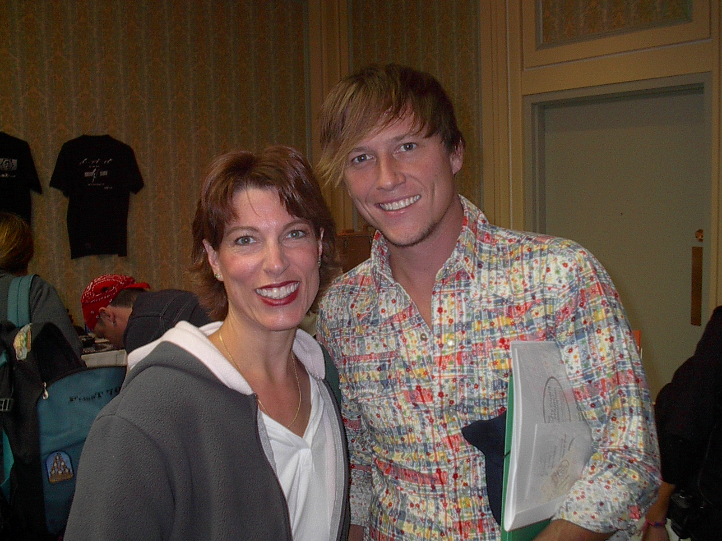

Slide 48
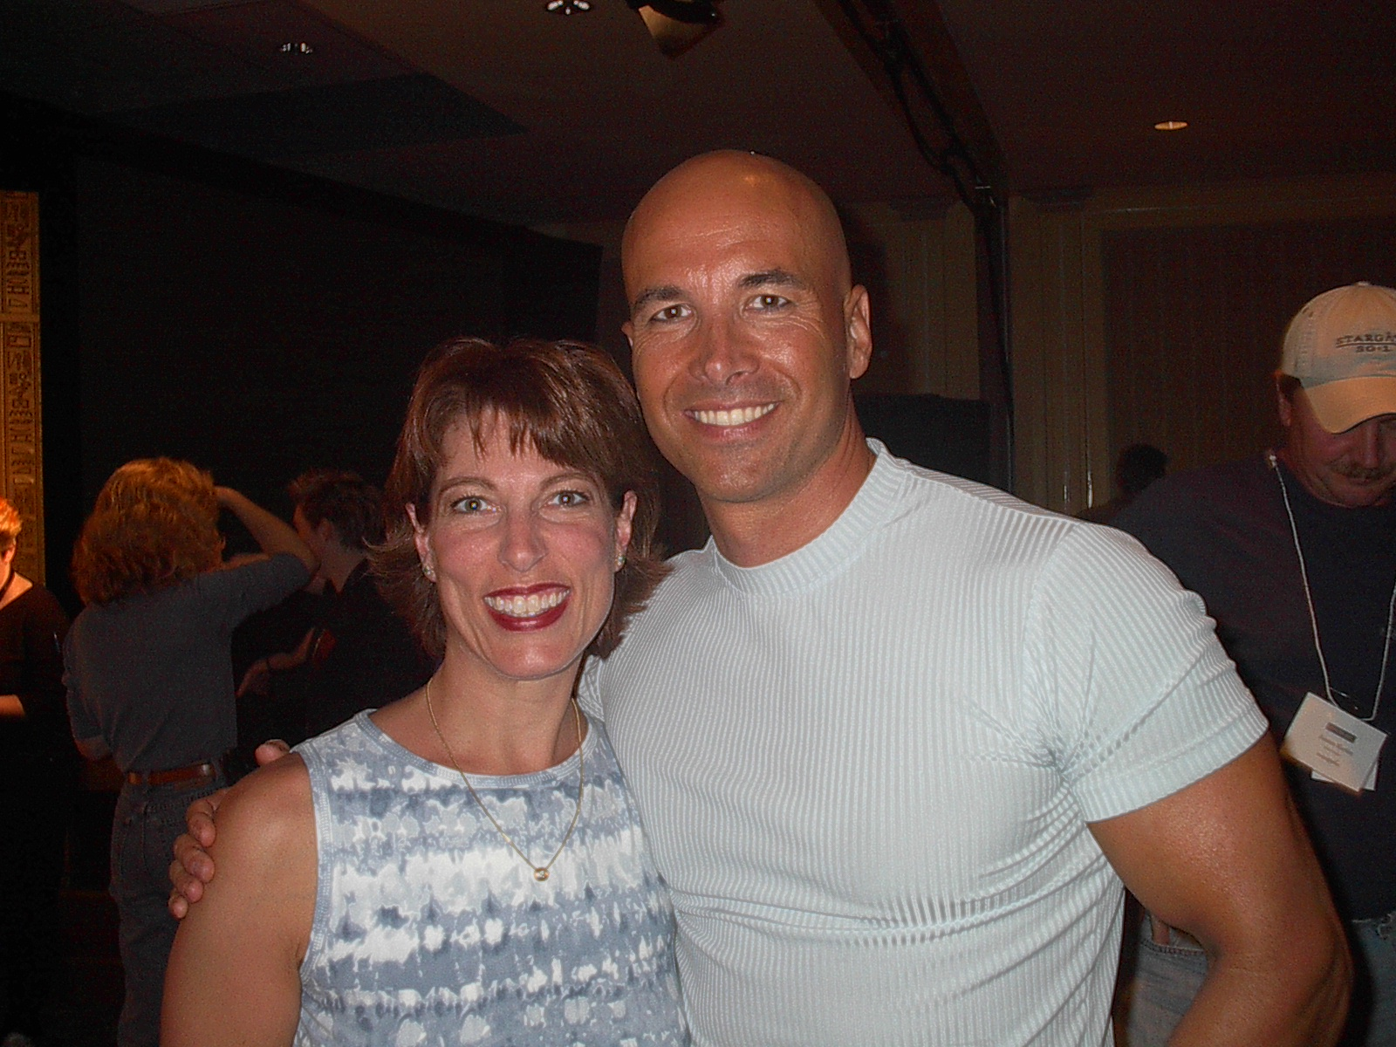

Slide 49
