Slide 1
January 15, 2010
Questions?
Follow up:
Nutritive versus non-nutritive suck
Suck-swallow
Breastfeeding/breastmilk

Slide 2
Nutritive suck (NS)
Non-nutritive suck (NNS)
Sucking rhythm
Sucking rate
Swallowing pattern
Sucking pressure

Slide 3
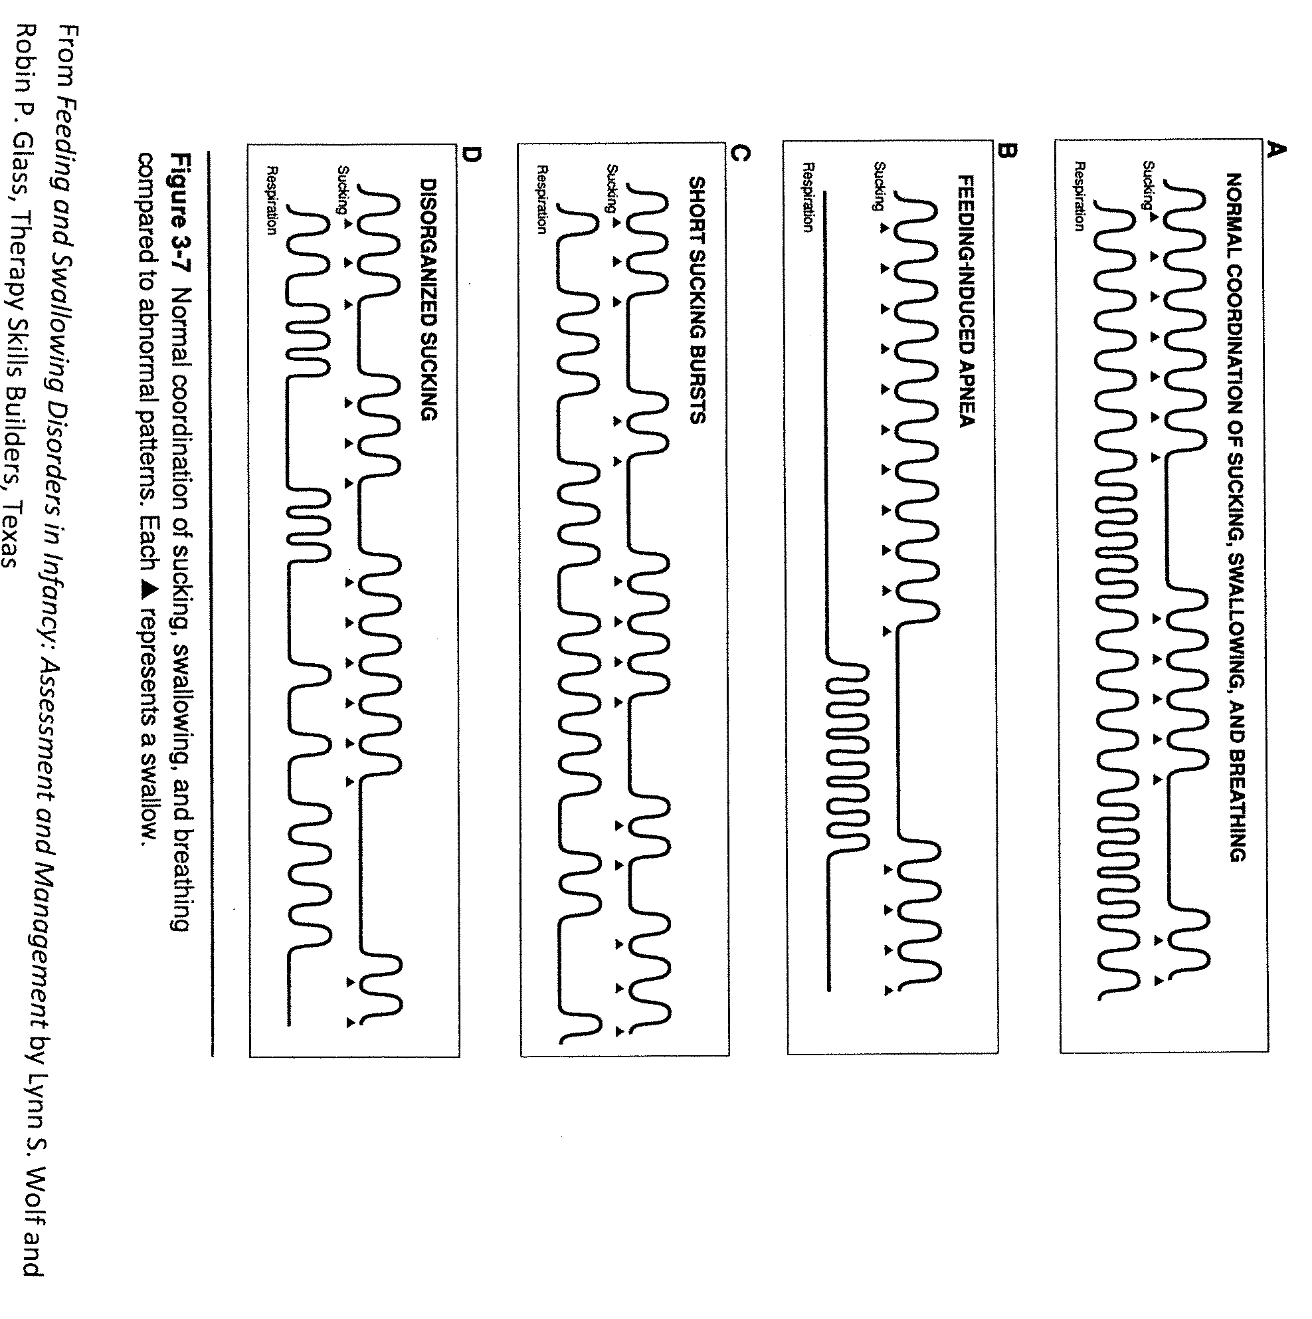

Slide 4
breastfeeding
Hormonally driven at first
Lactogenesis I – colostrum
Lactogenesis II – increase in milk volume after birth
Milk maintenance (supply – demand)
Lactogenesis III – Milk removal
Empty breast = milk production
Full breast = slower milk production

Slide 5
Breastfeeding preemies
Milk production as part of hormones during pregnancy
Midway through start making colostrum
Delivery of placenta
Need to express breastmilk to produce breastmilk
Weak suck, endurance, immature digestive system
NGT delivery
Herbs, medications

Slide 6
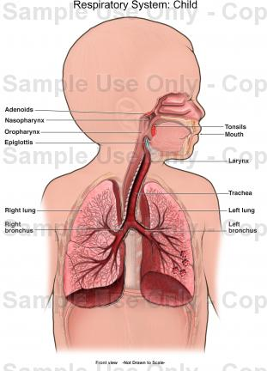
Respiratory system
Maintain a balance of oxygen and carbon dioxide

Slide 7
Respiration
Respiration
Biochemical definition
Ventilation
Gas transport

Slide 8
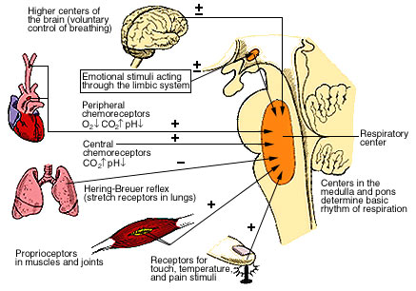

Slide 9
Respiratory system

Slide 10
Respiratory system
Respiratory rate
Depth of respiration
Work of breathing
Heart function
Airway maintenance

Slide 11
Factors affecting airway
Structural abnormalities
Neck flexion or extension
Overall posture

Slide 12
Etiologies of respiratory failure in children
Central nervous system
Upper airways
Lower airways
Lung parenchyma
The Pleurae
Thoracic cage and surroundings
Redding et al. 1987

Slide 13
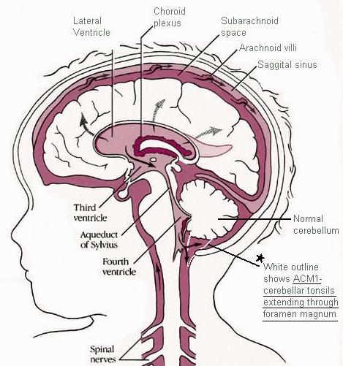

Slide 14
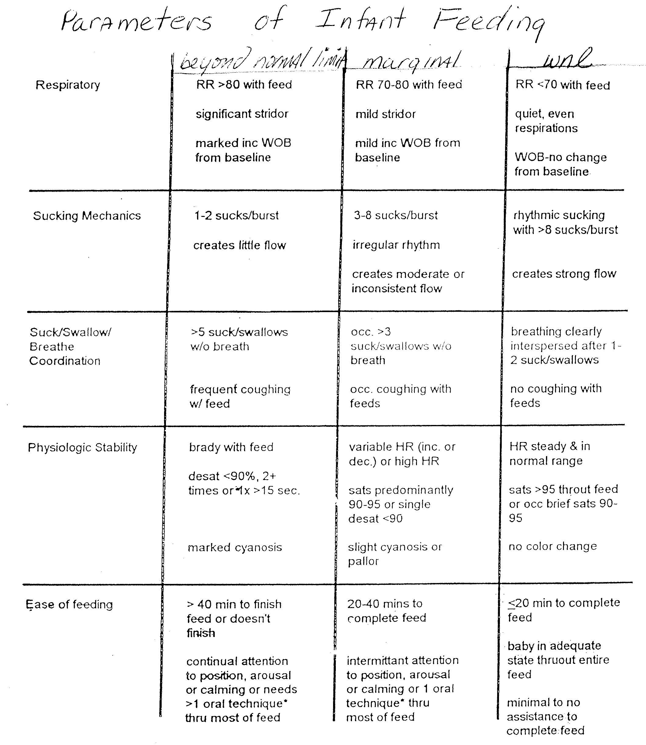

Slide 15
Airway defense mechanism apnea and infants
Belly breathers
Immature ribcage
Movement against gravity
Apnea and bradycardia in normal infants
Apneic pauses
Hypoxia and bradycardia
Maladaptive

Slide 16
Sucking, swallowing and breathing
Coordination is essential
Cessation of respiration with the swallow
Mean length of respiratory pause = 1 second

Slide 17
SSB
Timing of the swallow
Effect of swallowing on breathing rate and pattern
Impact of breathing on sucking
Impact of sucking on swallowing
Fluid flow through nipple
Maturation

Slide 18
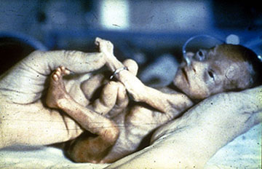
ssb
Compromised respiratory system
Immaturity

Slide 19
Assessing airway issues
Stridor (videos)
Intubation
Anatomic abnormalities
Overall neurological status
Patterns of respiration

Slide 20
Assessing Airway Issues
History
Stridor; Patterns of respiration
Anatomic abnormalities
Neurologic/congenital problems
Infections/Disease processes
Intubation

Slide 21
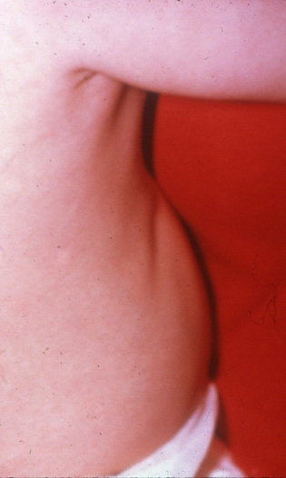
Assessing airway issues
Level of Obstruction
Pulmonary disease or Infection
Presence of Cough
Respiration at rest and with feeding

Slide 22
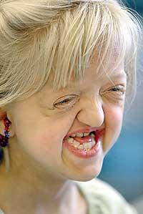
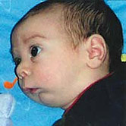
airway issues and treatment
Obstruction
Nasal
Tongue
Mandibular hypoplasia

Slide 23
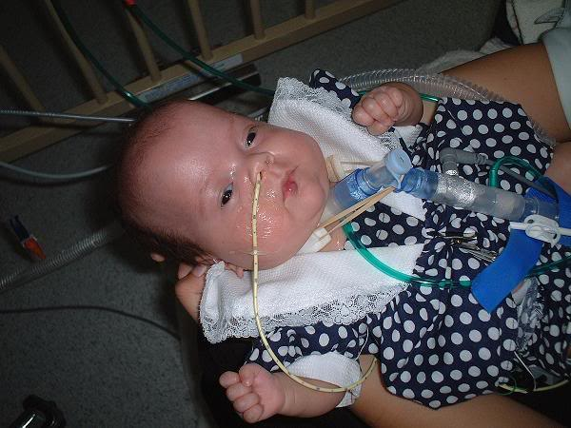
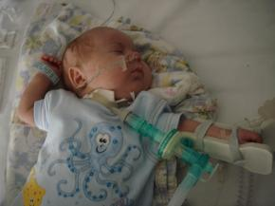
Tracheotomy in Children
Alternate pathway for respiration
Upper airway obstruction, neurologic impairment, chronic pulmonary disease
Pharyngeal phase most affected by trach

Slide 24
Airway issues and treatment
Laryngeal anomalies
Obstructive Sleep Apnea
Tracheoesophageal fistula
Congenital diaphragmatic hernia
GER

Slide 25
A few words about….pneumonia
Community acquired
Nosocomial
Aspiration

Slide 26
aspiration
Penetration of secretions or any foreign particulate substances beyond the laryngeal inlet into the tracheobronchial tree
Threatens lower airways
Frequency, amount and properties of aspirate
Red flags
Factors that can contribute to aspiration

Slide 27
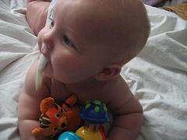
Gastroesophageal reflux
The return of gastric contents, either food alone or mixed with stomach acid, into the esophagus.
Reflux is normal!

Slide 28
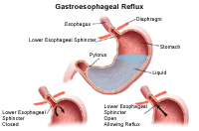
Barriers to reflux
LES
Growth
Saliva
Respiratory protective systems

Slide 29
GER
Gastric emptying
Pressure relationships
Respiratory impact

Slide 30
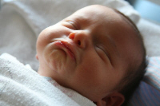
GER or GERD?
Weight loss or inadequate weight gain (FTT)
Persistent irritability
Food refusal/selectivity
Posture
Coughing/choking
Pain
Apnea
Sleep disturbance
Recurrent pneumonia

Slide 31
Causes of GERD
Food allergies/intolerance
Immature digestive system
Immature neurological system

Slide 32
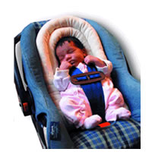
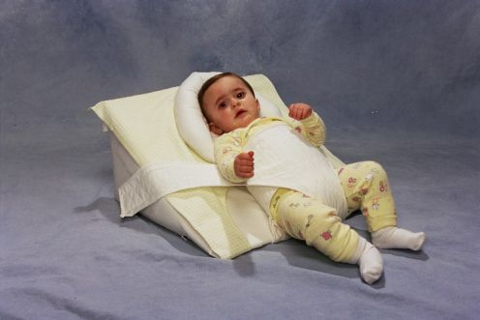
treatment
Medications
Thickening formula
Positioning

Slide 33
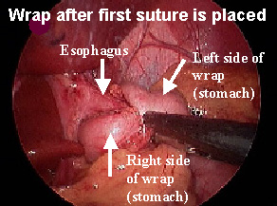
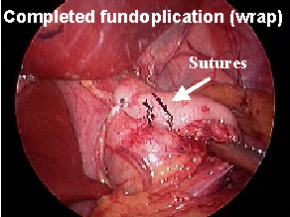
treatment
Small, frequent feedings
Frequent burping
Surgery
Percutaneous endoscopic gastrostomy (PEG)

Slide 34
Short bowl (gut) syndrome
Malabsorbtion and subsequent malnutrition that is induced following a massive small intestinal resection
Necrotizing enterocolitis (NEC)
Intestinal malrotation
Gastroschisis/Omphalocele
Multiple intestinal atresias

Slide 35
malnutrition
Loss of body composition that can be prevented or reversed by nutritional repletion
Multi-factorial
Primary and secondary types
Vicious cycle
Immune system

