Slide 1
Rhetoric, Argument, and Persuasion
ICS 139w
08/22/2011

Slide 2
Re: evaluations
Slides are available on the website
Have also added links from the Schedule for easier access
Role of Peer Reviewing
Supplements your own editing
Rule-of-thumb: 3 edits for a paper
Idea: evaluations for editors?

Slide 3
Exchange papers
Find a different reviewing partner (you can move around)
Exchange drafts of Assignment 4
We will use the papers for exercises/reviewing during class
Read your partner’s paper
Marking it up is not required
Underline the thesis or primary claim.

Slide 4
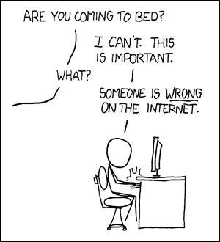
How to Make an Argument
xkcd.com/386

Slide 5
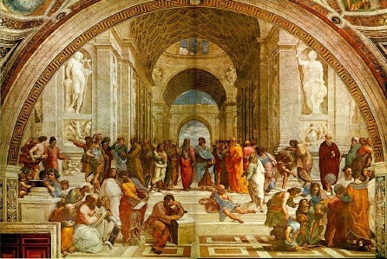
Rhetoric
“The Art of (Effective) Persuasion”
any connotations?
present whenever people speak
Rhetoric and Ancient Greece

Slide 6
Rhetorical Form (Plato)
How the Greeks Did it:
Introduction (prooemion)
Description or narration of events (diegesis)
Proof and evidence (pistis)
Probabilities that evidence is sound (epipistis)
Refute the opposing claim (elenkhos)
(Refute the opposing claim again) (epexelenkhos)
Conclusion, summary, recapitulation (epanodos)
Plato, Phaedrus (370 BCE), via Bogost 2007

Slide 7
Rhetorical Form (as Buildings)
Build an argument on top of points (evidence)
If one piece is weak, then the argument collapses

Slide 8
Peer Editing: Organization
In the left margin of the paper, identify each of:
Introduction and background information
Thesis or claim
Reasons
Facts that support each reason
Opposing arguments
Counters or concessions
Conclusion or summary
Is each piece sufficiently developed? Is anything missing?
Notes:
- Do this individually—basically create an outline of the paper (you have 5 minutes)
- Share with your partner, let them know how they did. Suggest elements that might be missing, etc
- Then poll the whole group

Slide 9
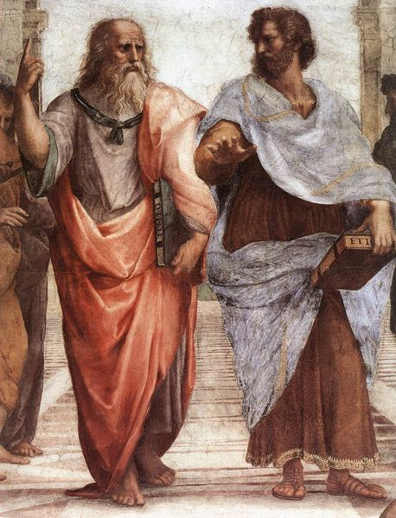
Other Forms: Dialectic
“The art of investigating the truth of opinions”
Reasoning about questions towards an unknown conclusion
Like a debate, but without sides
Arguments & counterarguments
Until truth is found
aka the Socratic method
More highly valued by the Greeks
But difficult to write
Notes:
Not the only form of organization

Slide 10
The Argument Sketch, Monty Python, 1972
Notes:
So is this an effective argument?
What do each of the characters do to try and reach their points?
Would you call this a dialectic?
Do not write a paper like this

Slide 11
Rhetorical Strategies
Message
Author
Audience
Notes:
How might each component affect the effectiveness of the argument?

Slide 12
Rhetorical Strategies
Logos
(Message)
Ethos
(Author)
Pathos
(Audience)

Slide 13
Pathos, Logos, and Ethos
Ethos: the credibility/character of the author
Trustworthiness, expertise, (sources)
Logos: the logic/subject of the message
Data, reasons, (sources)
Pathos: the emotion of the audience
Values, beliefs, passions
Logos
(Message)
Ethos
(Author)
Pathos
(Audience)
Notes:
Logos tends to be most important in technical writing

Slide 14
Peer-Reviewing: Strategies
In the right margin of the paper, identify any instances of:
Pathos (appeals to emotions)
Logos (appeals to logic)
Ethos (appeals to credibility)
Does each appeal hold water (check pathos/ethos)?
Does the paper appeal on multiple levels?
What new appeals could be added?
Notes:
- Do this individually (you have 5 minutes)
- (again, logos should be the most common likely)
- Share with your partner, let them know how they did. Suggest elements that might be missing, etc
- Then poll the whole group

Slide 15
Break

Slide 16
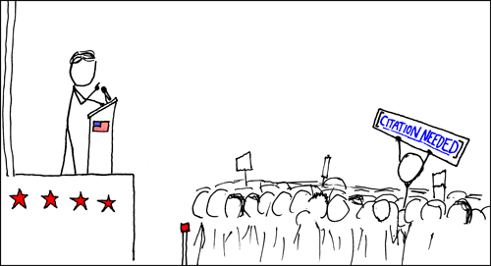
Evidence and Examples
Why do we use references / works cited?
What makes a good reference?
xkcd.com/285
Notes:
Reliability

Slide 17
When to use a citation
When you use someone else’s words or ideas
When you want to support a statement with evidence
“Anything challenged or likely to be challenged”
http://en.wikipedia.org/wiki/Wikipedia:Verifiability#When_a_reliable_source_is_required
To include “further reading” (literature references)
You do not need to cite (undisputed) facts or “common knowledge”

Slide 18
“Facts,” “Common Knowledge,” and Citations
Which of these statements need a citation?
“The Internet is a series of computers connected through standardized networking protocols.”
“The earliest computer programmers were women.”
“More than 300 million people in the United States have cell phones.”
“Bill Gates said, ‘640K [of memory] ought to be enough for anybody’.”
“Most experts agree that open source software is better than proprietary software.”

Slide 19
Plagiarism
Plagiarism is intellectual theft. It means use of the intellectual creations of another without proper attribution. Plagiarism may take two main forms, which are clearly related:
To steal or pass off as one's own the ideas or words, images, or other creative works of another.
To use a creative production without crediting the source, even if only minimal information is available to identify it for citation.
Credit must be given for every direct quotation, for paraphrasing or summarizing a work (in whole, or in part, in one's own words), and for information which is not common knowledge.
http://www.editor.uci.edu/catalogue/appx/appx.2.htm
How can you tell when an idea is yours and when it is
somebody else’s?
Notes:
The first on the list of reasons to use citations is to give proper credit for ideas.
This goes back to the ethics stuff from last week
The UCI Policy has the same not about stuff that isn’t “common knowledge”

Slide 20
Peer Reviewing: Examples
Read over your partner’s paper again. Put a box around:
Any citations used
Do they seem appropriate?
Is the citation used correctly (could you find the referenced work if you had to)?
Any ideas that lack citations
Where might the author find a good source?

Slide 21
Logic
Goal is to build an argument logically
Inductive logic: specific => general
Be careful of probabilistic reasoning!
Use hedges
Deductive logic: general => specific
P -> Q
Suppose P
Then Q
(mathematical induction goes here)
Notes:
Example of inductive logic: how many people own a cell phone?

Slide 22
Logical Fallacies
A common error in reasoning (often with a fancy name)
Begging the Question / Circular Argument
“Unsecured Wi-Fi connections are are easy to break into because they lack sufficient security”
post hoc ergo propter hoc
“The sun rises after the rooster crows, therefore the rooster causes the sun to rise.”
Genetic Fallacy / ad hominem
“Because the system was made by <COMPANY NAME>, it must be high quality.”
“Because you like products by <COMPANY NAME>, your opinion is biased and should be discounted.”
Slippery slope
“Since more people are getting smart phones, soon no one will use a desktop computer”
see also: Straw Man fallacy

Slide 23
Peer Reviewing: Fallacies
Read over your partner’s paper again. Put an X next to any logical flaws in their argument:
Begging the Question / Circular Argument
post hoc ergo propter hoc
Genetic Fallacy / ad hominem
Slippery Slope / Straw Man
Other
How can the author make their logic and argument more watertight?

Slide 24
Persuasion and Influence
Reciprocity
want to help others who have helped us previously
Consistency
want to be consistent with what we’ve already done
Social Proof
want to do what other people are doing as well
Liking
want to do what people we like tell us to
Authority
want to do what authorities tell us to
Scarcity
find rare objects more attractive, proportional to rarity
Cialdini, Influence: The Psychology of Persuasive, 2007

Slide 25
Thank You for Smoking, Reitman, 2005
Notes:
Argument structure
Audience?
Pathos, logos, ethos?
Fallacies?

Slide 26
Summary
Structure
Build arguments on a foundation of evidence
Rhetoric: Pathos, Logos, Ethos
Can appeal on multiple levels
(logos is the most common in technical writing)
Citations and Evidence
When to use, common knowledge
Logical Fallacies
Be careful in your writing

Slide 27
Assignment 4 Rubric
5pt - Analysis and Critical Thinking
2pt - Has a clear, identifiable, significant thesis or claim
1pt – Uses strong reasoning to support the thesis
1pt - Includes insightful discussions of the reasons or thesis
1pt - Is tailored to a specific audience
5pt - Evidence and Examples
2pt - Uses evidence and examples to back up claims
2pt - Uses citations appropriately and correctly
1pt - Addresses or acknowledges counter-examples
5pt - Organization and Structure
2pt - Argument follows from a series of understandable connections
1pt - Arguments, reasons, and evidence are appropriately divided into paragraphs, sections, and sentences
1pt - Each sentence follows from the previous
1pt - Does not overly retread or repeat previous claims or writing
5pt - Writing, Grammar, and Language
3pt - Is free of grammatical errors and shows evidence of proofreading
1pt - Uses words, terms, and rhetorical devices appropriately
1pt - The writing has effective style: easy flow, rhythm, and cadence
Notes:
Peer review: give your partner’s paper a score based on this rubric, then hand it back and discuss it with them

Slide 28
Homework
Assignment 4 due Tues 11:59pm to EEE Dropbox
Wednesday: bring draft of Assignment 5 to class

Slide 29
Assignment 5: Letter to Policy Maker
Write a letter proposing that some audience take action on a specific public policy issue
Take a position, recommend action, and justify reasoning
Write about something you care about!
Pick specific recipient, with power to take action
State what you want at the very beginning (opening sentence or two)
2-3 pages
Details on the website (read the prompt!)

Slide 30
Free Editing!
Notes:
(extra time can be used for more peer editing)

