Slide 1
Quantum Dots in Solar Cells
Hugh Higinbotham

Slide 2
Photovoltaics (PVs)
Convert light to electric current
GHG neutral energy source
Currently cheaper than coal/natural gas on the utility scale, but not efficient enough to be do well in current energy market
Huge demand for more efficient and/or easier to manufacture technologies

Slide 3
Semiconductor Review
(Uhl 2016)
n_{i}
https://commons.wikimedia.org/wiki/File:Semiconductor_band_structure_(lots_of_bands_2).svg
Notes:
Bands: extension of molecular orbitals to a crystal, become bands (chalk talk if needed), describes electron energies
Valence band: highest energies occupied at T= 0
Band gap = impossible energies
EXTRA NOTES IF MORE DETAIL NEEDED:

Slide 4
Semiconductors in PV
Junction (e.g. p-n) creates potential gradient causing current to flow after photon absorption
(Uhl 2016)
https://en.wikipedia.org/wiki/P%E2%80%93n_junction
Notes:
Photon excites electron from valence band into conduction band
Resulting electron-hole pair (exciton) contributes to current at pn junction
P vs N: “dope” with different impurities that increase number of charge carriers of a given type, donor for N, acceptor for P. Donors have more valence electrons
Fermi Level increases for N, decreases for P, so when matched at junction bands bend

Slide 5
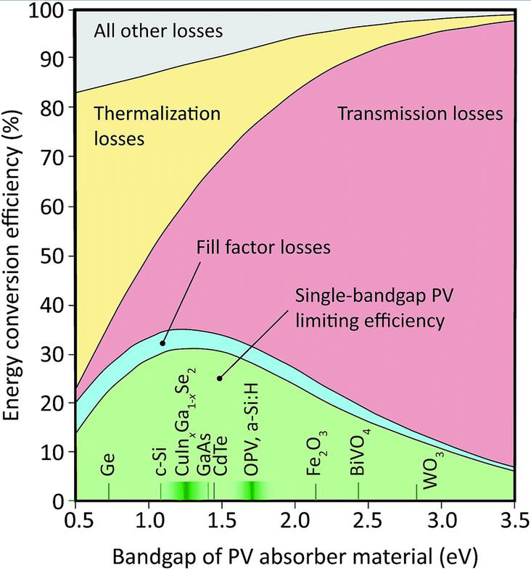
Energy Losses
Resistive
Reflection
Transmission,
absorption
Thermalization
Recombination
Schulze et al., Energy Environ. Sci.,2015, 8,103
Notes:
Accompany with reference to previous figure and a small bit of chalk talk (fill factor)
Way to minimize losses beyond theoretical limit is to couple diff. technologies to utilize parallel absorption and/or diff. bandgaps
Max theoretical limit (given some conditions like single-junction) is Shokley-Quaiser Limit, 34%

Slide 6
Thin Film PVs
Todorov et al., Prog. Photovolt. (2013) 21, 82-87
Notes:
Most new PVs involve thin semiconductor films: lots of potential for mass fabrication and precise bandgap engineering
Slide is largely for the sweet pic

Slide 7
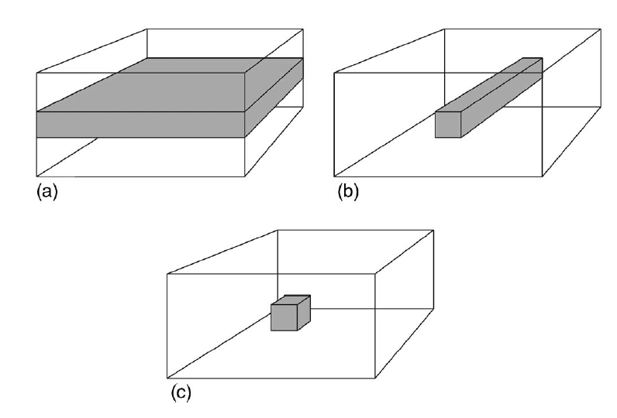
Quantum Dots
Engineering Bandgaps to create different potentials (e.g. finite square well)
Surround low bandgap nanocrystal with higher -> “artificial atom” Discrete energy levels, closer spaced for larger dot
(Riel 2008)
Notes:
Figure: show creating of potential well by matching bandgaps, then generalize to 2D and 3D with quantum wire and quantum dot
Also surprising property that multiple electrons can be excited by a single photon, mysterious mechanism

Slide 8
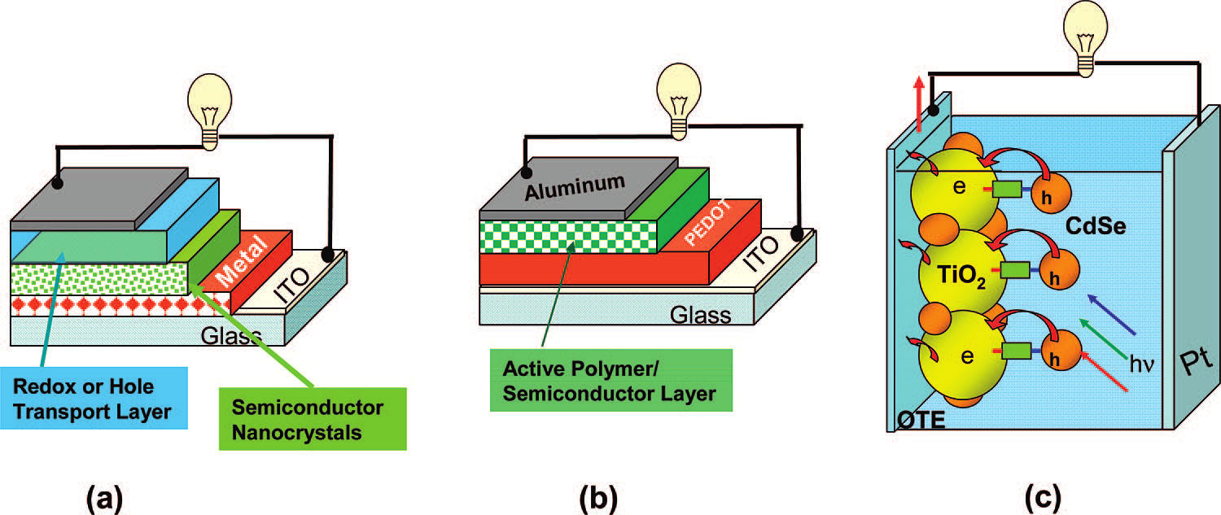
QDPV Types
(Kamat 2008)
Metal-Semiconductor (Schottkey) Junction
Polymer-Semiconductor
Semiconductor-Semiconductor
QDSSC
Notes:
3 Main schemes for using QDs in solar cells: differences lie in engineering bandgaps, energy landscapes of junctions, and manufacturing requirements of different materials

Slide 9
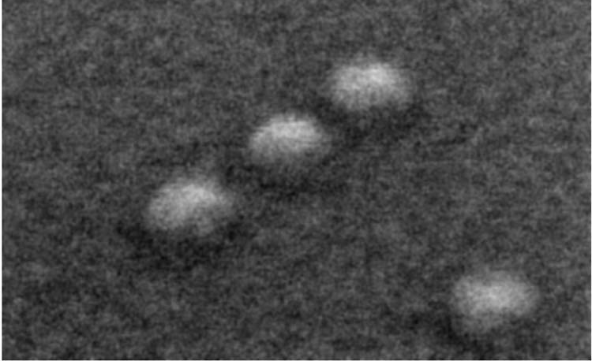
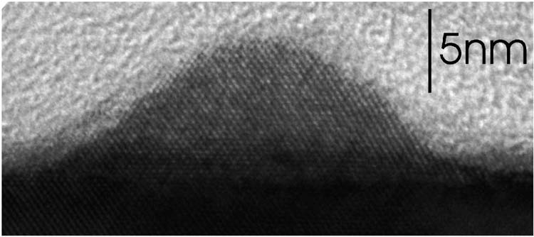
Experiments
Experimental work in classifying QD mixes and their properties in actual PVs
(Riel 2008)
(Kamat 2008)
Notes:
Building small cells and measuring efficiencies as well as creating thin films and classifying, lots of imaging and spectroscopy (UW MAF (molecular analysis facility)
Riel: Self-assembly quantum dots under scanning electron microscope
Kamat: a) Schematic of conductive AFM b) AFM height image of spin-coated film c) Photocurrent map under illumination w/0 external voltage

Slide 10
Schottkey-Junction Cells
(Kamat 2008)
Band bending only occurs in large metal-semiconductor junctions
Get improved energetics in nanoparticles with Fermi-level equilibration
Notes:
Use self-assembled quantum dots on metallic nanoparticle, excitons jump from QD to metal (Kamat ref. 127)
Rather than band-bending in p-n, Fermi-level equilibration causes excited carriers to jump the gap
Classify w/known redox pair
Use redox agent to transfer charge to electrodes
Ecb = conduction ban E, nc = density of conduction electrons, Nc = charge carrier density

Slide 11
Polymer-Semiconductor
Create junction between QD and organic polymer
Lower efficiencies, but potentially much cheaper to mass produce
Potential uses in medical devices
Use of
(Huynh 2002)
Notes:
Image is just an example of a polymer that is used to exchange carriers with excited CdSe quantum dot
Poly-3(hexylthiophene)

Slide 12
Nanorod Detail
100nm
100nm
(Kamat 2008)
Notes:
Hyperbranched nanocrystal solar cell with a) controlled morphology of templated approaches b) no defects c) hyperbranching spans thickness d) 3-D CdSe structure e) CdTe structure, scale bar is 100nM
Also mainly for the cool visual

Slide 13
QDSSC
(Kamat 2008)
Coupling QDs to larger semiconductor particles to improve charge transfer efficiency
TiO₂ has a larger bandgap, lower recombination rate
CdSe can absorb wider range of frequencies
Notes:
Can couple quantum dots to larger semiconductor particles, e.g. CdSe dot with TiO₂ particle
Coupling to larger bandgap increases power conversion efficiency
Band diagram: electron excited in CdSe and moves to lower energy state in TiO2 where larger bandgap prevents recombination

Slide 14
CdSe – TiO₂ Absorbance
Example absorption spectra of CdSe QDs coupled to TiO₂ semiconductor particles
Size dependence is maintained even in composite systems
Can match absorption to solar spectrum
(Kamat 2008)

Slide 15
Size Effect on Efficiency
ICPE = Incident Photon to Charge-carrier-generation Efficiency
Unknown why it’s higher for smaller dots
One cool theory: hot electrons injected
Might reduce thermalization losses
(Kamat 2008)

Slide 16
Current State of QD-PVs
Maximum efficiency: 10.6%
Compare to 34% single junction max, 45% multi-junction
Successful IR sensitive QD-PV
Efficiency above 4%
Initial promise and huge sample space -> high research potential
PV companies face economic and geopolitcal hurdles, high risk/reward market
Helped with better PV technology
Notes:
Molecular Engineering building: labs positively rolling in dough. I find that very comforting given climate change political drama

Slide 17
References
Uhl, A., “A Solar Cell From a Material Science Perspective”, Univ. of Washington, HONORS 396 A.
Charles Kittel (1995) Introduction to Solid State Physics, 7th ed. Wiley, ISBN 0-471-11181-3.
https://en.wikipedia.org/wiki/Valence_and_conduction_bands (for image)
Schulze et al., Energy Environ. Sci.,2015, 8,103 (for image)
K. W. Johnston, A. G. Pattantyus-Abraham, J. P. Clifford, S. H. Myrskog, D. D. MacNeil, L. Levina, and E. H. Sargent, "Schottky-quantum dot photovoltaics for efficient infrared power conversion," Applied Physics Letters, vol. 92, p. 151115, 2008.
J. P. Clifford, K. W. Johnston, L. Levina, E. H. Sargent , “Schottky barriers to colloidal quantum dot films,” Applied Physics Letters, vol. 91, pp. 253117, 2007.
Kamat, Prashant V. "Quantum Dot Solar Cells. Semiconductor Nanocrystals as Light Harvesters †." J. Phys. Chem. C The Journal of Physical Chemistry C 112.48 (2008): 18737-8753. Web. 8 Oct. 2016.
Riel, B. J. "An Introduction to Self-assembled Quantum Dots." American Journal of Physics 76.8 (2008): 750. Web. 8 Oct. 2016.
Guyot-Sionnest, Philippe. "Colloidal Quantum Dots." Comptes Rendus Physique 9.8 (2008): 777-87. Web.
Huynh, W.U. “Hybrid Nanorod-Polymer Solar Cells.” Science 295.5564 (2002) 2425-427. Web. 14 Nov. 2016

