Slide 1
Newborn Screening of Lysosomal Storage Diseases
Michael H. Gelb (Dept. of Chemistry & Biochemistry, Univ. of Washington)
30 yrs of experience in enzymology, organic chemistry, mass spec.
Frank Turecek (Dept. of Chemistry, Univ. of Washington)
35 yrs experience in mass spec instrumentation and theory
C. Ron Scott (Dept. of Medicine, Univ. of Washington)
40 yrs of experience in metabolic diseases and newborn screening
NIH Grant DK67859 (Salvatore Sechi, Program Official)
Today’s Slides:
Google me to find my home page.

Slide 2
Disclosures
We have received funding from and/or worked in
collaboration the following companies:
Perkin Elmer (funding and consulting) Mack Schermer, PE Life Sciecnes
Genzyme (funding and consulting) Joan Keutzer, Genzyme
BioMarin (funding) Nicole Miller, BioMarin
Shire (funding) David Whiteman, Shire
5. Synageva (collaboration) Dana Martin, Synageva
6. Ultragenyx (collaboration) Emil Kakkis, Ultragenyx

Slide 3
Presentation Outline
Brief historical overview.
Worldwide NBS labs live or near-live for LSD NBS
Development of the new UW/PE-FIA-MS/MS-2014 6-Plex Assay
Detailed comparision of the UW/PE-FIA-MS/MS-2014 and digital microfluidics
fluorimetry methods.
5. Large Scale Pilot studies for LSDs

Slide 4
Historical Summary of MS/MS LSD NBS Developments
2004-2009: UW team develops FIA-MS/MS assay for Pompe, Fabry, Niemann Pick-A/B, Krabbe,
MPS-I, Gaucher. Genzyme modifies the method a bit and manufacturers the reagents. CDC
distributes them and developes QC DBS UW/Genzyme/CDC-2008 FIA-MS/MS Method
2006: NY State (J. Orsini et al.) goes live for Krabbe NBS using a slight modification of the
UW/Genzyme/CDC-2008 FIA-MS/MS Method.
2009-2013: D. Kasper, G. La Marca, UW team simplify the pre-MS/MS sample prep by using LC
coupled to MS/MS. UW-LC-MS/MS-2013 Method.
2012: D. Kasper reports a large scale (n=40,000) pilot study of Gaucher, Fabry, NP-A/B, Pompe
using LC-MS/MS showing a very low false positive rate thus validating LSD NBS
Lancet (2012) 379, 335.
2012: Perkin Elmer and UW team up. Push back from some NBS labs to add LC so we return to
FIA-MS/MS. Reagents and buffer optimized. UW/PE-FIA-MS/MS-2014 Method.
2012: IL NBS lab sets up UW-LC-MS/MS-2013 Method. Plans to go live for Pompe, Fabry,
NP-A/B, MPS-I, Krabbe, Gaucher now (see their poster)
2013: WA NBS lab reports a large pilot study (n=110,000) of Pompe, Fabry, MPS-I using
n-1 version of UW/PE-FIA-MS/MS-2014 assay. J. Pediatr. (2013) 163, 498.
2014: WA NBS lab starts large pilot (n=100,000) of UW/PE-FIA-MS/MS Method for 6 LSDs.
.

Slide 5
Worldwide Update on LSD NBS Labs (Live or near-Live)
MS/MS
NY Krabbe UW/Genzyme/CDC-2008 method
IL Pompe, Fabry, MPS-I, Krabbe, NP-A/B, Gaucher UW-LC-MS/MS-2013 method
NJ Pompe, Fabry, MPS-I, Krabbe, NP-A/B, Gaucher UW/PE-FIA-MS/MS-2014 method
WA Pompe, Fabry, MPS-I, Krabbe, NP-A/B, Gaucher UW/PE-FIA-MS/MS-2014 method
PA Pompe, Fabry, MPS-I, Krabbe, NP-A/B, Gaucher UW/PE-FIA-MS/MS-2014 method
PE-Genetics Pompe, Fabry, MPS-I, Krabbe, NP-A/B, Gaucher UW/PE-FIA-MS/MS-2014 method
Greenwood Ctr up to 9 LSDS UW/PE-FIA-MS/MS-2014 method
CFH-Taiwan Pompe, Fabry, Gaucher, MPS-I, MPS-II UW/PE-FIA-MS/MS-2014 method
Taipei Inst Path. Pompe, Fabry, Gaucher, MPS-I UW/PE-FIA-MS/MS-2014 method
Digital Microfluidics Fluorimetry
MO Pompe, Fabry, MPS-I, Gaucher
96-well Plate Fluorimetry
Nat. Taiwan U. Hosp. Pompe, Fabry

Slide 6
Home Brew Reagents for LSD NBS? Maybe for a few but not for most.
Isomerization
Past problems with iduronic acid-4MU:
Availability has been off and on (synthesis is 10-12 steps).
Contains variable amounts of isomeric glucuronic acid-4MU (no good for
MPS-I assays since beta-glucuronidase will produce 4MU and thus give
variation in % activity at the low end.

Slide 7
UW/PE-FIA-MS/MS-2014 Reagents
for Gaucher, Krabbe, Fabry, Niemann-Pick-A/B, Pompe, and MPS-I
Commercialized by Perkin Elmer Corp.
2. Anticipated launch date for kit and reagents Q1, 2016
Mark Kuracina, Mack Schermer, Perkin Elmer Life Sciences

Slide 8
PE/UW 6-Plex Reagents
Similar or identical to the reagents original developed by the Gelb lab and manufactured
by Genzyme but improved to increase rate of dissolution in assay buffer, to increase
the dynamic range of the MS/MS assay, and to include internal standards that are
chemically identical but isotopically distinguished by MS/MS.
GMP manufactured by a company in the USA that has 45 years of experience in
production of related molecules. Syntheses optimized for production scale by
collaboration between Mike Gelb and the manufacturer.
Checked by LC/MSMS to be devoid of enzymatic products (< 0.005% product) and to
be devoid of interfering isomers (i.e. < 0.005% glucuronide in the iduronidate-based
MPS-I substrate). This is critical for enzymatic activity assay at the low end.
Checked in-house with the MS/MS NBS assay using the same SOP as provided with
the kit.
Arun Babu Kumar, Sophia Blanchard, Naveen Chennamaneni (Gelb lab, UW)
Joe Trometer (Perkin Elmer Life Sciences)

Slide 9
UW/PE-FIA-MS/MS-2014
Single buffer for 6 LSDs optimized over a 2 year period by systematic variation
of additives that have been previously reported to modulate lysosomal enzyme
activities

Slide 10
Fluorescence Assay for Niemann-Pick has a serious false negative problem and should not be used for NBS
15-20% cases of NP-AB
are missed with the fluorometric
assay due to a mutation that has no
activity with the natural substrate
but has normal activity with the fluorometric
substrate. This is a deal breaker !
Neuropediatr. (2003) 34, 301
J. Inherit. Metab. Dis. (2005) 28, 733
Use of MS/MS allows enzymes assays to be carried out with the natural substrate
or a close analog. Recent data in the Gelb lab shows that use of the MS/MS substate
solves the false negative problem (to be published). Fluor. substrate for Gaucher, and
Krabbe are also not like the natural substrates. Reasons for concern? Let’s see.

Slide 11
Detailed comparison of FIA-MS/MS Method to the Digital Microfluidics Fluorimetric Method
LSDs covered as of Oct. 2014:
FIA-MS/MS: MPS-I, Fabry, Gaucher, Pompe, MPS-II, Krabbe, Niemann-Pick-A/B,
MPS-IVA, MPS-VI
DMF: MPS-I, Fabry, Gaucher, Pompe, MPS-II

Slide 12
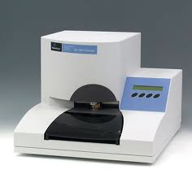
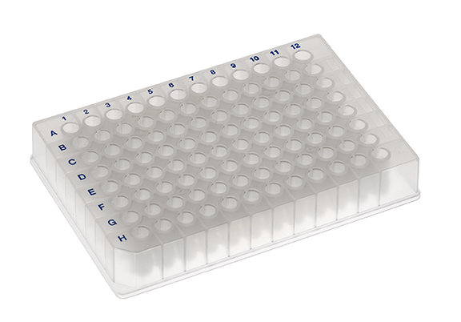
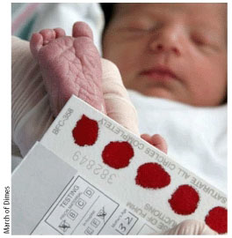
UW/PE-FIA-MS/MS-2014 Method
Note IL is using the UW-LC-MS/MS-2013 method and will likely switch to the
UW/PE-FIA-MS/MS-2014 method in 2016, easy for them to do, just remove the LC column.
Step 1: Punch DBS into 96-well plate
UW/PE to be published

Slide 13
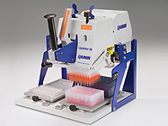
UW/PE-FIA-MS/MS-2014 Method
Step 2: Add 30 μL 6-plex assay cocktail containing 6 substrates and 6 int. stds. to
each well (96 newborns per plate)
1 liquid transfer per 96
newborns
Rainin Liquidator 96-channel pipettor
NO ROBOT needed
UW/PE to be published

Slide 14
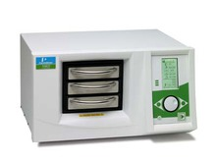
UW/PE-FIA-MS/MS-2014 Method
Step 3: Place 96-well plate in shaker/incubator for overnight incubation.
Already present in NBS labs.
UW/PE to be published

Slide 15
UW/PE-FIA-MS/MS-2014 Method
Step 4: Add 200 μL water then 400 μL ethyl acetate to each well, mix up and down with pipettor 4-5 times.
2 liquid transfer per 96
newborns
Rainin Liquidator 96-channel pipettor
UW/PE to be published

Slide 16
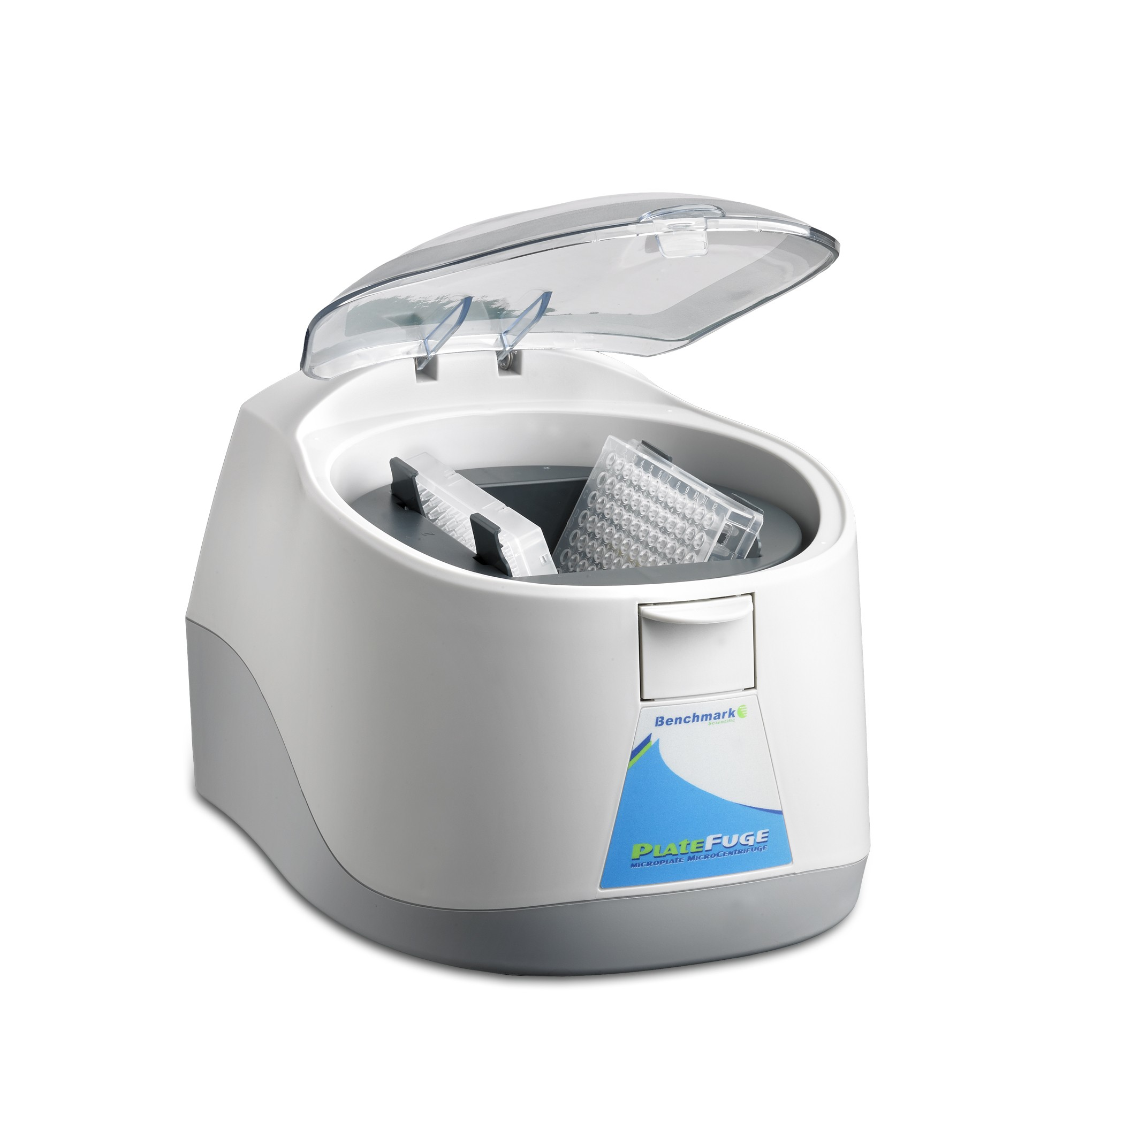
UW/PE-FIA-MS/MS-2014 Method
Step 5: Centrifuge plates 5 min to separate organic and aqueous layers
8 inch diameter plate centrifuge: $4500
UW/PE to be published

Slide 17
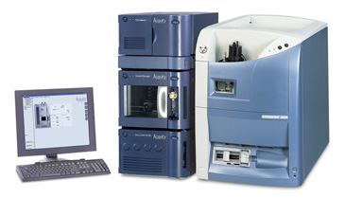
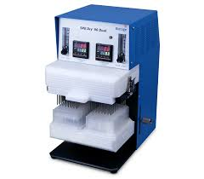
UW/PE-FIA-MS/MS-2014 Method
Step 6: Transfer 200 μL of upper ethyl acetate layer to new 96-well plate.
Step 7: Evaporate ethyl acetate .
Step 8: Add flow injection solvent
Step 9: Place on autosampler for flow injection MS/MS
2 liquid transfer per 96
newborns
Already present in most NBS labs
UW/PE to be published

Slide 18
UW/PE-FIA-MS/MS-2014 Method
Over past 3 years, a SINGLE FTE in the WA NBS lab has run 113,000 DBS per year
on a SINGLE FIA-MS/MS instrument.
No backup MS/MS purchased since the lab already has 1 for the amino acids/acyl
carnitines/organic acid NBS (same machine as used for LSD NBS).

Slide 19
Digital microfluidics fluorimetric 5-plex
Step 1: Punch DBS into 96-well plate, identical to FIA-MS/MS method
R.S. Sista et al. / Clinica Chimica Acta 424 (2013) 12–18

Slide 20
Digital microfluidics fluorimetric 5-plex
Step 2: Add DBS extraction solvent to each well.
Not sure how this is done but a 96-channel pipettor seems appropriate.
1 liquid transfer per
96 newborns
Rainin Liquidator 96-channel pipettor
R.S. Sista et al. / Clinica Chimica Acta 424 (2013) 12–18

Slide 21
Digital microfluidics fluorimetric 5-plex
Step 3: Place 96-well plate in shaker/incubator for 30 min to extract enzymes.
Already present in NBS labs.
R.S. Sista et al. / Clinica Chimica Acta 424 (2013) 12–18

Slide 22
Digital microfluidics fluorimetric 5-plex
Step 4: Centrifuge plates 5 min.
8 inch diameter plate centrifuge: $4500
R.S. Sista et al. / Clinica Chimica Acta 424 (2013) 12–18

Slide 23
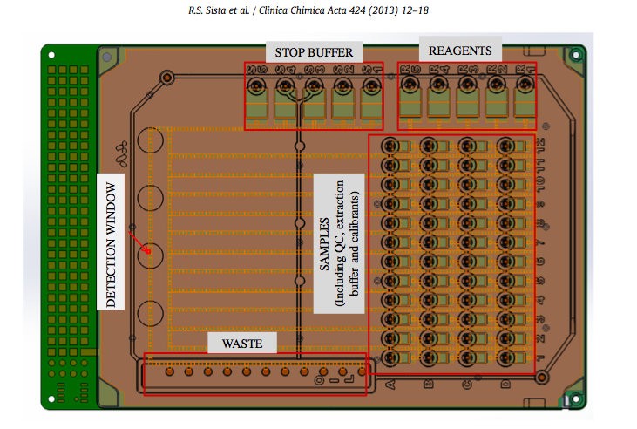
Digital microfluidics fluorimetric 5-plex
Step 5: Transfer 1.6 μL of DBS extract to sample well on microfluidics chip.
Not sure how the small volume is transferred. Each chip accepts 44 enzyme
extracts and 4 calibrators.
2 liquid transfer per
96 newborns if done with a 48-channel pipettor
R.S. Sista et al. / Clinica Chimica Acta 424 (2013) 12–18

Slide 24
Digital microfluidics fluorimetric 5-plex
Step 6: Transfer 5 different assay reagents to 5 different reservoirs on chip
2 liquid transfer per
96 newborns if done with
a 5-channel pipettor
R.S. Sista et al. / Clinica Chimica Acta 424 (2013) 12–18

Slide 25
Digital microfluidics fluorimetric 5-plex
Step 7: Transfer 5 different stop solutions to 5 different reservoirs on chip.
2 liquid transfer per
96 newborns if done with
a 5-channel pipettor
R.S. Sista et al. / Clinica Chimica Acta 424 (2013) 12–18

Slide 26
Digital microfluidics fluorimetric 5-plex
Step 8: Transfer silicone oil to cover chip.
2 liquid transfer per
96 newborns
R.S. Sista et al. / Clinica Chimica Acta 424 (2013) 12–18

Slide 27
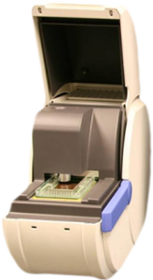
Digital microfluidics fluorimetric 5-plex
Step 9: Place chip in chip reader for reagent mixing, incubation, and fluorimetry.
One workstation is a set of 4 readers
One work station
One work station
R.S. Sista et al. / Clinica Chimica Acta 424 (2013) 12–18

Slide 28
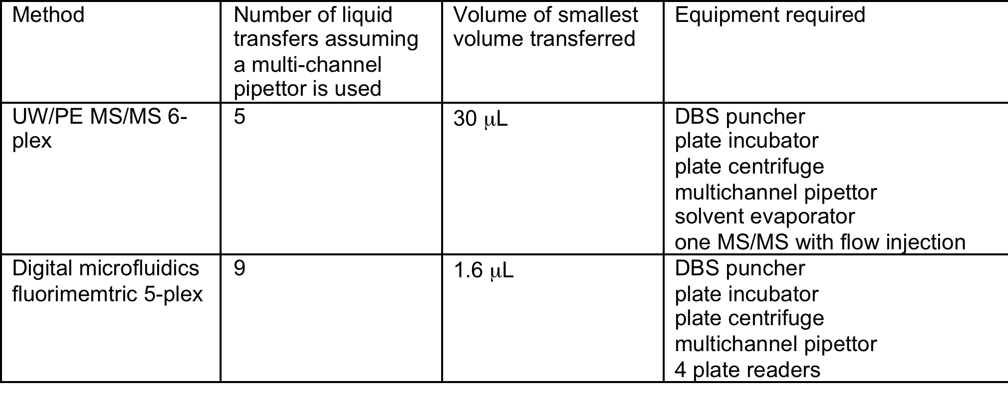
Summary
6
WA state NBS lab, 1 FTE (B.S. level) has been running 6-7 x 96 well plates per
day doing all steps except punching the blood spot (170,000 newborns per year)
using a SINGLE Waters TQD MS/MS with a flow-injection autosampler. A backup
machine may be required, but you could use the backup for amino acid/
acyl carnitine/organic acid analysis since it is the SAME instrument.
Throughput of 1 MS/MS = throughput of 7.8 digital microfluidics machines.

Slide 29
Space Requirements are Similar
MS/MS
one MS/MS instrument
Volume: 14 cu ft
Digital microfluidics fluorimetry
7 Fluorimeter plate readers
Volume: 12.6 cu ft

Slide 30
Estimated costs per newborn per LSD
$0.07
MS
PE
MS/MS
$.05
Reagents
plastic
Dig.
Micro-
Fluidics
Fluor.
$?
DMF
$?
Chips,
Reagents
plastic
~ $1 per newborn per LSD
MS/MS instrumentation cost is the cost of instrumentation purchasing, installation,
maintenance, nitrogen, and electricity divided by the number of LSD enzymes
analyzed before the instrument needs to be replaced (8-10 yrs). Does not include
a backup, presumably most labs already have one for their ongoing MS/MS NBS.
Does not include capital other than installation, but space requirements for MS/MS
is similar to that for digital microfluidics.

Slide 31
Comparison of new UW/PE-MS/MS assay to digital
microflluidics fluorimetric assay.
The critical parameter is the assay signal with blood divided by the signal without
blood, the so-called blood/no blood ratio, aka dynamic range.
Jason Cournoyer, PE Life Sciences

Slide 32
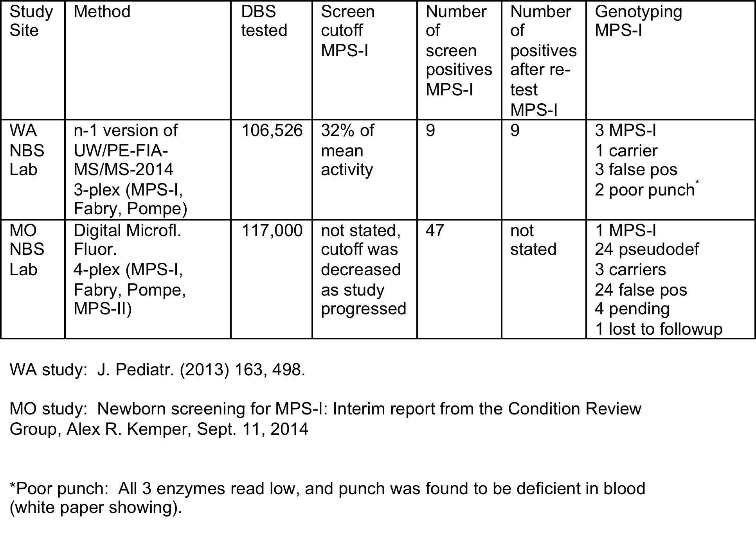
Comparision of 2 large MPS-I Pilots
7
7
57
~2020%
20% of
mean
activity
20%

Slide 33
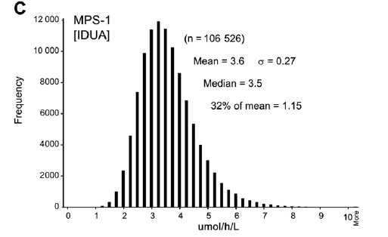
WA state NBS lab 3-plex pilot study
Distribution of IUDA enzymatic activity measured with n-1 version of
UW/PE-FIA-MS/MS-2014 Method
Screen cutoff

Slide 34
Putting all the large-scale NBS pilot studies together
WA vs MO large scale NBS lab comparison: The UW/PE-FIA-MS/MS-2014 method
outperforms the digital microfluidics fluorimetry method in terms of dynamic range
and estimated false positive rates.
Mayo Clinic Pilot: ~100,000 DBS submitted to 4 assays:
Standard microtiter plate fluorimetric assay
UW/Genzyme/CDC-2008-FIA-MS/MS assay
Digital microfluidics fluorimetry assay
Luminex immunoquantification of protein abundance assay
Matern D, Oglesbee D, Tortorelli S.Dev Disabil Res Rev. 2013 Jun;17(3):247-53.
NBS assay performance of assays 2-4 are similar and better than 1. False positive
rates of all four are unacceptably high.
Putting it all together: UW/PE-FIA-MS/MS-2014 assay is the top performing
LSD NBS assay. Furthermore the UW/Genzyme/CDC-2008 assay is becoming
obsolete and is being replaced by the UW/PE-FIA-MS/MS-2014 assay.

Slide 35
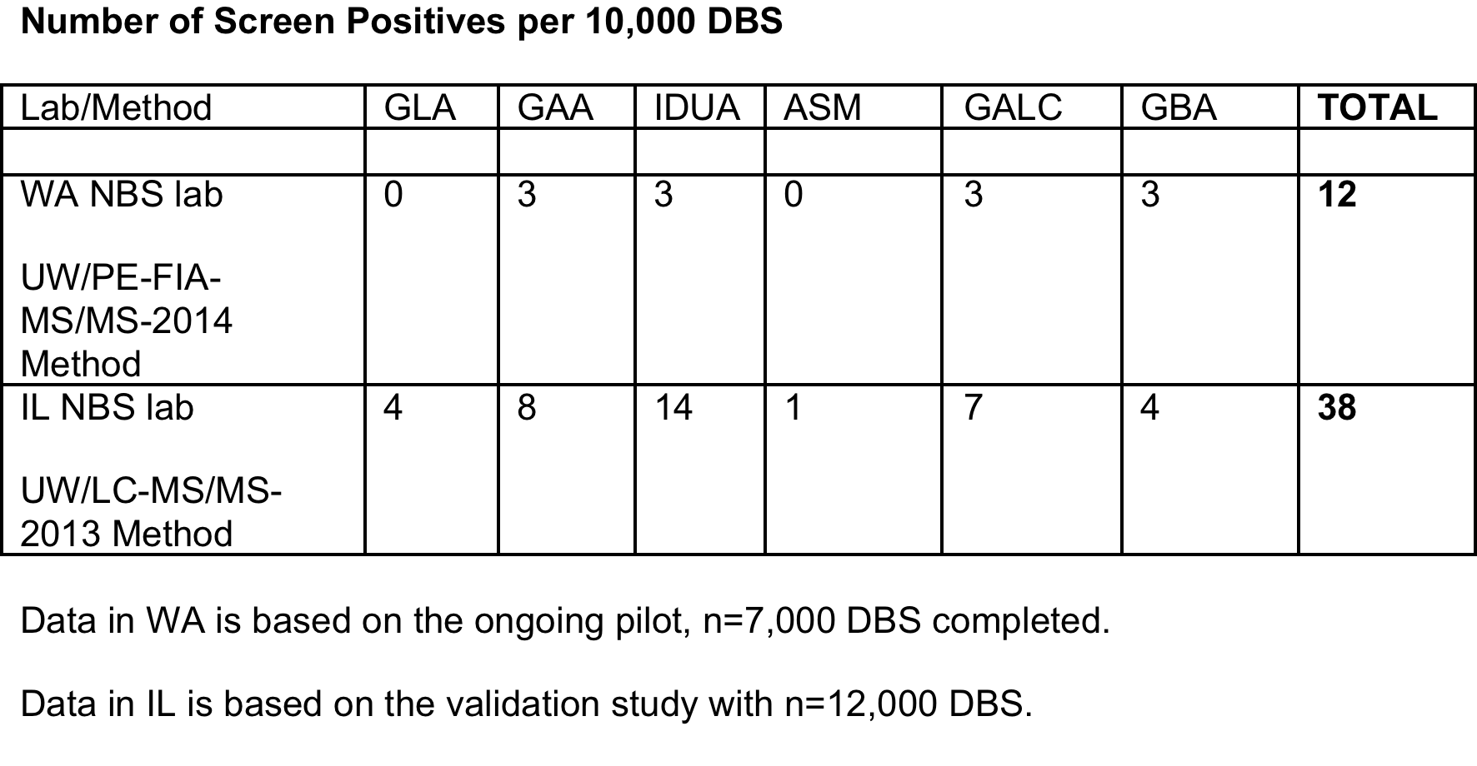
Comparison of UW/PE-FIA-MS/MS-2014 6-plex to UW-LC-MS/MS-2013 6-plex
LC and FIA MS/MS are likely to be equivalent, better performance in WA likely
due to improved reagents and buffer in assay cocktail

Slide 36
Summary
There are multiple fluorimetric and MS/MS methods for LSD NBS.
MS/MS methods are converging to the UW/PE-FIA-2014 method for 3 reasons:
1) It is simpler to carry out the pre-MS/MS steps.
2) It outperforms the earlier developed MS/MS methods in terms of false positives.
3) The PE kit will likely be the only long-term source of MS/MS reagents, and
home-brew is probably not feasible.
The comparison of 2 large pilot studies (~110,000 DBS), the WA state NBS lab
MS/MS 3-plex study (n-1 version of UW/PE-FIA-MS/MS-2104 method) and
the MO state NBS lab 4-plex study (digital microfluidics fluorimetry) shows
that the MS/MS method greatly outperforms the fluor. method in terms
the number of screen positives and the false positive rates. Large scale
pilot studies using conventional fluorimetry shows enormously high false positive rates.
4. Pre-instrumentation sample preparation is easier for the UW/PE-FIA-MS/MS-2014
method compared to digital microfluidics fluorimetry.
Manpower and space requirements of the two methods are similar
Cost of the two methods are likely to be similar.

Slide 37


UW
Mariana Barcenas
Sophie Blanchard
Naveen Chennamaneni
Trisha Duffey
Scott Gerber
Frances Hocutt
Tanvir Khaliq
Arun Babu Kumar
Yijun Li
Sophia Masi
Martin Sadilek
Zdenek Spacil
Haribabu Tatipaka
Ding Wang
Brian Wolfe
Perkin Elmer
Jason Cournoyer
Anna Butterfield
Carole Elbin
Joe Trometer
Alex Cherkasskiy
Mack Schermer
Mark Kuracina
Genzyme Corp.
Joan Keutzer
Helmut Kallwass
Kate Zhang
Petra Olivova
Daniel Scheidegger
xc
Shire Corp.
David Whiteman
BioMarin Corp.
Nicole Miller
Tom Lester
Frank Turecek
Dept. of Chemistry
Univ. of Washington
C. Ronald Scott
Dept. of Medicine
Univ. of Washington
Funding: NIH, Genzyme Corp.,
BioMarin Corp., Perkin Elmer, Shire

Slide 38
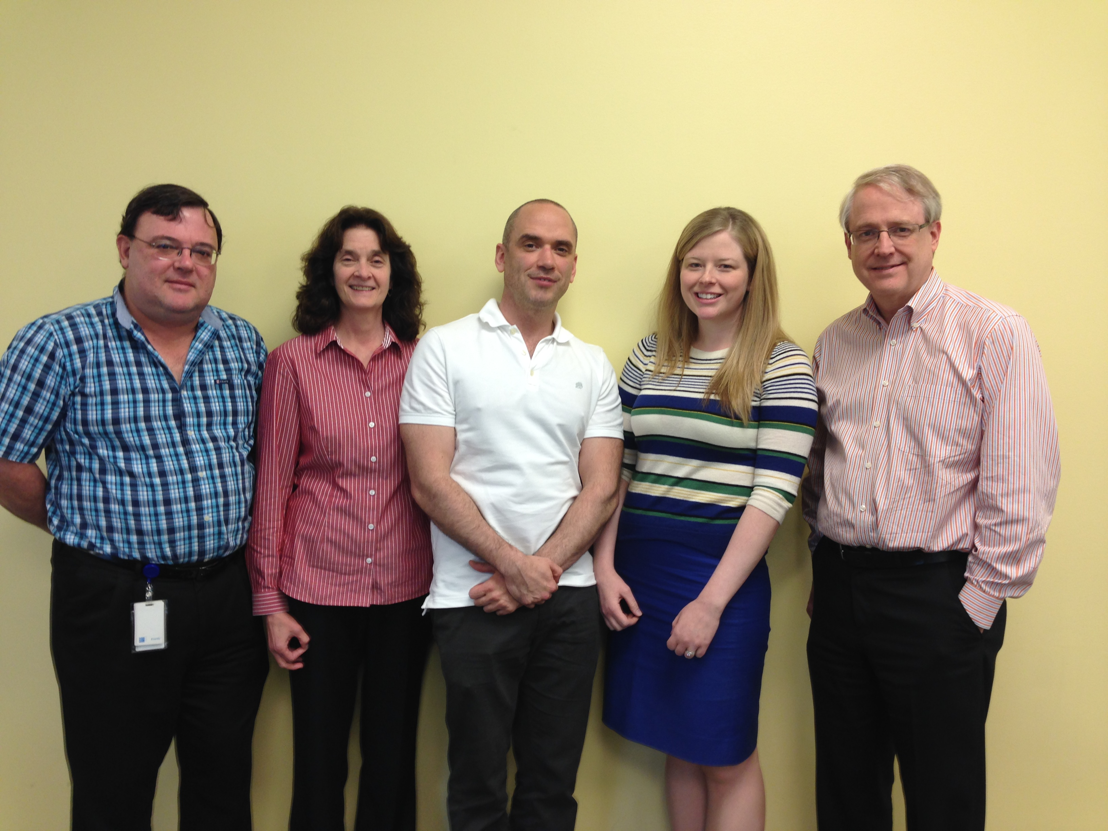
The Perkin Elmer Development Team

Slide 39
Improved Assays for the Enzymes Relevant to
the Mucopolysaccharidoses
Michael H. Gelb (Dept. of Chemistry & Biochemistry, Univ. of Washington)
30 yrs of experience in enzymology, organic chemistry, mass spec.
Frank Turecek (Dept. of Chemistry, Univ. of Washington)
35 yrs experience in mass spec instrumentation and theory
C. Ron Scott (Dept. of Medicine, Univ. of Washington)
40 yrs of experience in metabolic diseases and newborn screening
NIH Grant DK67859 (Salvatore Sechi, Program Official)
Today’s Slides:
Google me to find my home page.

Slide 40
Alpha-Iduronidase for Assay of MPS-I (Hurler, Schei Syndromes)
Original MPS-I Substrate
(made by Genzyme, distributed by CDC)
New MPS-I Substrate
Available from Perkin Elmer,
~Q1, 2016
~10-fold more sensitive than original
MPS-I substrate

Slide 41
Design of the aglycone
Simple to synthesize
Readily extracts into ethyl acetate from buffer.
Readily protonates in the gas phase.
Fragments in the gas phase along a major pahtway.
5. Easily deuterated in the benzoyl portion for internal standard
preparation.

Slide 42
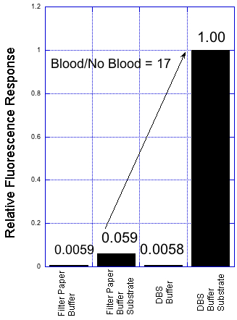
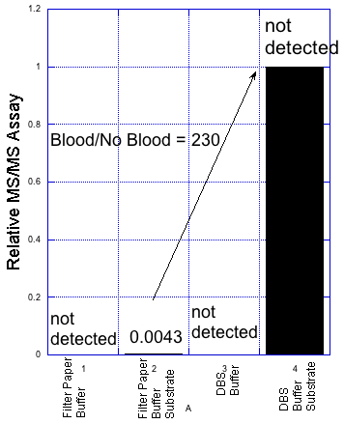
Fluorescence vs MS/MS Assay of IDUA in DBS for MPS-I

Slide 43
Comparision of 2 large MPS-I Pilots
7
7
57
~2020%
20% of
mean
activity
20%

Slide 44
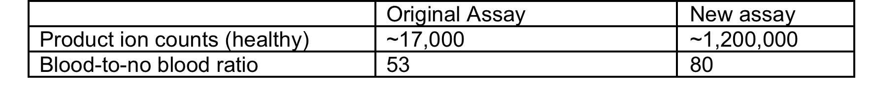
New MS/MS assay for ID2S for MPS-II
Detect by
flow injection
MS/MS

Slide 45
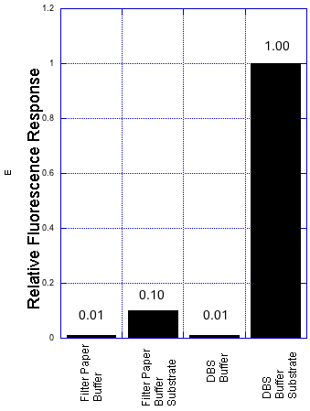
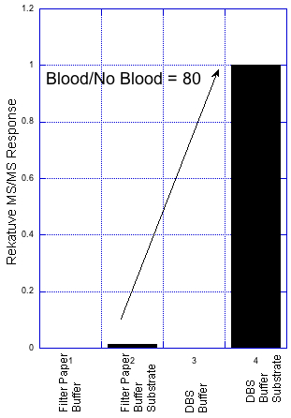
Fluorescence vs FIA-MS/MS assay of I2S (MPS-II) in DBS
Blood/No Blood = 10

Slide 46
MPS-II FIA-MS/MS Pilot Study, WA state NBS Lab
Started Aug, 2014. To reach n = 100,000.
Screen cutoff 20% of daily mean.
0 hits out of 4964
Cutoff
Pilot studies also started in Taiwan and Belgium

Slide 47
ASB (MPS-VI) Assay Reagents
Classical Reagent
New MS/MS Reagent

Slide 48
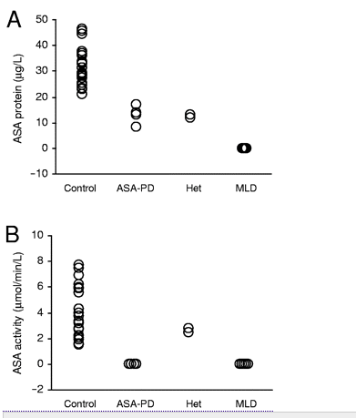
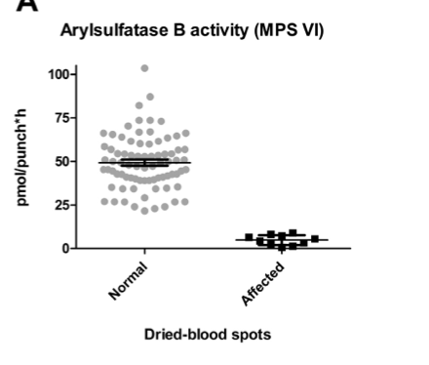
Assay with 4MU-Sulfate
ASA
ASB
Molec. Genet. Metabol. Reports
(2014) 1, 465
Clin. Chem. (2008) 54, 1925.

Slide 49
Improved Assay for GALNS for MPS-IVA (Morquio A)
Original MPS-IVA
Substrate
New MPS-IVA
Substrate

Slide 50
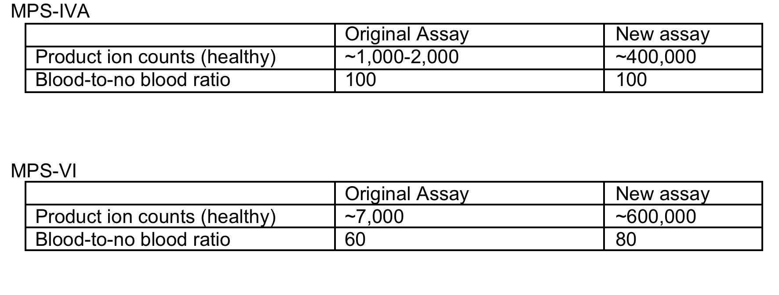
New MS/MS assays for MPS-IVA and VI

Slide 51
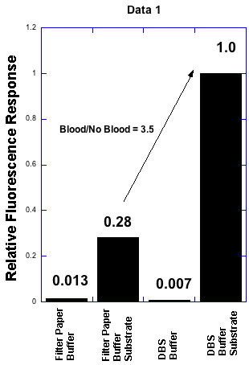
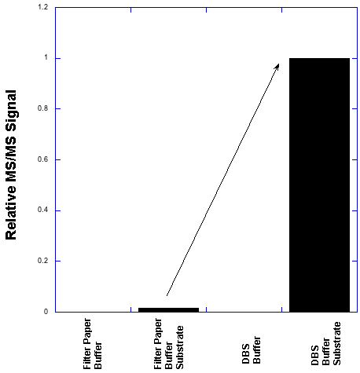
Fluorescence vs FIA-MS/MS assay of GALNS (MPS-IVA) in DBS
Fluorescence Asssay (4MU Substrate)
FIA-MS/MS Assay
Clin. Chim. Acta (2011) 412, 1805
Gelb lab, unpublished
1.0
48 hr incubation
12 hr incubation
Blood/No Blood = 68
not
detected
0.0147
not
detected

Slide 52
PE Genetics is gearing up to offer MPS-I, MPS-II, MPS-IVA, and MPS-VI
MS/MS assays for outside labs that need an enzyme test.
Reagents will also be available to diagnostic labs that want to do their
own assays.
Mack Schermer, Perkin Elmer
Marck Kuracina, Perkin Elmer

Slide 53
MS/MS for GLA/GAA activity distinguishes IOPD/LOPD from pseudodeficiencies
Data from Joyce Liao, Chinese Foundation of Health, Taiwan (to be published)

Slide 54
Radiometric Assay for GALC Activity in Leukocytes for
Evaluation of Screen Positive Krabbe Samples (NY)
high risk < 3.6% of mean normal
moderate risk 3.7-7% of mean normal
low risk 7.1-12 % of mean normal
no risk > 12% of mean normal
NY NBS program (Clin. Chim. Acta. 2013, 18, 73)

Slide 55
The Gold Standard?
4MU fluorescence enzyme assay with purified leukocytes
We think we can do better with MS/MS.
A collaborative study of 4MU-fluorescence vs MS/MS assays on
several hundred leukocytes from LSD patients
(early onset, late onset, and pseudodeficiencies)
has been initiated with the Women’s & Children’s Hospital,
Adelaide, Australia (Enzo Ranieri)

Slide 56
It seems clear that new diseases including additional LSDs will be
added to the NBS panel in the coming years.
Reliable fluorimetric assays for Niemann-Pick-A/B, MPS-VI, Metachromatic
Leukodystrophy and Wilson disease are not likely to be developed.
MS/MS not only provides the solution to assays for which a fluorimetric
assay does not exist but also allows biomarker-based screening to be
included in the same multiplex run as the enzyme assays.
IDUA activity for MPS-I
GAA activity for Pompe
Glu4 for Pompe
GLA activity for Fabry
Gal-Gal-Glu-Ceramide for Fabry
GALC activity for Krabbe
Psychosine for Krabbe
ABG activity for Gaucher
Glu-Sphingosine for Gaucher
C26-LPC for X-ALD
Biotinidase activity for biotinidase deficiency
Sulfatides for MLD
Enzyme activities for MPS-IIIA-D
C26-LPC for X-ALD
Psychosine for Krabbe
Glucosyl-sphingosine for Gaucher
Lyso-sphingomyelin for Niemann-Pick-A/B
Sulfatides for Metachromatic Leukodystrophy
Gal4 for Pompe
Gal-Gal-Glu-Ceramide for Fabry
GAG fragments for MPSs
Inclusion of the biomarkers will reduce false positives and help to
sort out early and late onset and pseudodeficiencies.
If I was a NBS lab I would invest in MS/MS.
GALNS activity for MPS-IVA
ASB activity for MPS-VI
GUS activity for MPS-VII
ASM activity for Niemann-Pick-A/B
Lysosphingomyelin for Niemann-Pick-A/B
Lysosomal acid lipase for Wilson disease

Slide 57
Summary
New MS/MS-based enzymatic assays for several MPS syndromes have been developed.
The new assays display a much larger dynamic range compared to first-generation
MS/MS assays and compared to fluorimetric assays.
4MU-fluorimetric assays have a low dynamic range because of intrinsic fluorescence
of the 4MU-substrates.
4. Pilot studies with the new MPS-I and MPS-II MS/MS reagents show a dramatic
reduction in the number of screen positives (less false positives and pseudodeficiencies).
5. Perkin Elmer Genetics will offer enzyme tests for multiple MPS diseases as well
as reagents to labs that want to do their own tests.
6. MPS-I NBS is starting in IL, MO, NJ, PA, and Taiwan.
7. MPS-II will be added to the IL and NJ NBS program in the next several months.
8. Additional MS/MS assays are being developed: MPS-IIIA-D, MPS-VII, MLD, LAL

Slide 58
UW
Mariana Barcenas
Sophie Blanchard
Naveen Chennamaneni
Trisha Duffey
Scott Gerber
Frances Hocutt
Tanvir Khaliq
Arun Babu Kumar
Yijun Li
Sophia Masi
Martin Sadilek
Zdenek Spacil
Haribabu Tatipaka
Ding Wang
Brian Wolfe
Perkin Elmer
Jason Cournoyer
Anna Butterfield
Carole Elbin
Joe Trometer
Alex Cherkasskiy
Mack Schermer
Mark Kuracina
Genzyme Corp.
Joan Keutzer
Helmut Kallwass
Kate Zhang
Petra Olivova
Daniel Scheidegger
xc
Shire Corp.
David Whiteman
BioMarin Corp.
Nicole Miller
Tom Lester
Frank Turecek
Dept. of Chemistry
Univ. of Washington
C. Ronald Scott
Dept. of Medicine
Univ. of Washington
Funding: NIH, Genzyme Corp.,
BioMarin Corp., Perkin Elmer, Shire

