Slide 1
Concepts for Information Design: Medium and Genre
Notes:
xx

Slide 2
HCDE 510 Information Design, Fall 2011
Department of Human Centered Design &
Engineering, University of Washington
David K. Farkas
Notes:
xx

Slide 3
Concepts
Media/Medium
Mediation/Mediation effects
Genre
Rhetorical moves
Standard Expository Model (SEM)
Genre bending
Notes:
Here are key concepts for TC 510
Many are standard. In some cases I have coined the term (in accordance with accepted theory).
Some of these concepts are complex, slippery, and contested

Slide 4
Media
Communication technologies that transcend time and space
Classifying media is difficult
Is the newspaper a single medium?
PowerPoint a medium?
Is Flash a medium or a application/tool used in other media?
Media space (convenient umbrella term)
Notes:
The challenge: classifying media
Media evolve, compete and (very slowly) die out
A medium can communicate many genres. Often, but not always, a genre can cross media
Media choice is a major design decision
Movies: traditional reel vs. digital projection—do you even know?
Email on WebPine vs. Outlook (etc.) very similar in some ways but very, very different.
Good term: “Media space”

Slide 5
Media
Media evolve, compete and (very slowly) die out
Notes:
The challenge: classifying media
Media evolve, compete and (very slowly) die out
A medium can communicate many genres. Often, but not always, a genre can cross media
Media choice is a major design decision

Slide 6
Mediation/Mediation effects
Any aspect of a medium that influences communication—font choices, authoring tool, speaker’s voice
Cultural influences on communication. Cultural forces mediate.
Mediation is a much broader concept than medium

Slide 7
Web
The web is an exceptionally broad medium (or
media space) that encompasses almost all other
modalities, media, and genres.
In addition, it does not fully constrain the
presentation of its content. The experience differs
by platform, browser, setting, etc.

Slide 8
Genre
A genre is a recognized category of document (or other communication event).
A genre is (1) recognizable as an instance of a genre and (2) fulfills a recognized social role (purpose).
“Social roles” are easier to articulate for functional documents than in literary and entertainment genres.
Notes:
There is a tension between categorization and the social constructed nature of genres. Genres are categories, but these categories are always being undermined as culture changes.

Slide 9
The centrality of genre
Every document belongs to one or more genres
We cannot create or intelligently comprehend documents independent of their genres
Genres evolve, blend, are spoofed, and (slowly) fade away

Slide 10
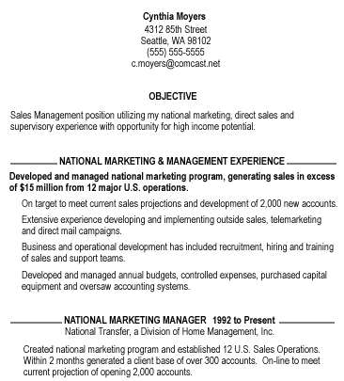
Identifying genres: How do we know what genre this is?

Slide 11
Rhetorical moves
Rhetorical moves are units of discourse that serve a specific purpose
Moves constitute genres—there are mandatory and elective moves
Expressiveness resides in choice and handling of moves
Expert communicators are masters of the moves of the genres they work in
Notes:
defined as a functional unit in a text used for
some identifiable purpose, Swales, J. (1990). Genre analysis: English in academic and research settings. Cambridge: Cambridge University
Press.
Units of meaning. Small specific components of meaning.
Personal statement when applying to graduate school. What do you SAY?
Like social “moves”

Slide 12
What are the “moves” for an email canceling a lunch meeting/date?
What happens if you handle these moves clumsily?
What happens if you diverge from the expected moves in an extreme way?
How might cancelling a first date with a prospective romantic partner differ from cancelling a lunch meeting with a friend or business associate?

Slide 13
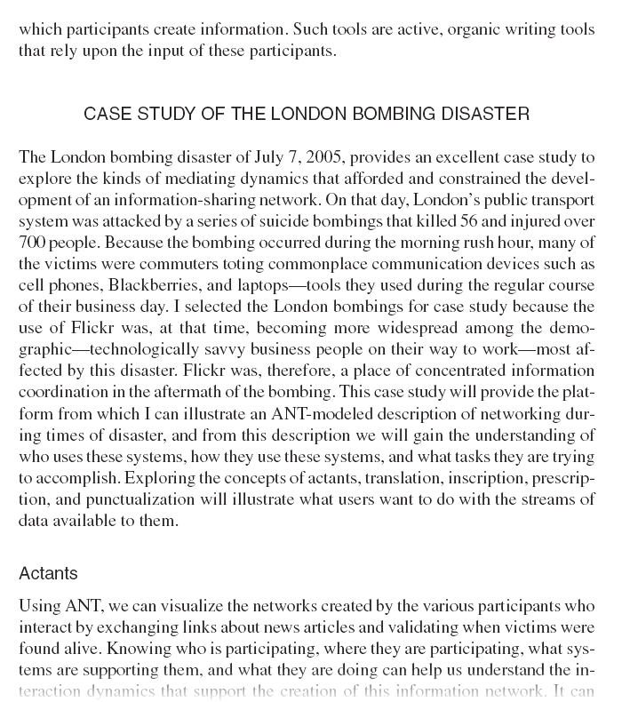
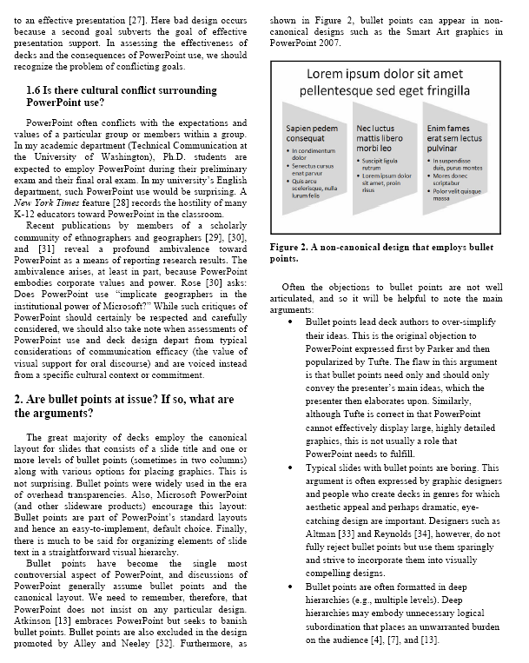
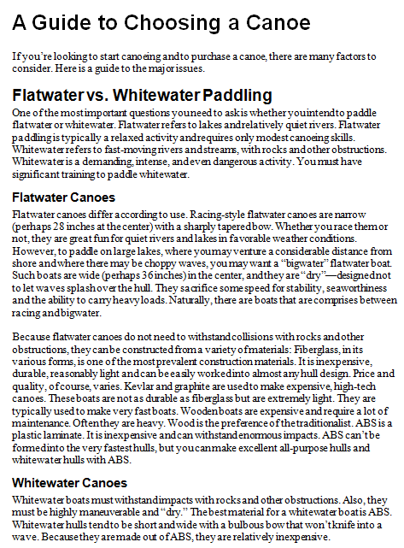
The standard expository model (SEM): A format for many genres

Slide 14
The centrality of genre
Every document belongs to one or more genres.
We cannot create or intelligently comprehend documents independent of their genres
Genres evolve, blend, are spoofed, and (slowly) fade away

Slide 15
How do we define a genre?
Is a business card a genre?
Is PowerPoint a genre?
Is a business letter a genre?
Is a technical briefing a genre?
Are tabs on a website a genre?
Is an web-based store a genre?

Slide 16
Many genres can cross media
But not all media
Examples?
Notes:
We are familiar with print, HTML, and PDF resumes.
The same content can appear in multiple media (e.g., Inconvenient Truth—book, movie; journal article—print, pdf).

Slide 17
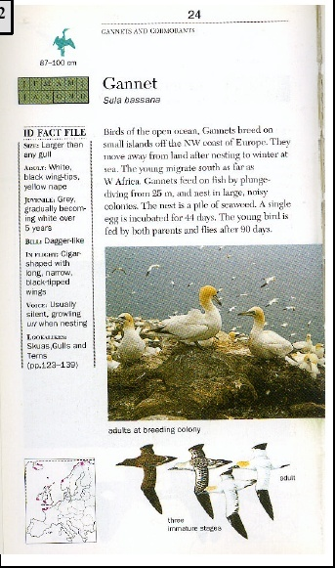
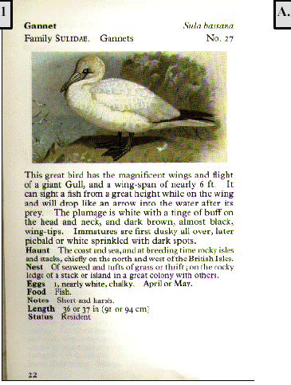
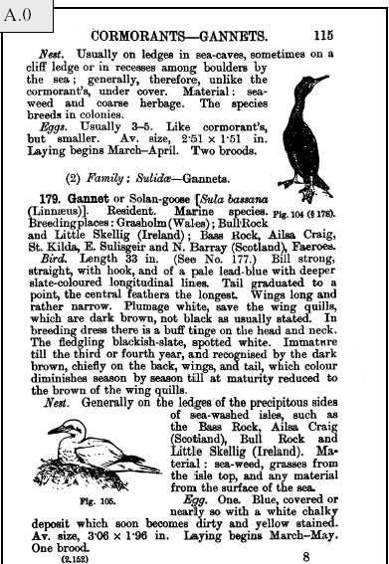
Genres evolve

Slide 18
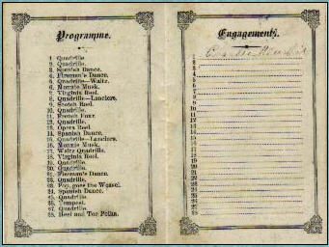
Genres sometimes die out

Slide 19
Genre bending-1
There is much “genre bending”—but will the audience “get it”

Slide 20
Genre bending-2

Slide 21
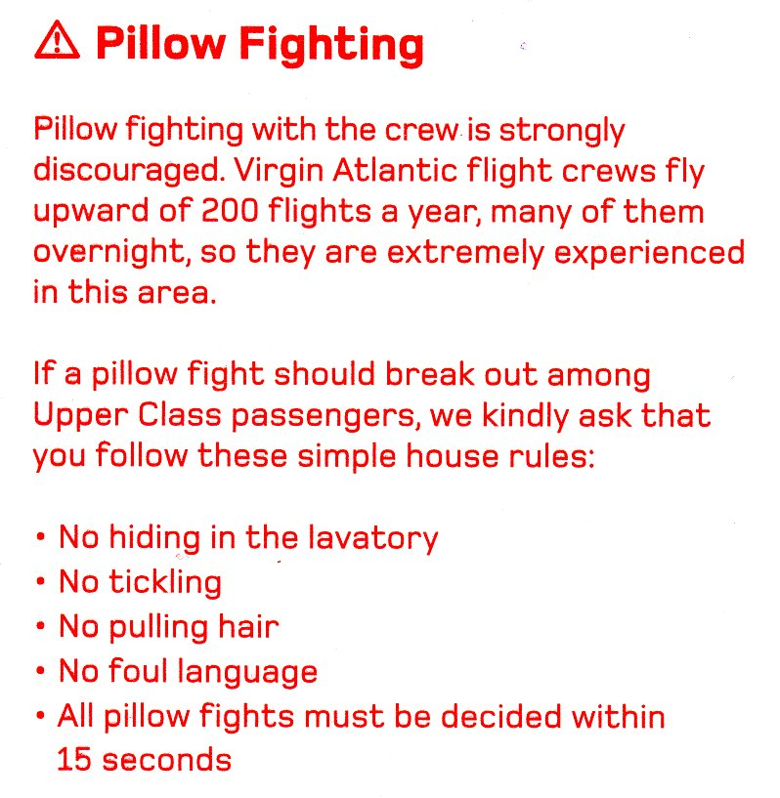
Genre bending-3

Slide 22
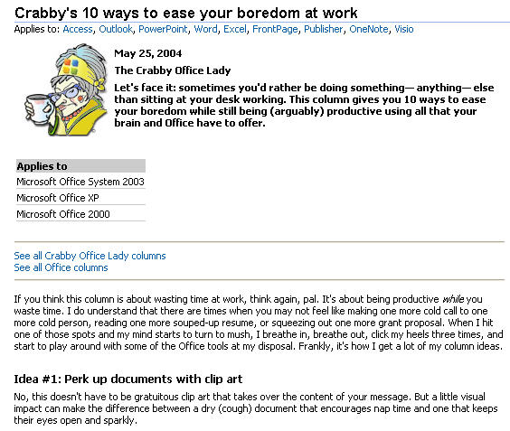
Genre bending-4

Slide 23
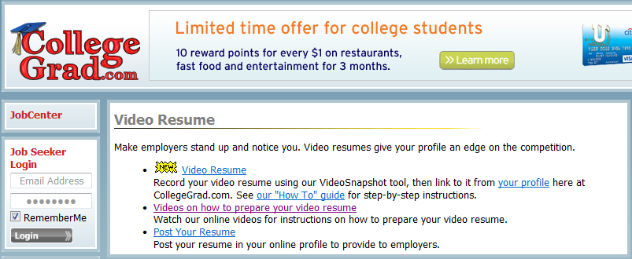
Genre bending-5

