Slide 1
Concepts for Information Design: Communication Concepts
Notes:
xx

Slide 2
HCDE 510 Information Design, Fall 2011
Department of Human Centered Design &
Engineering, University of Washington
David K. Farkas
Notes:
xx

Slide 3
Concepts
Communication
Discourse
Document
Negotiation of meaning
Media
Genre
Negotiation of meaning
Genre
Notes:
Here are key concepts for TC 510
Many are standard. In some cases I have coined the term (in accordance with accepted theory).
Some of these concepts are complex, slippery, and contested

Slide 4
Communication
Working definition: The process of sharing our
thoughts and experiences
We communicate messages, information,
knowledge, wisdom, etc.
Notes:
A “message” is a simple, unambiguous idea.
Complicated concept
Simple definition: The process of sharing ideas or experience
I come to the bus stop. “Did the 372 come by?” No, not yet. I have gained the benefit of being at the bus stop, even though I wasn’t. Simple message is easy to communicate
I tell you about a concert I attended. I describe the experience. You don’t get everything—a full experience is hard to convey. But you learn something about the concert and my reaction.

Slide 5
Discourse
Definition: Communication through language
Speech
Text
Visuals*
Content UX: User experience from content—primacy of crafted discourse.
Notes:
Includes multimedia, gestures, and artifacts such as beads with encoded meaning
Status as discourse a “stretch”
Evolution: Speech, visuals, text
Is there a syntax of visual, a true visual language? Highly debatable, but we will include visual communication as discourse (less than critical problem in that visual communication is usually complemented by text or speech.)
Other terms: graphics, images
Which came first, speech, visuals or text?

Slide 6
Document
Discourse that is crafted (has value) and recorded.
Traditionally documents were fixed, designed not to change. Now we have an “open” documents—e.g. Wikipedia.

Slide 7
Name some categories of documents
Static text and graphic
Moving graphics
Interactive
Emerging technologies

Slide 8
About documents
Is there a user experience?
Is there a UI?

Slide 9
Media
Communication technologies that transcend time and space
Notes:
The challenge: classifying media
Media evolve, compete and (very slowly) die out
A medium can communicate many genres. Often, but not always, a genre can cross media
Media choice is a major design decision
Movies: traditional reel vs. digital projection—do you even know?
Email on WebPine vs. Outlook (etc.) very similar in some ways but very, very different.
Good term: “Media space”

Slide 10
Genre
A genre is a recognized category of document.
A genre is (1) recognizable as an instance of a genre and (2) fulfills a recognized social role (purpose).
Notes:
There is a tension between categorization and the social constructed nature of genres. Genres are categories, but these categories are always being undermined as culture changes.

Slide 11
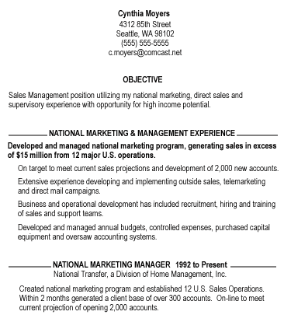
Identifying genres: How do we know what genre this is?

Slide 12
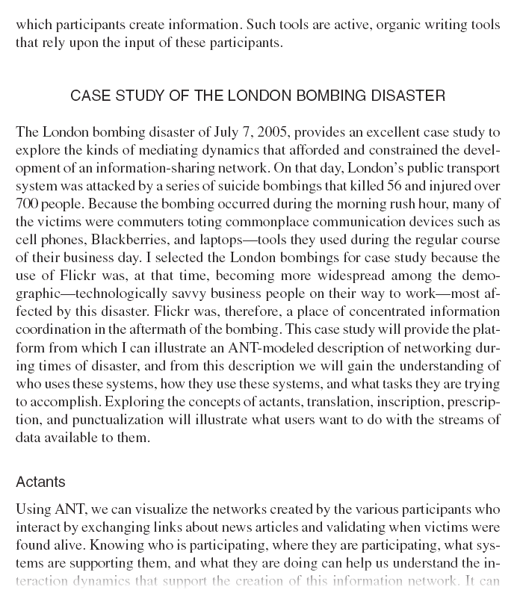
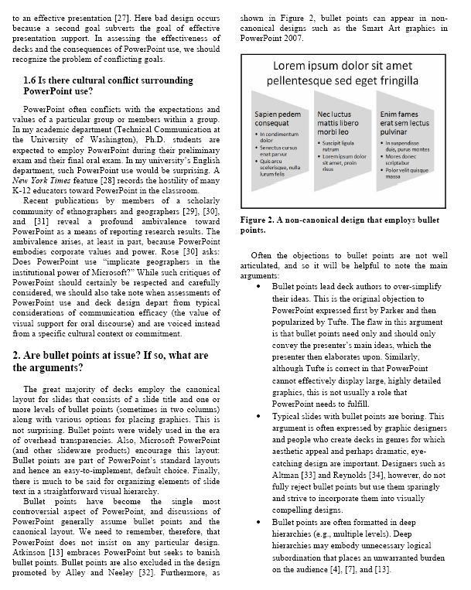
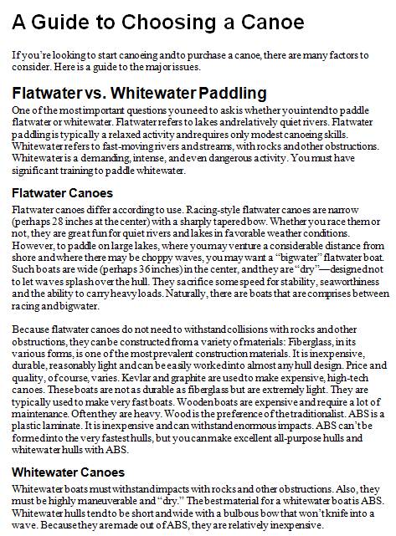
The standard expository model: A format for many genres

Slide 13
Negotiation of meaning
Communication is deeply social.
Meaning is co-constructed among communicators.
Writers internalize their audiences and stakeholders as they compose.
Readers do not passively absorb. Rather they apply their own framework, opinions, etc.
Notes:
Giving a talk about, say, PowerPoint. DF: They want a simple-minded set of do’s and don’t, but I’m not going to do that. Phil Bereano: What did you tell them about me?
Audiences make meaning drawing upon their backgrounds and predilections.
We take this into account when create discourse. Our audiences enter into our heads.
Shannon and Weaver’s model is inadequate: human beings don’t transmit meaning
Communication skills are social skills.
Bereano story (Stakeholders are part of your negotiation of meaning—not just audience)

Slide 14
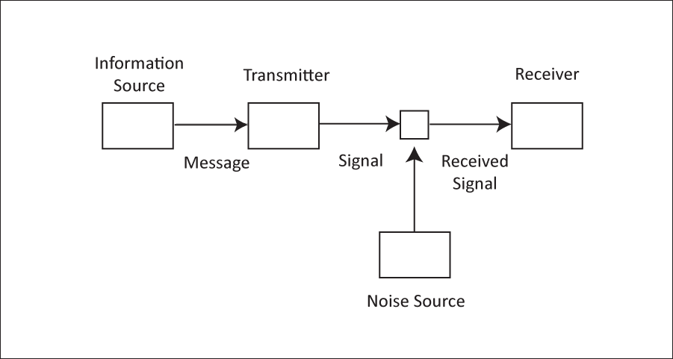
Negotiation of meaning
Shannon and Weaver’s model is inadequate.
Notes:
Audiences make meaning drawing upon their backgrounds and predilections
Shannon and Weaver’s model is inadequate: human beings don’t transmit meaning
Communication skills are social skills

Slide 15
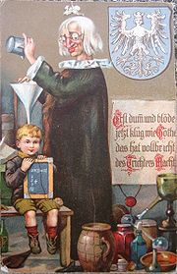
Negotiation of meaning
The Nuremberg Funnel
Notes:
This is a parody (I believe from the 17th century) of the notion that communication is a simple, one-direction process. This is a challenge to Shannon and Weaver and a more modern insight about communication centuries before Shannon and Weaver.

