Slide 1
Designing and Writing Procedures
Slides to support teaching from the chapter “Designing and Writing Procedures“
in
Teaching Professional and Technical Communication: A Practicum in a Book
edited by Tracy Bridgeford, University of Utah Press, 2018.
These slides are in the public domain and can be used or modified without restriction.

Slide 2
Procedures explain how to do something
Also called “instructions”
Process descriptions
Product demos
Functional descriptions (for instance “tool tips”)
Similar to procedures:

Slide 3
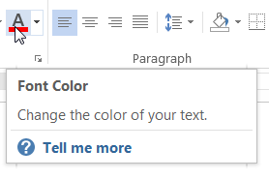
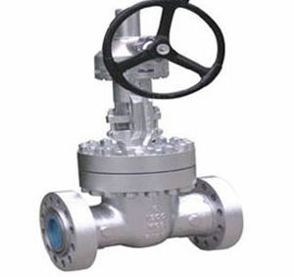
Functional descriptions
Functional descriptions tell you what a UI element is for. But they don’t explicitly tell you what to do.
Valve labeled “Pressure release”
Tool tip

Slide 4
Preview: Components of procedures
Standard procedures consist of a
Title
Introduction (optional)
Steps
Feedback statements (optional)
Notes (optional)

Slide 6
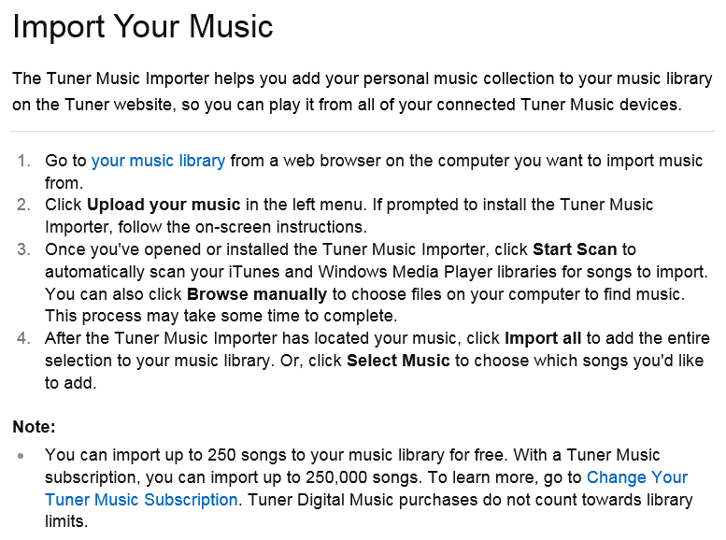

Slide 7
What about graphics? What about video?
Graphics show users what you’re referring to—where something is and what it looks like.
How to identify knotweed
Resize corner Status bar
Video is especially good at showing actions and movement
How to remove knotweed by herbicide injection

Slide 8
Procedure exercise: Part 1 Writing a procedure for Lego construction
Keep your Lego brick object hidden from the other team in your group.
Spend 10 minutes writing a procedure that will enable your audience, the other team, to replicate your object. Visuals cannot be used.
Exchange procedures. Then, working for 10 minutes, try to replicate the other team’s object.
Reveal the objects. Discuss the differences in the procedures and how well each procedure worked.

Slide 9
Tips for writing your procedure
Think about the points of the compass, alignment, corners, and offsetting a Lego brick one position from the edge.
Use techniques such as a limited amount of redundancy to prevent errors.

Slide 10
Procedure exercise: Part 2 Space invaders are attacking Earth. We can stop them with Legos!
The space invaders are afraid of another race of aliens who fly around in a wide variety of Lego-like space craft.
Our only hope is to create billions of small objects resembling these space craft. Each Earth dwelling needs one to ward off the invaders.

Slide 11
Revise your procedure
Make clear that color doesn’t matter. Any color Legos will do.
Should the Legos be glued together?
Use whatever components you need.
Title
Introduction
Steps
Feedback
Notes

Slide 12
Title
Make it long enough to explain the purpose of the procedure. A good guideline is 5 to 8 words.
Automating your work
Using macros
Automate your work with macros
How to use our built-in macros
How to save time by automating your work with our built-in macros

Slide 13
Introduction (if needed)
One or two paragraphs that elaborate on the title
“Is this really what I want to do?”
State anything the user should know before starting to carry out the procedure (or deciding not to)

Slide 14
A further explanation of the purpose
A graphic would be helpful

Slide 15
Pointing out consequences
Saving as text (.txt)
When you save a file in text format, the file size decreases greatly, and you will be able to open the file in a wide range of applications. Caution: All your formatting will be lost.

Slide 16
Pointing out pre-requisites
Sealing a case
When you seal a case, the contents of the file can no longer be changed in any way. A case can only be sealed if the Enable Sealing option was chosen when the case was created.

Slide 17
Steps
Steps are the central component of procedures. They tell the user to do something—and how.
Press the On button.
On the Home tab, in the Styles group, click . . . .

Slide 18
Special steps
Some steps show an option:
If you prefer a crispy-crust pizza, do not use a baking sheet and bake the pizza at 375 degrees.
Other steps explain a condition that must be dealt with:
If you are in the Transactions view, switch to the Report view.
If the System Load indicator shows high activity, launch a subsystem before proceeding further.

Slide 19
Feedback statements
Feedback statements are sometimes added to steps. They describe explicitly the result of carrying out a step. They can give the user confidence and help prevent errors.
Tap any note in your document. Blue boxes appear around all the notes.

Slide 20
Notes and tips
Notes and tips include all kinds of useful information. They can appear anywhere in a procedure. Use sparingly.
Tip: Make sure you click on the tip of the triangle.

Slide 21
Sports video exercise
A celebrity athlete who demonstrates how to serve a tennis ball, hit a golf ball, etc.
On-screen host for the intro and conclusion
Off-screen narrator who explains action in detail
Videographer
Fingers simulate a camera lens. Moves toward action for close-ups. Stiffens fingers for “freeze.” Rolls fingers slowly for slow motion.
Director
Everyone contributes to the script

