Slide 1
Designing and Writing Procedures
Slides to support teaching from the chapter “Designing and Writing Procedures“
in
Teaching Professional and Technical Communication: A Practicum in a Book
edited by Tracy Bridgeford, University of Utah Press, 2018.
These slides are in the public domain and can be used or modified without restriction.

Slide 2
Procedures explain how to do something
Also called “instructions”
Process descriptions
Product demos
Functional descriptions (for instance “tool tips”)
Similar to procedures:

Slide 3
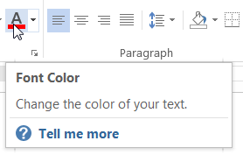
Functional descriptions
Functional descriptions tell you what a UI element is for. But they don’t explicitly tell you what to do.
Valve labeled “Pressure release”
Tool tip

Slide 4
Where do we find procedures?
How good are they?
What problems do we see?
Notes:
More complex than UI design. Procedures supplement UI. Users see and try the UI first. Procedures need to be perfectly tuned to the limitations of the UI. You lose users if you explain too much of what’s obvious. But you don’t want any of your users to fail.

Slide 5
Instructions for a digital consumer product
Notes:
This is an adequate instruction sheet for a very simple product. Consists of safety warnings, call-outs to identify some controls and a few procedures that are reasonably clear.
However, they are using one instruction sheet for multiple products and multiple languages. Look at the colored dots. Often, the user has a problem figuring out the parts of the instructions that pertain to the model you’ve bought.
Also, to fit the instruction sheet in a small box, the graphics are often too small. (Little Timex watch inserts?)

Slide 6
Preview: Components of procedures
Standard procedures consist of a
Title
Introduction (optional)
Steps
Feedback statements (optional)
Notes (optional)

Slide 8
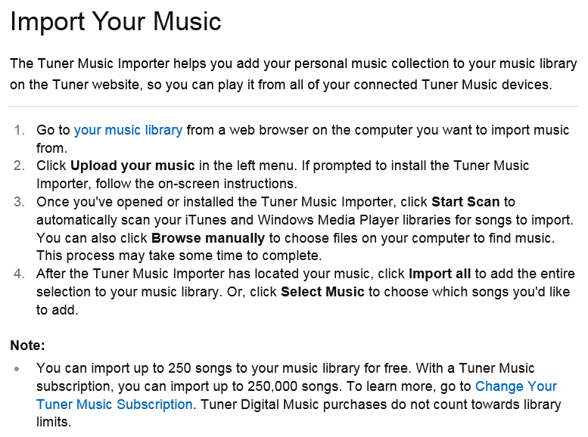

Slide 9
Preview: Components of procedures
Standard procedures consist of a
Title
Introduction (optional)
Steps
Notes (optional)
Notes:
Now I want to start talking about how we write procedures. (And you will be writing a procedure and submitting it to Joe). This is the simple overview—but it gets more complex than this.
TITLE
Everything typically has a title, just so it’s identified. “Instructions”
But very often a title gives the purpose of the procedure in brief. There is likely to be a set of procedures among which the user chooses. They are invitations.
INTRO
STEPS
NOTES

Slide 11
Notes:
The graphic should show HOW hanging indents are typically used: bulleted and numbered lists.

Slide 12
Domain (“subject matter”)
The domain of a procedure matters a lot to writers
Digital systems
Mechanical/electrical systems
Objects in physical world
Intangible (e.g., leadership, running a meeting)
Which domain is likely to be the most difficult?
Notes:
So many procedures are written for software and digital systems that people something equate procedures with digital products. This is certainly not so.
There are various domains (the kind of system you’re writing about)—and the domain will affect how you design and write your procedures.
Introduce some concepts as background. You always design procedures to fit the situation—esp. what you’re writing about. So you need to think about the domain.

Slide 13
System state
Procedures vary a lot according to the initial state of the system and how the user wishes to change that state
Assembly, installation, configuration
Operation (routine and emergency)
Troubleshooting
Dismantling and recycling
Notes:
And system state.
Most domains have multiple possible system states.
Many procedure genres derive from system state.

Slide 14
Audiences differ
Different backgrounds and abilities
Different goals and information needs
How much do they want to know?
Do they want to retain the content?
Different cultures

Slide 15
. . . But they also share important traits
Have limited short-term memory (minimize “cognitive load”)
Like examples
Are impatient (want to do work, not read instructions)

Slide 16
Procedures communicate via the following (usually in combination):
Text
Images (diagrams, drawings, screen captures, photographs)
Video
Voice

Slide 17
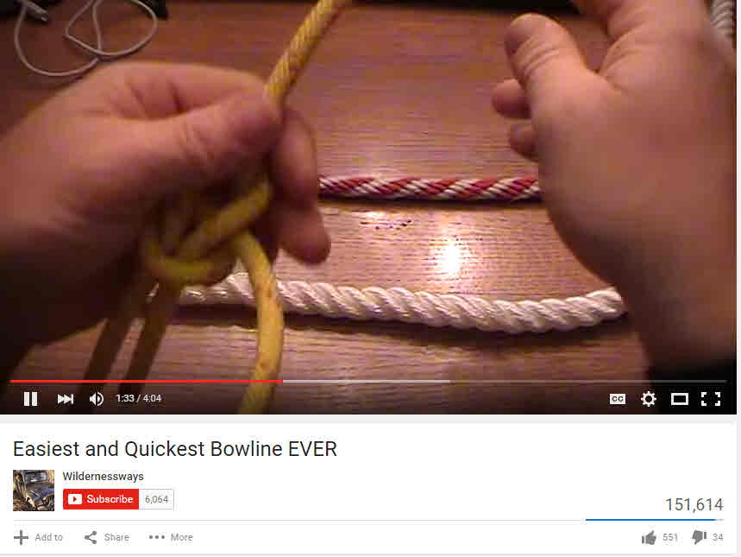
Example: Video procedures

Slide 18
What about graphics? What about video?
Graphics show users what you’re referring to—where something is and what it looks like.
How to identify knotweed
Resize corner Status bar
Video is especially good at showing actions and movement
How to remove knotweed by herbicide injection

Slide 19
Procedure exercise: Part 1 Writing a procedure for Lego construction
Keep your Lego brick object hidden from the other team in your group.
Spend 10 minutes writing a procedure that will enable your audience, the other team, to replicate your object. Visuals cannot be used.
Exchange procedures. Then, working for 10 minutes, try to replicate the other team’s object.
Reveal the objects. Discuss the differences in the procedures and how well each procedure worked.

Slide 20
Tips for writing your procedure
Think about the points of the compass, alignment, corners, and offsetting a Lego brick one position from the edge.
Use techniques such as a limited amount of redundancy to prevent errors.

Slide 21
Procedure exercise: Part 2 Space invaders are attacking Earth. We can stop them with Legos!
The space invaders are afraid of another race of aliens who fly around in a wide variety of Lego-like space craft.
Our only hope is to create billions of small objects resembling these space craft. Each Earth dwelling needs one to ward off the invaders.

Slide 22
Revise your procedure
Make clear that color doesn’t matter. Any color Legos will do.
Should the Legos be glued together?
Use whatever components you need.
Title
Introduction
Steps
Feedback
Notes

Slide 23
Title
Make it long enough to explain the purpose of the procedure. A good guideline is 5 to 8 words.
Automating your work
Using macros
Automate your work with macros
How to use our built-in macros
How to save time by automating your work with our built-in macros

Slide 24
Introduction (if needed)
One or two paragraphs that elaborate on the title
“Is this really what I want to do?”
State anything the user should know before starting to carry out the procedure (or deciding not to)

Slide 25
A further explanation of the purpose
A graphic would be helpful

Slide 26
Pointing out consequences
Saving as text (.txt)
When you save a file in text format, the file size decreases greatly, and you will be able to open the file in a wide range of applications. Caution: All your formatting will be lost.

Slide 27
Pointing out pre-requisites
Sealing a case
When you seal a case, the contents of the file can no longer be changed in any way. A case can only be sealed if the Enable Sealing option was chosen when the case was created.

Slide 28
Steps
Steps are the central component of procedures. They tell the user to do something—and how.
Press the On button.
On the Home tab, in the Styles group, click . . . .

Slide 29
Do-it steps
Express a simple action :
Press the On button.
Can also show location:
On the Home tab, in the Styles group, click . . . .
Can also explain how to carry out the action:
Release the catch mechanism by pushing firmly on the ends of both latches.

Slide 30
Feedback statements
Feedback statements are sometimes added to Do it steps and other steps as well. They describe explicitly the result of carrying out a step. They can give the user confidence and help prevent errors.
Tap any note in your document. Blue boxes appear around all the notes.

Slide 31
User option steps
Offer an opportunity to achieve a variation on the main goal
If you prefer a crispy-crust pizza, do not use a baking sheet and bake the pizza at 375 degrees.
Click the files you wish to archive. To select multiple adjacent files, drag the mouse pointer over these files.

Slide 32
Conditional steps
Explain how to identify and address an unwanted condition. These are not presented as options.
If you are in the Transactions view, switch to the Report view.
If the System Load indicator shows high activity, launch a subsystem before proceeding further.

Slide 33
This one is different. What’s going on here?
Rap periodically on the filter housing to ensure maximum suction.
Click Bottom to complete the first box.
Is this just a simple “Do it step?
Is this a user option?
Is this conditional?

Slide 34
Local purpose steps
Often added to a Do It step. They add extra words explaining why this step is necessary.
During prolonged use on very dusty surfaces, rap periodically on the filter housing to clear it of dust and ensure maximum suction.
May also serve as milestones in a long procedure:
Click Bottom to complete the box.

Slide 35
Feedback statements
Feedback statements are sometimes added to steps. They describe explicitly the result of carrying out a step. They can give the user confidence and help prevent errors.
Tap any note in your document. Blue boxes appear around all the notes.

Slide 36
Notes and tips
Notes and tips include all kinds of useful information. They can appear anywhere in a procedure. Use sparingly.
Tip: Make sure you click on the tip of the triangle.

Slide 37
Notes, warnings, tips
Notes and tips include all kinds of useful information. They can appear anywhere in a procedure. Use sparingly.
Cautions and warnings must be highly visible and appear before the place in the procedure where the user can get into trouble
Tip: Make sure you click on the tip of the triangle.

Slide 38
Sports video exercise
A celebrity athlete who demonstrates how to serve a tennis ball, hit a golf ball, etc.
On-screen host for the intro and conclusion
Off-screen narrator who explains action in detail
Videographer
Fingers simulate a camera lens. Moves toward action for close-ups. Stiffens fingers for “freeze.” Rolls fingers slowly for slow motion.
Director
Everyone contributes to the script

