Slide 1
Contemporary Procedure Writing
Prof. David K. Farkas
Boot Camp for UA 2015
Seattle, WA
April 15, 2015
farkas@uw.edu
http://faculty.washington.edu/farkas
Notes:
Studied 30 years; Joe 25
Early: full of energy
“Basic Training” No background needed
But not entirely simple
Language and logic.
Daunting tech terms
Explain it all. --Time at the end for questions
My website: publications on UA.

Slide 2
Introduction
Procedures are the workhorse of UA
If you understand procedures, you can figure out the other forms of UA
In this session you will gain a deep level understanding of procedures
Occasionally, I’ll rope in a related idea
Introduction
Notes:
Most of your content will be procedures.
Core form of UA:
Tutorials, wizards, troubleshooting are offshoots, variants
OPPORTUNISTIC

Slide 3
Procedures consist of components—mandatory and optional
Topic title
Conceptual element
Infinitive subheading
Step(s)
“Do-it" step
User option step
Conditional step
Local purpose step
Feedback statement(s)
Notes
Based on:
D.K. Farkas
The Logical and Rhetorical Construction of Procedural Discourse, Technical Communication, 46(1), February 1999, pp. 42-54.
Notes:
ANALYTICAL METHOD
Each components has a role.
Not an art or talent but a craft—principles.
Based on article
Foundation for learning DITA (DITA compatible: one exception)
http://ditaspec.suite-sol.com/langref/context.html

Slide 4
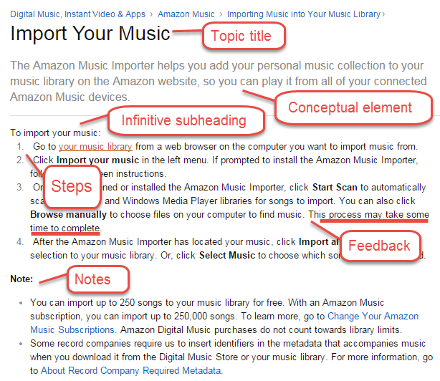
Introduction
Notes:
. . . each component.
“Information machine” Very robust and serviceable.
I’m not talking DITA,
but this is DITA compatible.

Slide 5
Topic titles

Slide 6
Topic titles (mandatory)
Briefly explain the purpose of the procedure
Make your topic titles “longish,” so they can help the user pick out the desired help topic
Automating your work
Using macros
Automating your work with macros
Topic titles
Notes:
Role
Does title match my need, my goal?

Slide 7
Topic title
Phrasing options:
Verb root: Automate your work with macros
Gerund: Automating your work with macros
“How to”: How to automate your work with macros
Infinitive: To automate your work with macros
Topic titles
Notes:
How to and infinitive are problematic.
You standardize on one of these constructions
(a few exceptions)

Slide 8
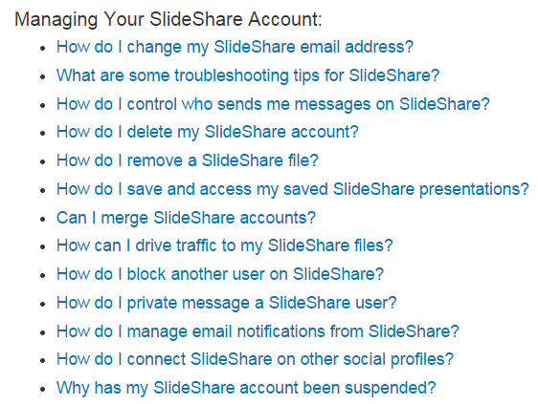
“How to” phrasing creates a scanning problem on this pick list
Topic titles
Notes:
Hard to find significant words: delete, block.
Alphabetizing
Deleting my SlideShare Account
Blocking another user
Maybe: Troubleshooting: Why has . . .

Slide 9
Infinitives create the expectation that a step will follow immediately
You lose the option to add a conceptual element, etc.
To specify Backup configuration options
On the Configuration tab, click Backup.
Topic titles
Notes:
Straightjacket

Slide 10
Designing UA: You need to make a plan
Part of the UA design process is to create a set of model procedures that will accommodate the variations you intend.
For example, it is possible that some of your procedures will use a table. So you need to design a model procedure that includes a table.
Notes:
You’re not writing individual topics in isolation.
A design model: set of model procedures
Encompass all your variations.
DITA has table elements

Slide 11
Conceptual element

Slide 12
Conceptual element (optional)
Further explains the purpose (goal) of the procedure and essential information about the system
Also:
Points out pre-requisites
Points out non-obvious consequences
Use only when the topic title isn’t sufficient
Conceptual element
Notes:
Optional/Role:
Role: more information than topic title:
Case by case (Once, every topic)

Slide 13
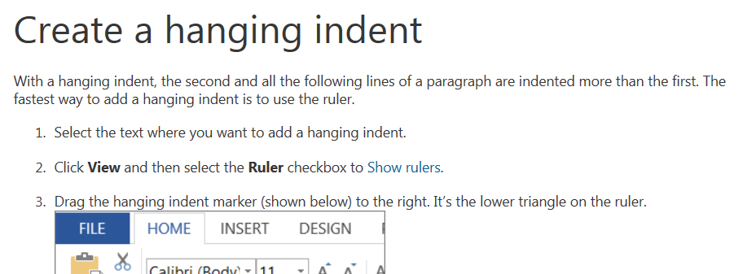
A further explanation of the purpose
A graphic would be helpful
Conceptual element
Notes:
User may not know the phrase “hanging indent”
Conceptual element explains it.
Small graphic showing a hanging indent

Slide 14
A further explanation of the purpose
An example would be helpful here, but this is mobile UA
Copy and paste a text style
You can copy the style of selected text and apply that style to other text.
Select text.
Tap Style, then tap Copy Style.
Select other text to apply the style to.
Tap Style, then tap Paste Style.
Conceptual element
Notes:
Phrase “text style” is not very explanatory.
Conceptual element unpacks it a little.
“For example, you can copy the boldface styling and larger font size of a heading.”

Slide 15
Indicating prerequisites
Sealing a case
When you seal case, the contents of the file can no longer be changed in any way. A case can only be sealed if the Enable Sealing option was chosen when the case was created.
Conceptual element
Notes:
Usually, you are told to perform the pre-requisite step.
THIS pre-requisite: You MAY be unable to perform this task at all.
Presumably, this option will be visible when the user starts the procedure.

Slide 16
Pointing out consequences
Saving as text (.txt)
When you save a file in text format, the file size decreases greatly, and you will be able to open the file in a wide range of applications. Note: All your formatting will be lost.
Inserting a manual page break
You can end a page and start a new page at any time. When you enter a manual page break, the existing automatic page breaks re-adjust themselves.
Conceptual element
Notes:
Consequence: losing formatting (Might be a Caution.)
Manual page break: Avoid puzzling reader

Slide 17
Overviews
Overviews are longer, higher-level conceptual elements that usually introduce a group of procedures
Overviews are also often used to help users make the best choice from a pick list of procedure titles
Notes:
Conceptual info to provide context for multiple procedures.
Good to link to overview from a procedure that depends on it.

Slide 18
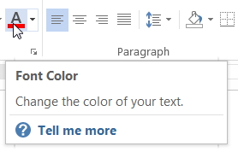
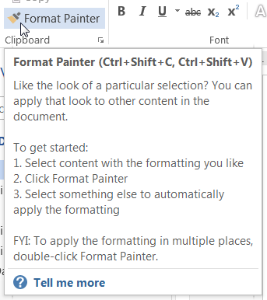
Tool tips
In their “pure” form tooltips are functional descriptions
They don’t tell how to locate or how to use (click, drag, etc.) the UI element
Elaborated form
Notes:
Procedures: goal → what UI elements to do it.
Tooltips (specific UI element→ tells user what does this do?
Do we like tooltips????
What are pros and cons????
Limitation: User needs to have found correct location.
Limitation: Best for simple tasks that can be executed in one location.
Work well together:
“Tell me more”

Slide 19
Infinitive subheading

Slide 20
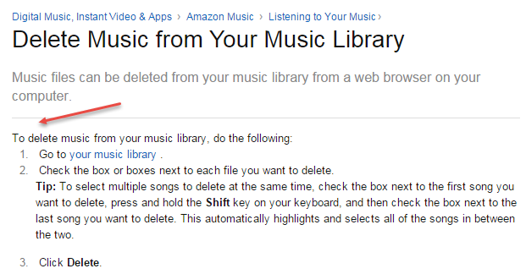
Infinitive subheading (optional)
Signals that steps follow immediately
Infinitive subheading
Notes:
Immediately precedes the steps.
Once standard practice, . . . now coming back.
Don’t need “do the following”
DITA: “stem sentence”

Slide 21
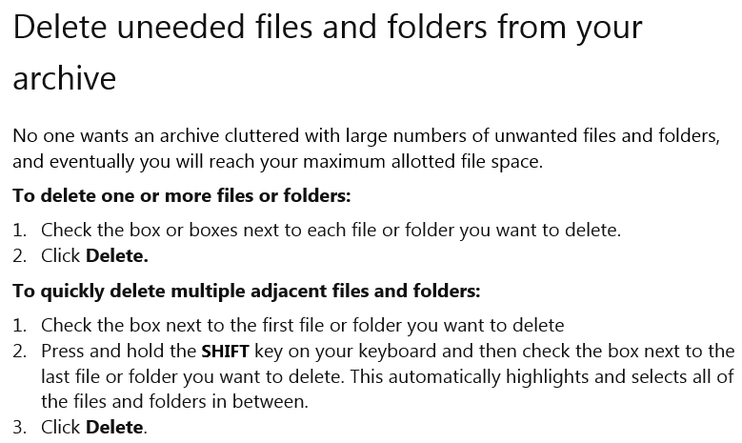
Infinitive subheading (optional)
Can introduce multiple short procedures in a topic
Notes:
Special use . . . never went way.
Differentiates multiple closely related procedures on same topic.
Perfect use:
Do to one; do to many
Stretching the DITA spec here. Two procedures on one topic
But plenty of UA is not DITA.

Slide 22
How much functionality should individual procedures cover?
Short, narrowly focused procedure topics are easily digestible. But the much larger number of topics degrades findability.
A smaller number of broader topics improves findability. This is usually the better practice—even though the user has the second task of finding the desired procedure within the chosen topic.
Notes:
A lot of specific topics?
A smaller number of broader topics?
Better for reuse But

Slide 23
Steps
“Do-it" step
User option step
Conditional step
Local purpose step

Slide 24
Steps (mandatory)
Steps mark the transition from deciding to executing
deciding: Is this the right topic for me?
executing—Am I following the steps correctly?
But a user option step throws the user back into decision-making mode
Steps
Notes:
Title, conceptual element, infin sub: very task oriented.
Now: UI focused. Following the procedure.
Except: user option

Slide 25
“Do-it” steps
Consist of an imperative verb (a command), an object, and usually some modifiers (location, how to, appearance)
Click Add and then click Browse.
From the Select Action menu, click Apply Configuration Changes to configure the database and restore the backup tables.
Drag the hanging indent marker to the right. It’s the lower triangle on the ruler.
Full sentence acting as a modifier
Notes:
First example has no modifiers or actions.
Add and Browse are UI elements.

Slide 26
User option steps
Present the user with a decision
Usually phrased as introductory “To” clauses
Can be appended to another step. Can be formatted as a separate step.
Appended
Click the files you wish to archive. To select multiple adjacent files, drag the mouse pointer over these files.
Separate
To open the document so that it can be read but not altered, click Read Only.
Steps
Notes:
An alternative end state.
DITA: “choice element”

Slide 27
Deep structure vs. surface structure
Language is infinitely varied. For example, writers can substitute “You can” for “To” in a user option step.
Good technical writers easily recognize the deep structure beneath the surface structure in procedures
Click the files you wish to archive. To select multiple adjacent files, drag the mouse pointer over these files.
Click the files you wish to archive. You can select multiple adjacent files by dragging the mouse pointer over these files.
Notes:
Naturally, there are always many ways to see the same thing.
“You can select” (surface)
“To select” (deep)

Slide 28
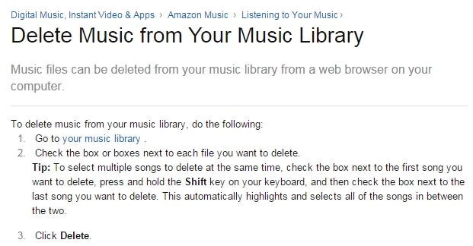
This tip is really a lengthy user option step. Perhaps there should be two procedures.
Steps
Notes:
Sentence caps?
LONG tip
Maybe two infinitive subheadings:
Do to one; do to many
It IS a user option.

Slide 29
Conditional steps
Require the user to test for a condition. If the condition is true, an action must be taken: If X, do Y
The impediment facing the user can be trivial or serious
If you are in the Transactions view, switch to the Report view.
If the System Load indicator shows High activity, launch a subsystem before proceeding further.
Steps
Notes:
Very different logic.
Test for unwanted state and address it:
If X, do Y
Begin with “If” (not “To”)
“Must”: You could defy the procedure in second example.

Slide 30
Local purpose steps
Explain the purpose of a step or group of steps
The “to” clause ends the step (vs. user option step)
Explaining the purpose of a step can motivate users to comply:
Click Bottom to complete the box.
Before starting motor, rap on filter housing to clear it of dust and ensure maximum suction.
Steps
Notes:
No necessary logical function. Write a manual w/o any.
User option steps starts with a “To” clause
To complete box—reminds user what it’s all about.
Use to mark a milestone in a long procedure.
User comply
(TWO non-computer procedures in my slides.)

Slide 31
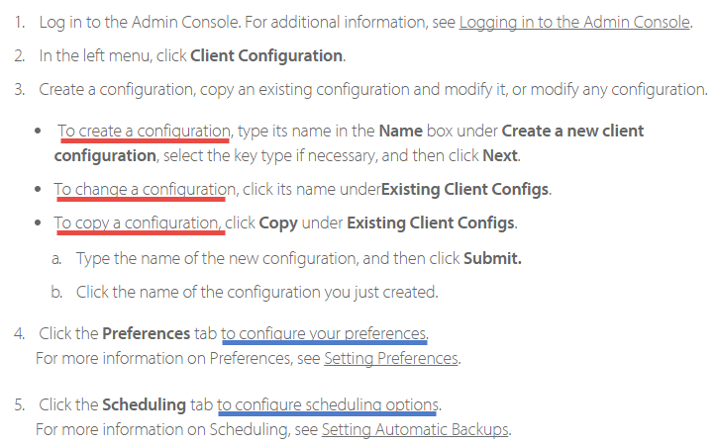
User option vs. local purpose
Notes:
Step 3: User option: “To . . . “
Steps 4 and 5: Whatever choice you made in Step 4, you do.
“To” comes at end.

Slide 32
Feedback statements

Slide 33
Feedback statements (optional)
Enable the user to verify that she did the right thing and that the system responded correctly
Use sparingly: Use when the system response is imperceptible, easy to miss, or surprising
Click Update Archives. This process may take some time to complete.
Tap any note in your document. Blue boxes appear around all the notes in the document.
Feedback
Notes:
Sometimes we describe the system’s response to a user action.
User may be wondering why nothing has happened.
Even though it’s a component, feedback statements are usually appended to a step
DITA: “Step result” element

Slide 34
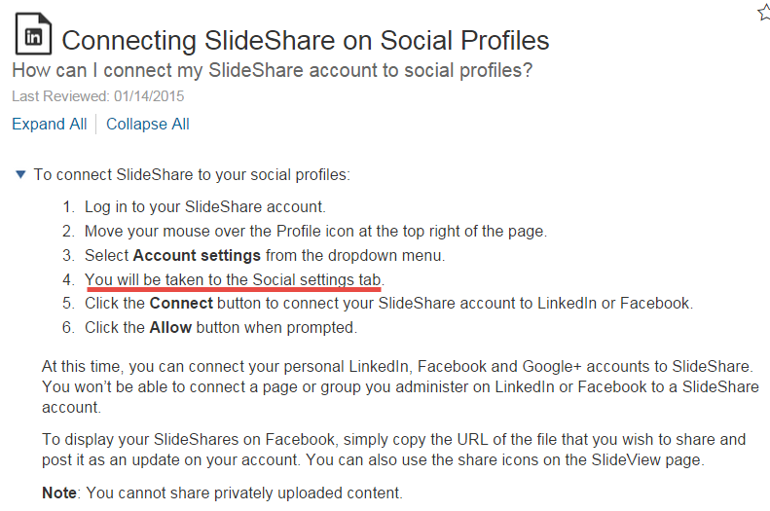
Feedback statements may be formatted like steps
Notes:
But the feedback component may stand alone. This makes sense here because this feedback statement reflects a major milestone in the procedure. It is both feedback and local purpose????

Slide 35
Feedback is usually provided implicitly
An introductory modifier confirms that the previous step was successful
On the Options menu, choose Resources and Costs.
On the Resources tab, choose Assign Workloads.????????
Feedback
Notes:
Implicit feedback is usually enough.
The modifier in the second step makes clear what was supposed to happen.

Slide 36
Video narration: You can often omit what the user is seeing
The narrator often skips the modifiers that show how an action is carried out
The narrator might even skip the action
User option and purpose info is retained
From the Select Action menu, click Apply Configuration Changes to configure the database and restore the backup tables.
Video script:
. . . . “Now you configure the database and restore the backup tables.”
Notes:
Less need to narrate what user can see.
Key challenge is timing. Narrator has to be very well synched

Slide 37
Notes
Cautions and Warnings
Tips
Hints
“Note notes”

Slide 38
Notes (optional)
The function of a note is emphasis
Various kinds of information can be treated as notes
The note heading indicates the type of note—e.g.
Caution:
Tip:
Note:
Notes
Notes:
No unique logical function.
The function is emphasis.
Many kinds of info can be treated as notes
The different note headings differ in how specific they are.
Rev slide
A note takes an item of information outside the main flow of the procedure
There should be a good reason for doing this
The differences between tips, hints, and “Note notes” are fuzzy. Not so, cautions and warnings.

Slide 39
Cautions and warnings
Very specific heading
Warn about actions that might cause harm to human beings, damage to systems, or unexpected loss of data
Must be highly visible and must appear before the place in the procedure where the user can get into trouble
CAUTION: In this beta release surnames beginning with “van” or “von” will be deleted from the system if you attempt to sort the list of names.
Notes
Notes:
Cautions and warnings: very specific note heading
Not: Do not sort
Consequence of sorting you probably don’t want.

Slide 40
Tips and hints
More general heading. Tips and hints suggest a better way to carry out a task, a desirable user option, and other useful information.
Preventing a user error
Tip: Make sure you click on the upper part of the marker—toward the tip of the triangle.
For more precise control when creating a hanging indent, see Adjust indents and spacing.
Showing a better way
Notes
Notes:
Tips, hints: heading is more general.
(Not a shortcut, slightly different result.)
Long tip: To select multiple songs to delete --User option

Slide 41
“Note notes”
Most general of the note headings: Almost anything you wish to emphasize can follow “Note:”
Use sparingly
Especially avoid multiple notes at the bottom of a procedure—a sign of lazy procedure writing
Notes
Notes:
Simple “Note” notes are the most general.
“Caution,” “Tip,” say more about the role of the information.

Slide 42
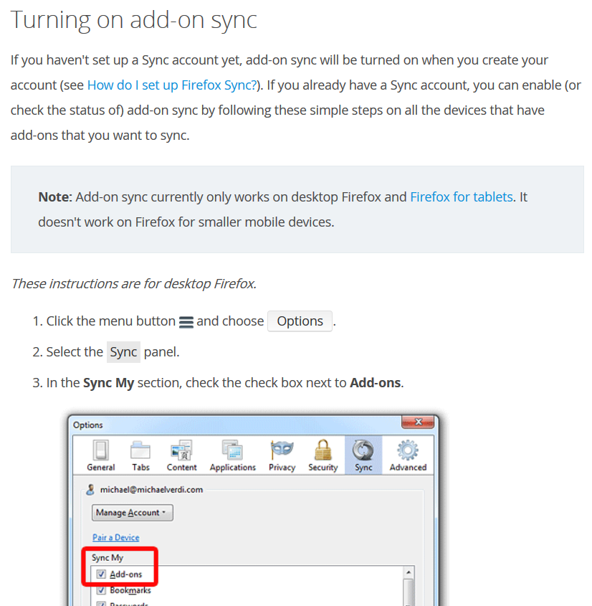
“Note notes” can be used to show limitations
Notes
Notes:
Good use of a Note note
Limitation: Really a prerequisite: You must be using . . . .

Slide 43
Summing up: This is enduring knowledge
Favored practices change from year. But the underlying principles you’ve learned today never change.
Put the ryng of thyn Astrelabie upon thy right thombe, and turne thi lift syde ageyn the light of the sonne.
Geoffrey Chaucer
A Treatise on the Astrolabe, 1391

