Slide 1
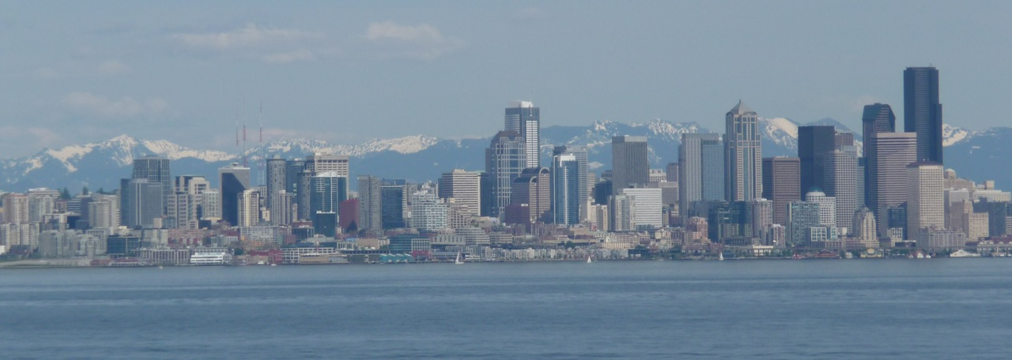
Financial Reporting & Analysis
Day 9
Dawn Matsumoto
December 1, 2012

Slide 2
Administrative Details
Next (and Last) Class
  Project presentations!
Final Exam
  Available after class on Dec 7th, due Monday Dec 10th by midnight
  Practice Final posted on BB
  Brady will go over in help session this week

Slide 3
Today’s Agenda
Harnischfeger
  Earnings quality
Wrap-up
But first…

Slide 4

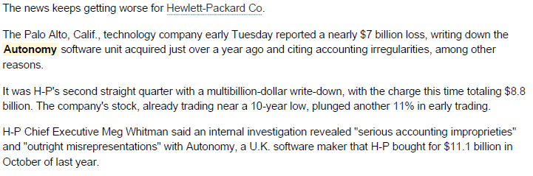
Accounting in the News

Slide 5

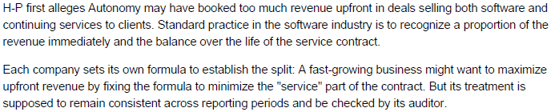

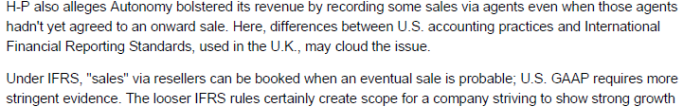

Slide 6
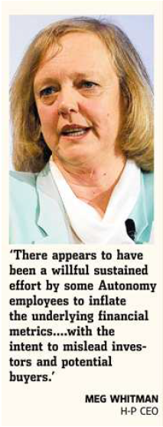
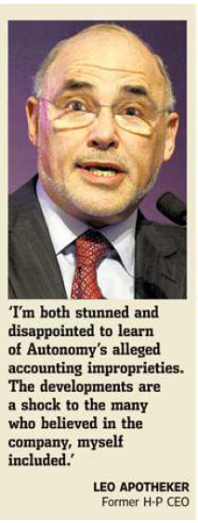
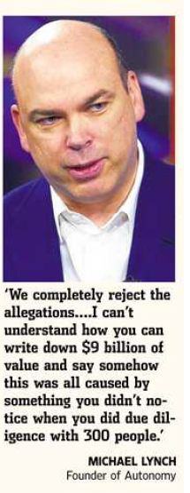
Three reactions…

Slide 7
Now, on to the case…

Slide 8

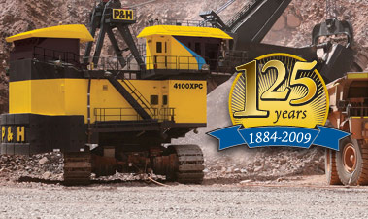

Slide 9
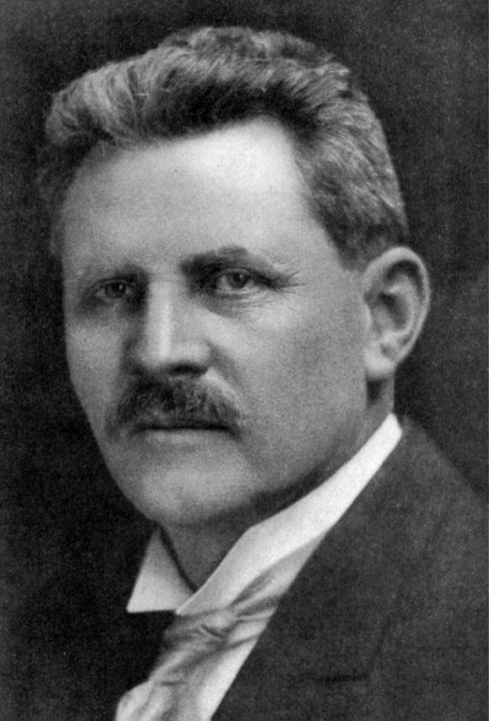
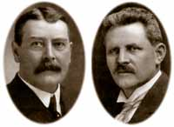

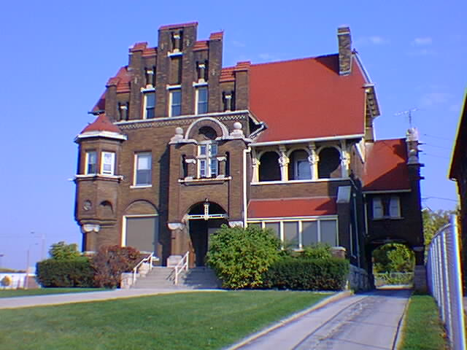
Quick History
1884: Alonzo Pawling and Henry Harnischfeger opened a machine shop in Milwaukee
P&H cranes
Experienced considerable success...
Henry’s home built in 1905
Notes:
The company had one milling machine, one drill press, one planer, and two lathes.

Slide 10
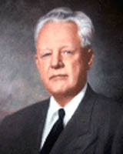
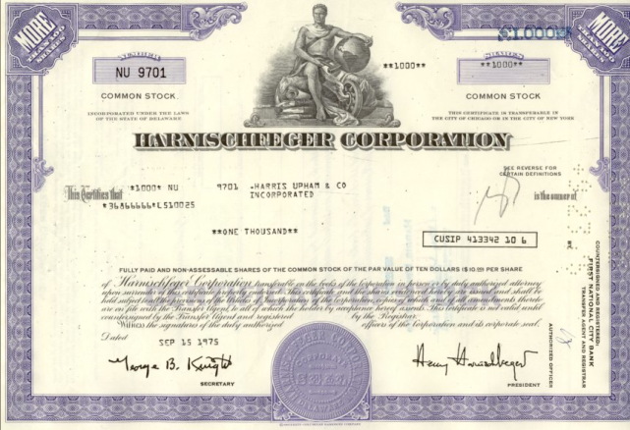
Quick History
1931: son Walter Harnischfeger becomes president; retires as Chairman of the Board in 1970
1959: grandson Henry Harnischfeger becomes president and guides Harnischfeger Corporation through significant growth in the 1960s & 70s
1971: listed on NYSE
1970s: explosive growth largely financed with debt

Slide 11
Case setting: 1980s
Early 1980’s: worldwide recession reduced demand for Company products
1982: net loss of $77 million and...
Defaulted on debt covenants:
Unconsolidated Finance subsidiary also defaulted on debt covenant
“Qualified” audit opinion
>
>
>
Notes:
1980s: products include machinery for construction, mining, and equipment for materials handling

Slide 12
1982 Recovery plan
Hired new COO William Goessel. (Grandson Henry Harnischfeger steps aside.) In 1983, hired new CFO (Jeffrey Grade)
Cost reductions to lower break-even point
Reorient business strategy
Renegotiated debt with bankers
Net loss narrowed to $35 million in 1983. “Return to profitability soon”

Slide 13
Management Statement
Early 1984
“We approach our second century with optimism, knowing that the negative events of the last three years are behind us, and with a firm belief that positive achievements will be recorded in 1984. By the time the corporation celebrates its 100th birthday on December 1, we are confident it will be operating profitably and attaining new levels of market strength and leadership.”
two “promises”?

Slide 14
1984 “centennial” year results
Reported profits in each of the 4 quarters
Sales up 24% (mining equipment up over 60%)
Raised new equity capital to pay off restructured debt
Increase in unshipped Backlog and Bookings of new orders
Early 1985: Analyst issued buy recommendation
Notes:
backlog = level of unshipped orders
Bookings are new orders

Slide 15
Leading Wall Street Investment House
(just before release of 1984 Annual Report)
“We recommend the stock of Harnischfeger Corporation for purchase in speculative accounts because we expect the company to report a modest profit this year and untaxed earning of $3 per share in 1985, following ten years of deteriorating financial statements and two years of large losses. Earning power, assuming a sustained recovery of the company’s markets, could be $4 to $6 per share in the 1986-87 time period. Harnischfeger stock is selling at less than three times these peak earnings (were they taxed) and at a slight discount to book value.”

Slide 16
Would you potentially have been interested in investing in Harnischfeger?
Trying to avoid hindsight & before taking this course...
VOTE?

Slide 17
Would you now?

Slide 18
How did they achieve profitability?
Q1: Identify areas of concern...

Slide 20
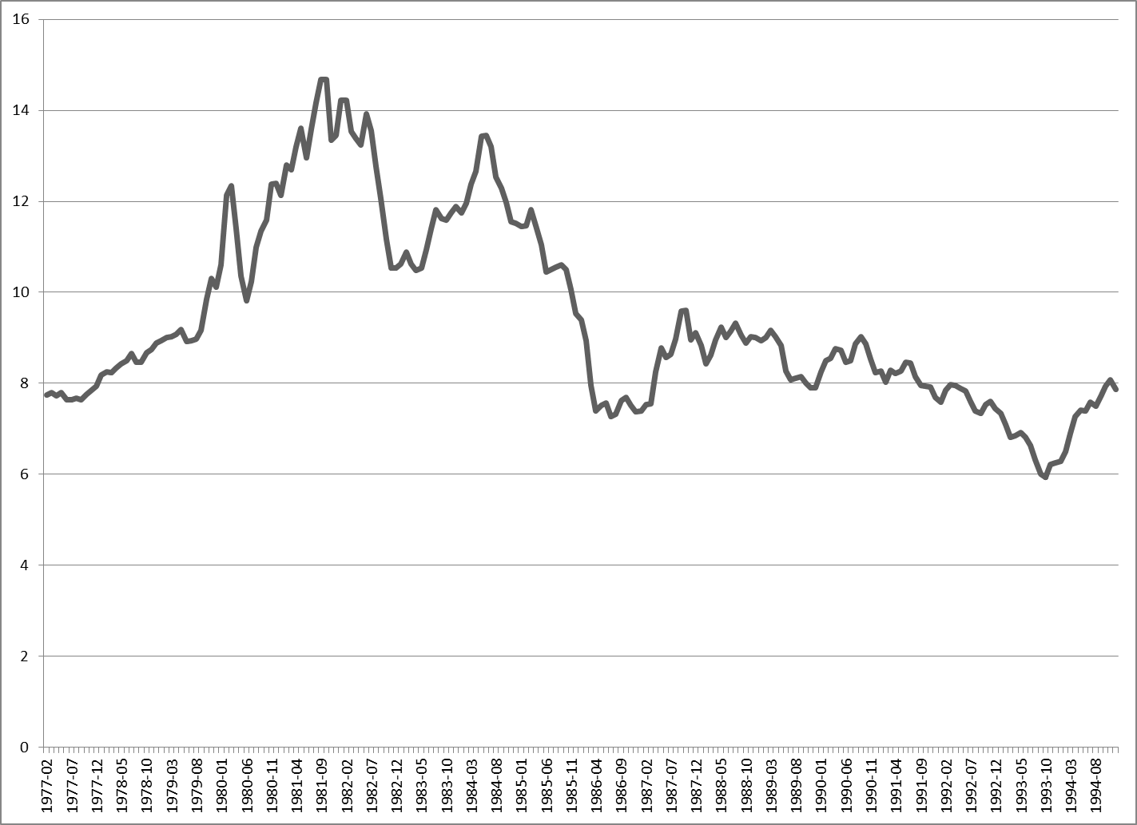
Historical Interest Rates

Slide 21
Q2a. Why did management make these changes?
Q2b. Will analysts, investors & others “see through” these changes?

Slide 22
Harnischfeger Management speaks...
“In accounting there is no such thing as an absolute truth. The same underlying reality can be accounted for using a range of assumptions. The earlier philosophy of this company was to choose the conservative alternative whenever there was a choice. Now we have decided to change this. We would like to tell the world we are still alive and well.”

Slide 23
More Management Quotes
“When the outside world compares our financial performance with that of other companies, they may or may not take the time and effort to untangle the effects of the differences in financial policies that various companies follow.”
“But suppose (users) do not adjust. Then clearly we are better off following the more liberal policies rather than conservative policies.”

Slide 24
Last Management Quote
“As a company you have to put your best foot forward if you want to raise capital, convince customers that you are a viable company, and attract talented people to work for the company. I feel that financial reporting should help rather than hinder the implementation of our operating strategy.”

Slide 25
Harnischfeger Subsequent Events
1987:
  Received takeover offer from Columbia Ventures, Inc. for $19 per share in cash. Considered inadequate and rejected.
1990:
  Jeffrey Grade took over as Chairman & CEO
  “Dashing & flamboyant leader”
  More acquisitions & debt
Notes:
Acquired Beloit Co. for $175 million. Sold 20% of this to Mitsubishi for $60 million cash.
Acquired Syscon Co. for $92 million. Develops advanced computer systems for military markets.
Announced plan to sell Construction Equipment Division for $17 million cash and $55 million in debentures
Engineering division received major order for design of automated car assembly plant.
Grade was by all accounts a dashing and flamboyant leader, who claimed to have been a fighter pilot in Vietnam, hero of dangerous night landings on aircraft carriers, who had been shot down deep in enemy territory and fought his way to safety. He was a notoriously flashy dresser, with three company cars and a company jet at his disposal. He enraged Wall Street by continually falling short of earnings expectations, a feat he accomplished for 14 out of 24 quarters while he was CEO. A profile in Barron's for July 12, 1999 revealed that Grade had no Navy record, and Grade revised his story to say that he had been a passenger on some practice flights while a college student enrolled in the Navy ROTC. By the time his false war record was exposed, Grade already had led Harnischfeger into bankruptcy.

Slide 26
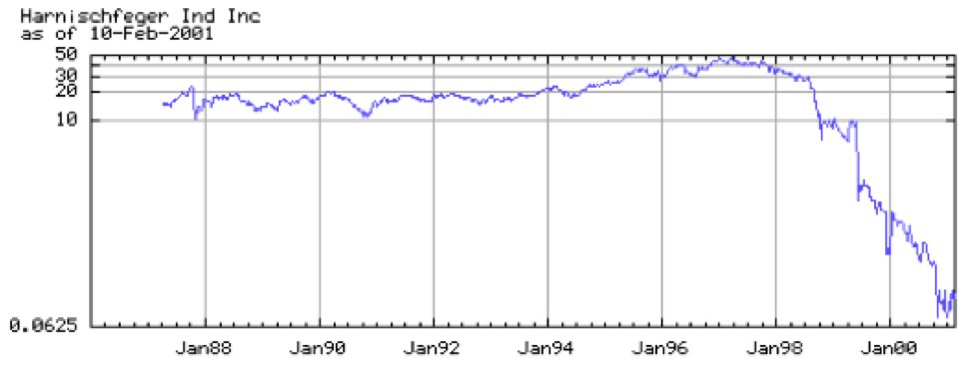
Harnischfeger Stock prices: 1988-2001
$50
$10
1999:
  Jeffrey Grade resigned
  Delisted from NYSE
  Filed for Chapter 11
failed to meet expectations
in 14 of 24 quarters as CEO

Slide 27
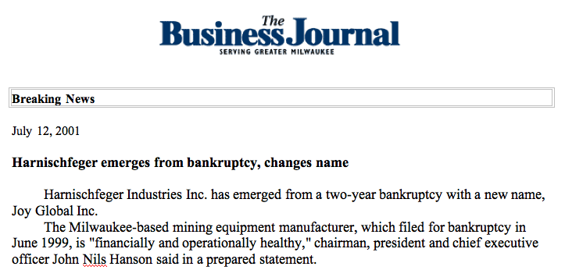
July 2001: Emerged from bankruptcy as Joy Global...
Notes:
2001
Emerges from Chapter 11 with new name – “Joy Global”
NI for FY 2001 reflects $45m fresh start accounting adjustmt

Slide 28

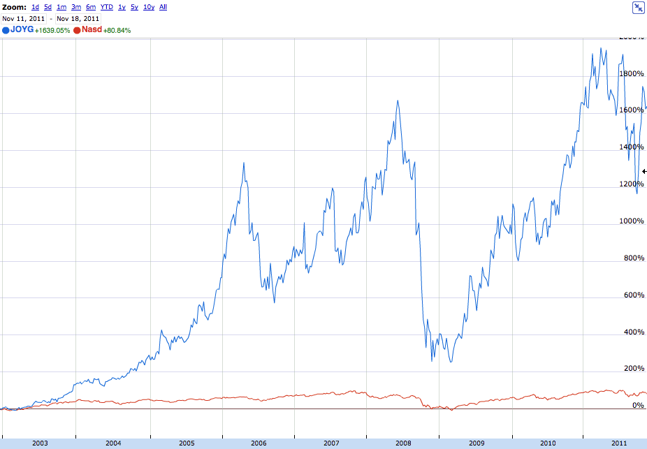
Joy Global stock prices: 2003-2011

Slide 29
Takeaways
Accounting numbers are widely used by external parties. Managers want to influence the perceptions and behaviors of these company stakeholders.
U.S. GAAP allows managers latitude in accounting choices (e.g., selection of methods and estimates, timing of recognition, classification on financial statements).

Slide 30
Takeaways
Management may choose its accounting policies:
  as a reflection of the company’s overall strategy,
  as an attempt to influence analysts,
  as an attempt to influence other stakeholders (including employees, customers and suppliers),
  as an attempt to provide more useful information to users of financial statements, and/or
  as an attempt to increase their personal wealth

Slide 31
Takeaways
Understanding management’s motives is important in assessing the firm’s current performance and future potential.
Lots of attention is appropriately focused on the motives and actions of management, the board & the external auditor.

Slide 32
Takeaways
Adjusting for differences in financial reporting policies can be crucial in evaluating a company’s performance and/or financial position relative to its competitors. Since we are ultimately interested in understanding the firm’s underlying economics, we should ask:
    What are the firm’s “core” continuing earnings?
    What reported items are one-time effects?
    What reported items have no cash flow effect?
    How “cosmetic” differences affect stakeholder behavior?

Slide 33
Our Goal...
To uncover the underlying economics, we have repeatedly taken an analyst perspective and adjusted for differences in financial reporting policies, e.g.,
  Alaska Gold’s success in mining operations
  Exxon Mobil’s use of LIFO (inventory, CGS, earnings & tax effects)
  Circuit City’s partial recognition versus full deferral of extended warranty contracts
  Microsoft’s research & development costs
  Starbuck’s off-balance sheet financing via long-term leases
  Groupon’s gross method for revenue; adding back mktg costs
  Harnischfeger (in many areas)
Notes:
As we approach the end of the course, how much have you learned since early September?

Slide 34
As we approach the end of the course, how much have you learned since early September?

Slide 35
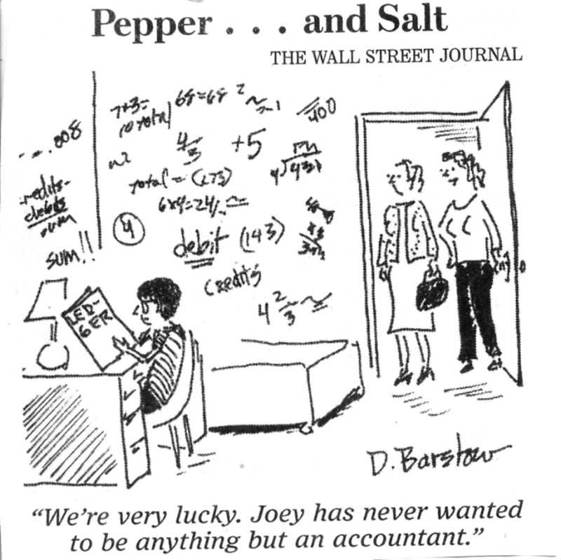

Slide 37
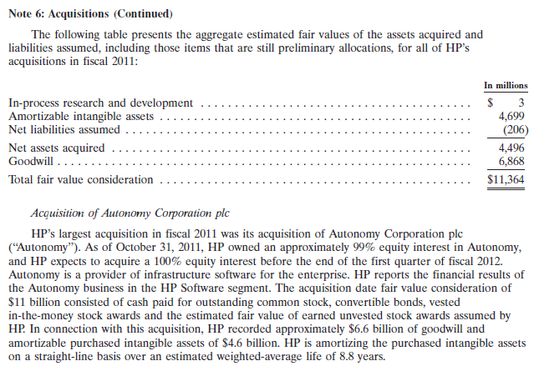

Slide 38
HP Recent Performance

Slide 39
Autonomy Pre-merger Performance

Slide 41
“Top Ten” Takeaways from Financial Reporting
Dawn Matsumoto
Executive MBA program
Regional 30
December 1, 2012

Slide 42
Financial reporting is an art, not a science
11…
Users & analysts should NOT take financial reporting as the “TRUTH”
Notes:
Despite many rules, managers have lots of discretion
Can’t be the truth since rules are always changing

Slide 43


10. Reliable Financial Information is crucial for a well functioning global market economy
Entrepreneurs
Information
Capital Providers

Slide 44
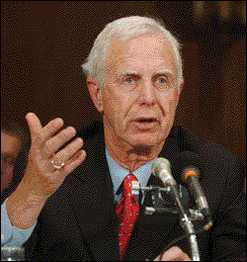


Fmr SEC Chairman Levitt
“If a company fails to provide meaningful disclosure to investors about where it has been, where it is, and where is going, a damaging pattern ensues. The bond between shareholders and the company is shaken; investors grow anxious; prices fluctuate for no discernable reasons; and the trust that is the bedrock of our capital markets is severely tested.”
1998 speech
Notes:
If a company fails to provide meaningful disclosure to investors about where it has been, where it is, and where it is going, a damaging pattern ensues. The bond between shareholders and the company is shaken; investors grow anxious; prices fluctuate for no discernable reasons; and the trust that is the bedrock of our capital markets is severely tested.
1998 Speech

Slide 45



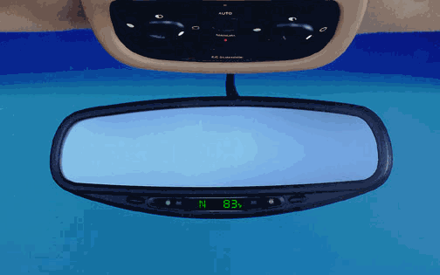

9. Financial Statements provide a view into the economics of the organization (not the view)
(Largely) A rear view mirror
View keeps changing
Size and quality of view varies from:
>LARGE & CLEAR
>small & obstructed

Slide 46
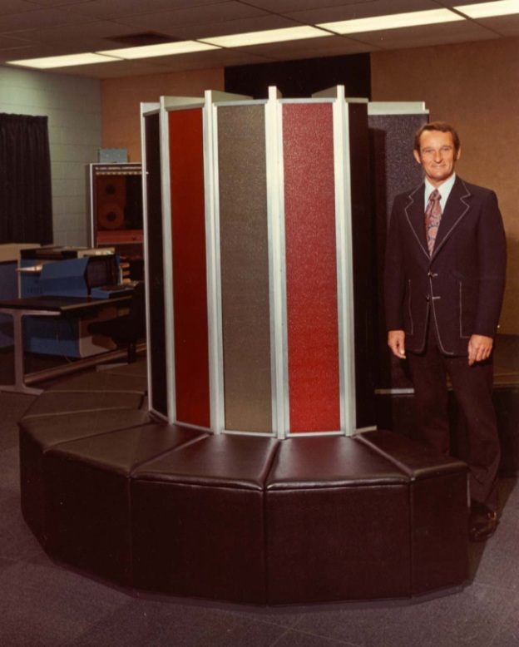
Seymour Cray Story
Founder Seymour Cray voluntarily decides to leave Cray Computing
On that day, the stock price of Cray drops dramatically
On that day, the Company’s accounting system records...
In the next fiscal qtr, the accounting system records...
Nothing
less compensation expense (because...) and thus higher earnings
Notes:
Points: Fin acct does not record the current value of human capital

Slide 47

8. How Accounting Works
Beg of Period
ASSETS = LIAB + EQUITY
Balance Sheet
Contributed Capital
Retained Earnings
ΔR/E
NI - DIV
Income Statement
Contributed Capital
Retained Earnings
End of Period
Balance Sheet
ASSETS = LIAB + EQUITY

Slide 48
7. Tax Reporting ≠
Financial Reporting!
Tax Return |  | Income Stmt
Income | ≠ | Revenue
- Deductions | ≠ | - Expenses
Taxable Income | ≠ | NI b4 tax
Tax owed | ≠ | Tax expense

Slide 49
6. Earnings ≠ Cash flows
I/S (accrual) | ≠ | CF Stmt (cash)
Revenue | ≠ | Cash collected from customers
Expenses | ≠ | Cash expenditures
NI | ≠ | Cash from operations

Slide 50

5. Consider the time value of money!
“Compounding is mankind’s greatest invention...”

Slide 51

4. Managers face HUGE pressure to meet/beat Wall Street targets

Slide 52
3. You get what you measure!
Setting targets (benchmarks, budgets can:
Align employee and company (shareholder) goals
Motivate employees to perform
Lead to genuine positive economic performance

Slide 53
3. (cont’d) OR you might get...
the DARK side...
pressure to make the numbers (anyway that you can)
pressure to guide analysts to lower their forecasts
pressure to time economic decisions even if not in the long run interest of the company
pressure to play accounting games

Slide 54
2. More than ever, everyone is watching...
SEC
Congress
Press
External auditor
PCAOB
Board of directors
Internal auditor
Management (hopefully)

Slide 55
and takeaway #1 is...

Slide 56
#1
Beware of the earnings game!

Slide 57
So, what do managers ‘dream’ about?
Blockbuster new products?
Mega-mergers?
Dominating the Internet?
Global domination?
Galactic domination?
Making quarterly earnings!?

Slide 58
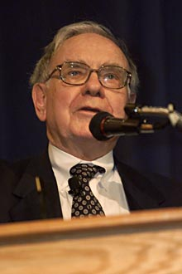
The Big Problem?
“Many major corporations still play things straight, but a significant and growing number of otherwise high-grade managers -- CEOS you would be happy to have as spouses for your children... -- have come to the view that it’s okay to manipulate earnings to satisfy what they believe are Wall Street desires. Indeed, many CEOs think this kind of manipulation is not only okay, but actually their duty.”
Warren Buffett
July/Aug 1999
Directorship

Slide 59
Objectives of the Earnings Game
Smooth (non-volatile) earnings
Avoid losses
Avoid decreases in earnings
Beat the consensus analyst forecast of earnings

Slide 60
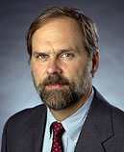
Evidence of Earnings Management (EM)?
Research by Prof. Dave Burgstahler
your managerial accounting instructor

Slide 61
Meet or Beat?
Target #1 = to be profitable (i.e., avoid losses)
Loss
Profits
too many
So what is odd in this figure?
too few

Slide 62
Meet or Beat?
Target #2 = to improve profits
Lower Profits
Higher Profits
too many
too few
So what is odd in this figure?

Slide 63
Takeaway from Dave’s Research?
In a large sample, we see direct evidence of earnings management (EM) to beat targets:
1. Reporting positive profits
2. Improving profits
3. Meeting/Beating analysts’ forecasts
i.e., EM is more common than the occasional
anecdote one reads about in the press

Slide 64
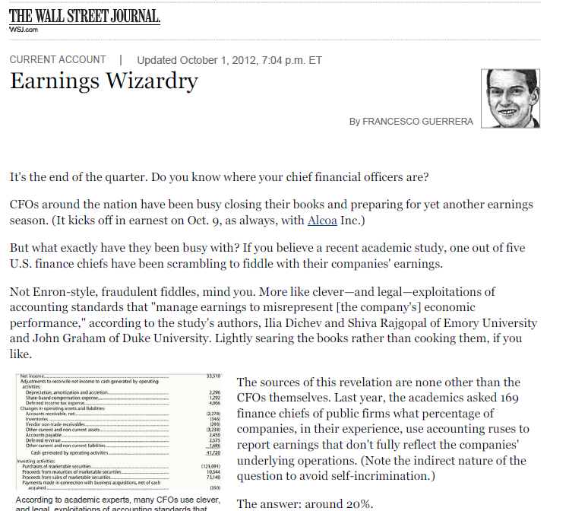

Slide 65
And now for our final
“course summary”...

Slide 66
IT’S JEOPARDY!
the rules of the game are...

Slide 67
Official EMBA 505 Jeopardy Rules
Scorekeeper is Brady.
Rotate by study group starting with the RED team .
Select category and point amount up to 300 in round #1, 400 in round #2, 500 in round #3.
You must respond in the form of a question, e.g., to the answer “State capital of Washington.” you would respond: “What is Olympia?”
Your group has 15 seconds to respond. (The class may sing along: Do, do, do doo…)
If your question is incorrect, next team in line can answer (and then the next team, and the next team…). Whichever team answers correctly, gets the points.
Regardless of who answers the question, we return to the original order.
The top two teams will compete in the “Final Jeopardy” round starting with zero points.
Dawn will resolve any disputes.
The team with the highest point total wins! (but don’t get too excited)

Slide 68
to the game...

Slide 70

Next week:
Project Presentations
Notes:
(“Bob-for-a-Day” tba...)

Slide 72
What I hear, I forget
What I see, I remember
for awhile
What I do, I know
When I do Accounting,
I marvel, and I learn to
be a better person
Chinese proverb (roughly translated with liberties taken)

