Slide 1
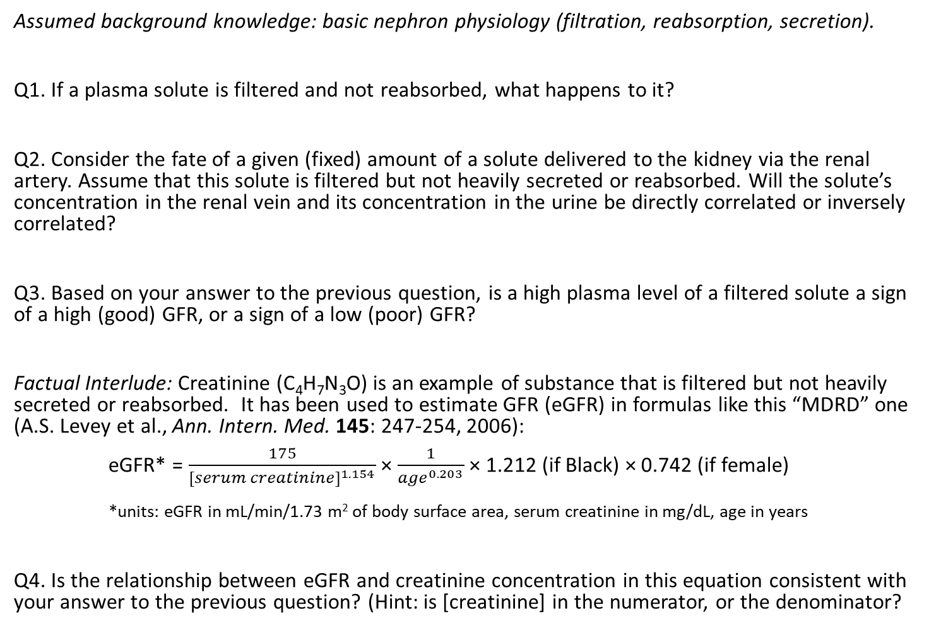
Glomerular Filtration Rate, Chronic Kidney Disease, and Transplant Eligibility
Assumed background knowledge: basic nephron physiology (filtration, reabsorption, secretion).
Q1. If a plasma solute is filtered and not reabsorbed, what happens to it?
Q2. Consider the fate of a given (fixed) amount of a solute delivered to the kidney via the renal artery. Assume that this solute is filtered but not heavily secreted or reabsorbed. Will the solute’s concentration in the renal vein and its concentration in the urine be directly correlated or inversely correlated?
Q3. Based on your answer to the previous question, is a high plasma level of a filtered solute a sign of a high (good) GFR, or a sign of a low (poor) GFR?
Factual Interlude: Creatinine (C₄H₇N₃O) is an example of substance that is filtered but not heavily secreted or reabsorbed. It has been used to estimate GFR (eGFR) in formulas like this “MDRD” one (A.S. Levey et al., Ann. Intern. Med. 145: 247-254, 2006):
eGFR* = $\frac{175}{{[serum creatinine]}^{1.154}}$ × $\frac{1}{{age}^{0.203}}$ × 1.212 (if Black) × 0.742 (if female)
*units: eGFR in mL/min/1.73 m² of body surface area, serum creatinine in mg/dL, age in years
Q4. Is the relationship between eGFR and creatinine concentration in this equation consistent with your answer to the previous question? (Hint: is [creatinine] in the numerator, or the denominator?

Slide 2
Q5. You can calculate eGFR from serum creatinine levels using online calculators like this: https://www.mdcalc.com/mdrd-gfr-equation. For example, what is the eGFR for a 55-year-old white woman with a (normal, healthy) serum [creatinine] of 1 mg/dL?
Q6. Now imagine that this patient’s serum [creatinine] has risen to 3 mg/dL. Should her eGFR go up, or should it go down? Make a prediction, then confirm your prediction with the online calculator.
Factual Interlude: Creatinine is produced by muscles. The less muscle mass you have, the less creatinine your muscles release, and the less there is for the kidneys to filter. Thus, the sex coefficient of 0.742 reflects the fact that, on average, females have less muscle mass than males of similar size. Similarly, the race coefficient of 1.212 is based on the idea (validated for some populations) that, on average, Black people have more muscle mass than non-Black people.
Question for self-reflection: Do these sex and race coefficients seem reasonable, or highly problematic, or somewhere in between?
Factual Interlude: eGFR often has important clinical implications. For example, patients may become eligible for a referral for a kidney transplant when their eGFR falls below 20 mL/min/1.73 m².

Slide 3
Now consider the following scenario…. Beth and Wendy are women of similar height, weight, fitness levels, and body composition. Both are 55 years old. Both have chronic kidney disease (CKD) and receive dialysis 3 times a week. Both have serum creatinine levels of 3 mg/dL. However, Beth is of West African ancestry, while Wendy is of Caucasian heritage.
Q7. Estimate Beth’s GFR using the online calculator. Is Beth currently eligible for a kidney transplant, based on the cutoff given above?
Q8. Now estimate Wendy’s GFR. Is Wendy currently eligible for a kidney transplant?
Q9. What ethical issues are raised by your answers to the previous two questions?

Slide 4
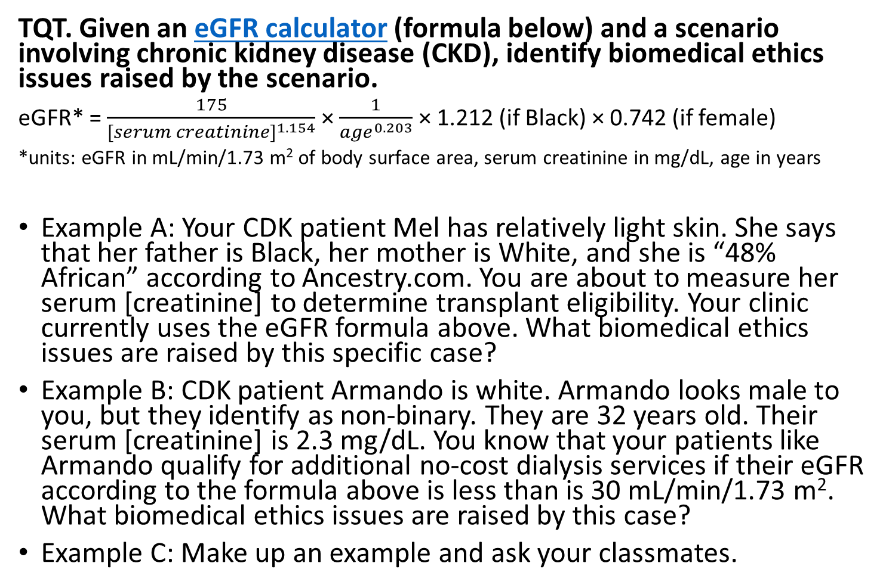
TQT. Given an eGFR calculator (formula below) and a scenario involving chronic kidney disease (CKD), identify biomedical ethics issues raised by the scenario.
eGFR* = $\frac{175}{{[serum creatinine]}^{1.154}}$ × $\frac{1}{{age}^{0.203}}$ × 1.212 (if Black) × 0.742 (if female)
*units: eGFR in mL/min/1.73 m² of body surface area, serum creatinine in mg/dL, age in years
Example A: Your CDK patient Mel has relatively light skin. She says that her father is Black, her mother is White, and she is “48% African” according to Ancestry.com. You are about to measure her serum [creatinine] to determine transplant eligibility. Your clinic currently uses the eGFR formula above. What biomedical ethics issues are raised by this specific case?
Example B: CDK patient Armando is white. Armando looks male to you, but they identify as non-binary. They are 32 years old. Their serum [creatinine] is 2.3 mg/dL. You know that your patients like Armando qualify for additional no-cost dialysis services if their eGFR according to the formula above is less than is 30 mL/min/1.73 m². What biomedical ethics issues are raised by this case?
Example C: Make up an example and ask your classmates.

