Slide 1
Note to instructors:
This worksheet represents a way that I have taught this material, which incorporates figures/tables created by others. I have cited my sources, but I have not obtained formal permission to use the figures/tables. As far as I’m concerned, you’re welcome to use this worksheet as is or modify it. If you do the latter, please continue to cite the sources – and be aware that their inclusion here may or may not be permissible under “fair use” doctrine.
--Greg Crowther, Everett Community College (gcrowther@everettcc.edu)

Slide 2
Spirometry: quantifying ventilation
Q1. Definition of tidal volume?
Q2. Definition of residual volume?
Q3. Definition of Vital Capacity (VC or FVC)? What is it in this particular example?
Marieb & Hoehn (2019), Figure 22.19

Slide 3
Minute ventilation: just like cardiac output!
Stroke Volume x Heart Rate = Cardiac Output
mL/beat x beats/min = mL/min
Tidal Volume x Respiration Rate = Minute Ventilation
mL/breath x breaths/min = mL/min
Two Equations in One!
Volume moved per beat Volume moved per breath Times number of beats per minute Times number of breaths per minute Is volume of blood per minute; Is volume of air per minute; That’s all this equation has in it! That’s all this equation has in it!
faculty.washington.edu/crowther/Misc/Songs/2equations.shtml

Slide 4
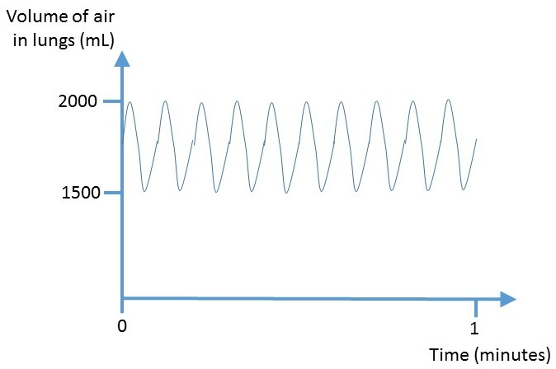
Q1. What is the minute ventilation based on the data below?
(Hint: this should remind you of CO calculations!)

Slide 5
Q2. Lola takes 10 breaths per minute, and her minute ventilation is 6000 mL air per minute. What is her tidal volume?
Q3. Jamelle is breathing normally and steadily. His minute ventilation is 4000 milliliters of air per minute. Fill in the graph below with ndata tthat are realistic and quantitatively consistent with this minute ventilation. Briefly explain or show how the numbers work out.

Slide 6
To our previous spirometry terms we now add one more: FEV₁.
Time (sec)
1 2 3 4 5 6 7
FEV₁ stands for Forced Expiratory Volume in 1 second. To measure FEV₁, the patient is instructed to inflate maximally and then exhale as quickly and as fully as possible. How much air leaves in that first second?
Q4. What is the approximate FEV₁ in this example?
Marieb & Hoehn (2019), Figure 22.19a

Slide 7
FEV₁ could be low for different reasons:
Maybe the patient can’t get air out quickly.
Or maybe there isn’t much air in the lungs at the start of exhalation, so FEV₁ will be small regardless of how quickly the air leaves.
To distinguish between these options, FEV₁ is often expressed as a percentage of the FVC. In other words, “Out of all the air that COULD come out of your lungs, how much of it can you get out in 1 second?”
Rule of thumb: less than 80% is bad; 80% or above is fine.
Q5. Does the previous slide represent a FEV₁/FVC ratio that is normal, or low?

Slide 8
Two general types of lung disease…
NORMAL OBSTRUCTIVE RESTRICTIVE
Problem
Example
FVC
FEV₁
FEV₁/FVC
Narrow airways Poor inflation of lungs
Inflammation => mucus buildup Lack of surfactant
Normal Low
Low Low
Low Normal
For each box: Normal, or Low?

Slide 9
Q6. Rik is put through various pulmonary function tests. The FVC predicted for a man of his age and height is 3.3 liters. At time 0 in the table below, he begins deflating his fully inflated lungs as forcefully and rapidly as he can. You can assume that by the time of 4 seconds, he has reached his residual volume (RV). Based on these data, is he likely to have an obstructive lung disease? Explain your reasoning, citing any relevant math.

