Slide 1
Worksheet: the heart
Note to instructors: This worksheet represents a way that I have taught this material, which incorporates figures/tables created by others. I have cited my sources, but I have not obtained formal permission to use the figures/tables. As far as I’m concerned, you’re welcome to use this worksheet as is or modify it. If you do the latter, please continue to cite the sources – and be aware that their inclusion here may or may not be permissible under “fair use” doctrine.
--Greg Crowther, Everett Community College (gcrowther@everettcc.edu)
Goals:
Understand how conduction of electrical signals through the heart can be detected as an electrocardiogram (ECG or EKG).
Understand the relationships between ECGs, blood pressures, blood flows, and the opening and closing of cardiac valves.
References/Sources:
Patrick J. P. Brown, Anatomy & Physiology: A Guided Inquiry, 2016
Murray Jensen et al., POGIL Activities for Introductory Anatomy and Physiology Courses, 2015

Slide 2
Part A: Electrical activity of the heart
A1. List the specialized cardiac structures through which electrical signals spread during a heartbeat, in the order in which they are depolarized.
A2. Underline the structure above where the spread of depolarization is slowed down the most. Why does this slow-down help the heart perform its function? (Hint: what would happen if the atria and ventricles contracted simultaneously?)

Slide 3
The picture at right is an electrocardiogram (ECG or EKG), as detected with electrodes on the surface of the body.
A3. Label the X axis and Y axis. What could the units be for each?
A4. Is this a direct readout of a heart muscle cell’s membrane potential? (Hint: where are the electrodes?)
A5. Label the P wave, QRS complex, and T wave and list which chambers of the heart are depolarizing or repolarizing in each case.
Image: remotea.com

Slide 4
A6. Why is the QRS complex generally much larger than the P wave?
A7. Electrocardiograms can vary for many reasons. The magnitudes and directions of the deflections and the time intervals between components can all vary, and these variations can indicate cardiac problems, making the ECG a valuable clinical tool. Let’s explore a few cases.

Slide 5
Description | ECG appearance
a. Normal
b. Tachycardia (rapid heartbeat)
c. Bundle branch block (depolarization reaches 1 ventricle more slowly using alternate routes)
d. Wolf-Parkinson-White Syndrome (depolarization goes through AV node without pausing)

Slide 6
Part B: cardiac valves, blood pressure, and blood flow
Heart valves prevent the backflow of blood and thus keep blood flowing in one direction. Heart valves open and close, somewhat like swinging double doors, because of the pressure on the two sides. When pressure on the “upstream side” is greater, the doors are open. When pressure on the “downstream side” is greater, the doors are closed.
Note: a “chamber” in this diagram could be a heart chamber OR a blood vessel.
M. Jensen et al. (2014)

Slide 7
B1. When the pressure in Chamber A is greater than the pressure in Chamber B (P_{A} > P_{B}), is valve 1 open or closed?
B2. When the pressure in Chamber C is less than the pressure in Chamber B (P_{C} < P_{A}), is valve 2 open or closed?
B3. What relationship between pressures in Chambers A, B, and C results in valves 1 and 2 both being closed?
B4. If Chamber A represents the left atrium and Chamber B represents the left ventricle, name the part of the heart represented by the following elements of the diagram above.
a. Valve 1 =
b. Valve 2 =
c. Chamber C =
B5. Using your answer to B4, what do you predict would happen to the net cardiac output (CO) if Valve 2 did not close completely?

Slide 8
B6. When the left ventricle pumps blood into the aorta, is left ventricular pressure greater than, less than, or equal to aortic pressure?
B7. Is the aortic (left semilunar) valve open during this time (B6)?
B8. Predict whether the bicuspid (mitral, or left AV) valve is open during this time (B6). Explain.
B9. When the ventricles are filling with blood, is the blood pressure in the left ventricle pressure greater than the blood pressure in the left atrium?
B10. Is the bicuspid (mitral) valve open or closed during this time (B9)?
B11. Predict if the aortic valve is open or closed during this time (B9). Explain.

Slide 9
Part C: the Wiggers diagram
The Wiggers diagram (see next slide) combines several different types of cardiac information:
Mechanical contraction/relaxation
Blood pressure
Ventricular volume
ECG
Heart sounds
It can be intimidating to look at all at once, but we will go through it piece by piece.
First notice that the Wiggers diagram includes an ECG, which we’ve already discussed. So that part should already make sense. Label that part “ECG.”

Slide 10
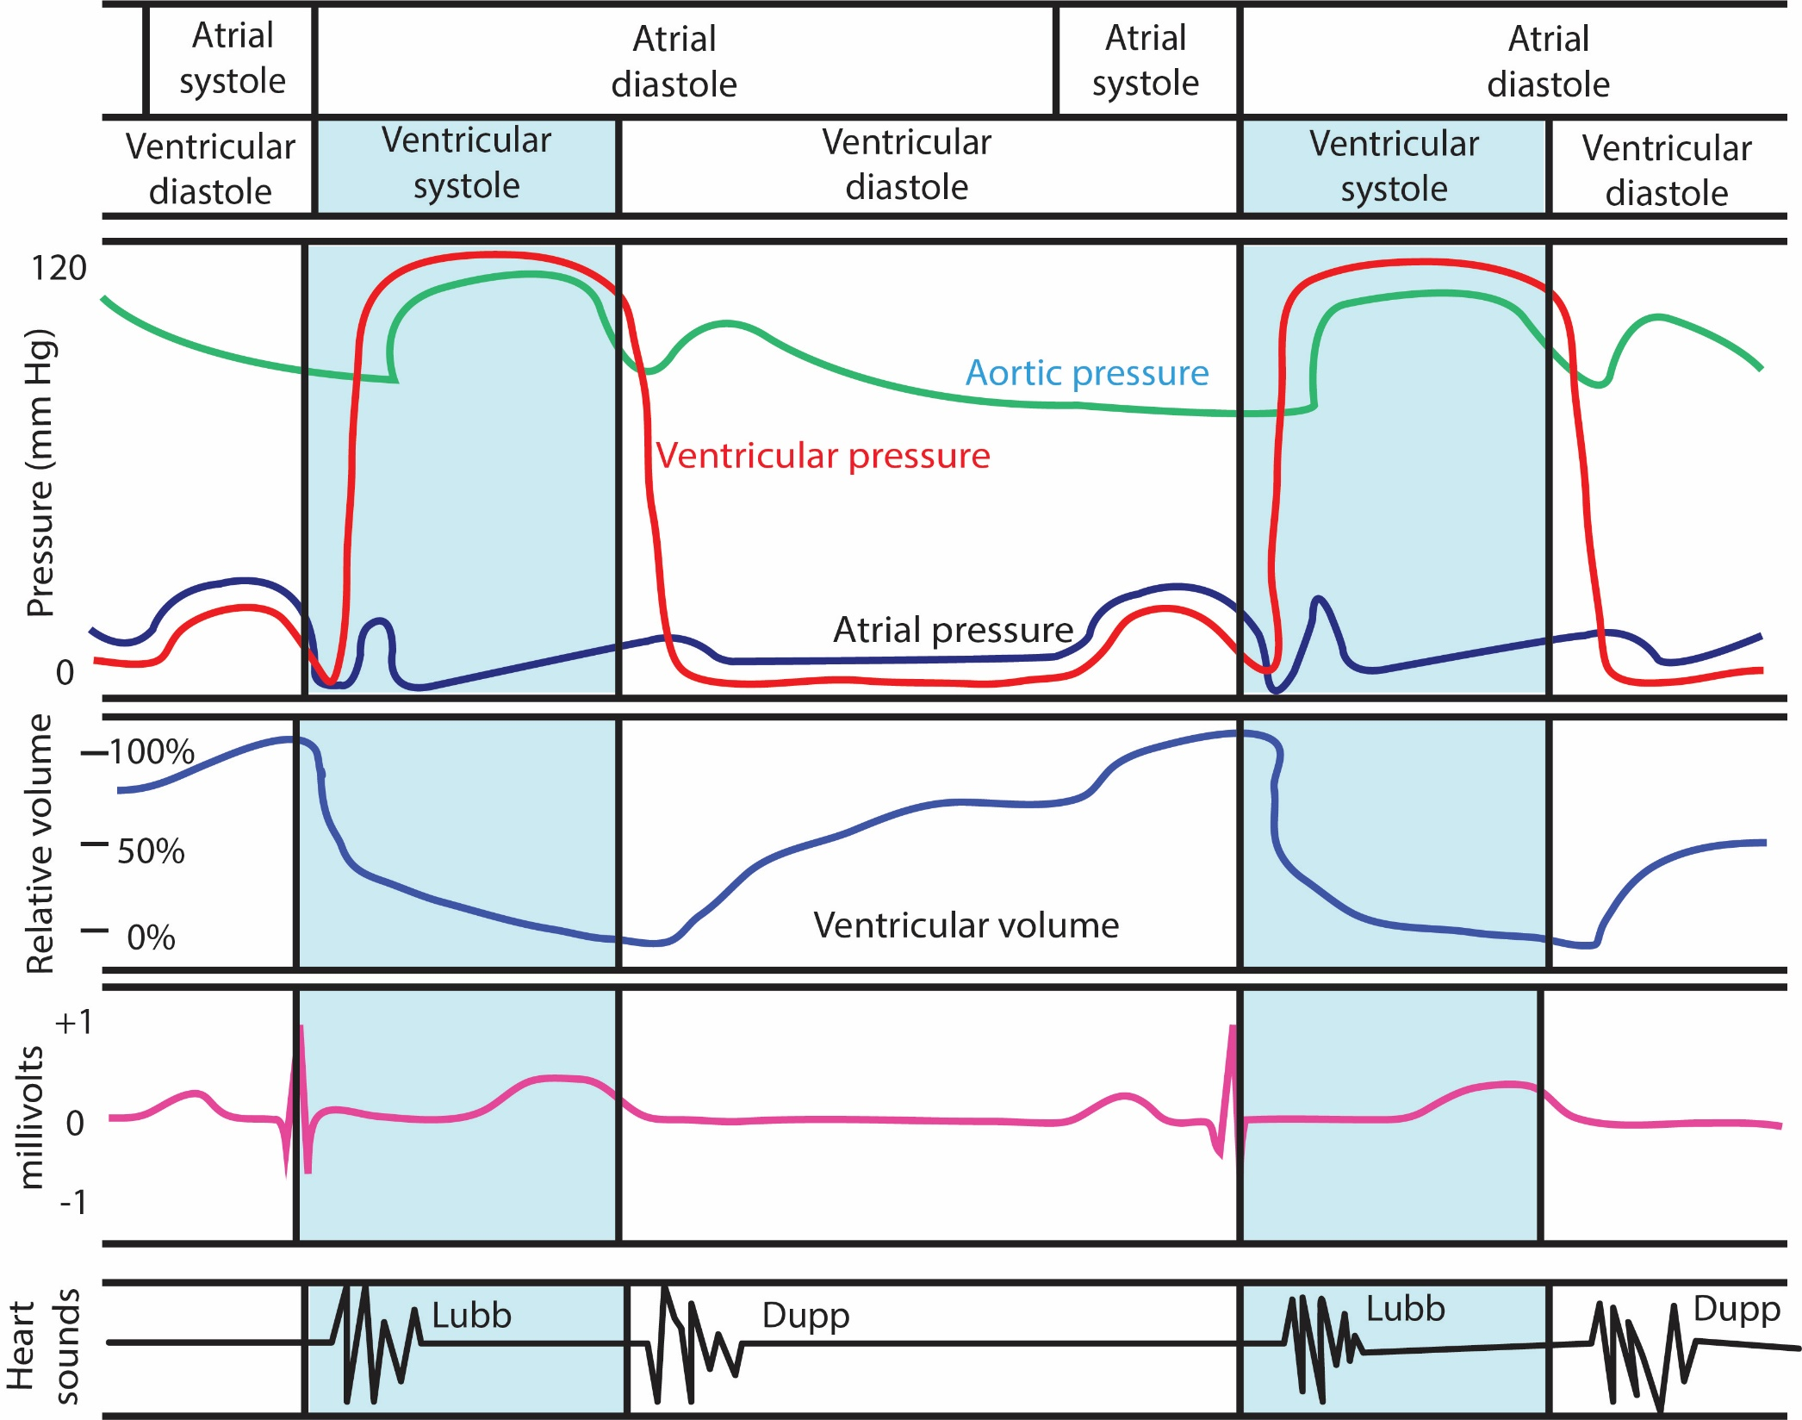
Adapted from Patrick J.P. Brown (2016) by Subin Hyun

Slide 11
Next, let’s connect the heart’s electrical events (depolarization and repolarization/ECG) to its mechanical behavior (contraction and relaxation). When a chamber of the heart depolarizes, it will contract, decreasing the volume of that chamber. Find the part of the Wiggers diagram that indicates the contraction of the ventricles. Another word for “contraction” is “systole.”
C1. The times during which the atria and ventricles contract are already labeled. Where on the diagram are these labels?
C2. What does “diastole” mean?
C3. Compare the timing of a chamber’s electrical depolarization and its mechanical contraction.
Which must begin first, depolarization or contraction?
Once the muscle cells are fully depolarized, does contraction stop?

Slide 12
C4. Now let’s connect the mechanical events (contraction and relaxation) to the volume of blood in the chambers.
a. When the ventricle contracts, what happens to its volume of blood?
b. When does most of the change in volume occur, according to the diagram?
c. What do you think happens to the atrial volume during atrial contraction?
C5. Now let’s connect the changes in chamber volumes to changes in the blood pressure within those chambers.
a. When a contracting chamber reduces its volume, what (if anything) will happen to the pressure on the blood in that chamber?
b. When a relaxing chamber increases its volume, what (if anything) will happen to the pressure on the blood in that chamber?
C6. Find the atrial and ventricular pressures in the Wiggers diagram. Do the pressure increases and decreases occur about where you would expect, based on C5?

Slide 13
C7. Finally, let’s connect blood pressures to the heart valves, remembering the earlier slides about valves.
a. Under what conditions should the aortic semilunar (SL) valve be open?
when the ________________ pressure is higher than the _______________ pressure
b. Under what conditions should the left atrioventricular (AV) valve be open?
when the ________________ pressure is higher than the _______________ pressure
c. Look on the Wiggers diagram for indications of when these valves open and close. Do they match your predictions in (a) and (b)?

Slide 14
C8. The heart sounds, “lubb” (S₁) and “dubb” or “dupp” (S₂), are shown at the bottom of the Wiggers diagram. Guess what causes these sounds, then check your book or the Internet to see if you are right.
Now take a final fond look back at the Wiggers diagram. Note that we were able to navigate our way through this very complicated figure by connecting electrical activity (ECG) to contractile activity and volumes, connecting volumes to pressures, and connecting pressures to valve activities. Hooray -- you have conquered the Wiggers diagram!
Sound | Guess at reason for sound | Verification of reason
Lubb (S₁)
Dupp (S₂)

