Slide 1
Return to Home Page
Introduction to GEOG 495:
The Geographies of Climate Change
March 4, 2014
All slides from The City and the Coming Climate: Climate Change in the Places We Live by Brian Stone, Jr.

Slide 2
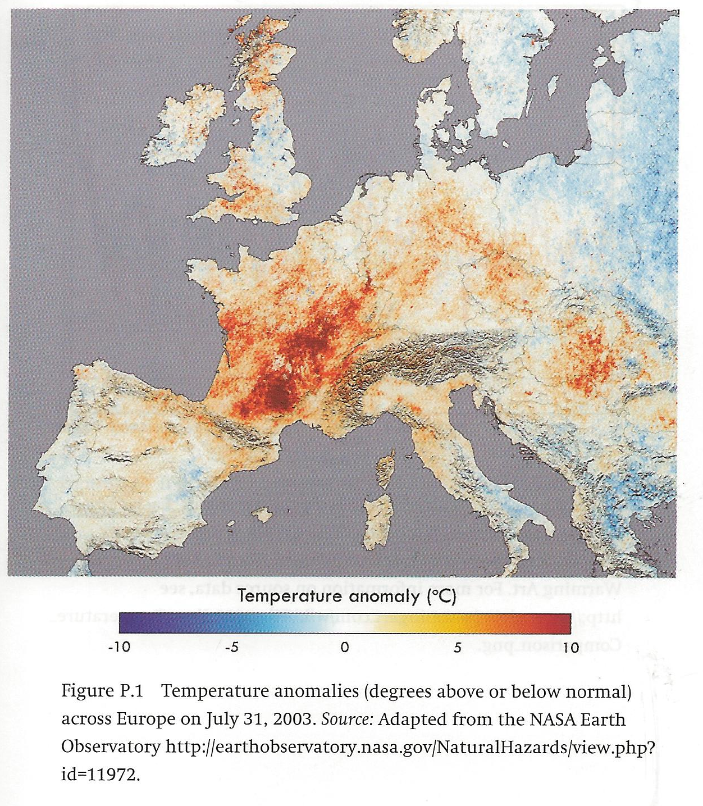
Fig. P.1, p. 8
p. 8.

Slide 3
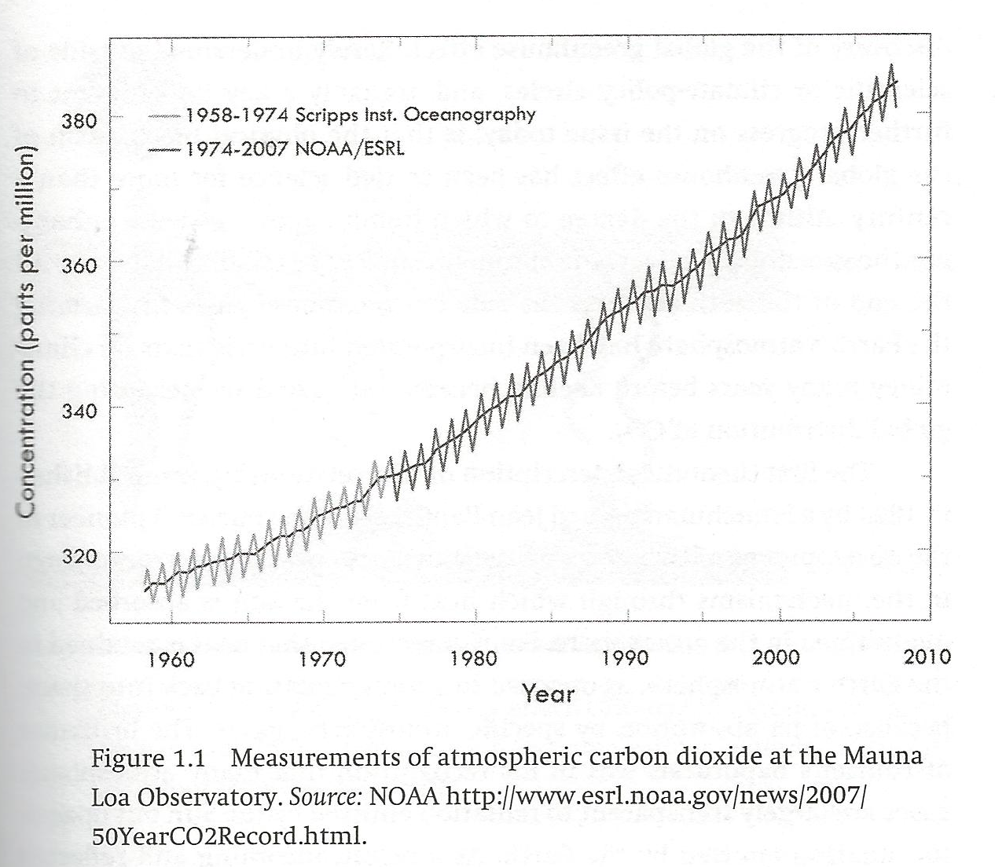
Figure 1.1p. 17
p. 17

Slide 4
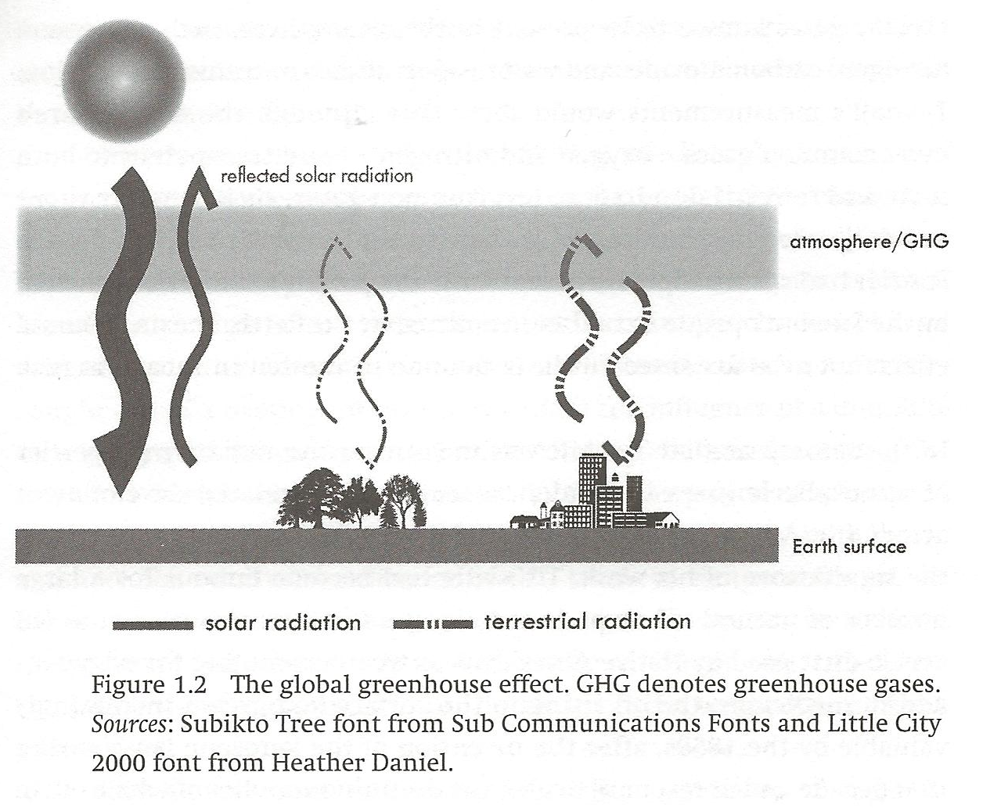
Figure 1.2, p. 19
p. 19

Slide 5
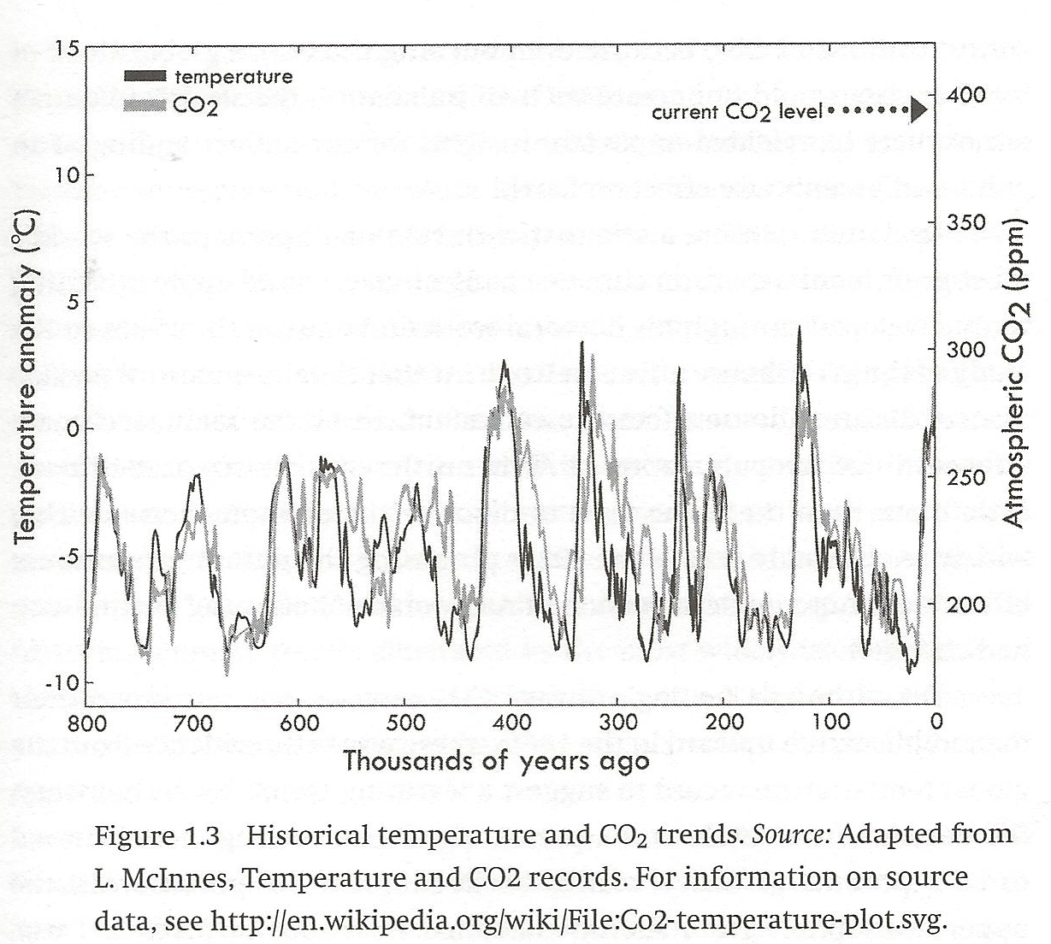
Figure 1.3, p. 25

Slide 6
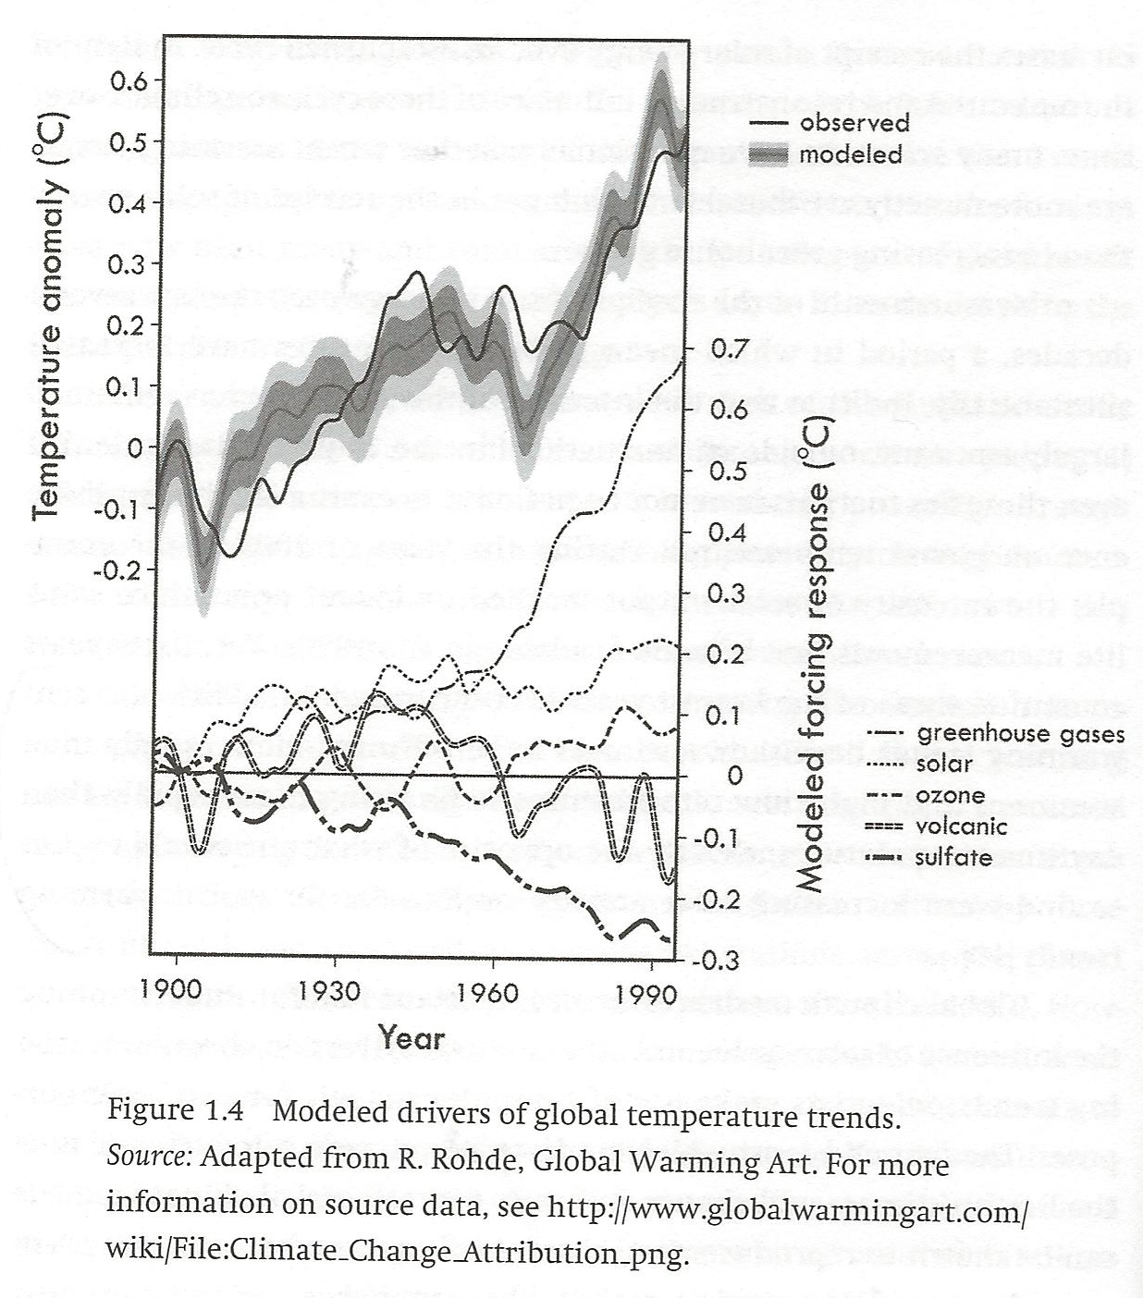
Figure 1.4, p. 32
p. 32

Slide 7
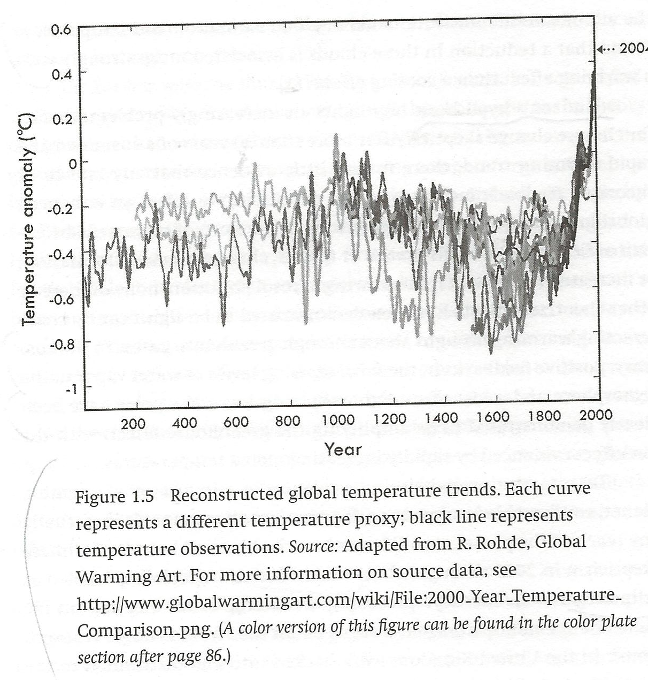
Figure 1.5, p. 36

Slide 8
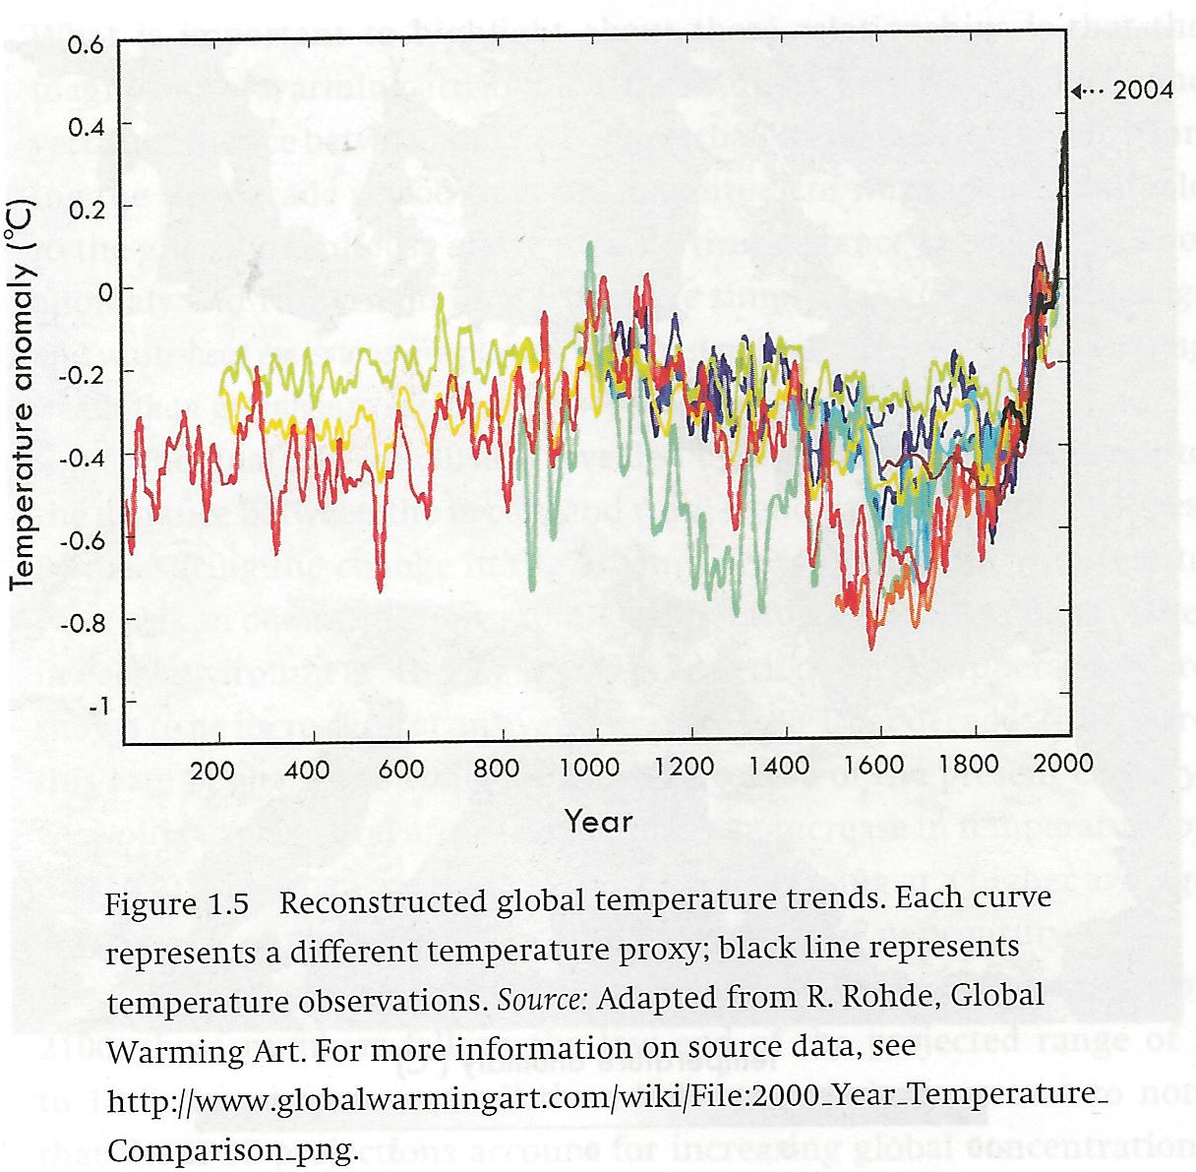
Fig. 1.5, page 36, color
p. 36

Slide 9
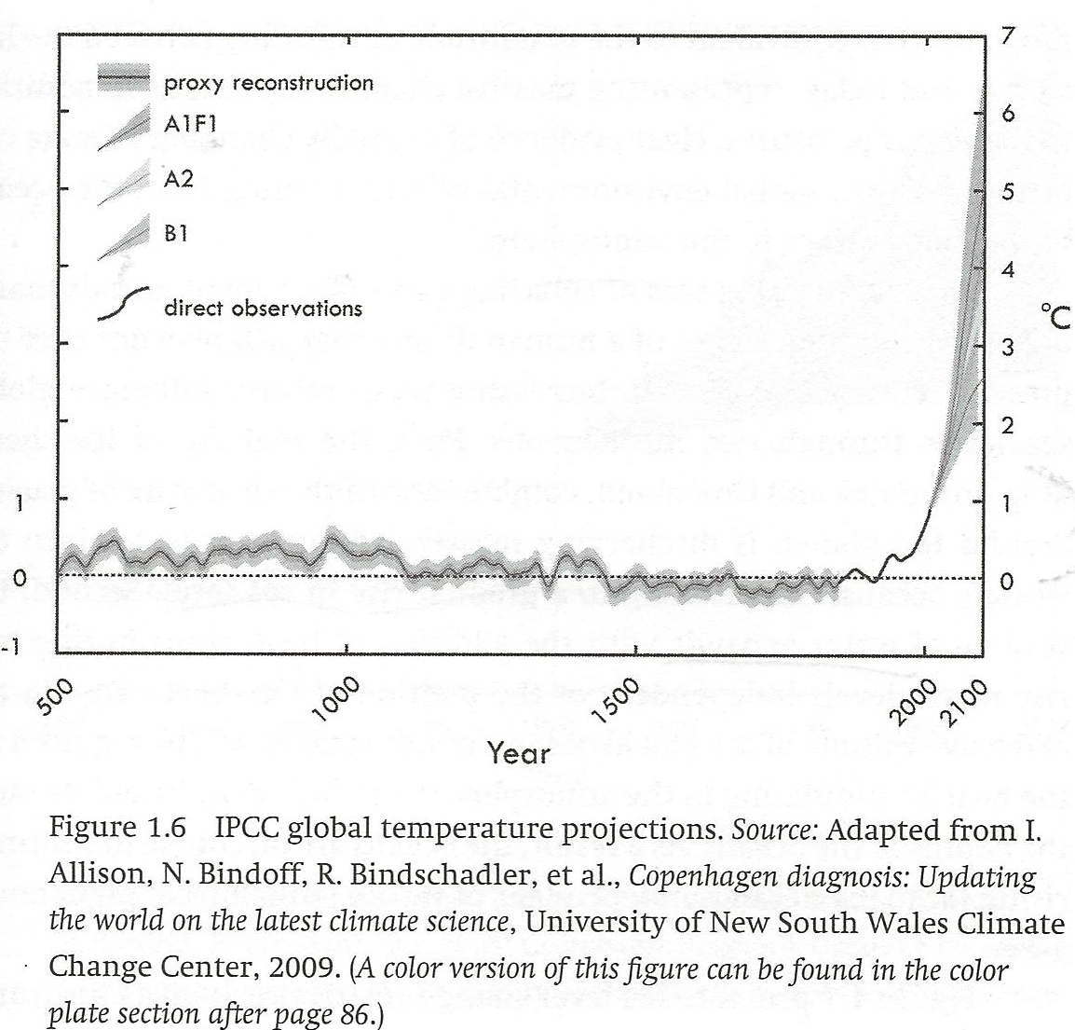
Figure 1.6, p. 39

Slide 10
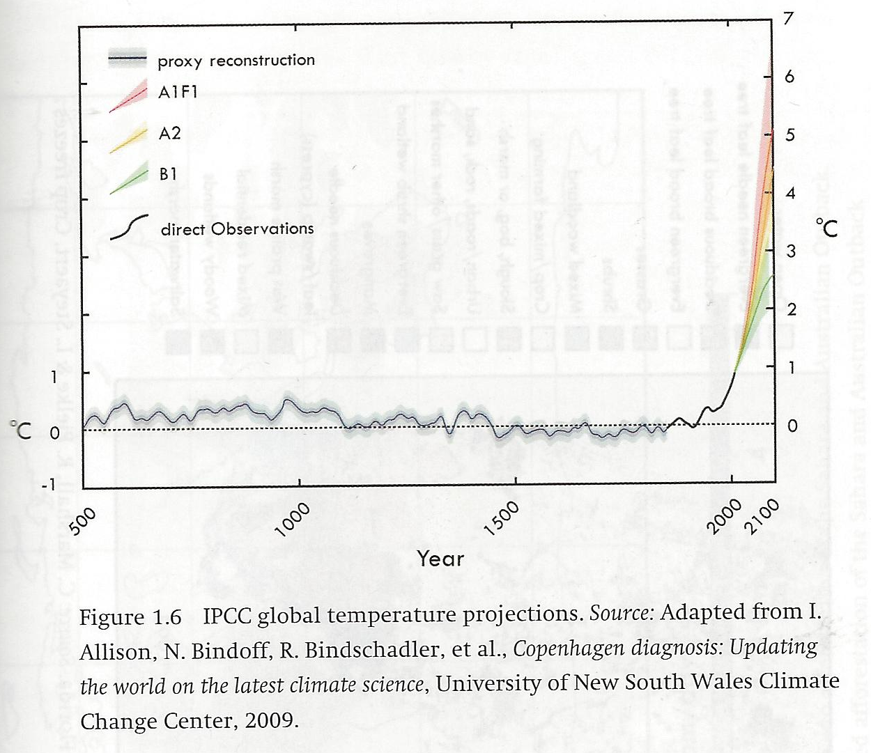
Fig. 1.6, p. 39 color

Slide 11
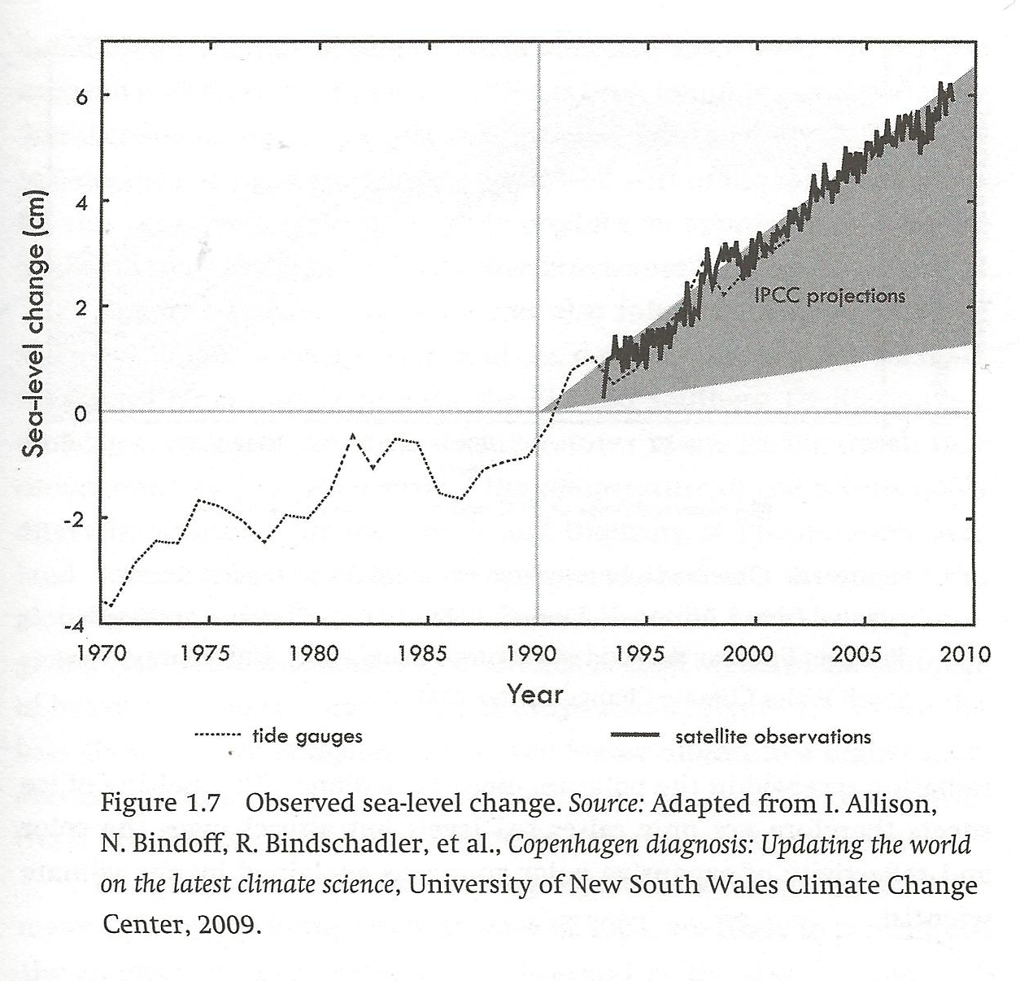
Figure 1.7, p. 41
p. 36

Slide 12
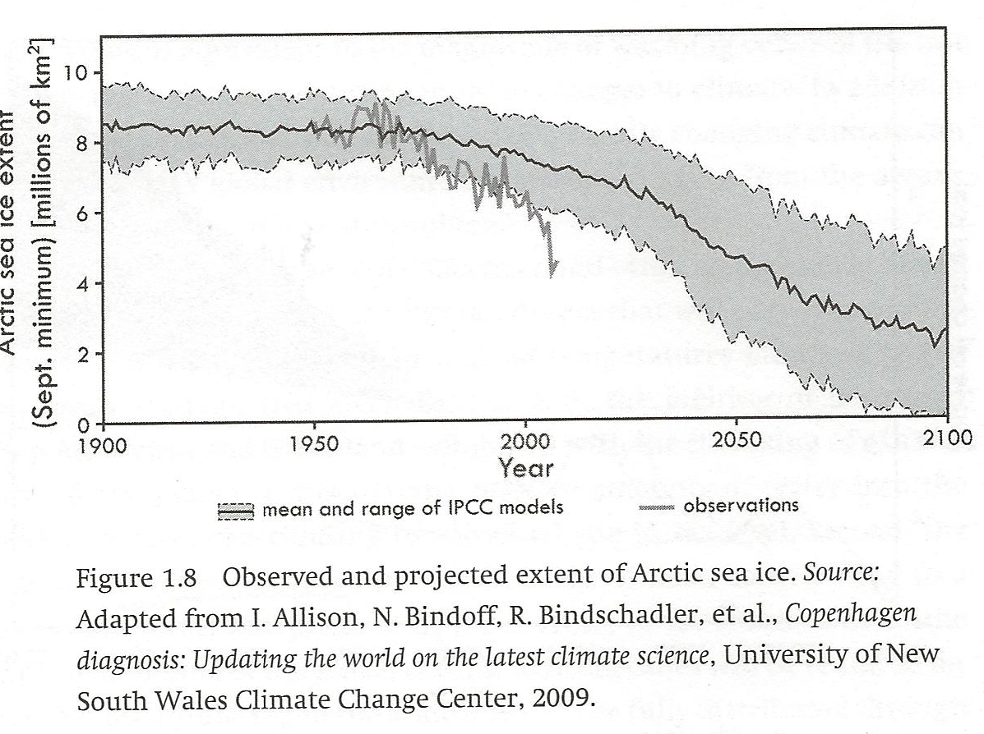
Figure 1.8, p. 42
p. 42.

Slide 13
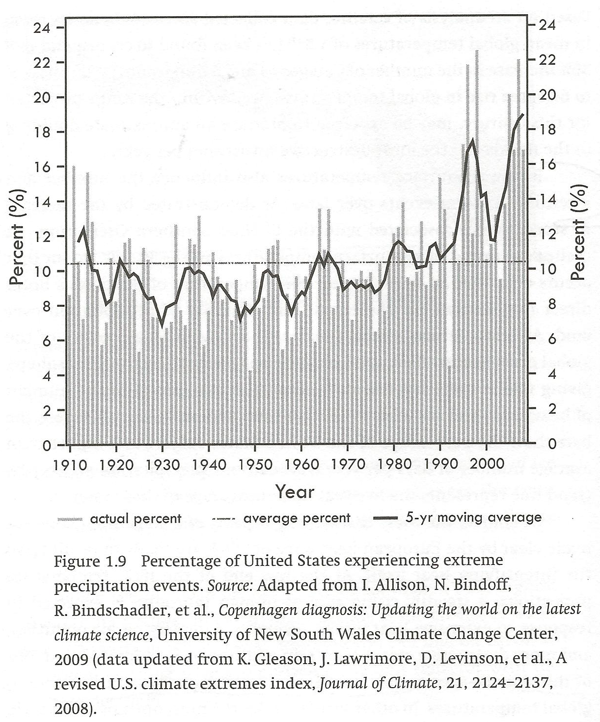
Figure 1.9, p. 44
p. 44

Slide 14
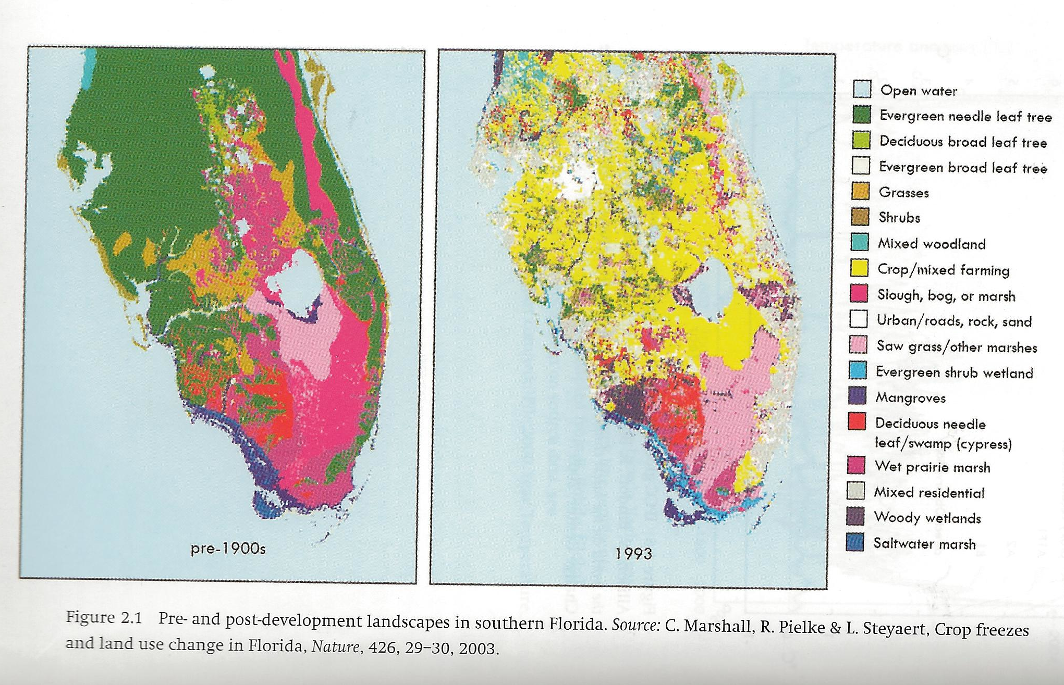
Figure 2.1, p. 49

Slide 15
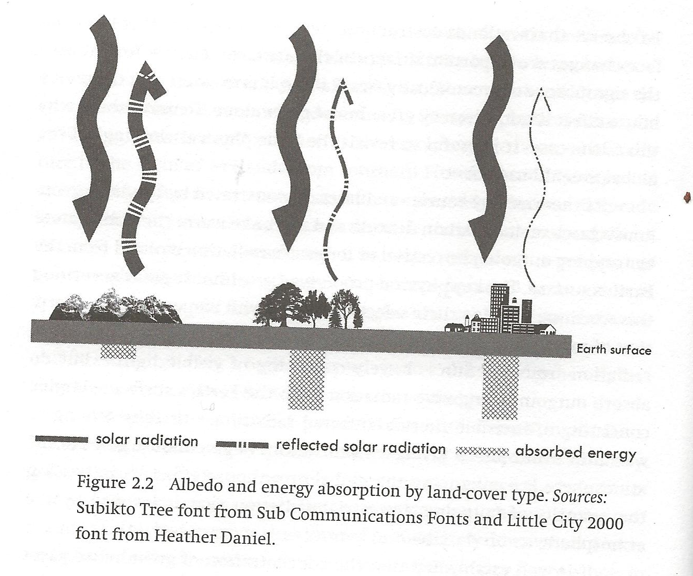
Figure 2.2, p. 52
p. 52

Slide 16
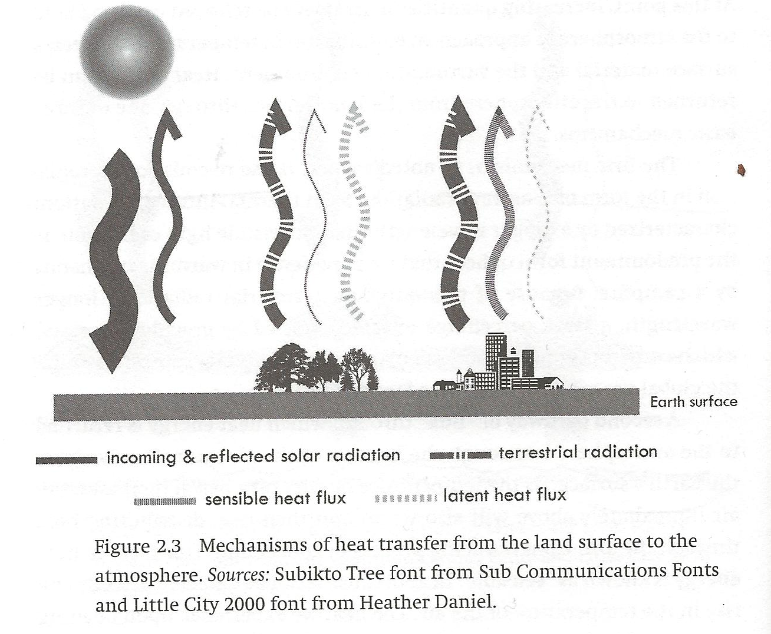
Figure 2.3, p. 54
p. 54

Slide 17
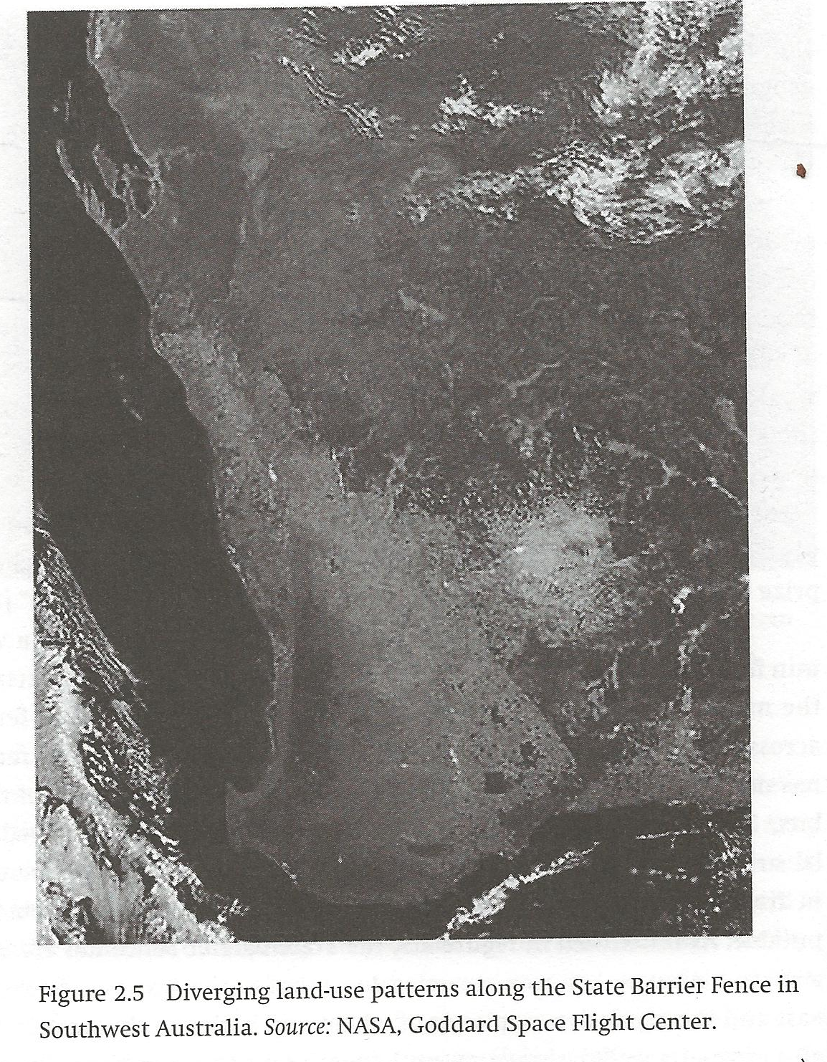
Figure 2.5, p. 60

Slide 18
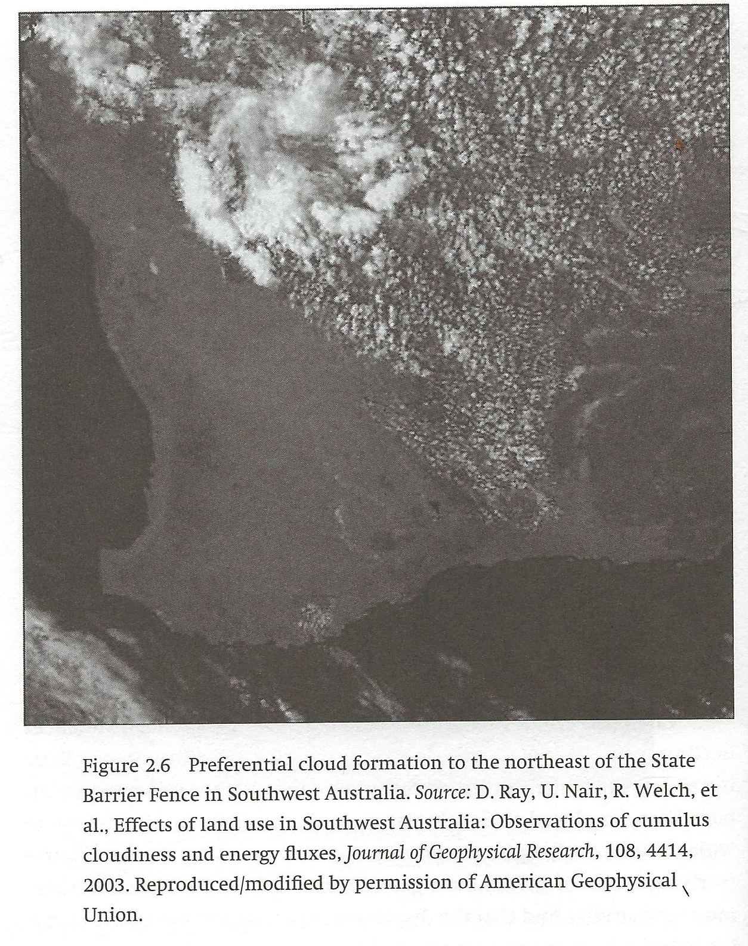
Figure 2.6, p. 62

Slide 19
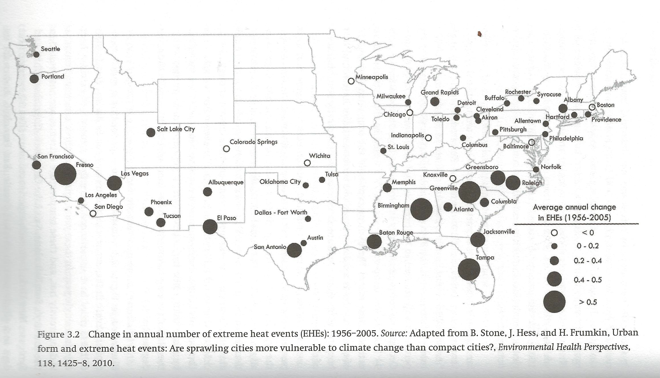
Figure 3.2, p. 72
p. 3.2

Slide 20
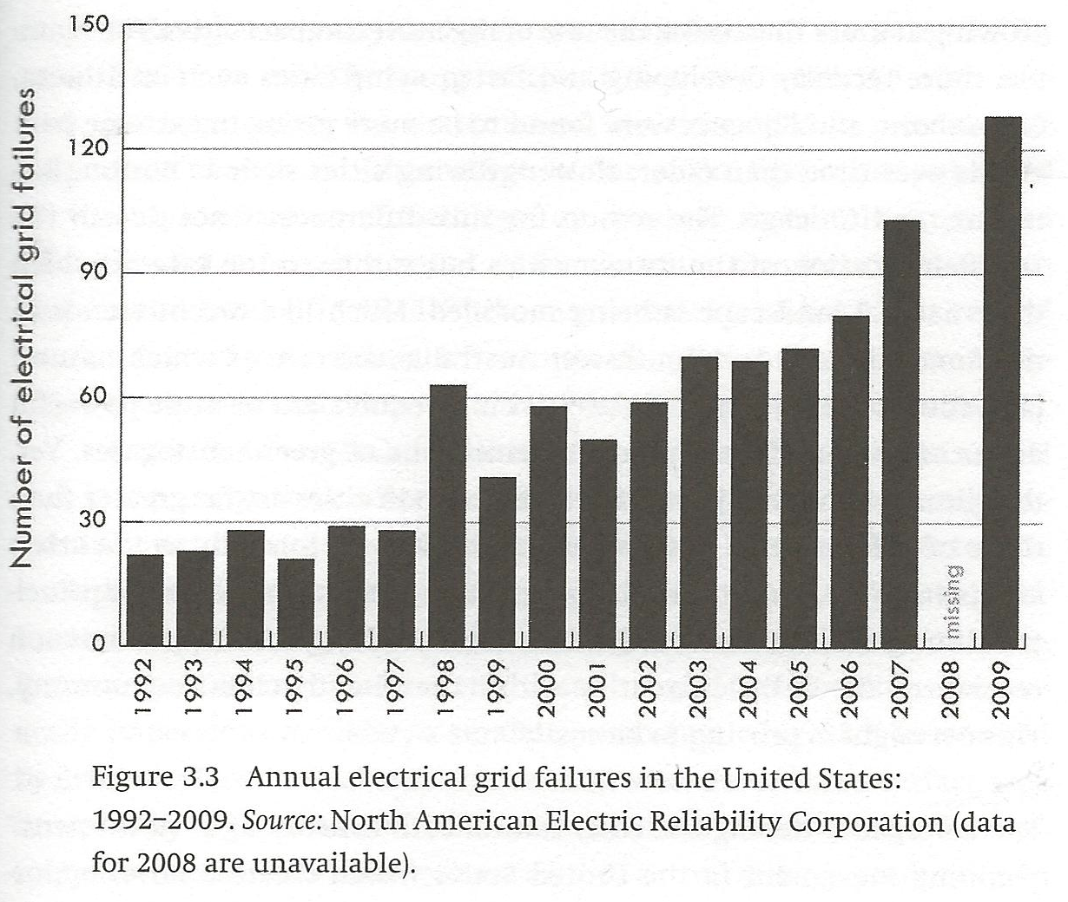
Figure 3.3, p. 73
p. 73

Slide 21
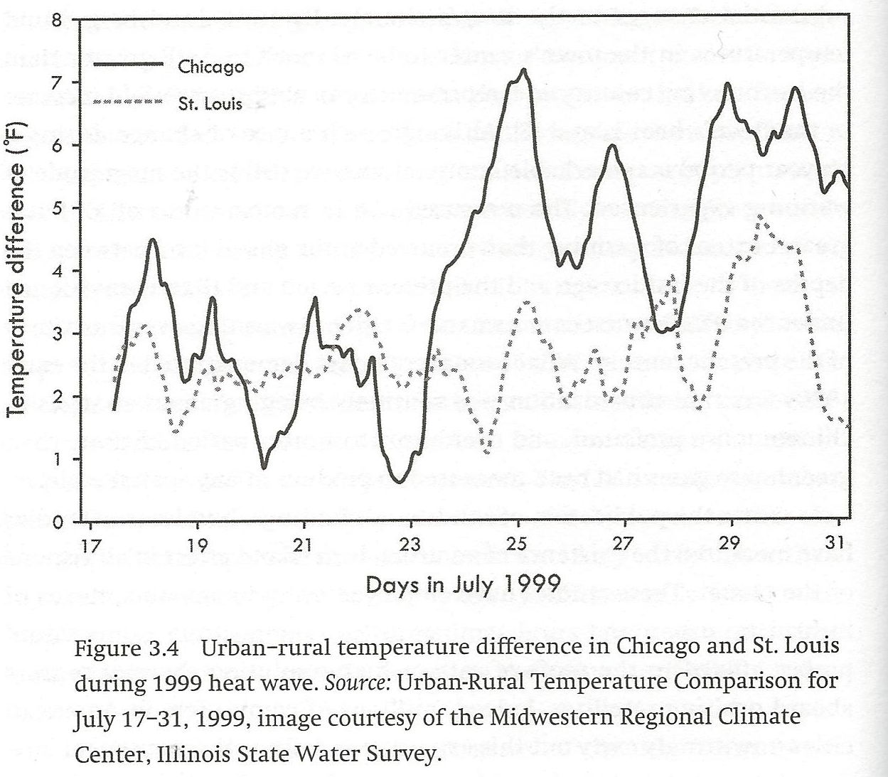
Figure 3.4, p. 78
p. 78

Slide 22
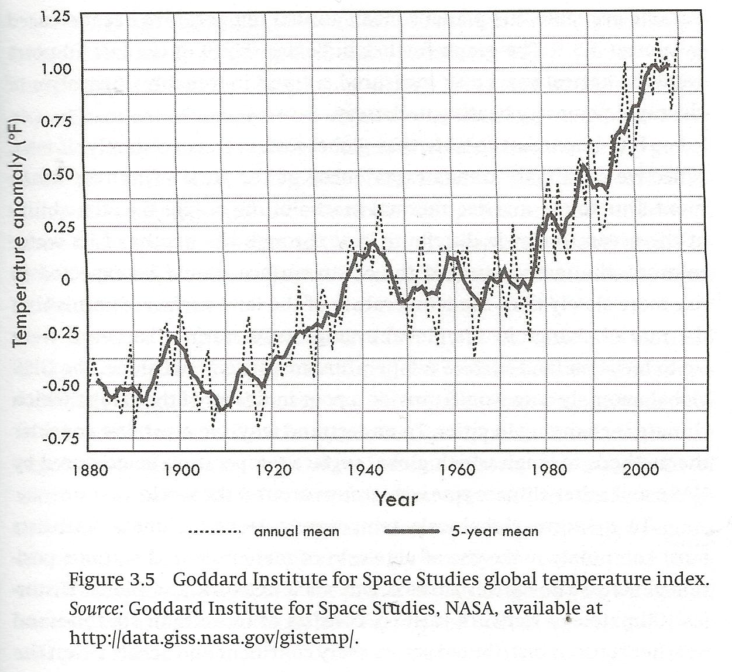
Figure 3.5, p. 79
p. 79

Slide 23
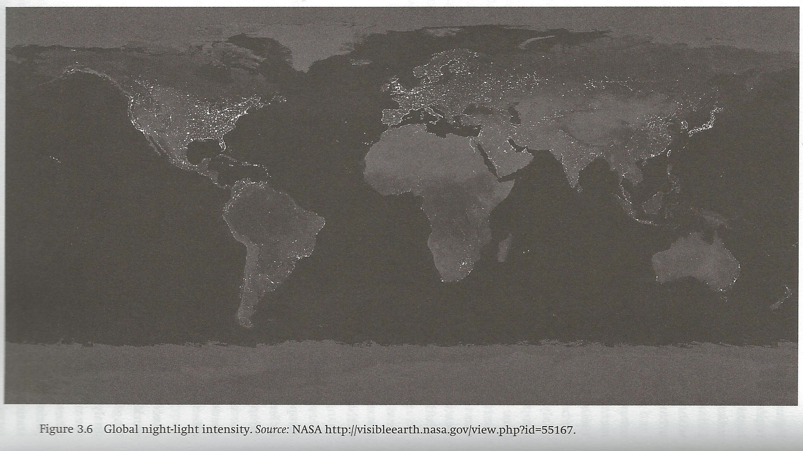
Figure 3.6, p. 84

Slide 24
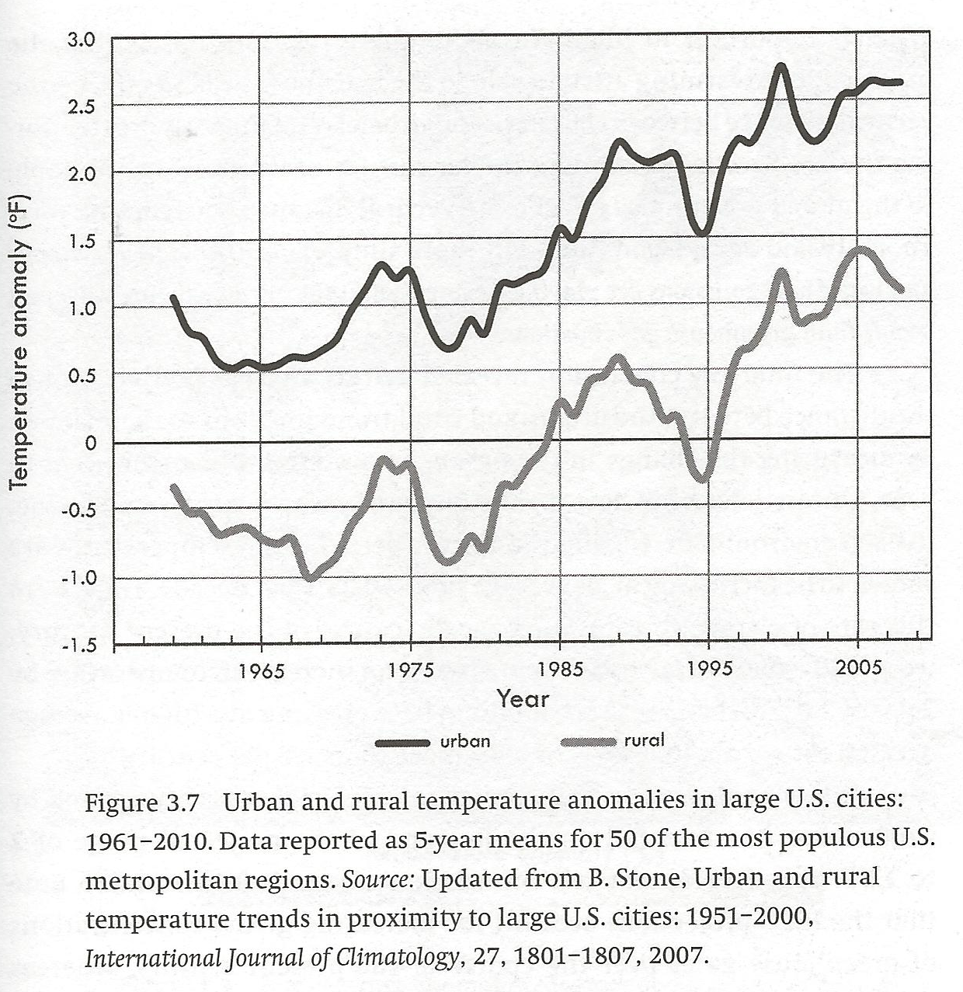
Figure 3.7, p. 85
p. 85

Slide 25
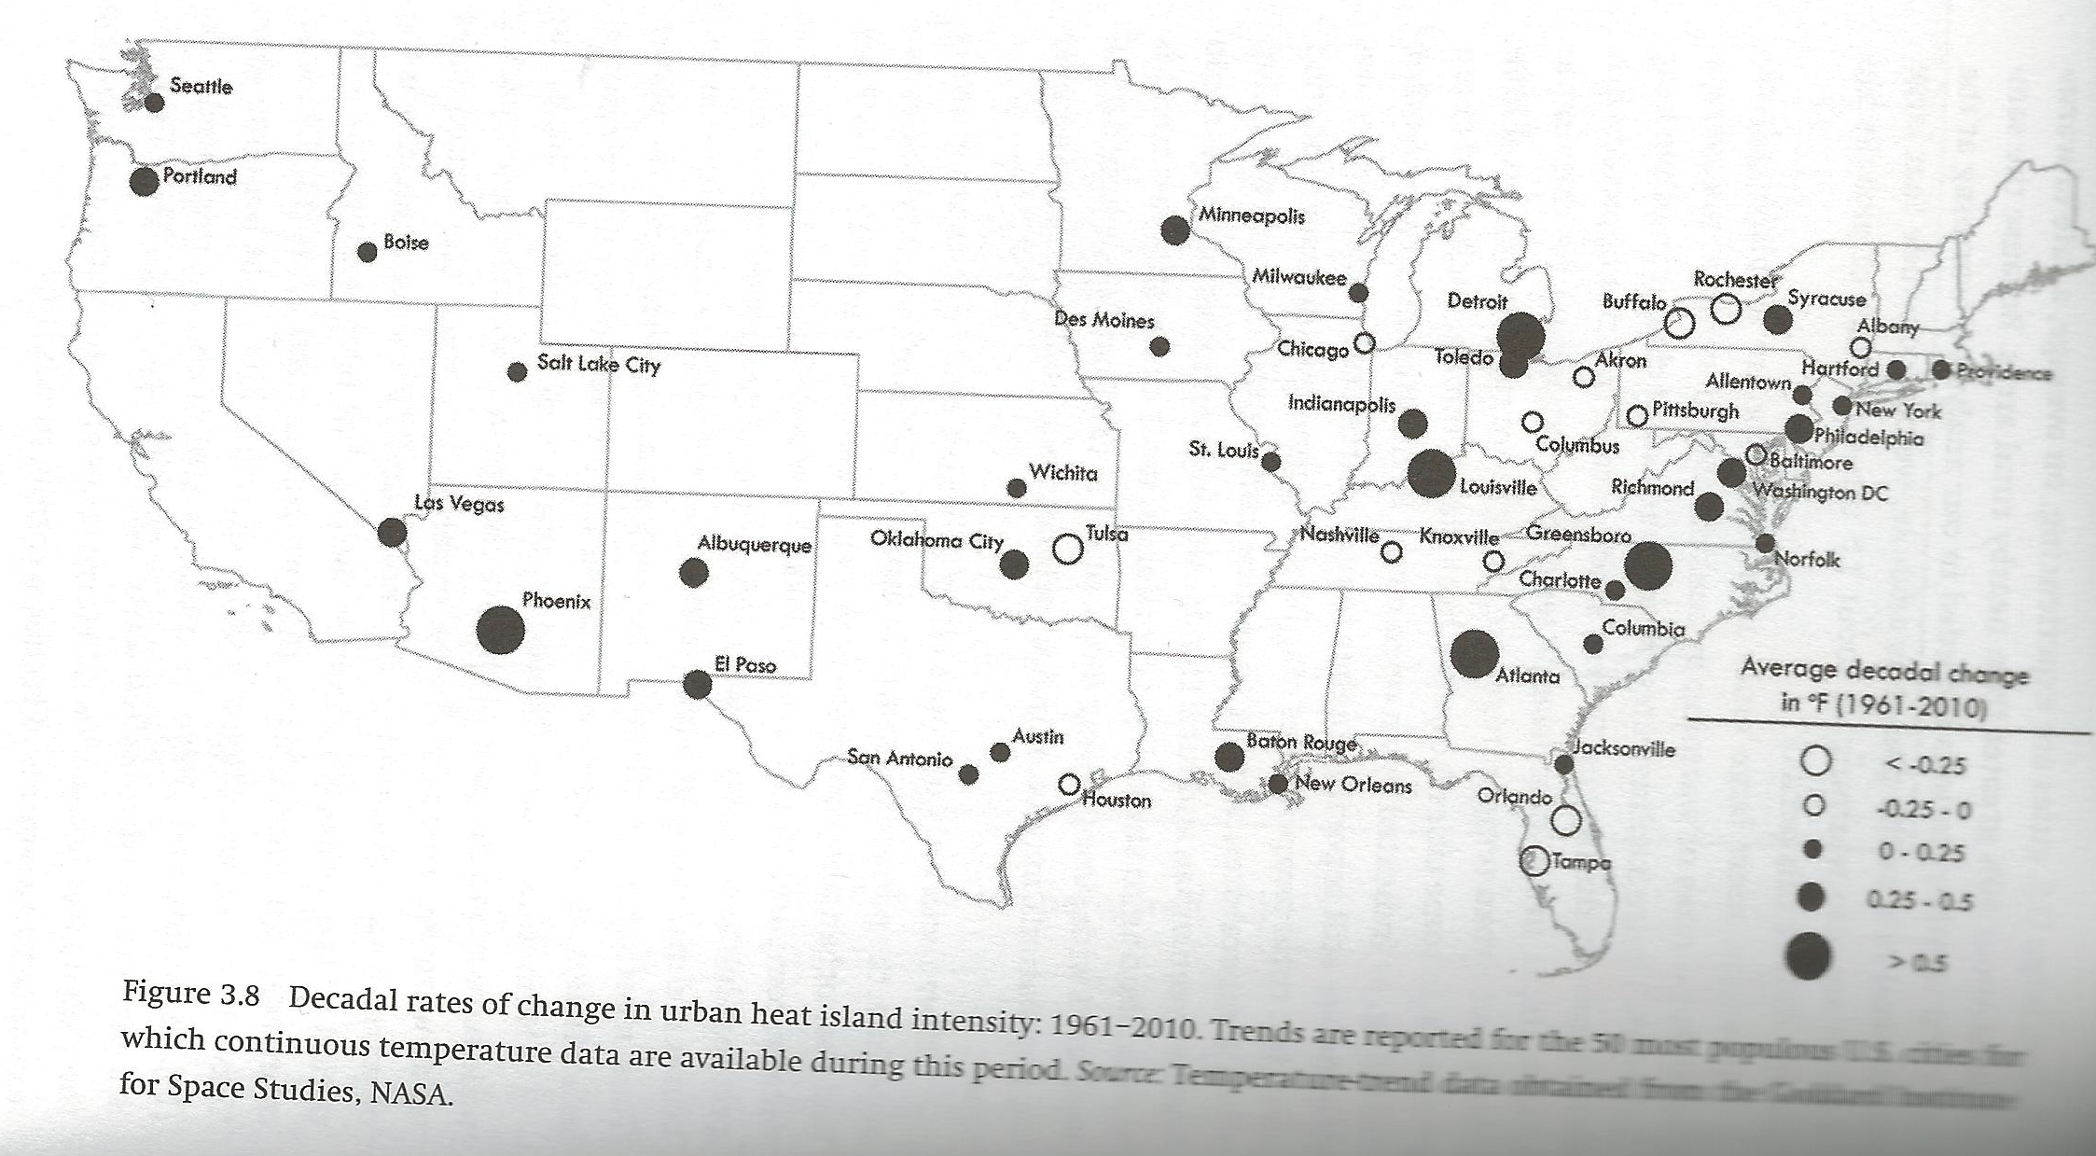
Figure 3.8, p. 88
p. 88

Slide 26
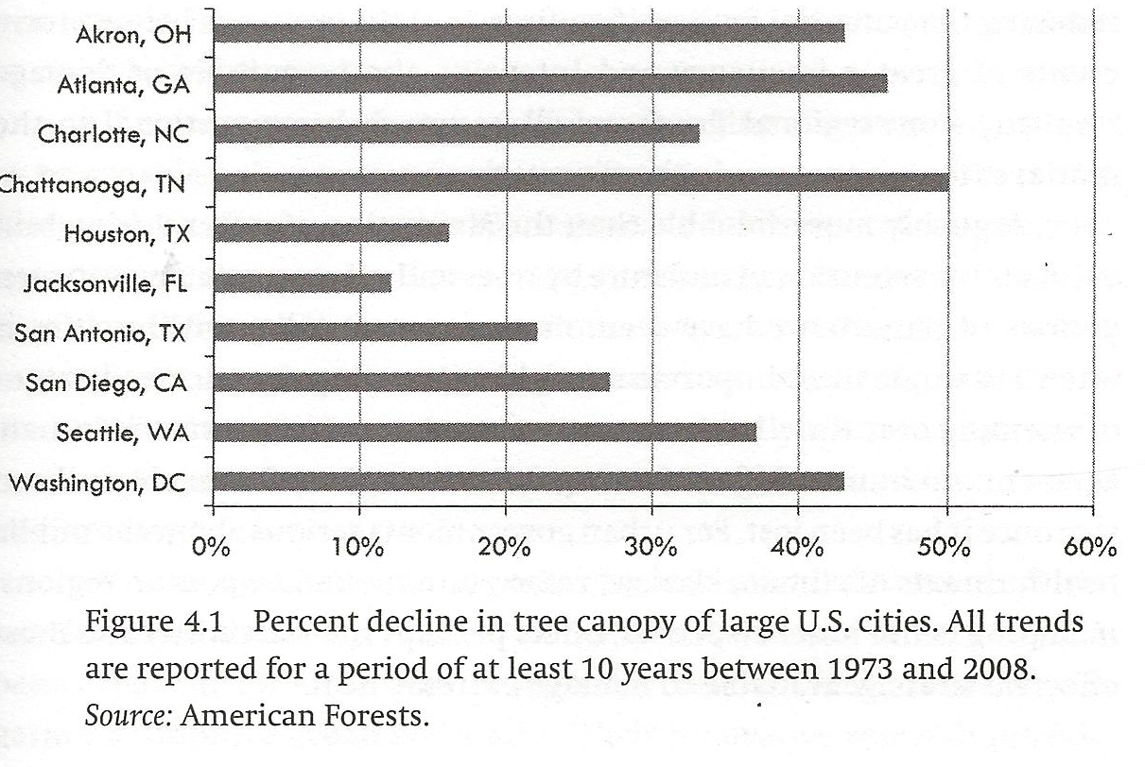
Figure 4.1, p. 101
p. 101

Slide 27
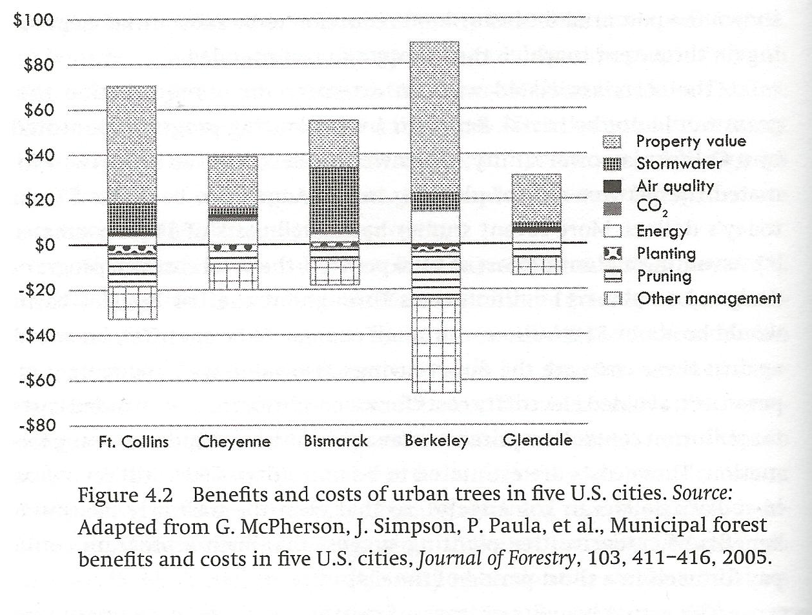
Figure 4.2, p. 106
106

Slide 28
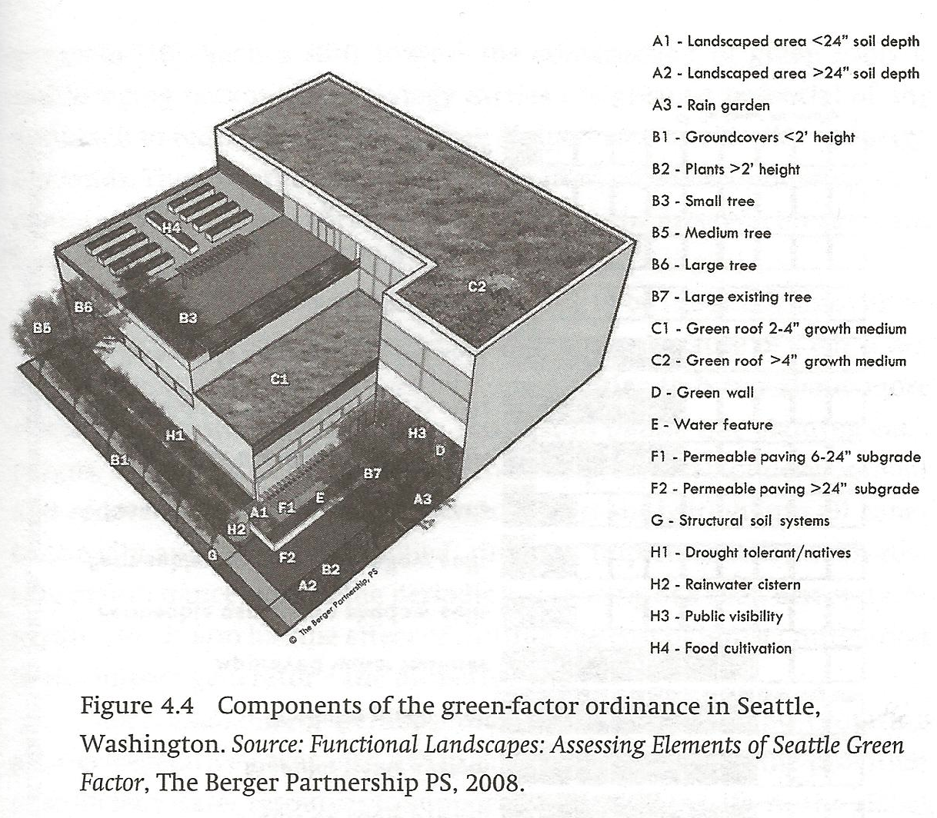
Figure 4.4, p. 113
p. 113

Slide 29
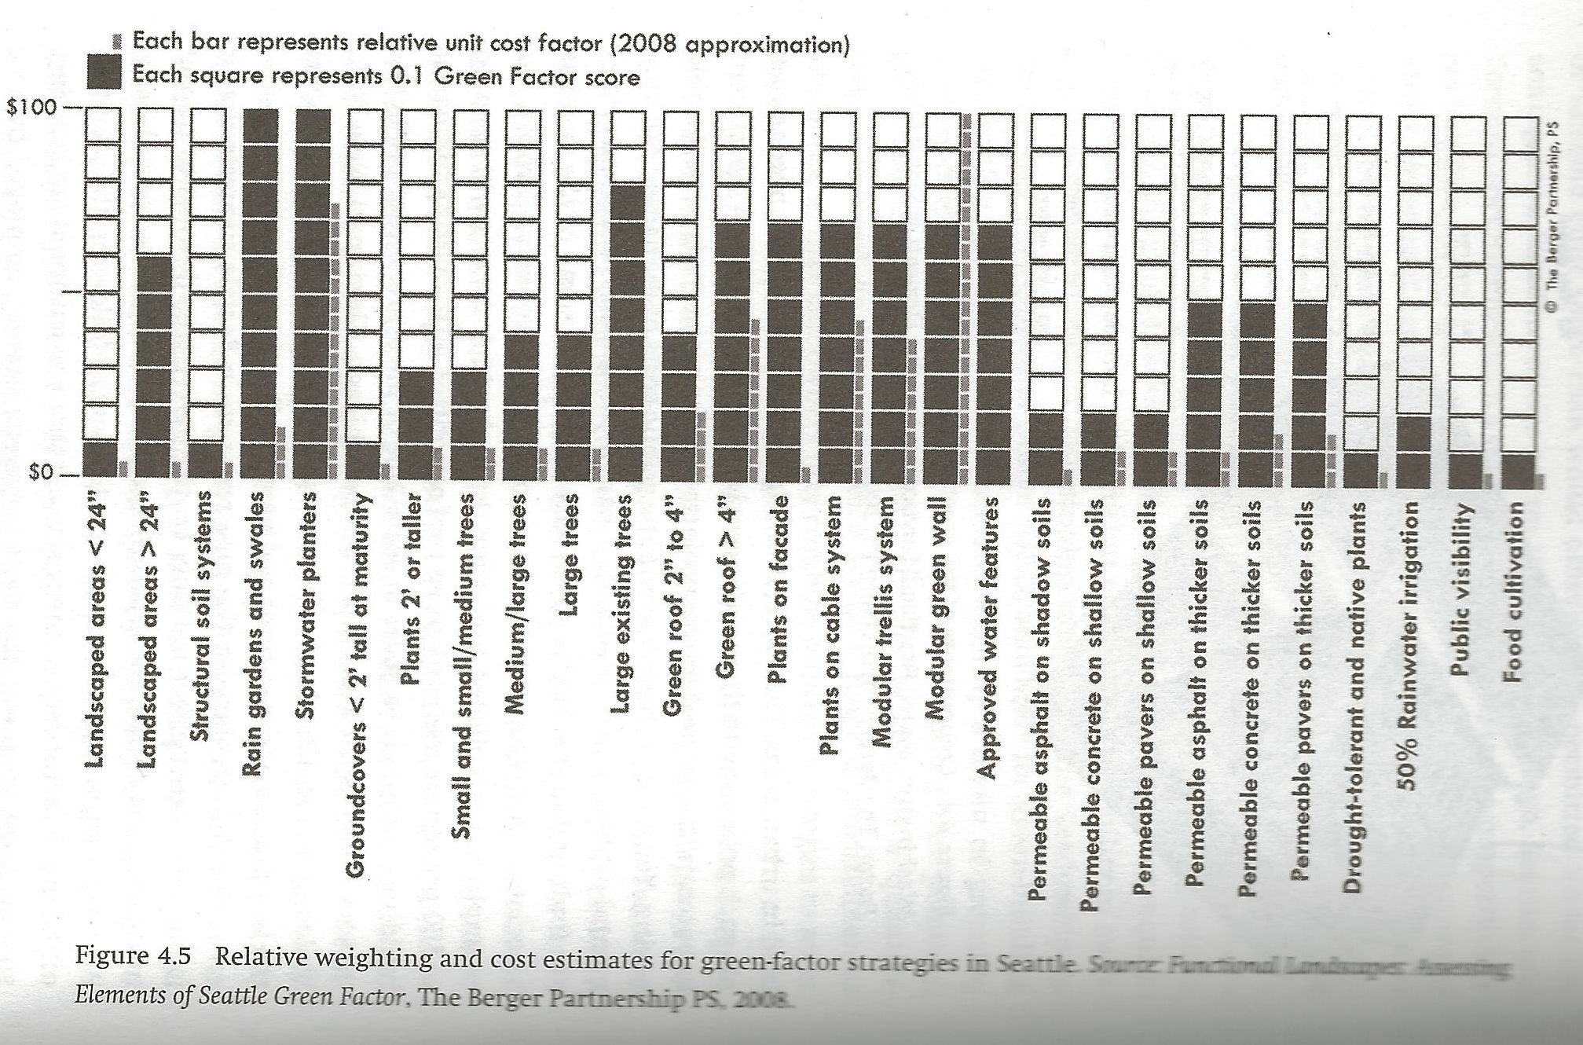
Figure 4.5, p. 114
p. 114

Slide 30
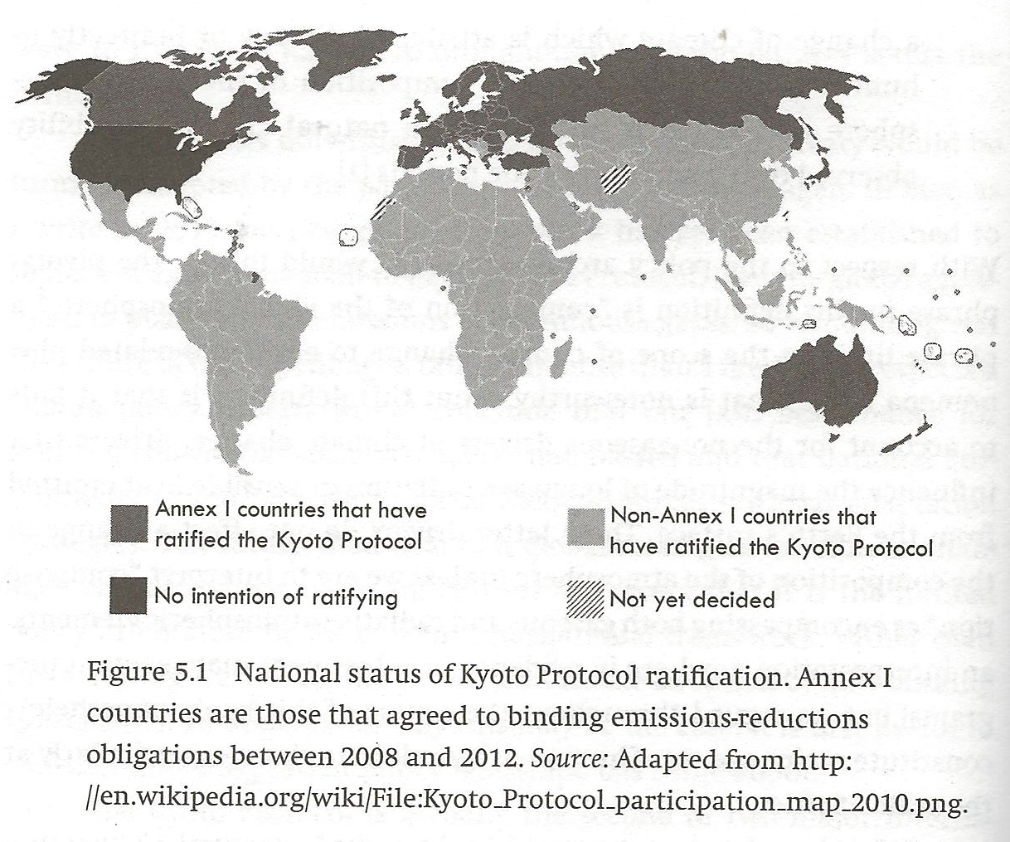
Figure 5.1, p. 132
p. 132

Slide 31
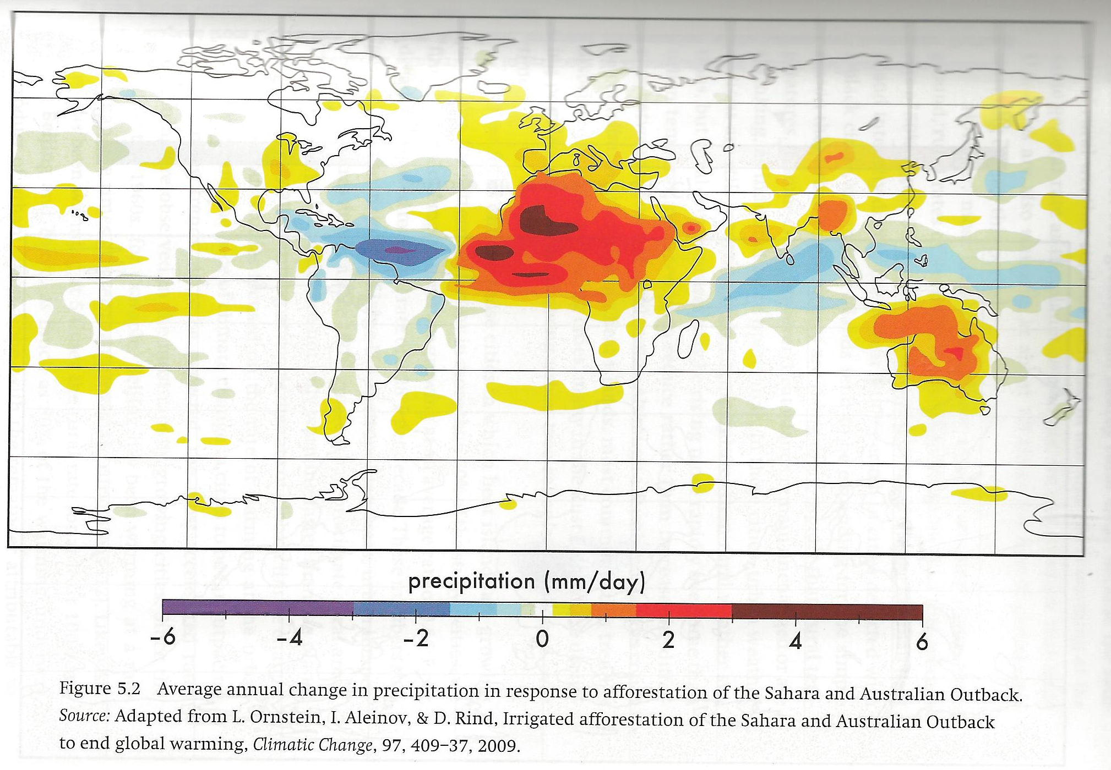
Figure 5.2, p. 138
p. 136

Slide 32
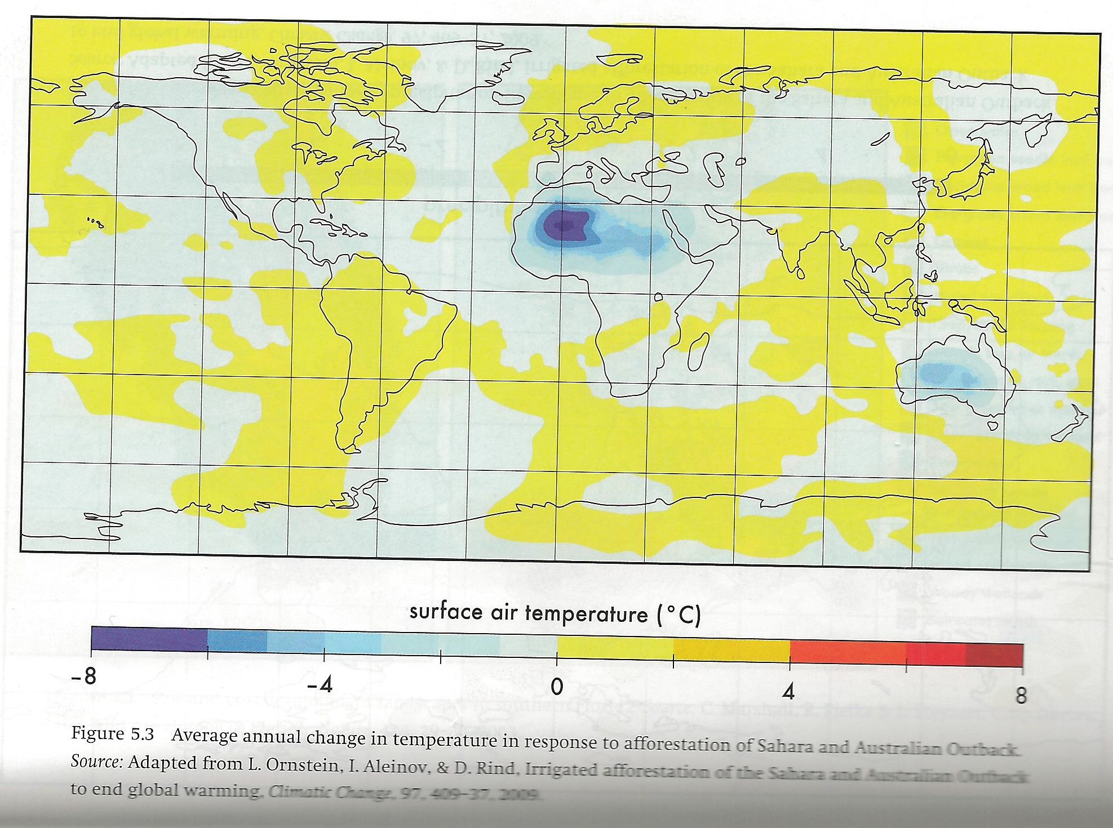
Figure 5.3, p. 141
p. 141

Slide 33
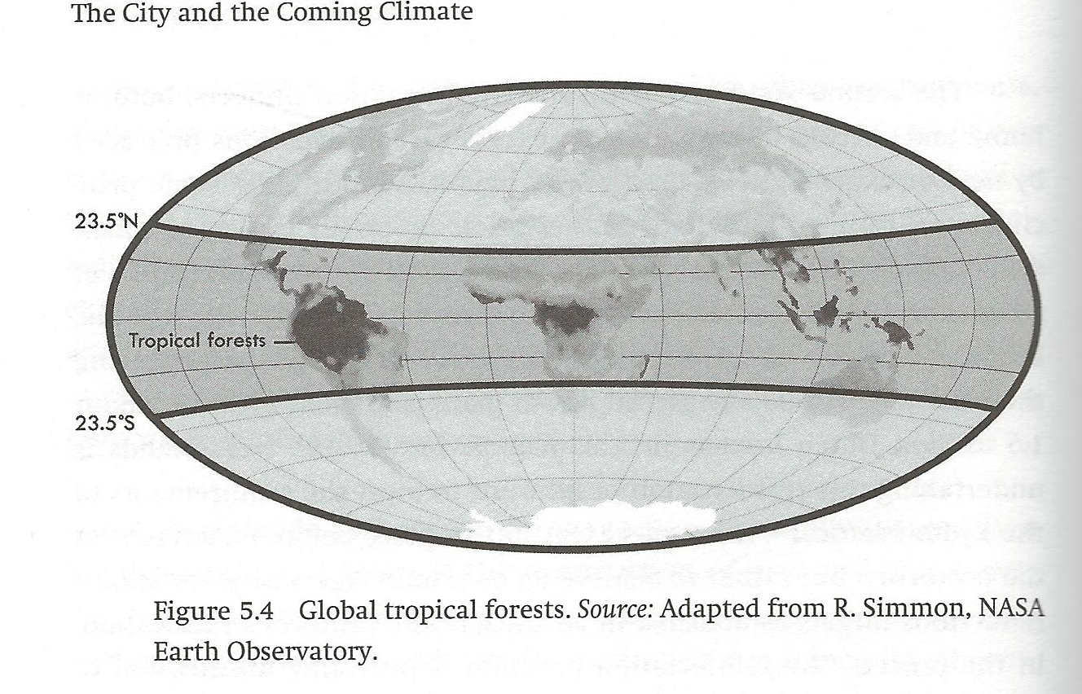
Figure 5.4, p. 144
p. 144

Slide 34
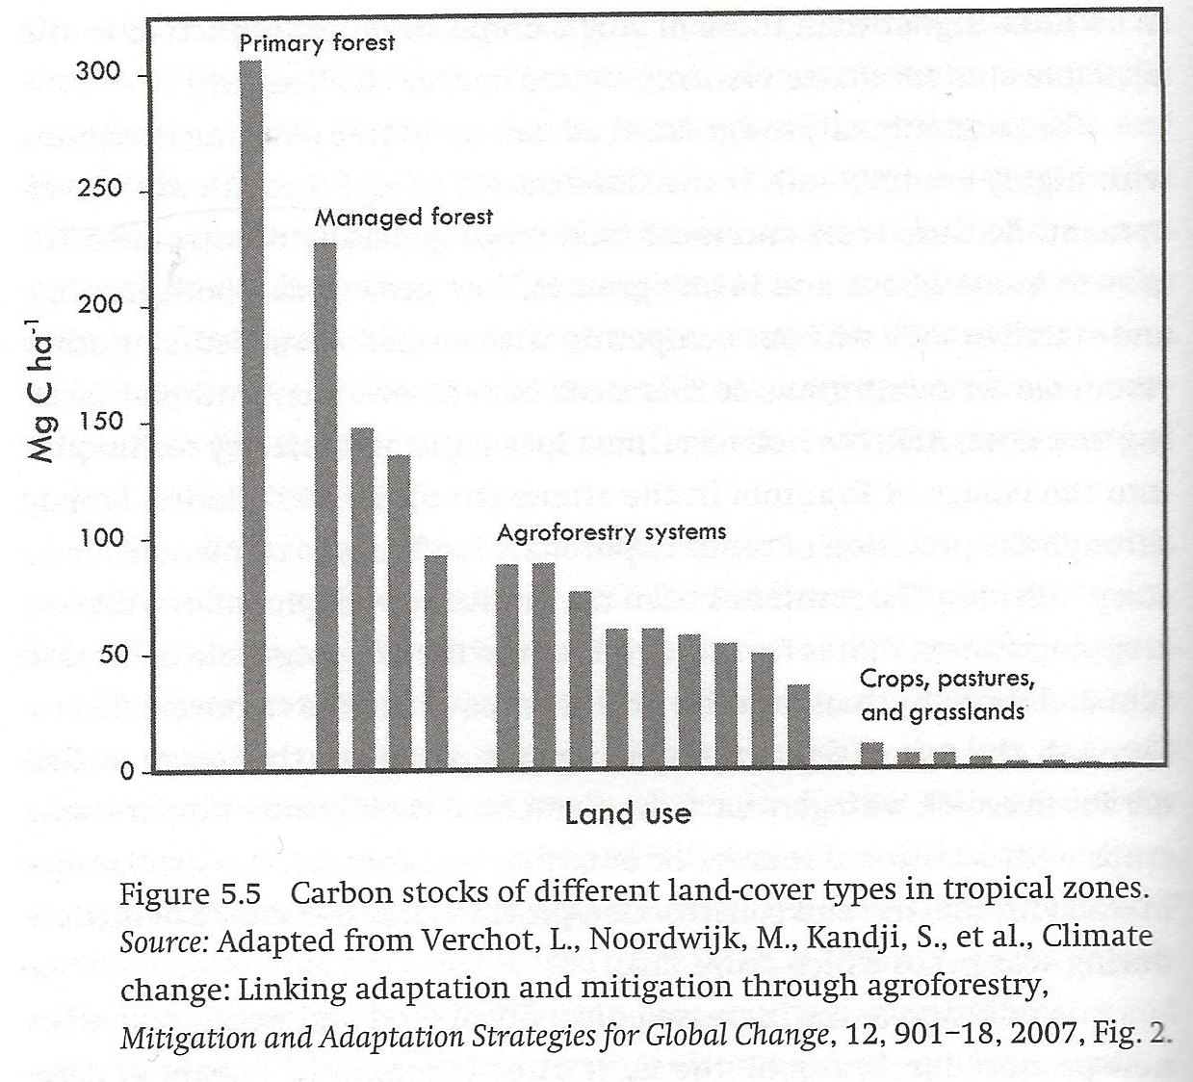
Figure 5.5, p. 150
p. 150

Slide 35
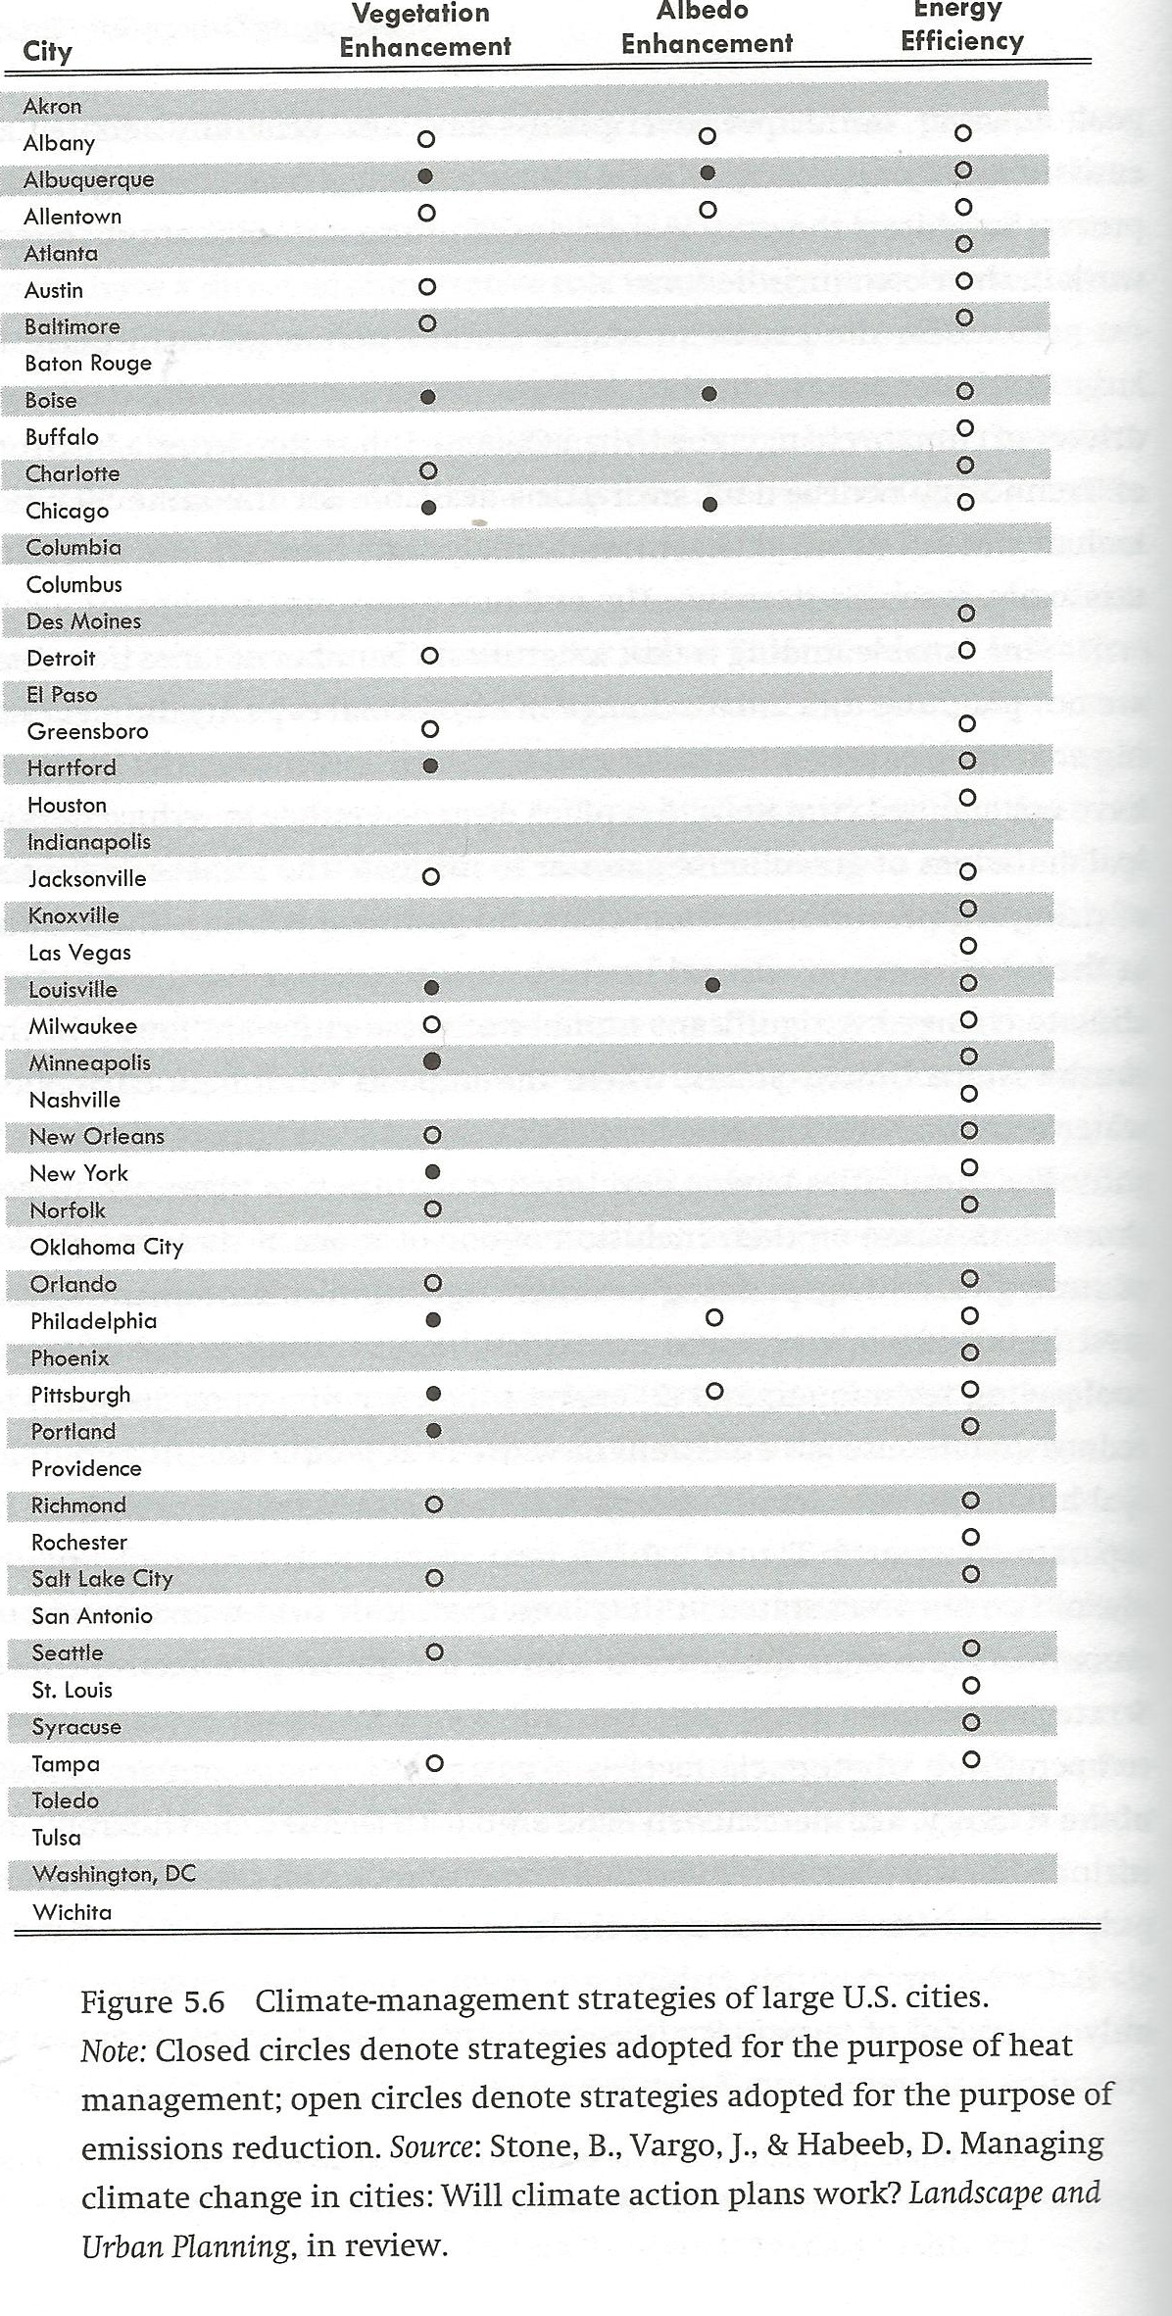
Figure 5.6, p. 156

Slide 36
Four Recommendd Changes (pp. 161-169)
1 – Broaden the definition of climate change adopted by the UN Framework Convention on Climate Change to encompass the land-surface drivers of climate change.
2 - Adopt the regional scale as the primary focus of scientific assessemnts of climate change.
3 – Establish forest protection and reforestration commitments for paticipating nations.
4 – Prioritize adoptive mitigation over nonadaptive mitigation.

Slide 37
p. 17

