Slide 1
Return to Home Page
Introduction to GEOG 495:
The Geographies of Climate Change
January 16, 2014

Slide 2
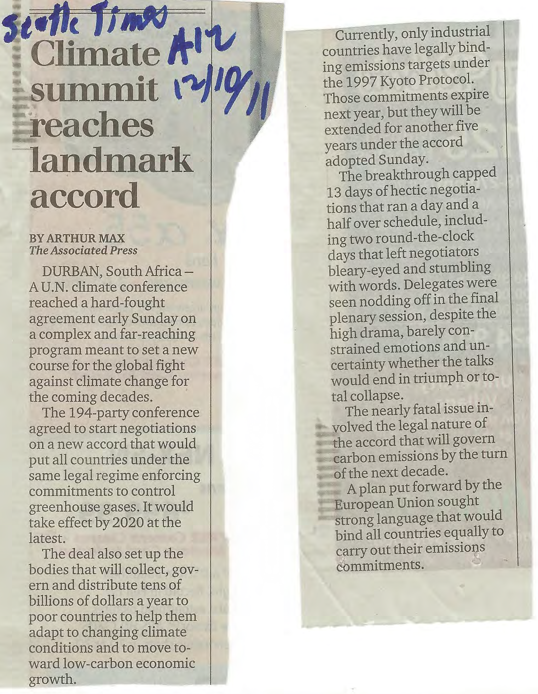
Climate summit reaches landmark accord

Slide 3
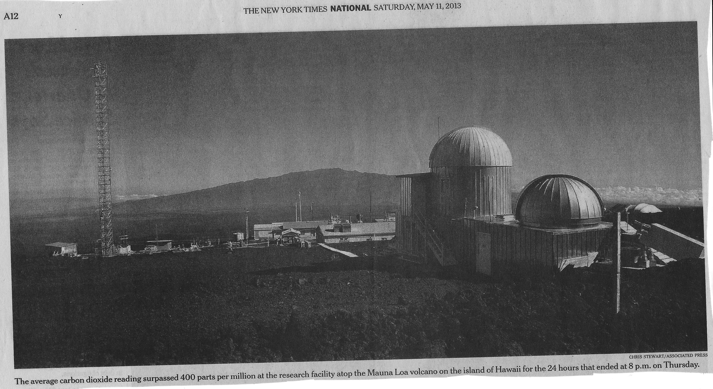
NY Times, May 11, 2013, Mauna Loa, Hawaii, CO₂ reaches 400 ppm

Slide 4
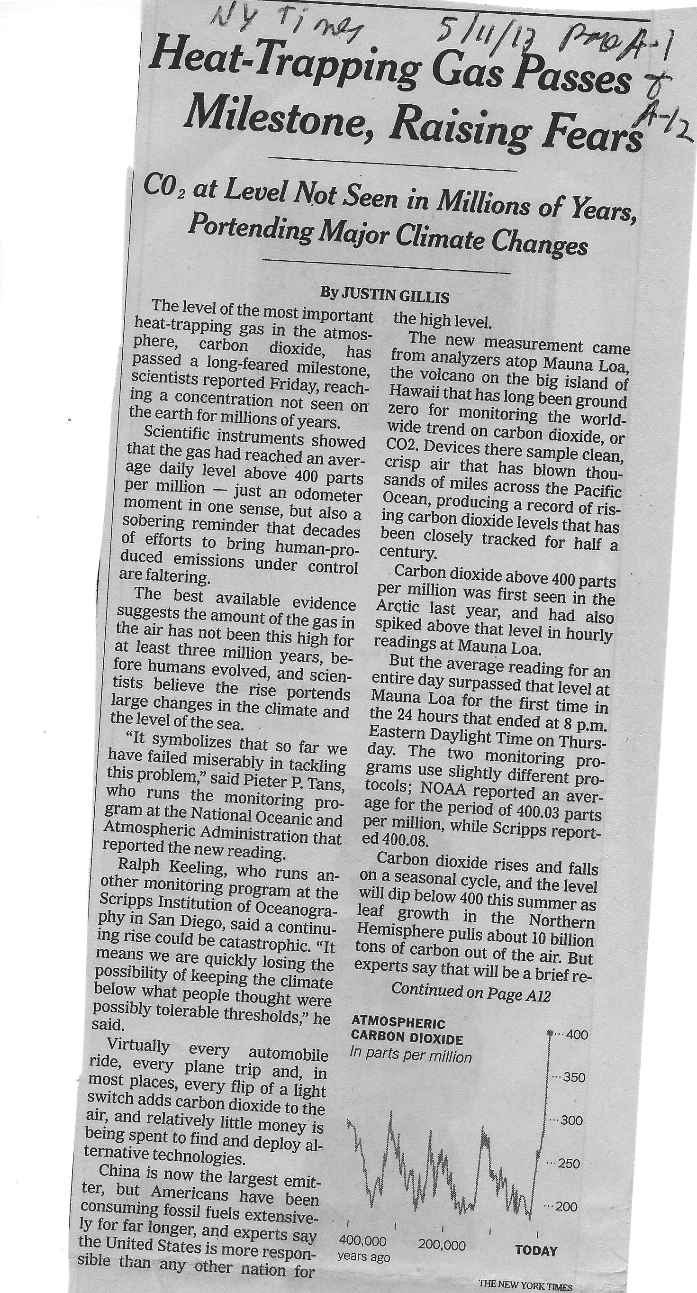
Heat-Trapping Gas Passes Milestone (p. A-1)

Slide 5
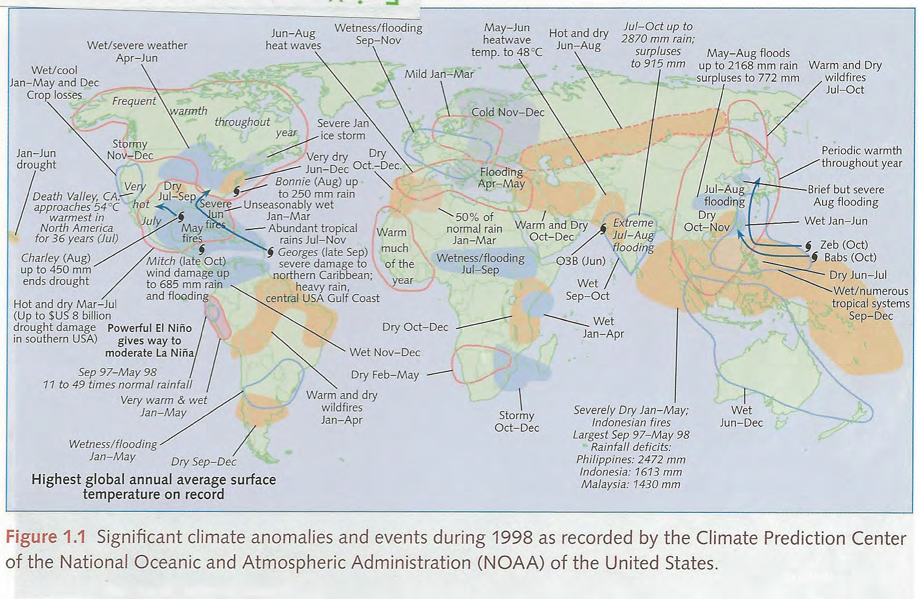
Fig. 1.1 Significant climate anolalies & events during 1998.
Source: John Houghton, Global Warming, 4th edit., 2009, p. 3

Slide 6
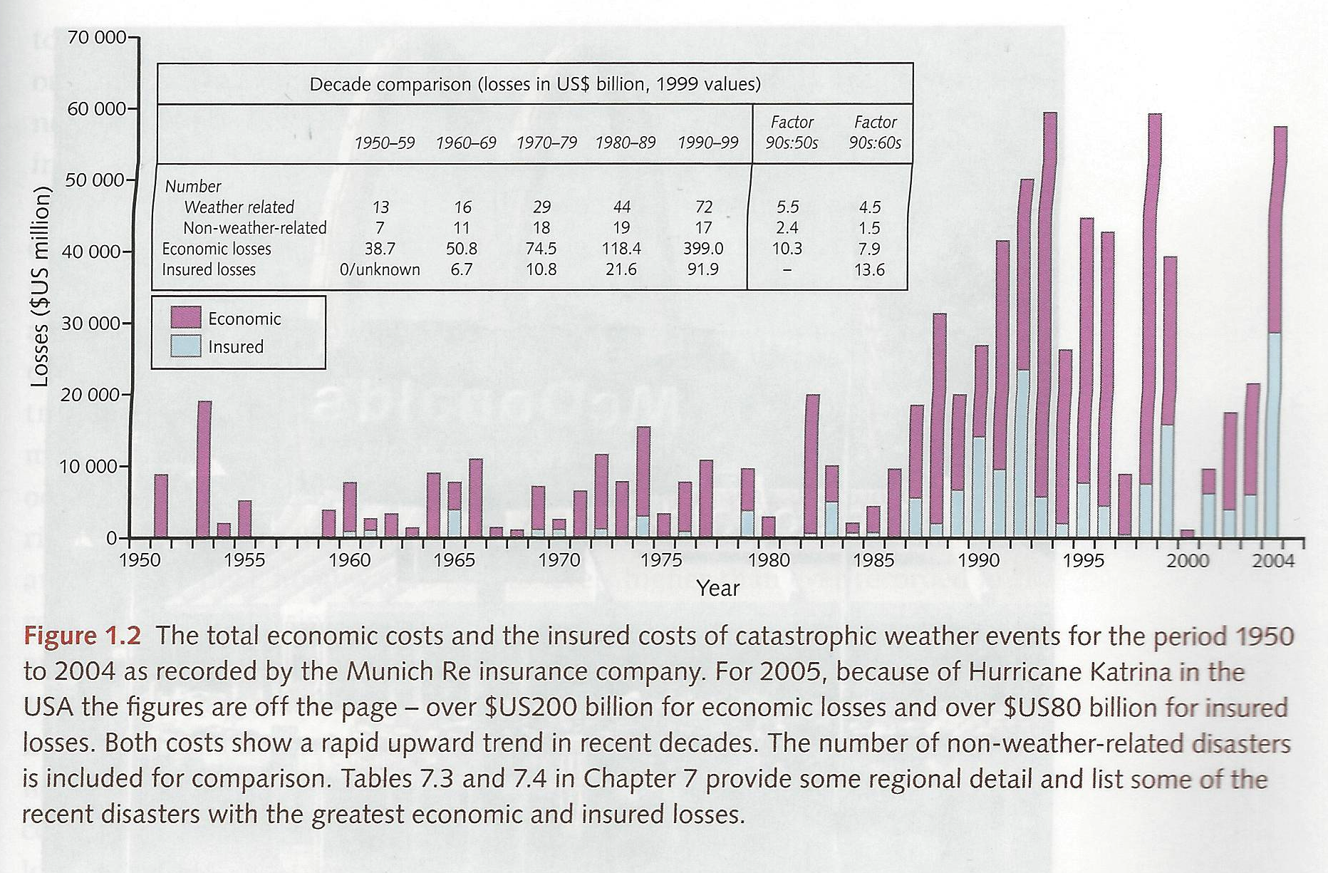
Fig. 1.2 Total Economic costs & insured costs of catastrophic weather events – 1950-2004.
Houghton, 2009, p. 5.

Slide 7
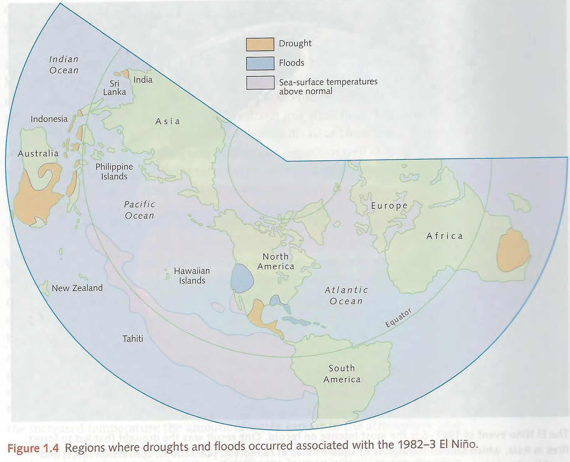
FIG. 1.4 Regions where droughts & floods occurred associated with El Nino
Houghton, 2009, p. 11.

Slide 8
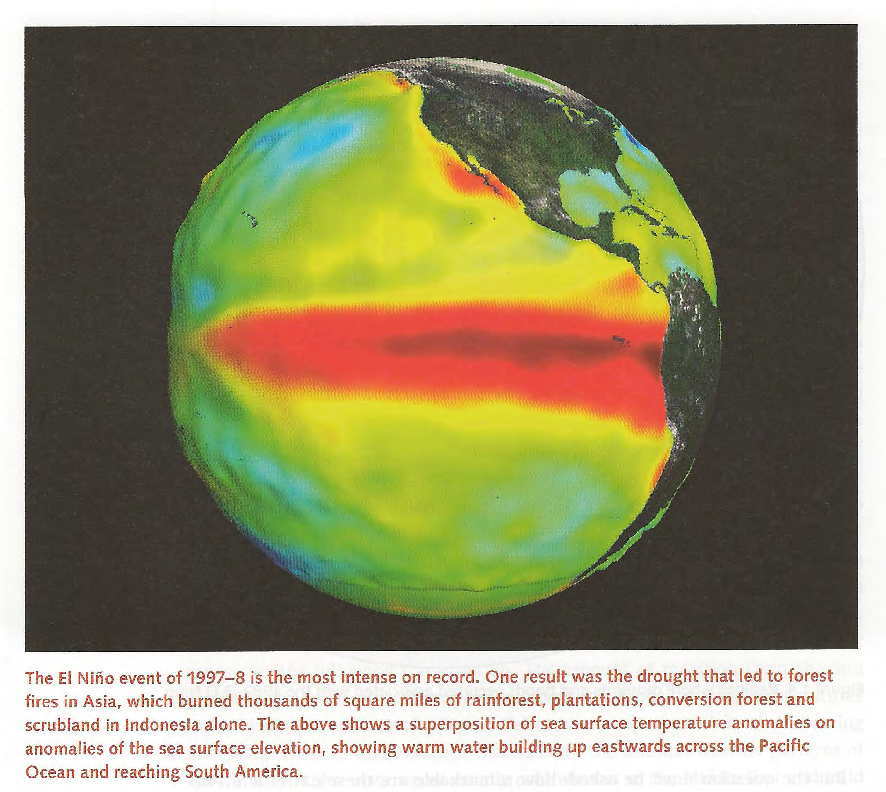
The El Nino event of 1997-8
Houghton, 2009, p. 12.

Slide 9
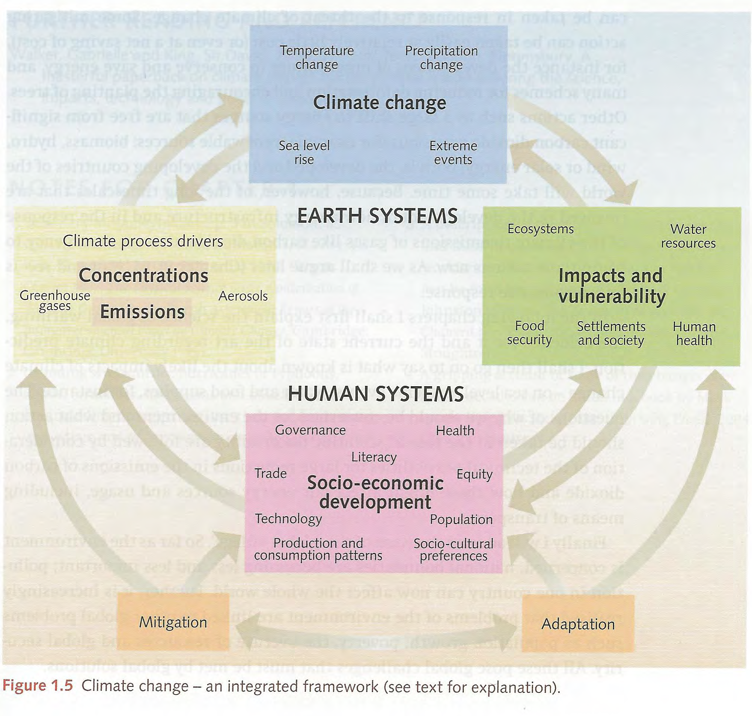
Figure 1.5 Climate change – an integrated framework
Houghton, 2009, p. 15.

Slide 10
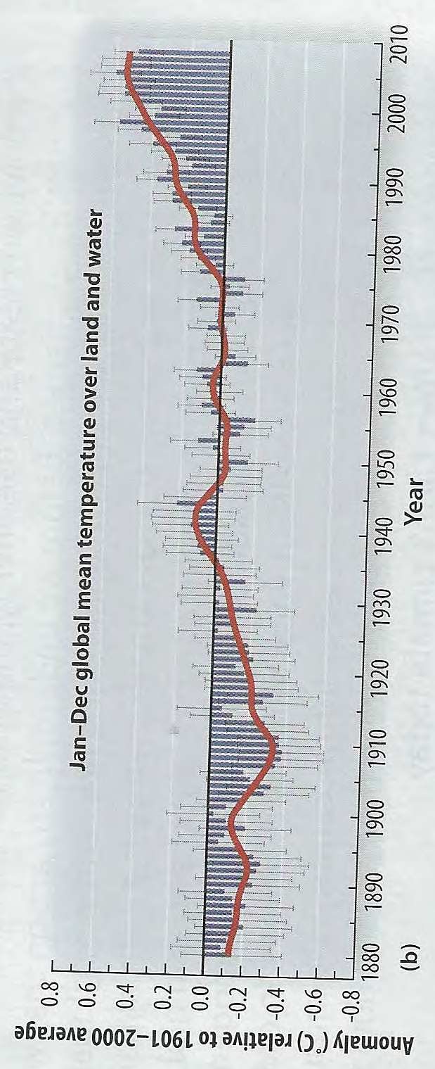
Figure 1.1a Average Annual Global Surface Temperature Change 1880-2010. Source: Kitchen, Global Climate Change, 2014, p. 4.

Slide 11
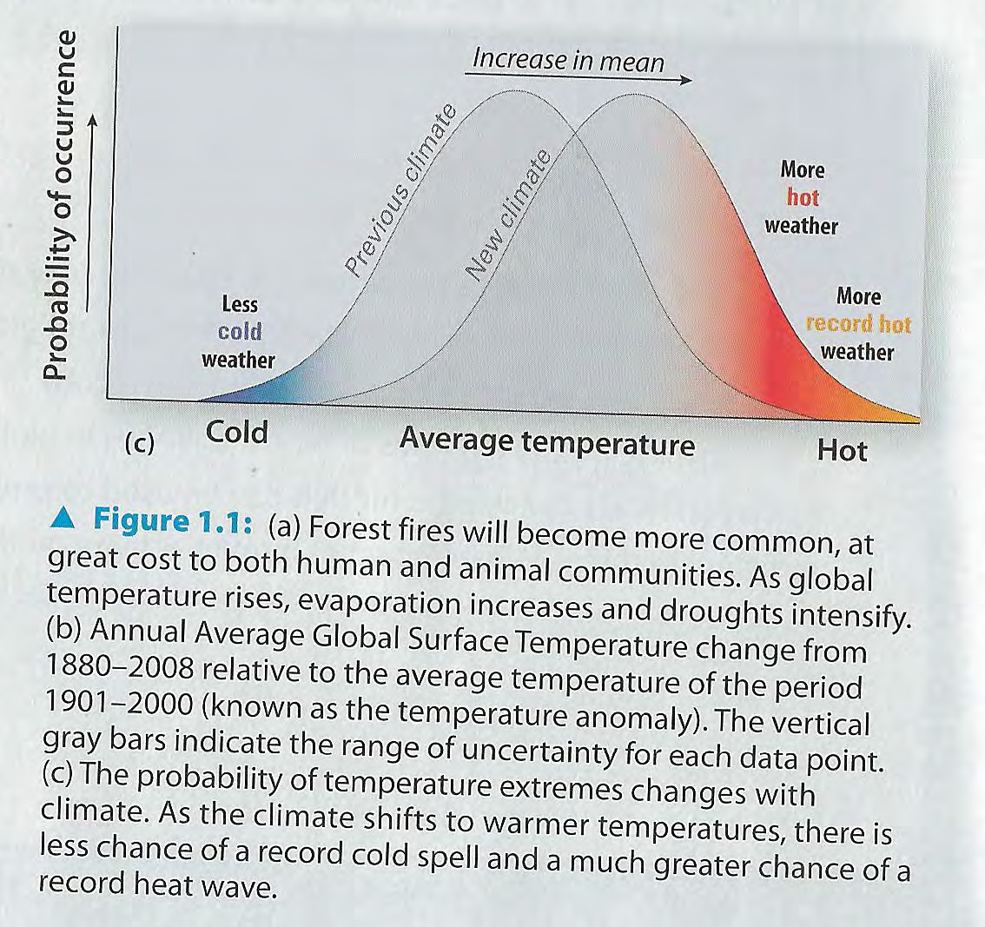
Figure 1.1b Probability of temperature extremes changes with climate.
Source: Kitchen, Global Climate Change, 2014, p. 4.

Slide 12
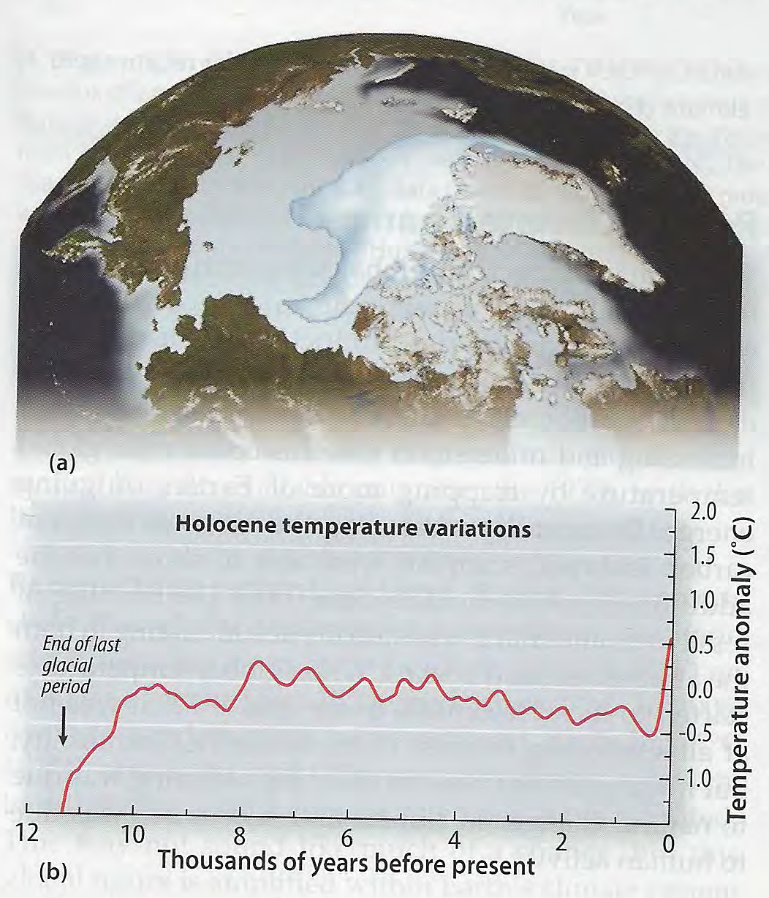
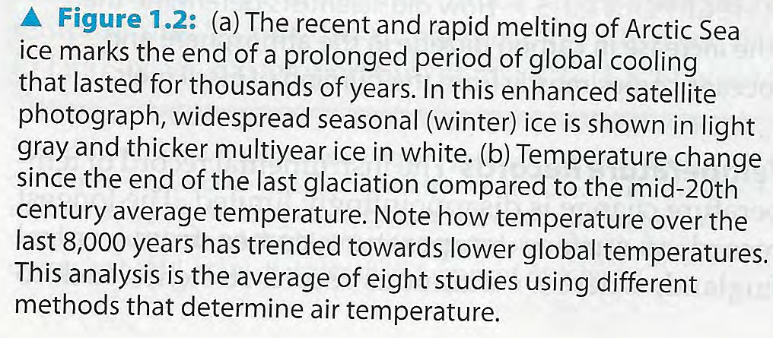
Figure 1.2 Source: Kitchen, Global Climate Change, 2014, p. 5.

Slide 13
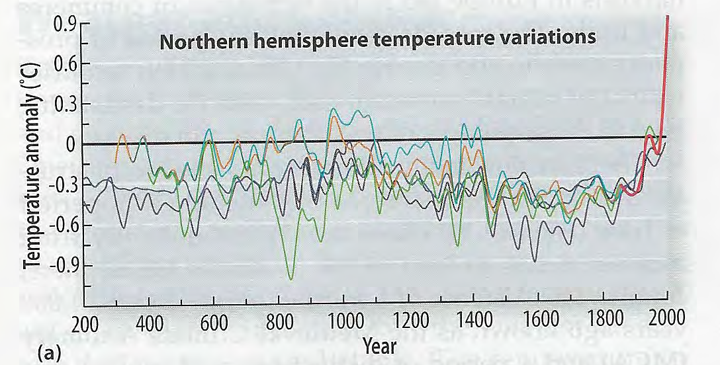
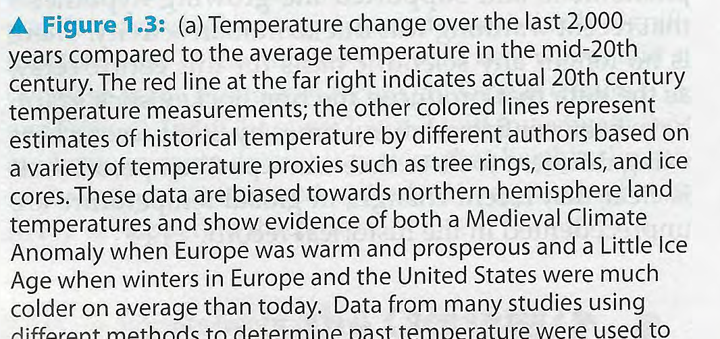
Figure 1.3 Source: Kitchen, Global Climate Change, 2014, p. 6.

Slide 14
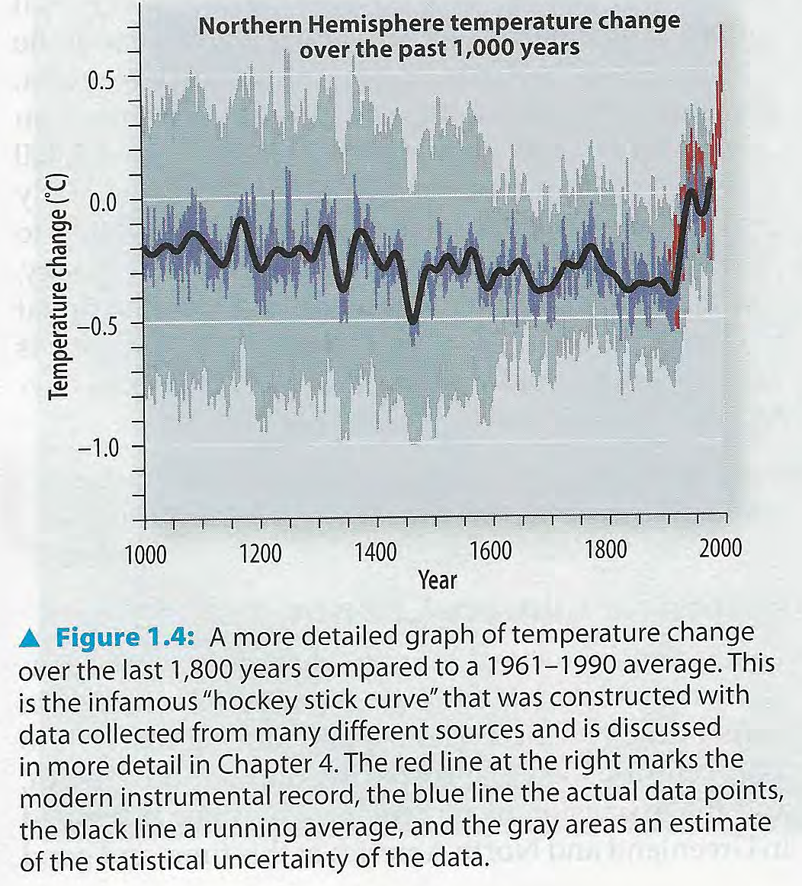
Figure 1.4. Source: Kitchen, Global Climate Change, 2014, p. 6.

Slide 15
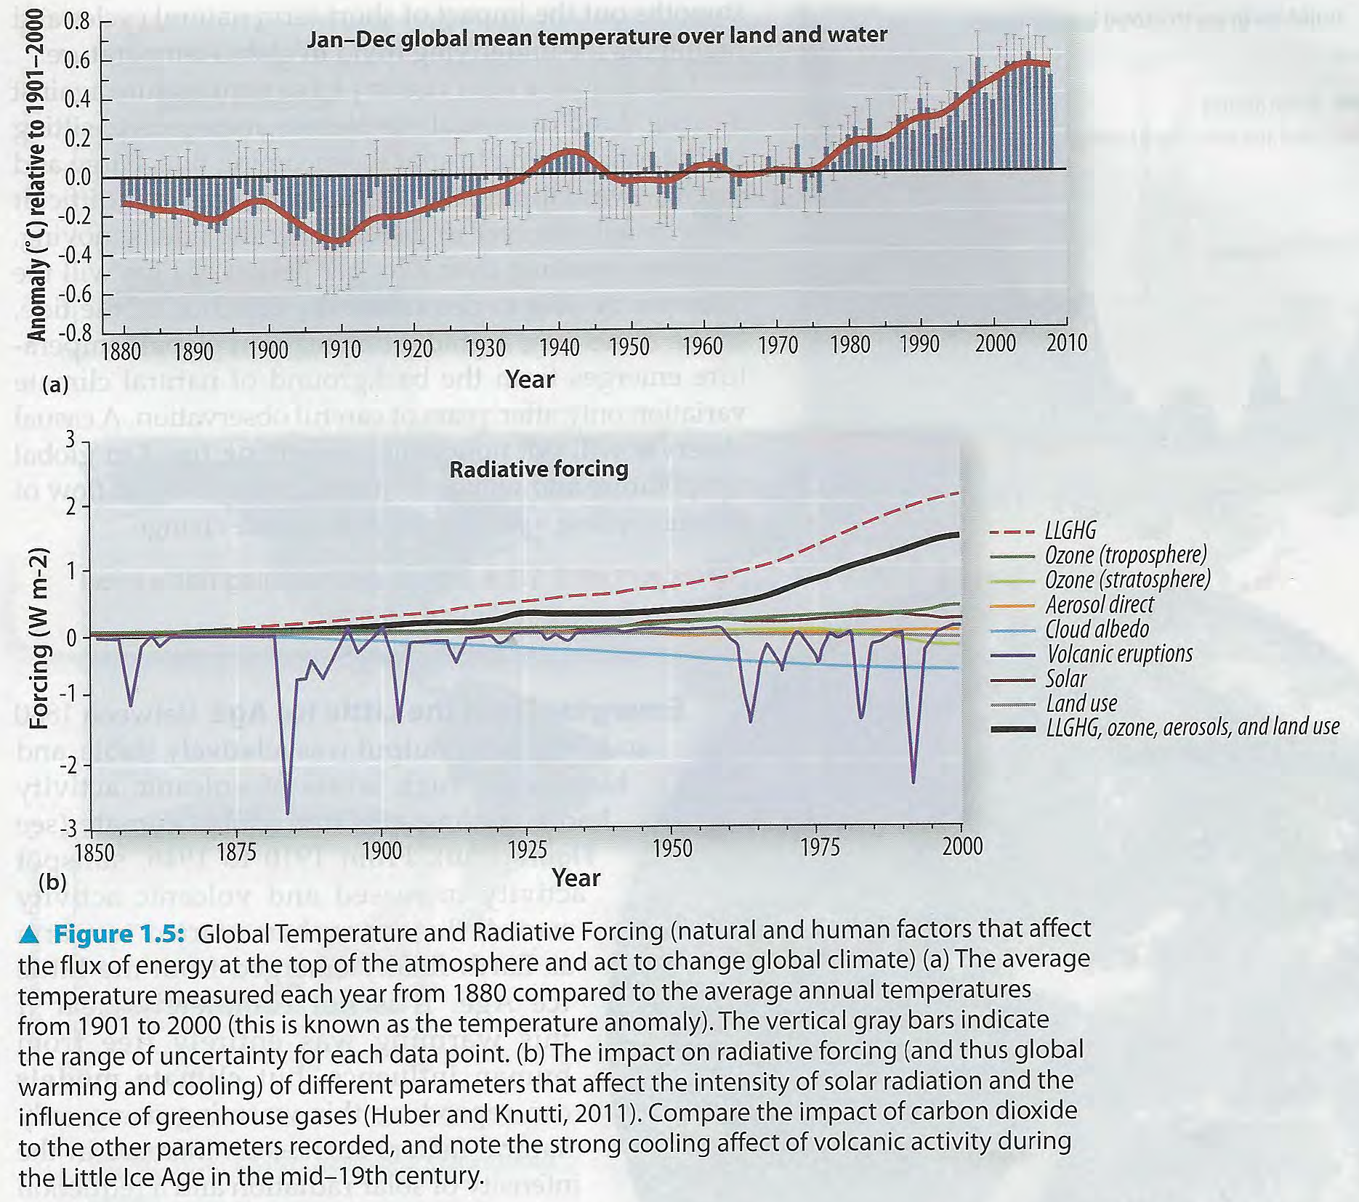
Figure 1.5 Source: Kitchen, Global Climate Change, 2014, p. 7.

Slide 16
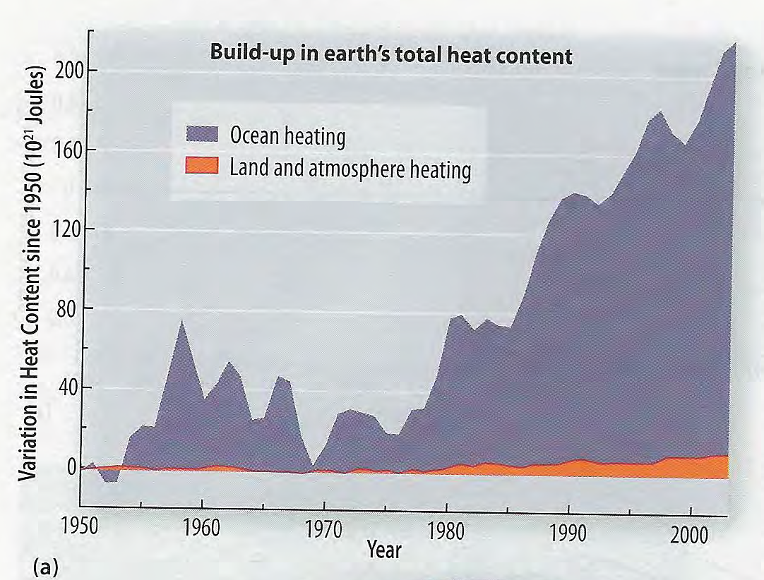
Figure 1.6a Source: Kitchen, Global Climate Change, 2014, p. 8.

Slide 17
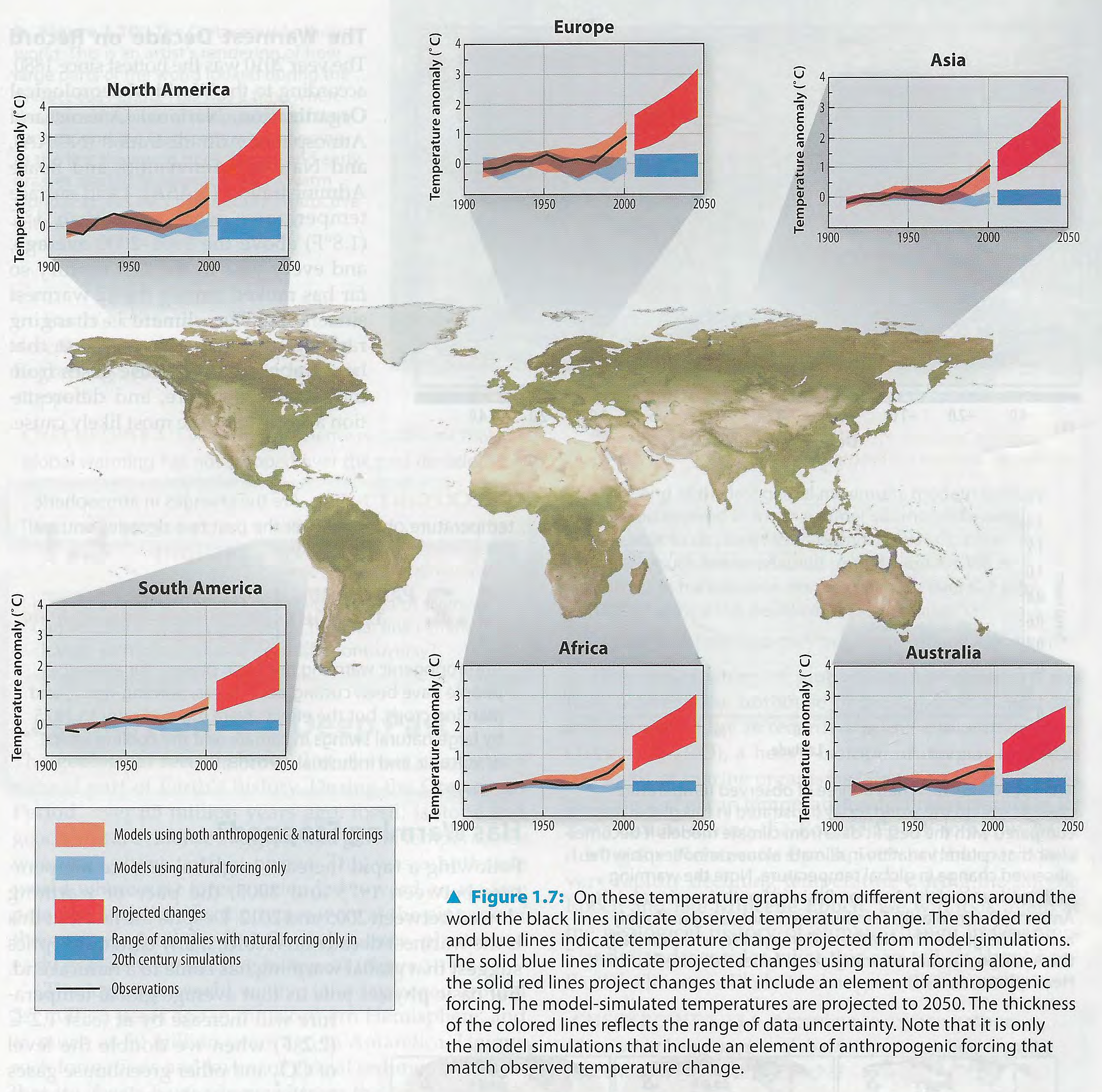
Figure 1.7 Source: Kitchen, Global Climate Change, 2014, p. 7.

Slide 18
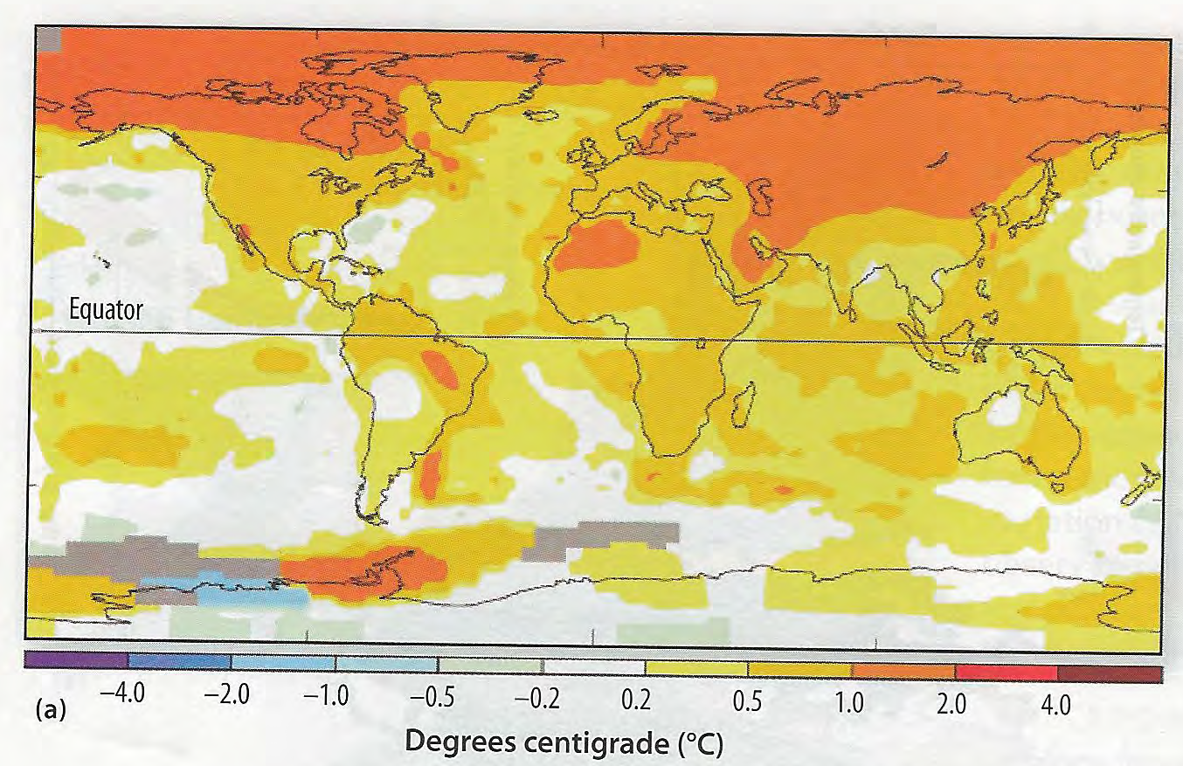
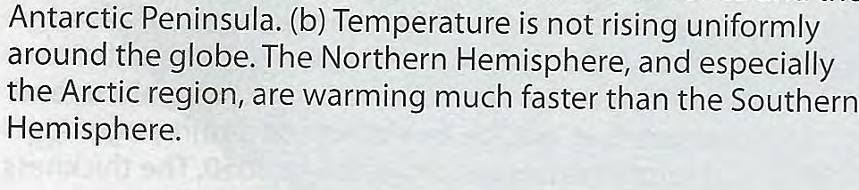
Figure 1.8a Source: Kitchen, Global Climate Change, 2014, p. 10.

Slide 19
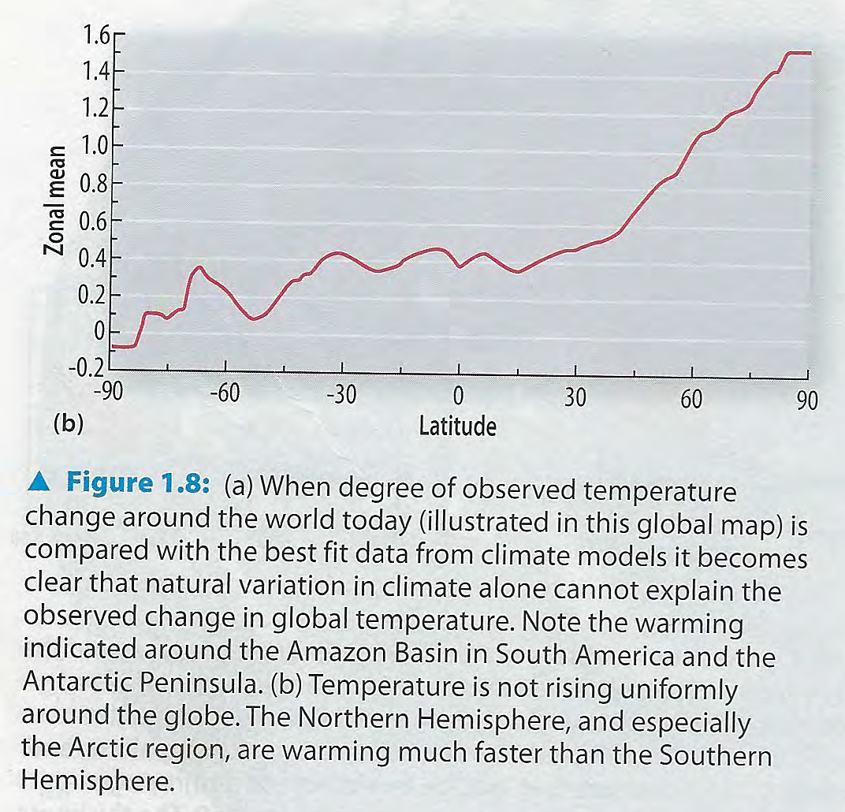
Figure 1.8b Source: Kitchen, Global Climate Change, 2014, p. 10.

Slide 20
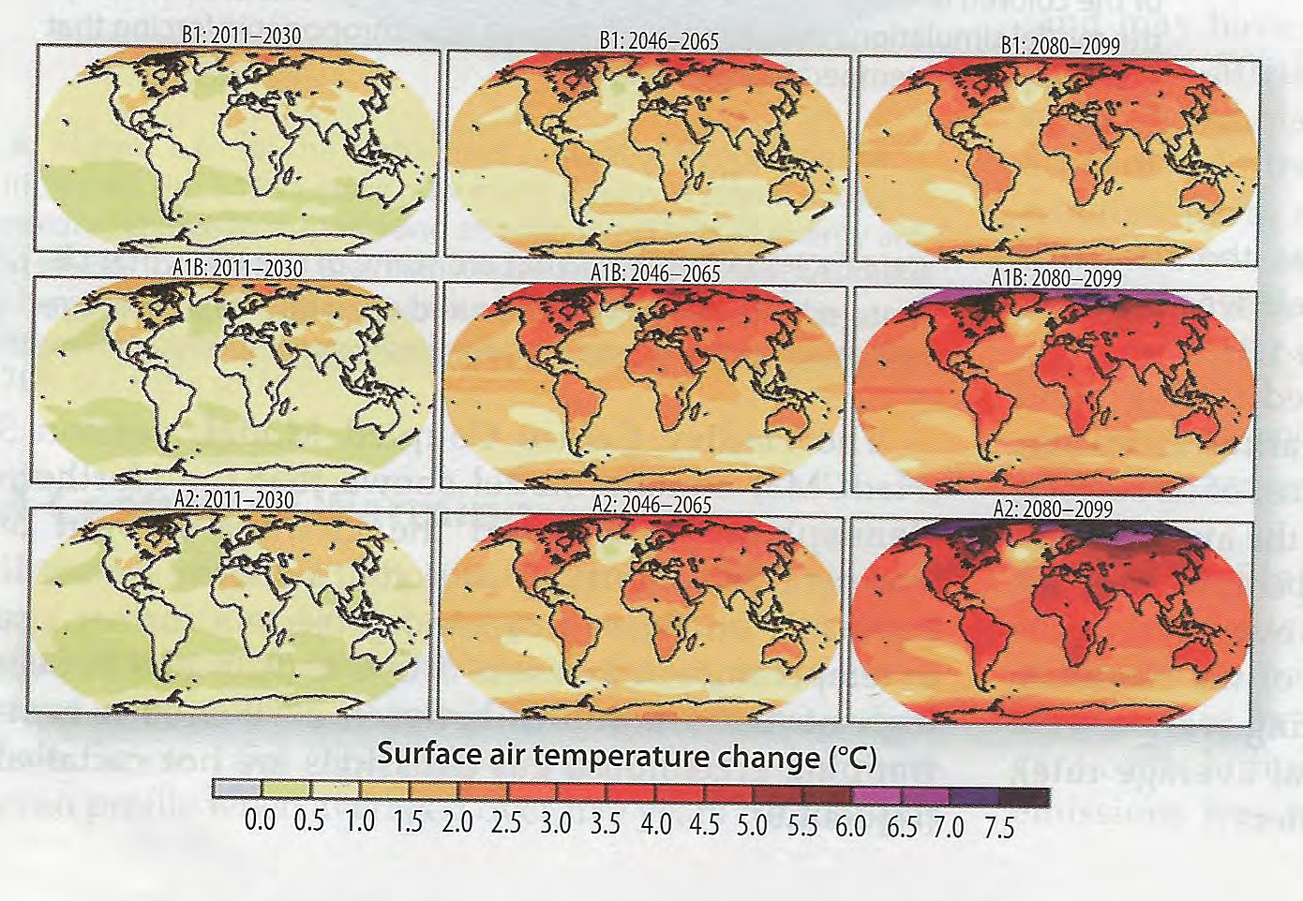
Source: Kitchen, Global Climate Change, 2014, p. 10

