Slide 1
Riverscape approaches in practice: perspectives and applications
Christian Torgersen ft. Colden Baxter
Forest and Rangeland Ecosystem Science Center (FRESC), Cascadia Field Station, University of Washington, Seattle

Slide 2
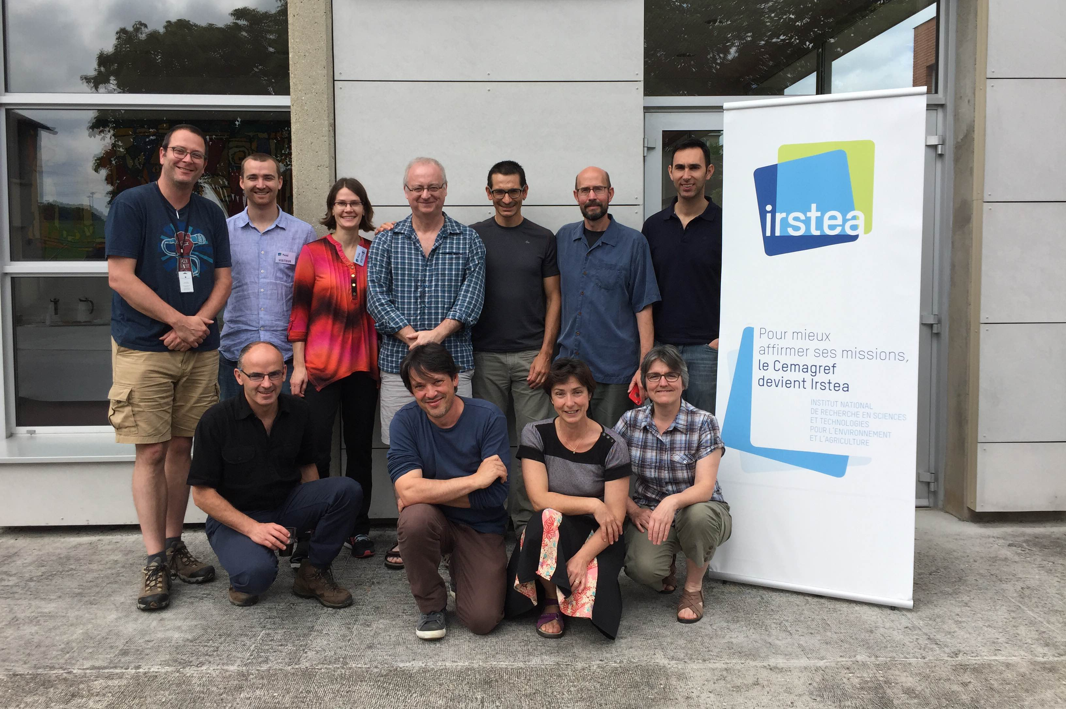
2016

Slide 3
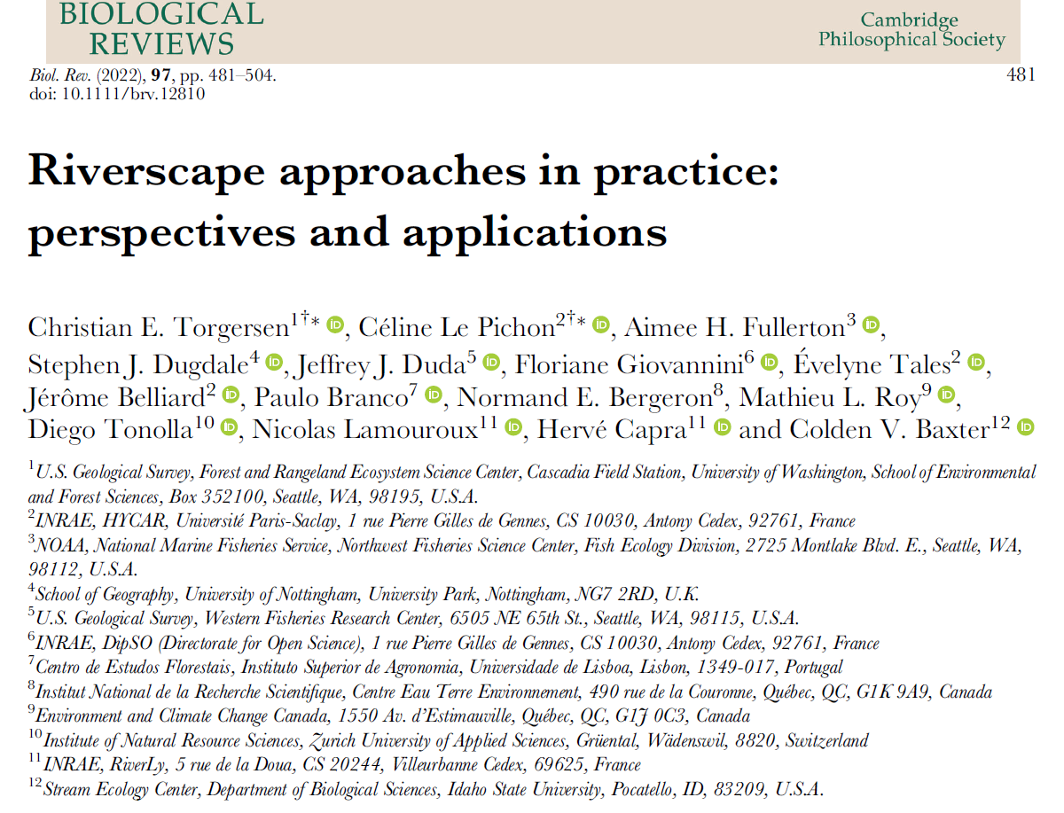
2022

Slide 4
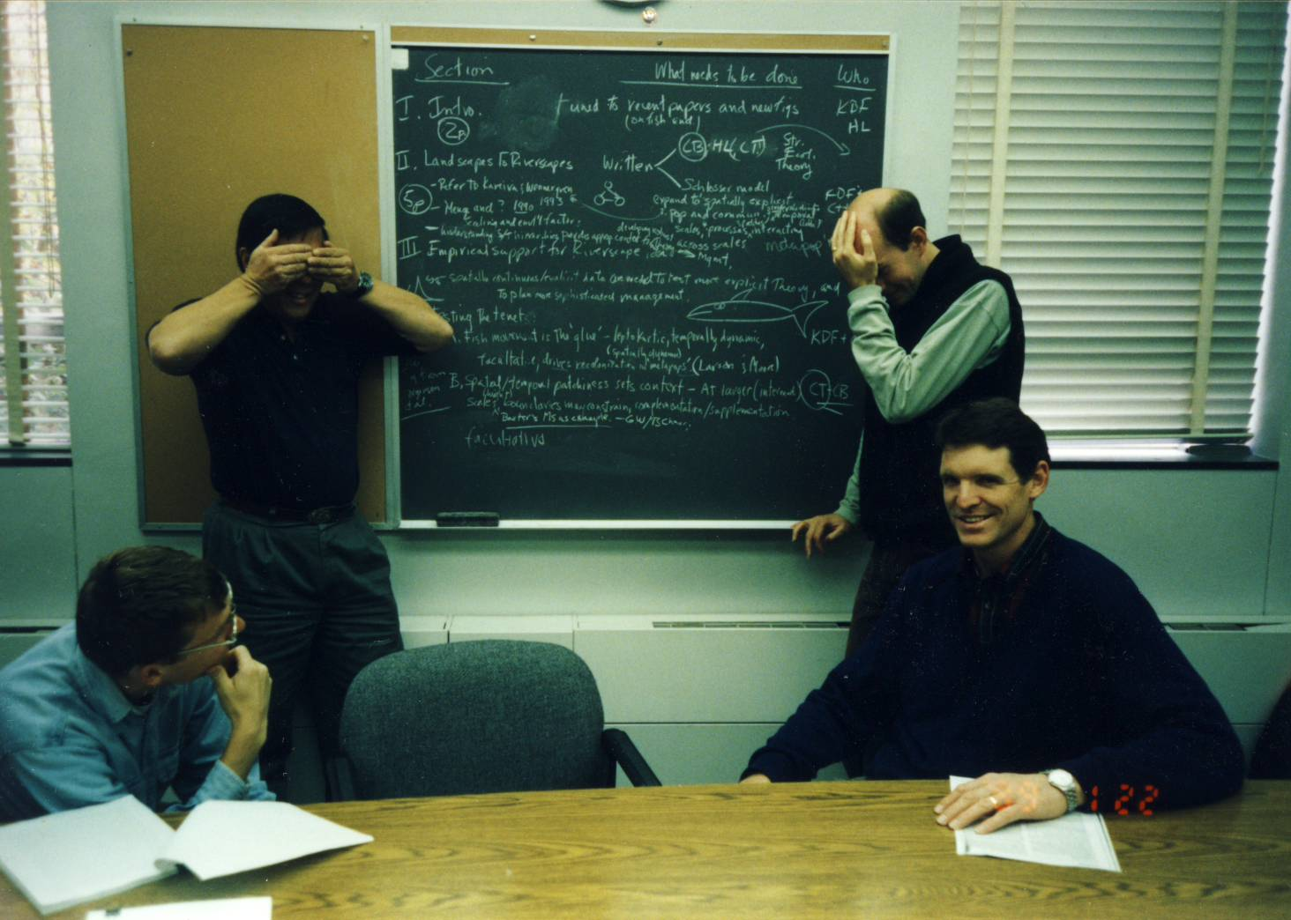
2000

Slide 5

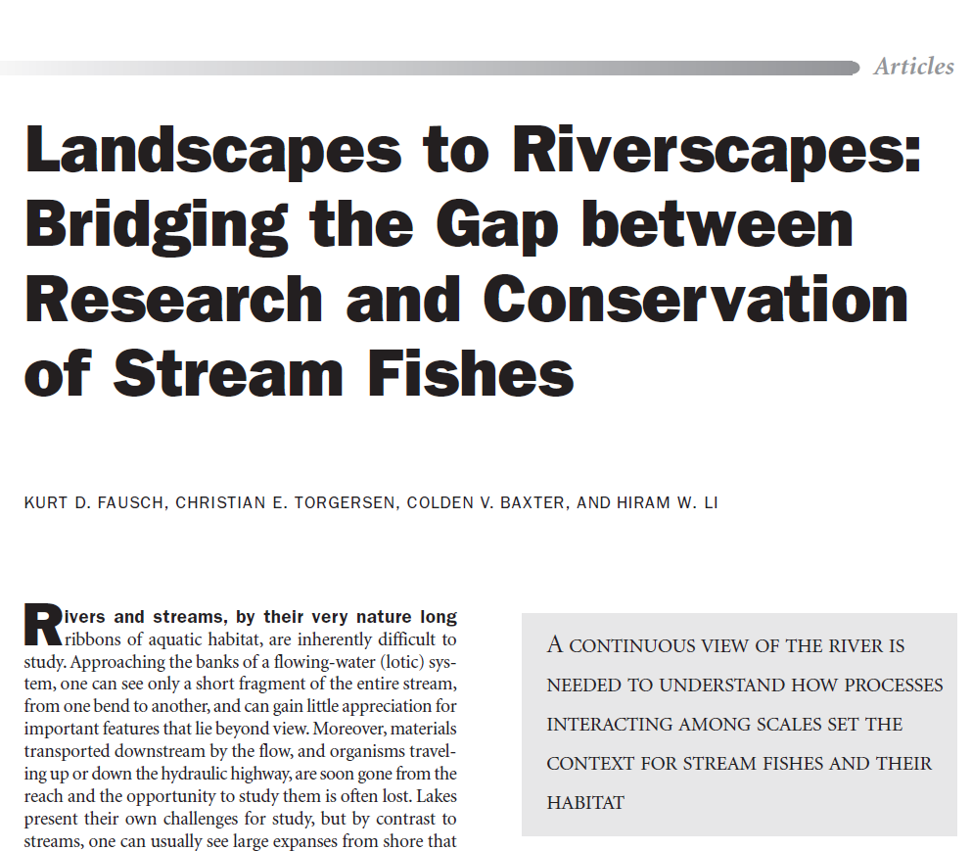
June 2002 / Vol. 52 No. 6 • pp. 483-498
2002
Google Scholar
citations: 1,781

Slide 6
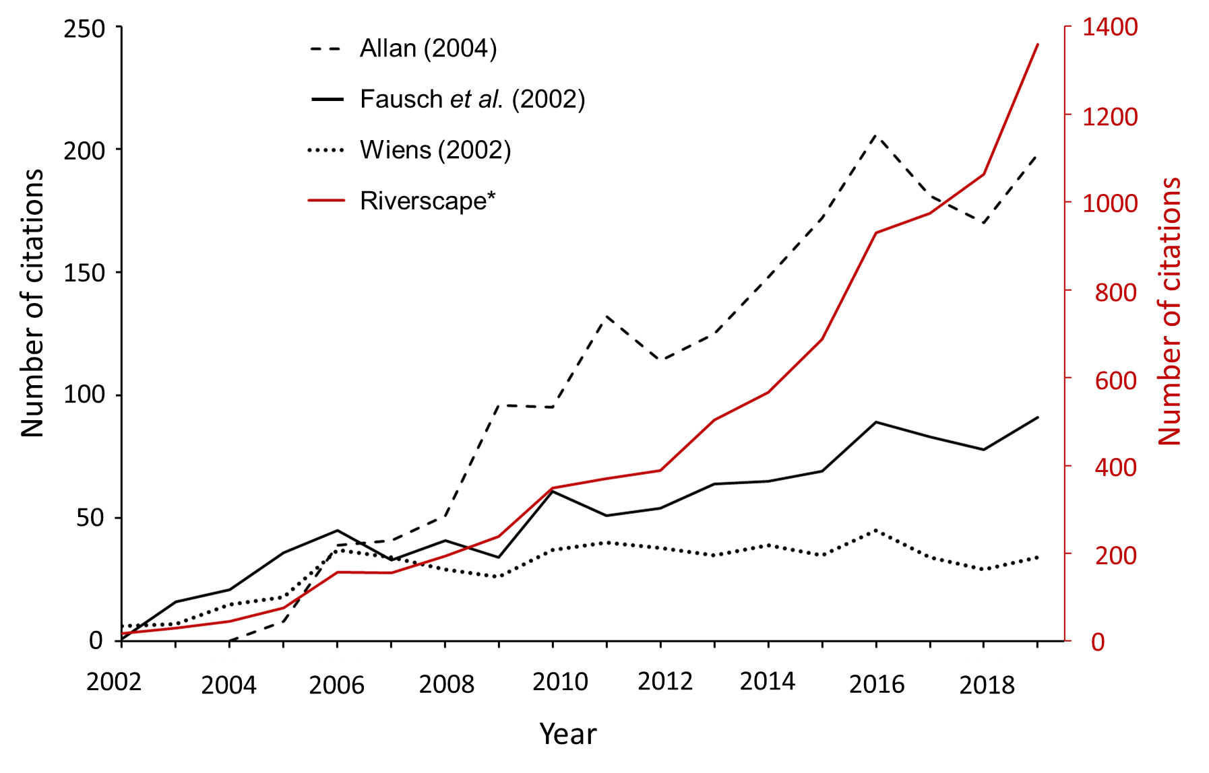
Torgersen et al. 2022. Biological Reviews

Slide 7
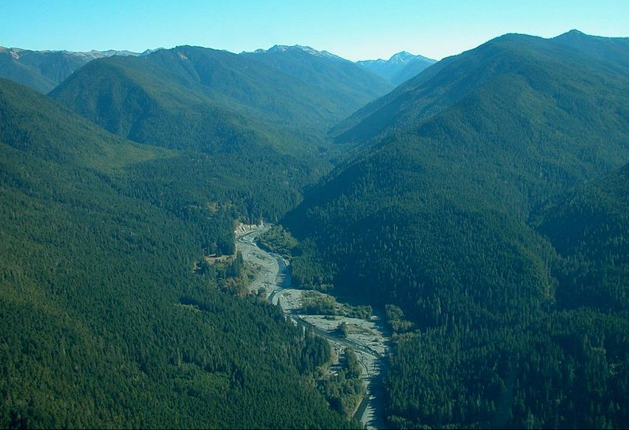
Photo: Sam Brenkman, Olympic National Park, NPS

Slide 8
Photo: Sam Brenkman, Olympic National Park, NPS

Slide 9
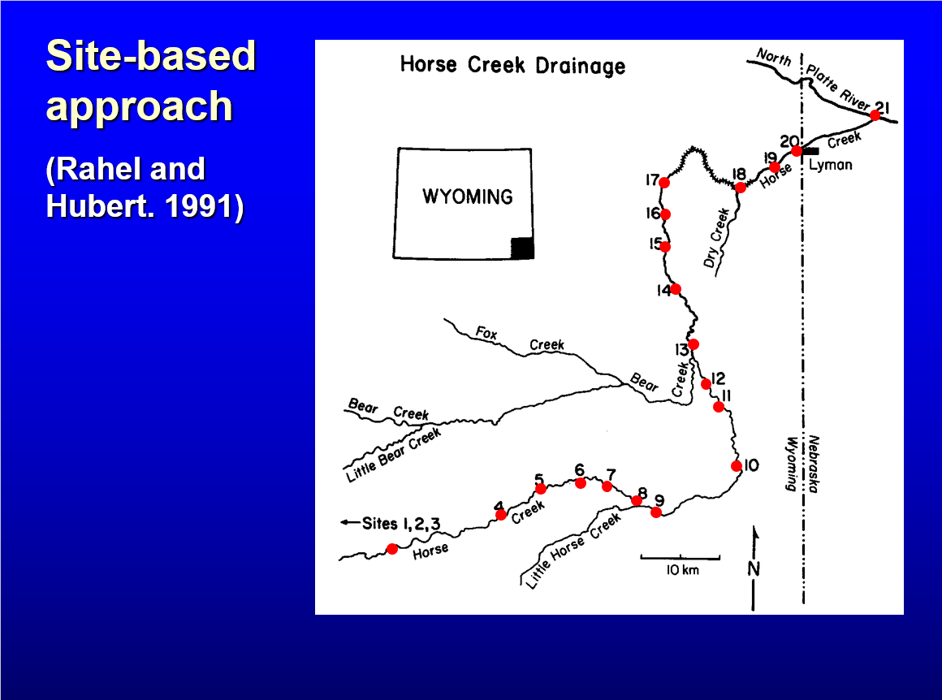

Slide 10
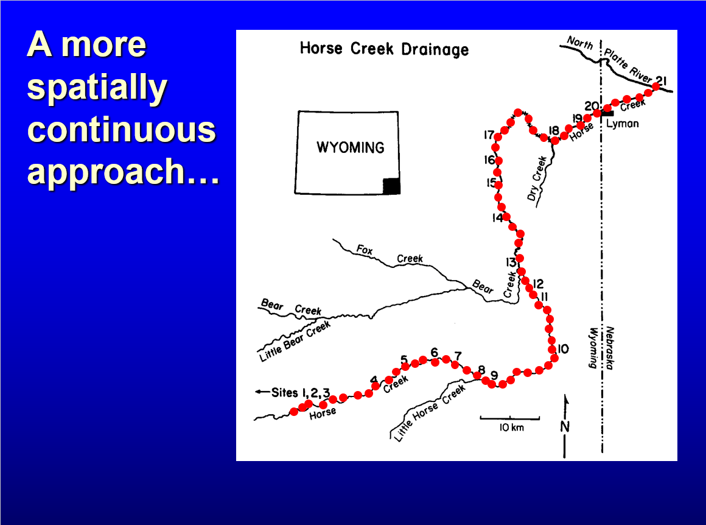

Slide 11
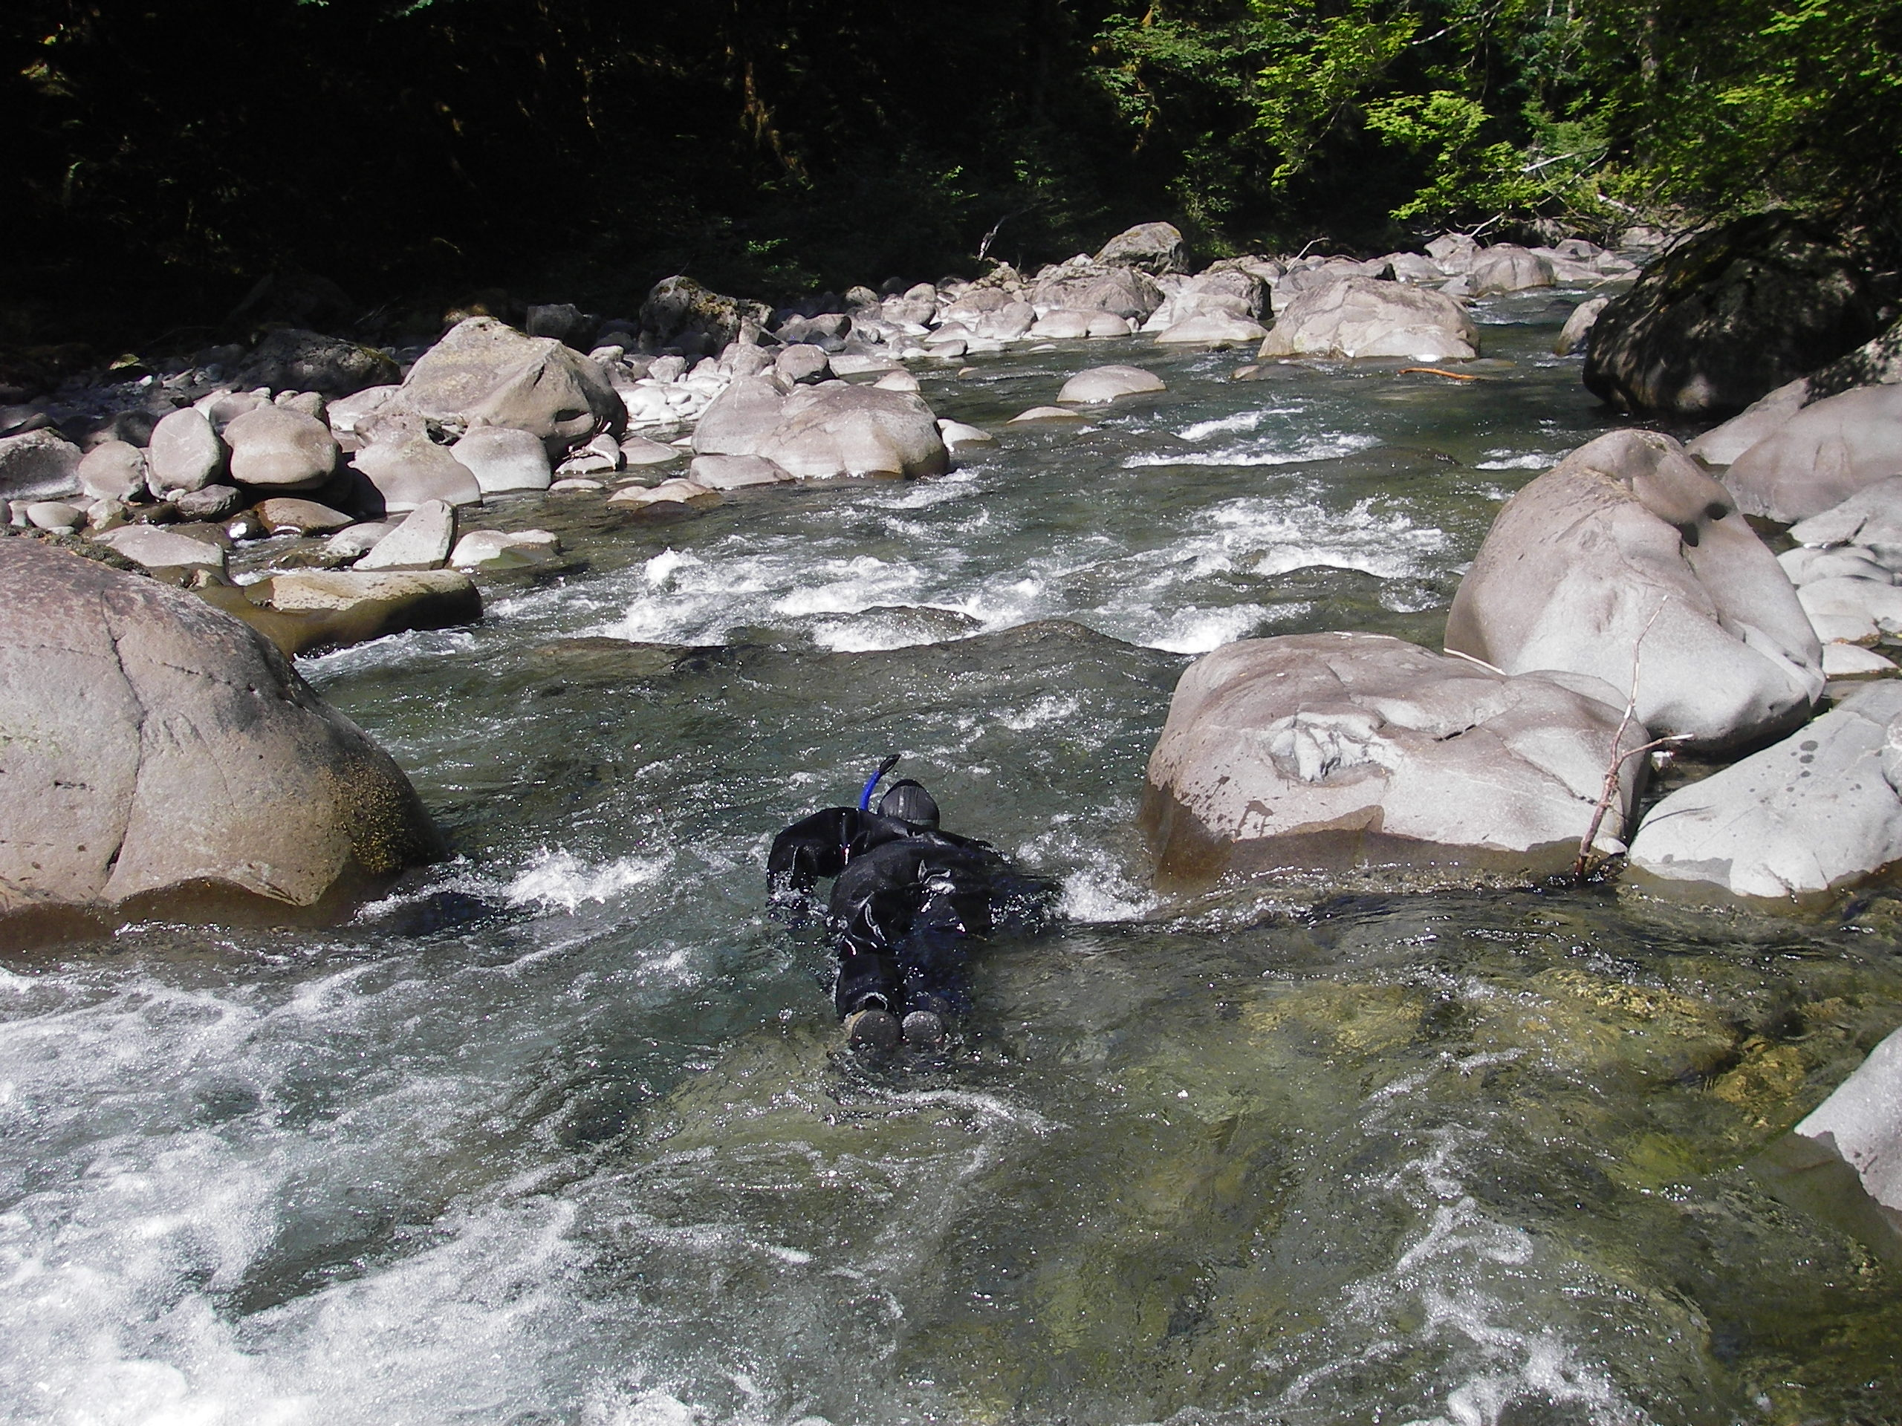
Photo: C. Torgersen, USGS

Slide 12
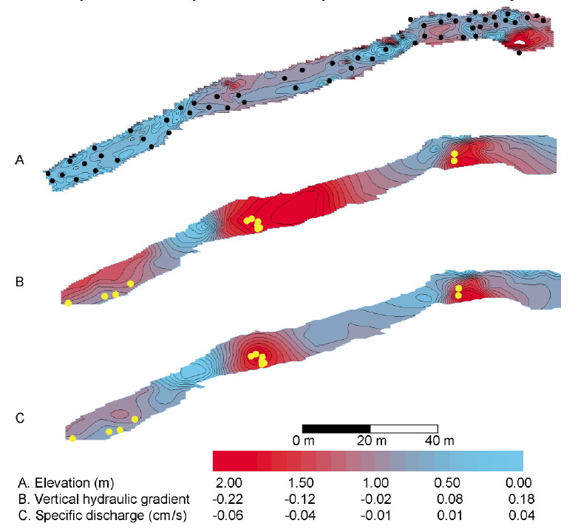
Bull trout redds and hyporheic exchange
Colden Baxter and
Ric Hauer (2000)
“We installed more than 500 piezometers in alluvial valley segments of these [four] drainages.”
“At a finer spatial scale, we installed 50 piezometers in each 100-m of stream length.”

Slide 13
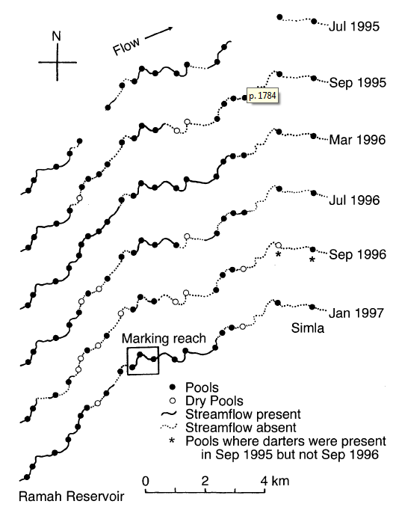
Tedd Labbe and Kurt Fausch (2000)
“The senior author walked a 14.6-km segment of Big Sandy Creek between Simla and Ramah Reservoir (Fig. IC) six times during the study to chart changes in flow connectivity that constrained fish dispersal among reaches”

Slide 14
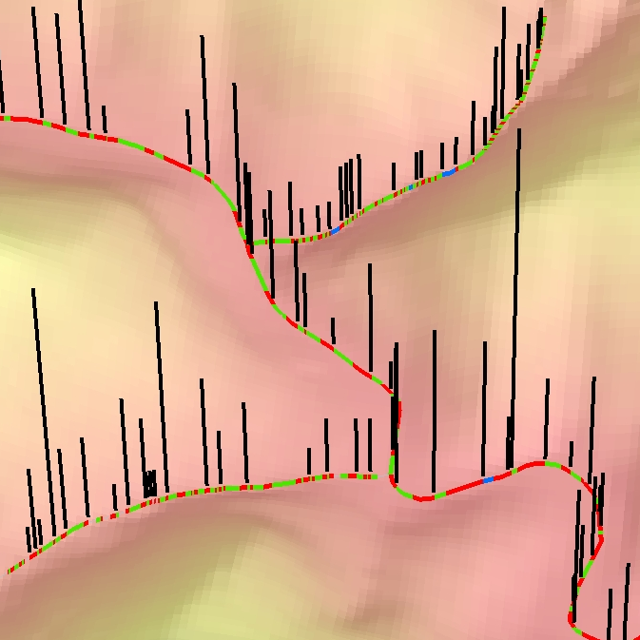
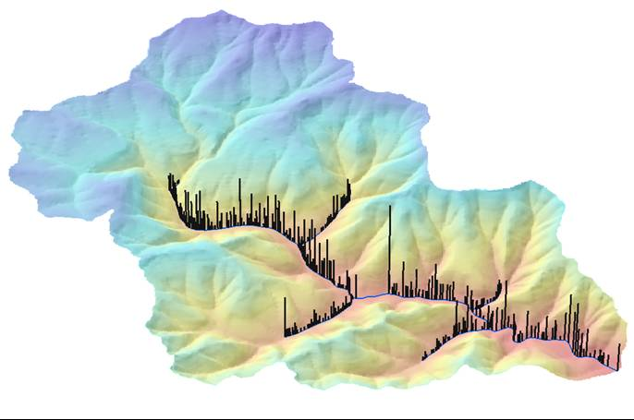
Fine- and coarse-scale patterns
12
Pool
9
Riffle/rapid
7
Cascade
3
0
350 m
(Torgersen et al. 2004, GIS in Fisheries and Aquatic Sciences)

Slide 15
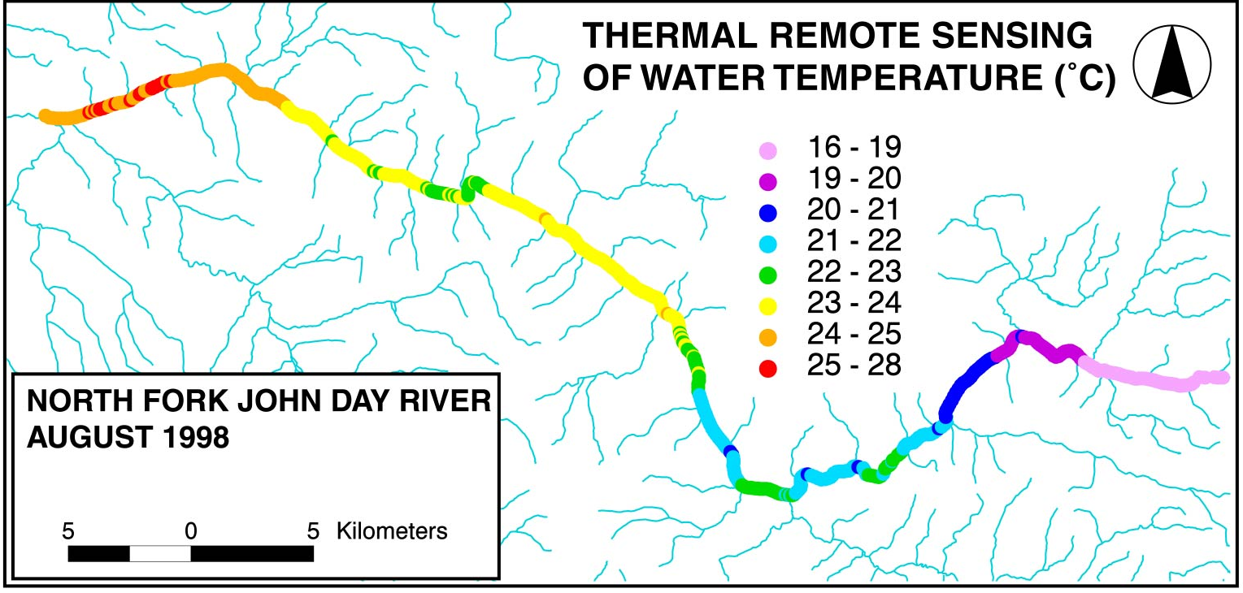
Thermal heterogeneity
Torgersen et al. 2006.

Slide 16
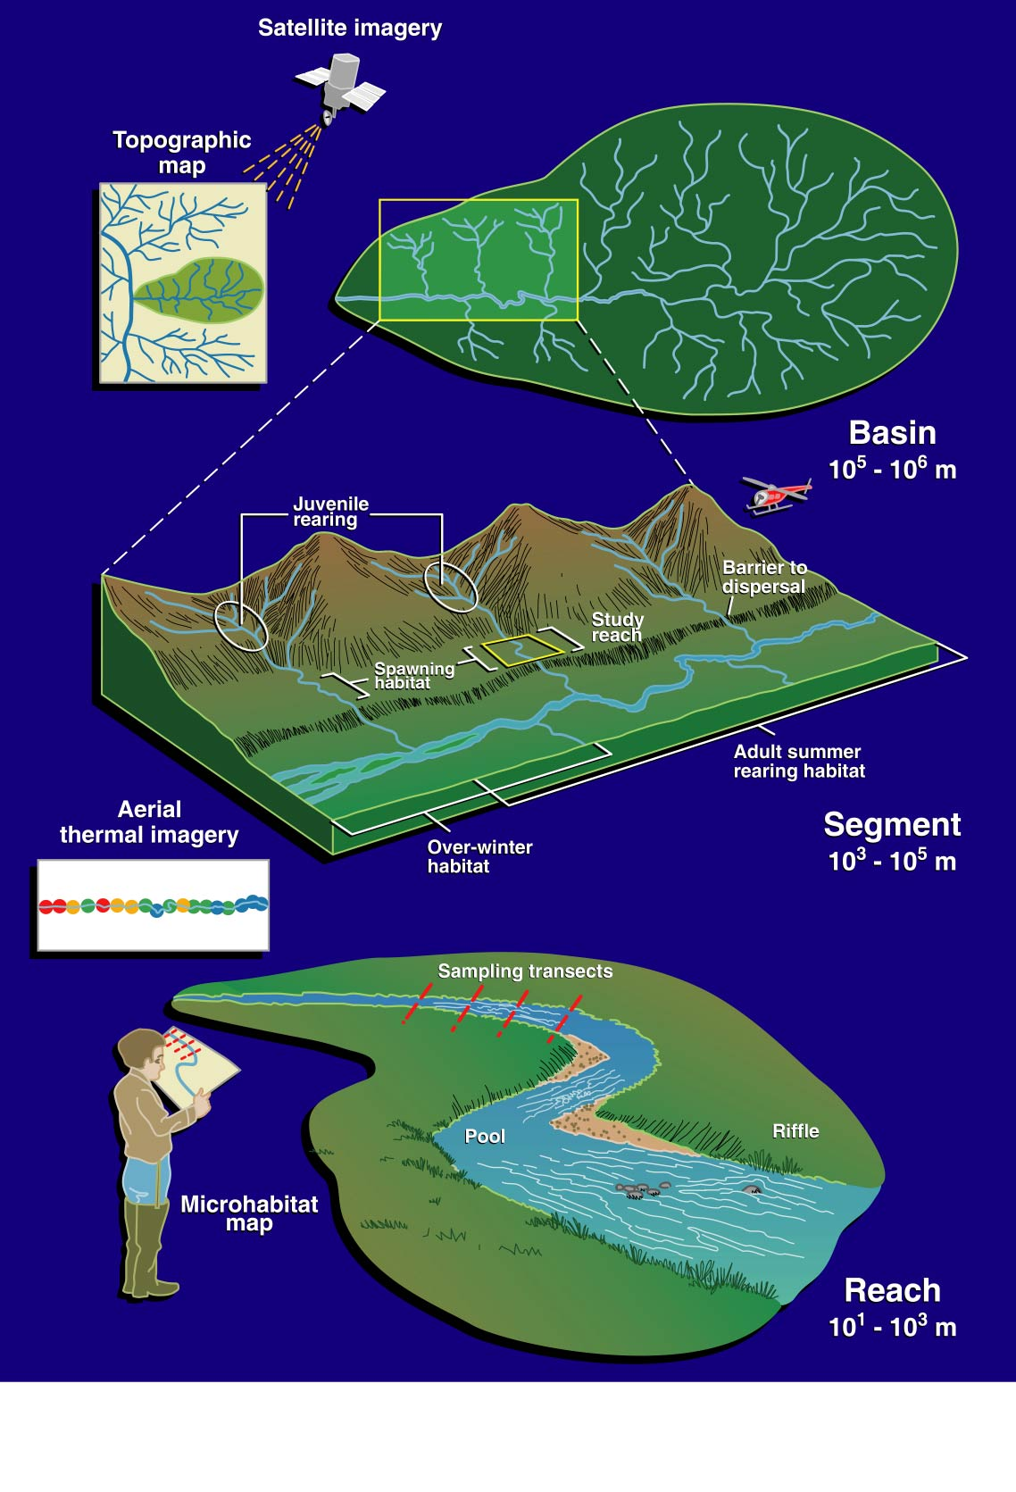
Landscapes to riverscapes…
We propose that a continuous view of rivers is essential…a view not just of disjunct reaches but of the entire spatially heterogeneous scene of the river environment, the riverscape, unfolding through time.
Fausch, Torgersen, Baxter, & Li. 2002. BioScience

Slide 17

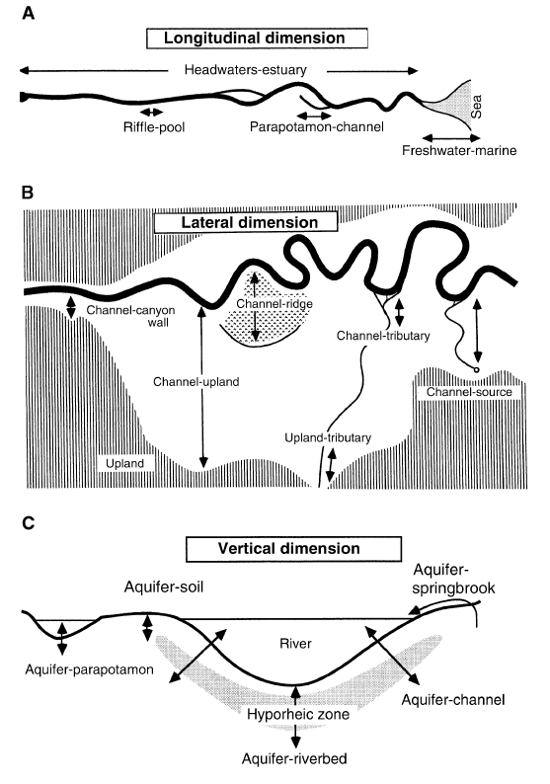
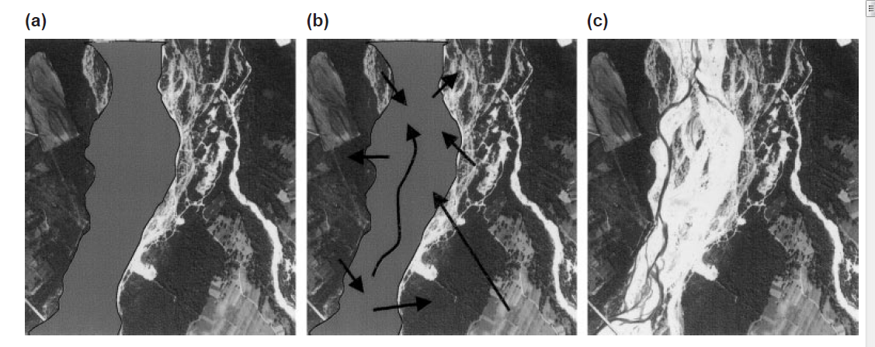
“Rivers as internally heterogeneous landscapes”
Freshwater Biology (2002)

Slide 18
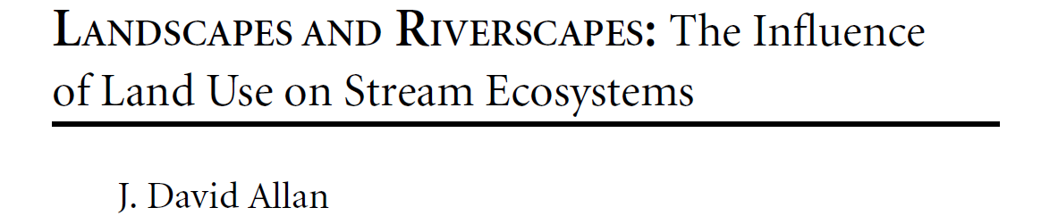
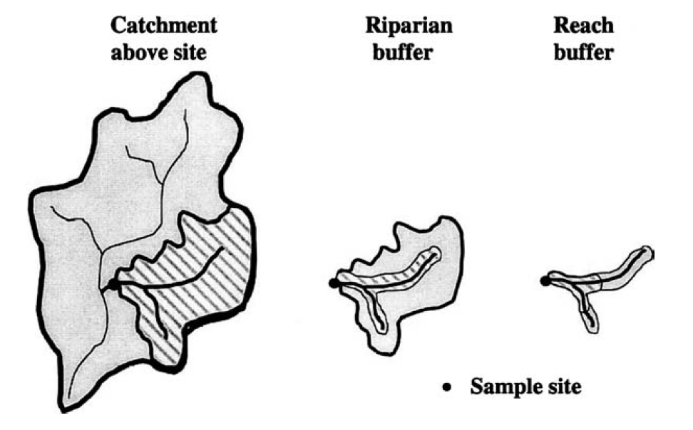
Google Scholar
citations: 3,965
Annual Review of Ecology and Systematics (2004)

Slide 19
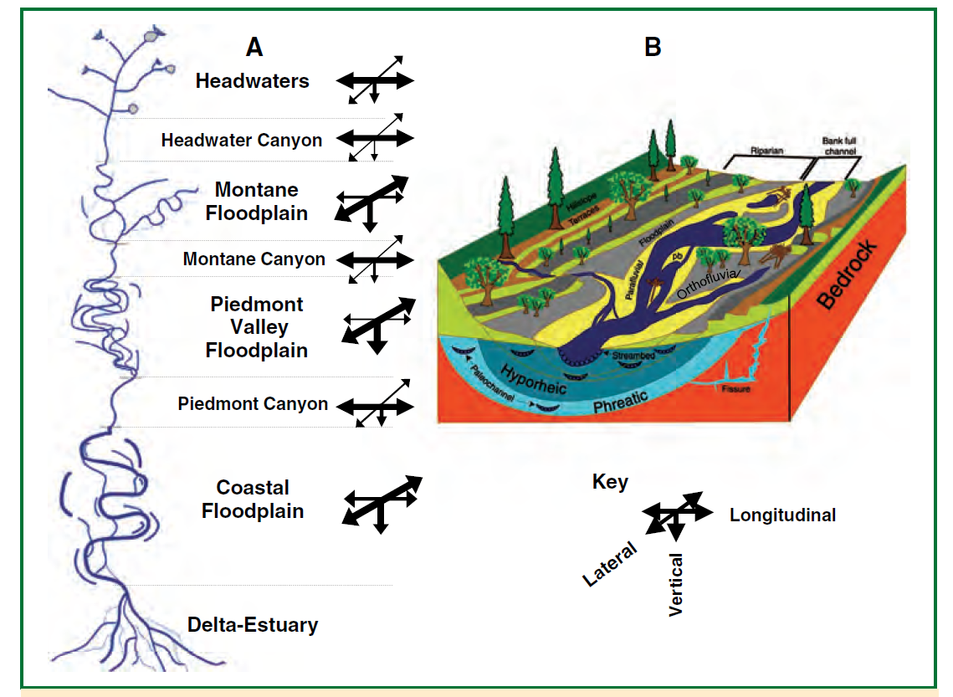
“An expansive view of a stream or river and its catchment, including natural and cultural attributes and interactions, is the “riverscape.”
J. A. Stanford (2006), Chapter 1 in Benfield, Hauer, and Lamberti. Methods in stream ecology, Academic Press.

Slide 20
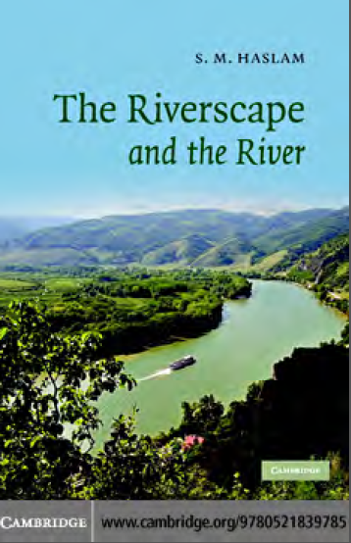
The riverscape and the river?
“The riverscape is that part of landscape which has (or had) a watercourse as its focus.” (2008)

Slide 21
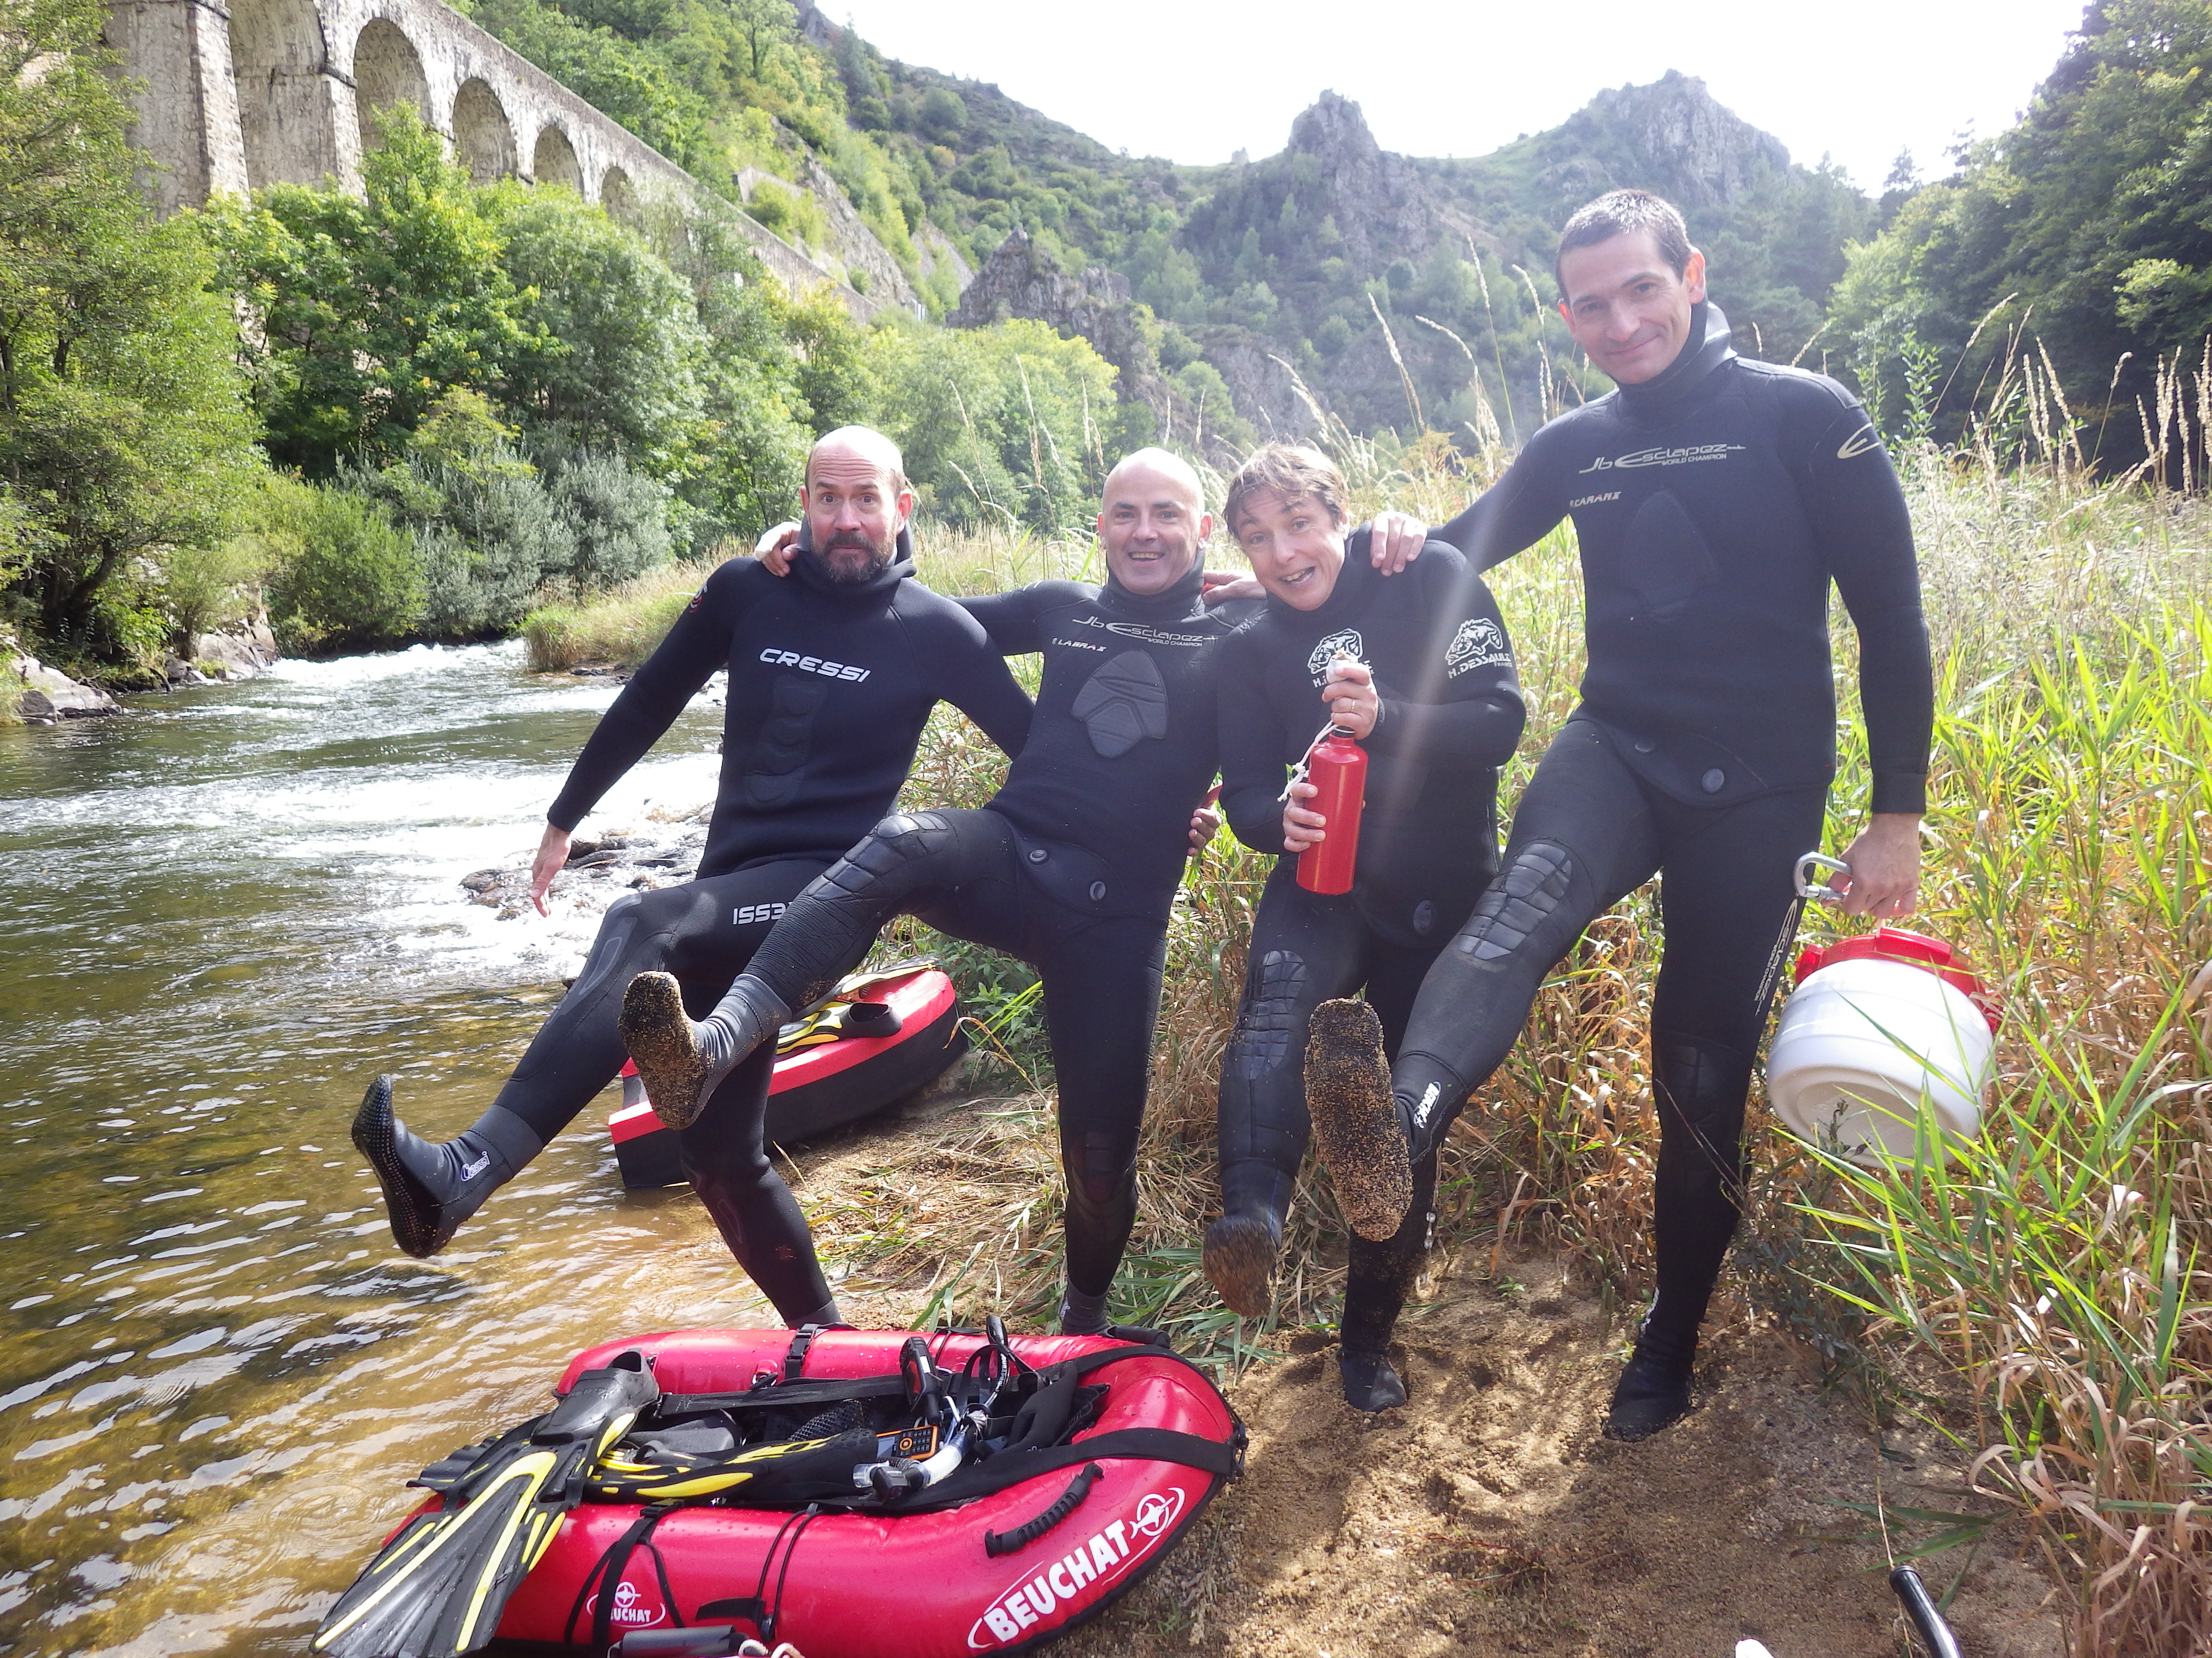
2015

Slide 22
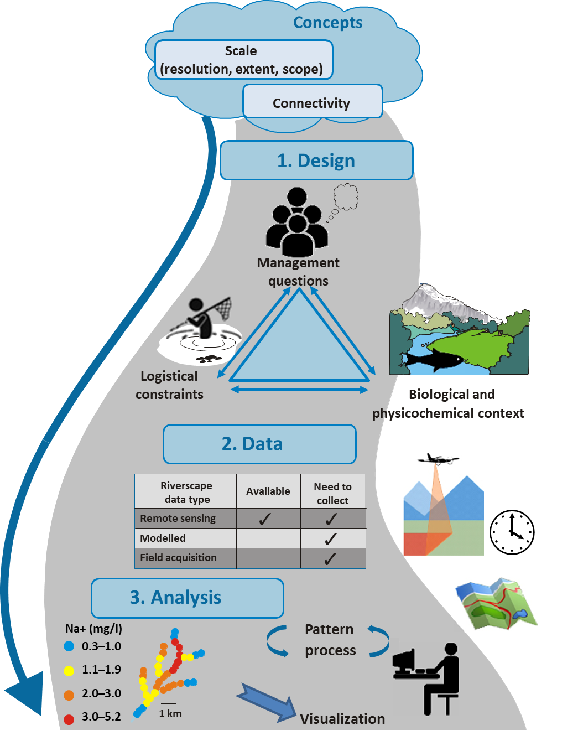
Applying a riverscape approach
in practice
Overarching concepts:
- Scale (resolution, extent, and scope)
- Connectivity
  Steps
  Design
  Data
  Analysis
Torgersen et al. 2022. Biological Reviews

Slide 23
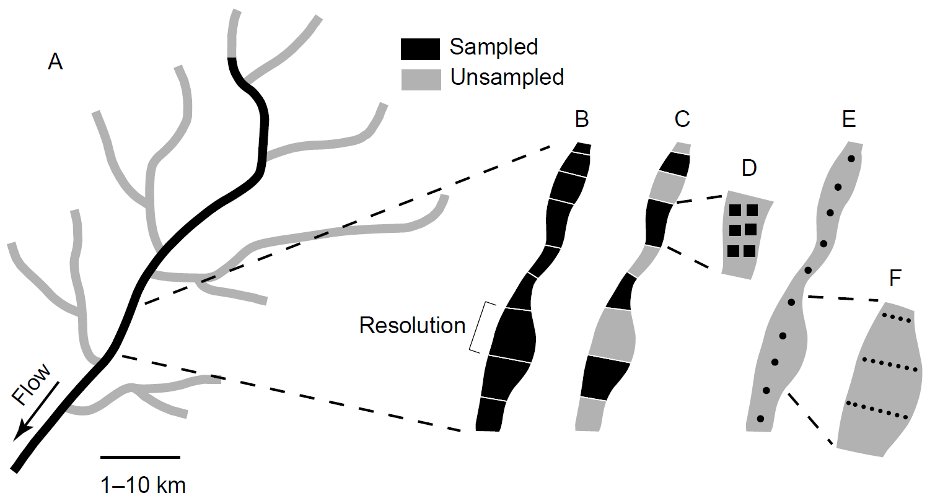
Scale: extent, resolution, and scope
Torgersen et al. 2022. Biological Reviews

Slide 24
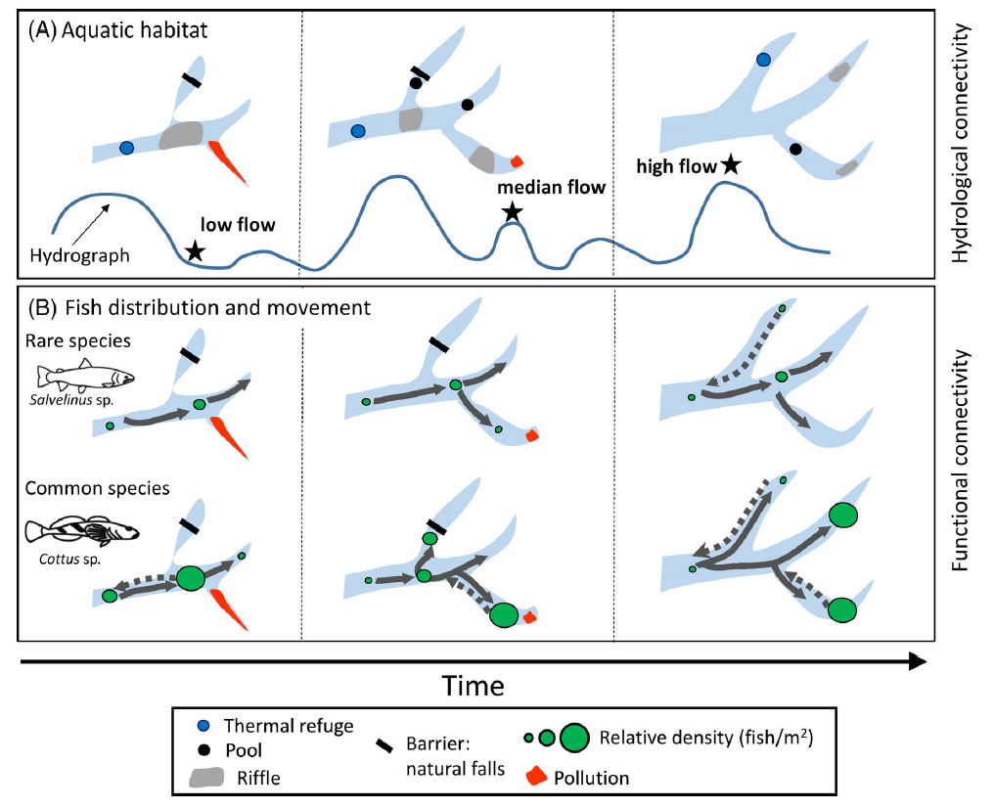
Connectivity: flow and movement
Torgersen et al. 2022. Biological Reviews

Slide 25
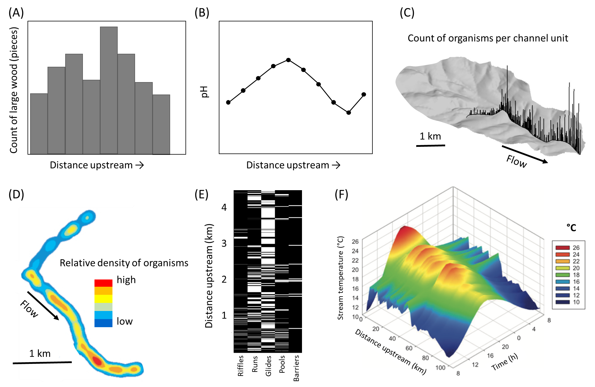
Torgersen et al. 2022. Biological Reviews

Slide 26
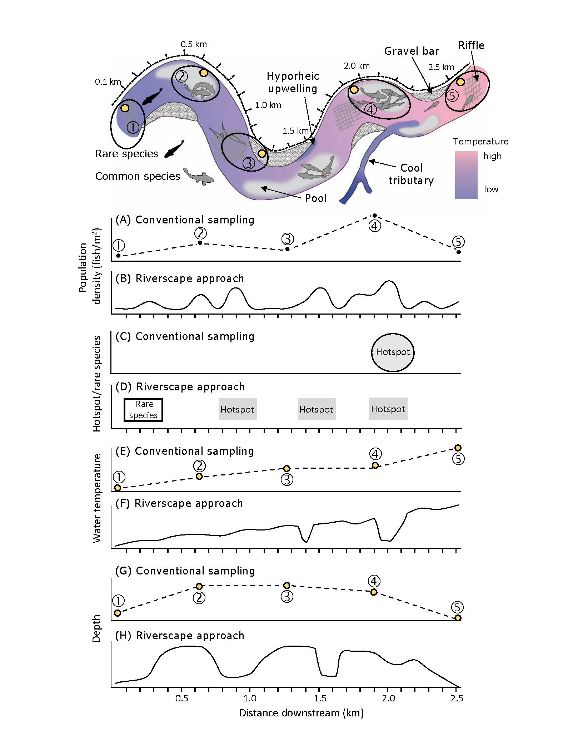
Comparing conventional versus riverscape sampling approaches
Torgersen et al. 2022. Biological Reviews

Slide 27
Detecting rare species, “hotspots”, and patchiness
Torgersen et al. 2022. Biological Reviews

Slide 28
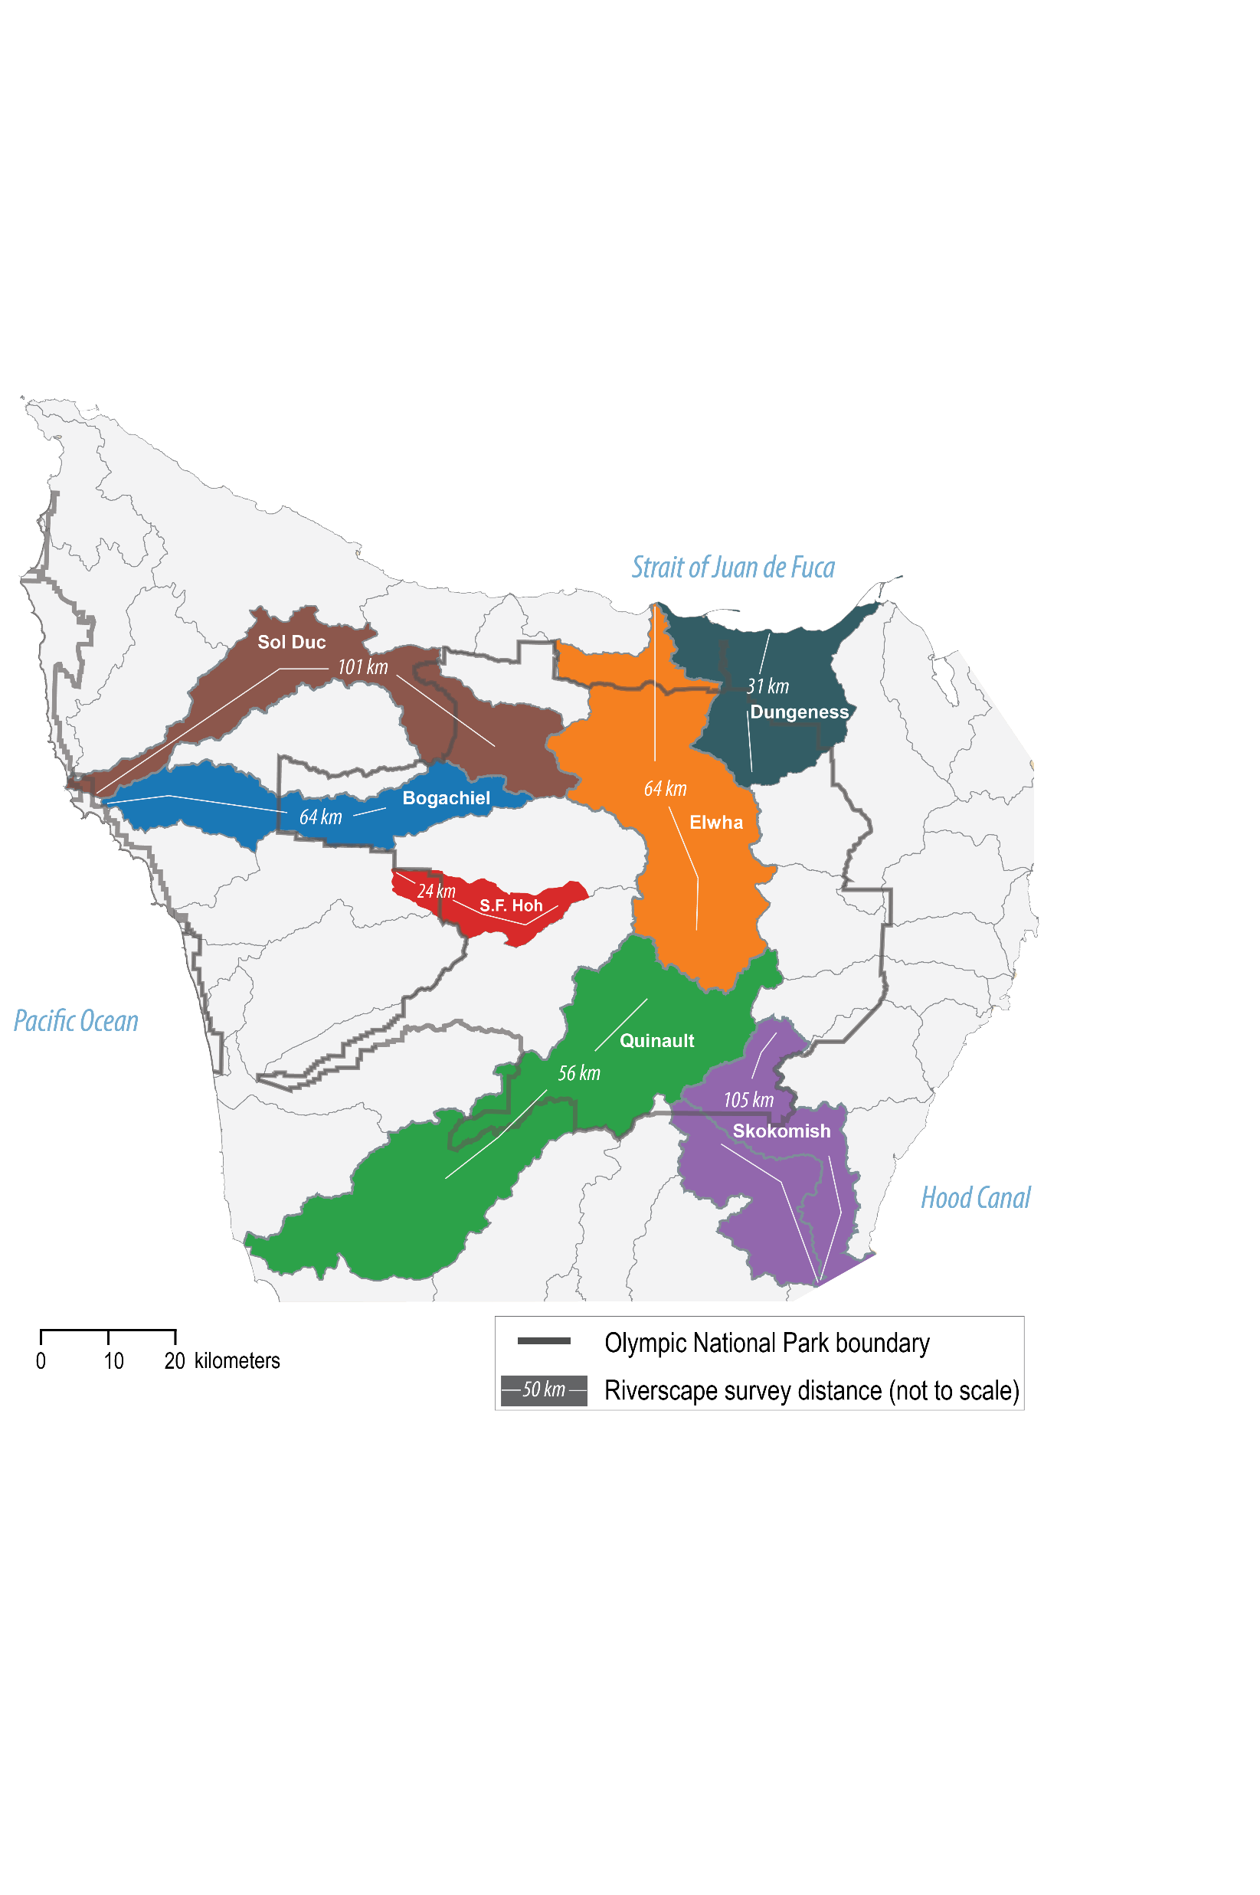
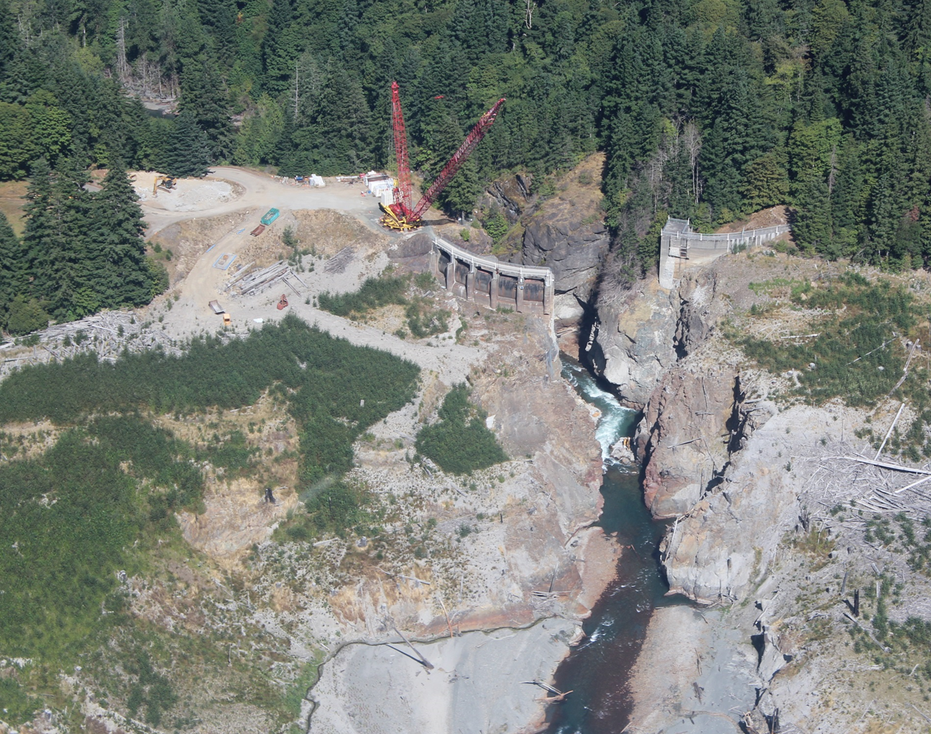

Assessing spatial patterns of fish distribution in the Elwha River before and after dam removal
Applications
How does dam removal influence the spatial structure of fish populations?
How far are adult salmon migrating upstream of the former dams?
Photo: Courtesy John Gussman
Notes:
My talk is going to focus on a project where we applied the Riverscape Approach to assess the spatial patterns of fish distribution in the Elwha River before and after dam removal. We were specifically interested in two questions (1) how does dam removal influence the Spatial Structure of fish populations? (2) How far upstream are adult salmon migrating upstream of the former dams? This second question related to spatial distribution is, along with productivity and life history diversity, being used to track the recovery of Chinook and Steelhead, which are two threatened species under ESA.
And I’d like to point out that project is part of a larger one to assess salmon populations on the Olympic Peninsula using Riverscape approaches. We refer to this as the riverscape atlas project, and we are working on summarizing the results from riverscape surveys of 7 different rivers.

Slide 29
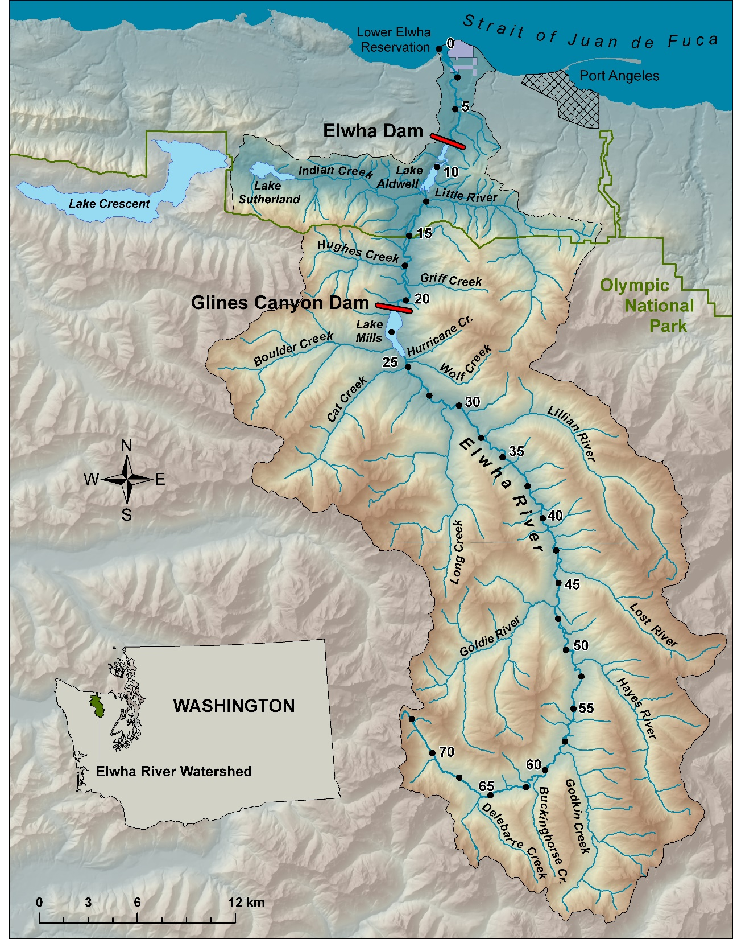
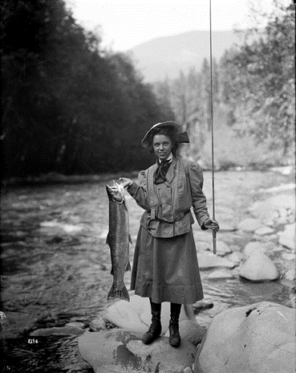
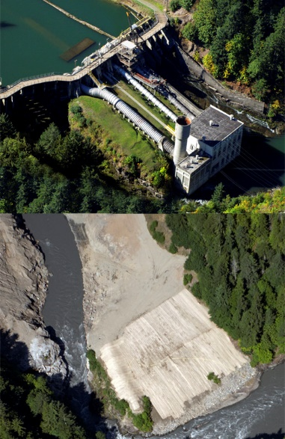
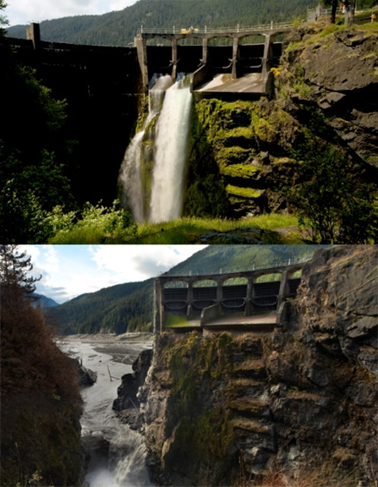
Study Area
Elwha Dam
>90% Habitat lost
~98% decline of salmon populations
Elwha Dam
32-m concrete gravity
Completed in 1912
Removed in 2012
NPS
Glines Canyon Dam
64-m concrete arch
Completed in 1927
Removed in 2014
Dam photographs courtesy John Gussman
Notes:
I’m not going to get into the details of dam removal, but at least wanted to provide a few basics. The map on the left shows the Elwha river and the location of the dams. The two dams were built in the early 1800s to produce hydroelectric power, but they did not install any fish passage. This limited migratory fish to the lower 8 miles of the river, which caused 90% spawning and rearing habitat loss and an estimated 98% reduction in population size. This devastating effect on salmon populations was a major factor driving dam removal, which occurred over a 3 year period from 2011 to 2014.

Slide 30
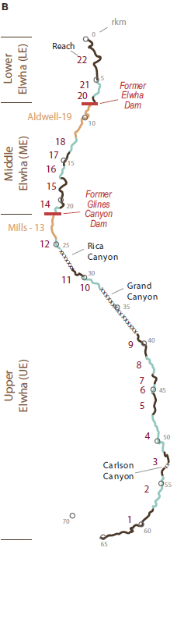
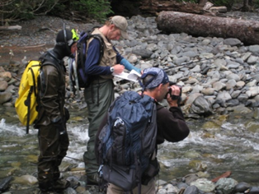
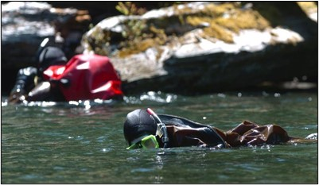
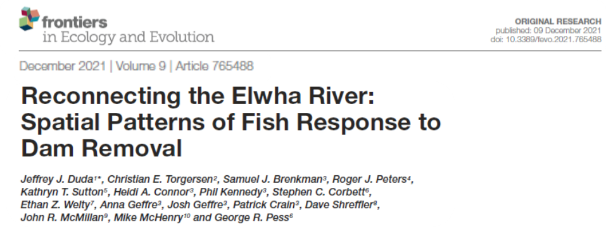
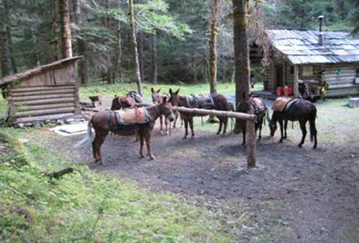
Duda et al. 2021. Frontiers in Ecology and Evolution
Riverscape Snorkel Surveys
The “Riverscape Approach”
Spatially continuous adult and juvenile fish counts in 22 reaches from headwaters to the sea (avoiding 3-4 canyons).
2 before, 2 after dam removal
4 teams of 4/5 biologists sampling
Divers identify and count adult fish and the presence of juveniles.
  Adults: Bull Trout, Resident Trout, Chinook salmon, Steelhead
  Juveniles: Coho, Chinook, Trout
Photos: NPS and USGS
Notes:
*So we applied the Riverscape Approach in designing snorkel surveys of the Elwha. The spatially continuous survey counted adult fish and noted presence of juveniles from the headwaters to the sea. Data were binned into 22 different reaches to look at spatial patterns, but for 3 of the 4 surveys we have data on a finer habitat unit scale as well.
*We conducted 2 surveys before dam removal in 2007 and 2008 and 2 surveys after dam removal in 2018 and 2019, a time period when the major dam removal effects from sediment release had largely dissipated.
*We used over 20 people, most of them volunteers from collaborating agencies and the Lower Elwha Klallam Tribe, divided into 4 teams. Two of the teams covering the upper watershed had to backpack into the upper watershed assisted with pack mules.
*Surveys occurred in the late summer, and so the focal species were Chinook salmon and steelhead adults, resident and bull trout, and juvenile coho.
*The methods and results are described more fully in our recent pub in Frontiers in ecology and the environment.
For the Elwha, we used 4 teams of 4-5 biologists to continuously snorkel 22 reaches from the upper extent of anadromy to the mouth of the river, avoiding 3 or 4 canyons for safety. Divers identify fish by species and count their numbers, focused on adult bull, resident trout (mostly rainbow, but a few cutthroat), chinook salmon and steelhead. For juveniles, we documented the presence of coho, chinook and trout.

Slide 31
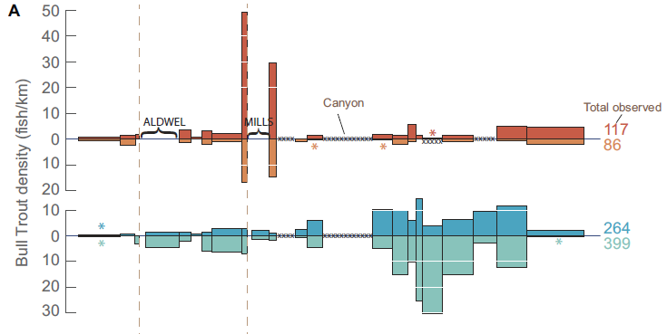
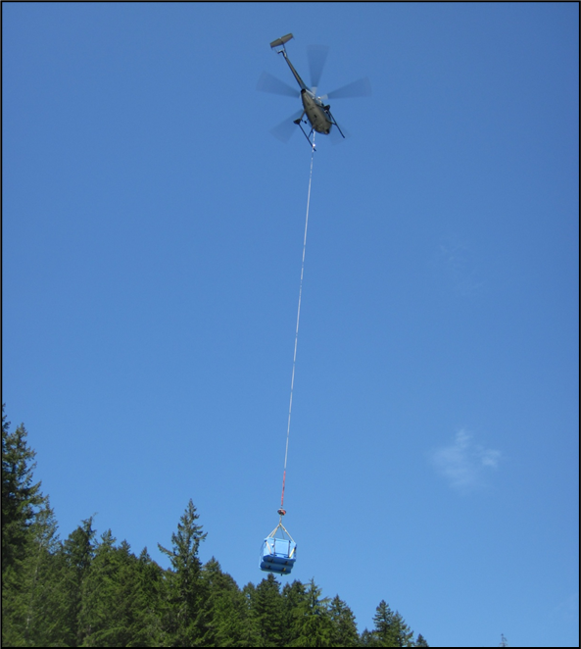
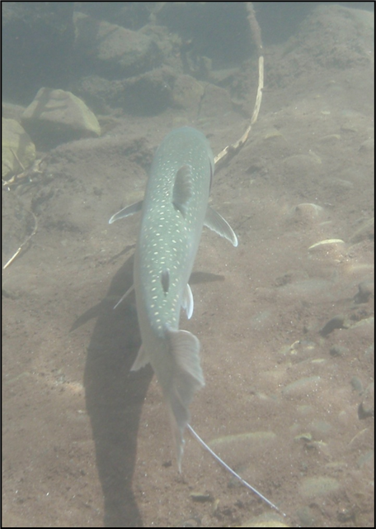
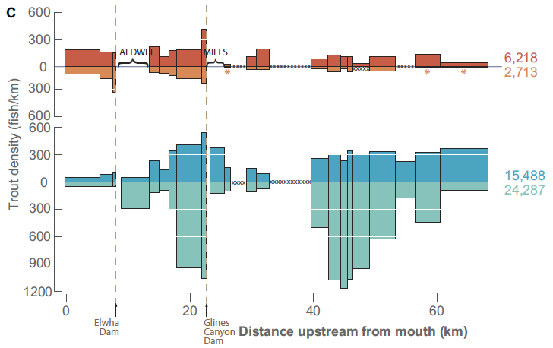
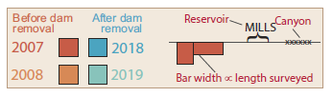
Snorkel Survey Results: Bull Trout
Widely distributed before and after dam removal
Before dam removal, two “hot spots” associated with upper dam and reservoir
  Leads to focused “fish rescue and relocation” effort before dam removal
Higher densities in most reaches after dam removal
Upstream shift in higher density reaches
Bull trout ‘hot spots’
National Park Service
Duda et al. 2021. Front. Ecol. Evol.
Notes:
So lets get into the main results of the Elwha Riverscapes. Here is a graph showing the spatial distribution of fish density for bull trout. The width of each bar represents the length of each reach. Warm colors are the pre-dam removal surveys in 2007 and 2008 and the post dam removal surveys are in cool colors.
Bull trout were widely distributed before and after dam removal. The patterns of fish density were fairly consistent between the pairs of surveys, with a high correlation before dam removal and a moderate one after dam removal. This showed that although we were not counting every fish, that there was pretty stable and repeatable spatial patterns between years.
There was a peak, or hot spot of bull trout associated with the Mills reservoir before dam removal. The National Park Service used that information top direct fish rescue efforts prior to dam removal, where as many bull trout as possible were collected from the project area and moved out of harms way to upstream areas. Some of the fish were implanted with radio transmitters and over 90% of them remained in those upstream areas.
After dam removal, there were higher densities in most reaches and an upstream shift in higher density reaches. With the ability to freely migrate the entirety of the Elwha, bull trout seem to be favoring upstream areas with colder water.

Slide 32
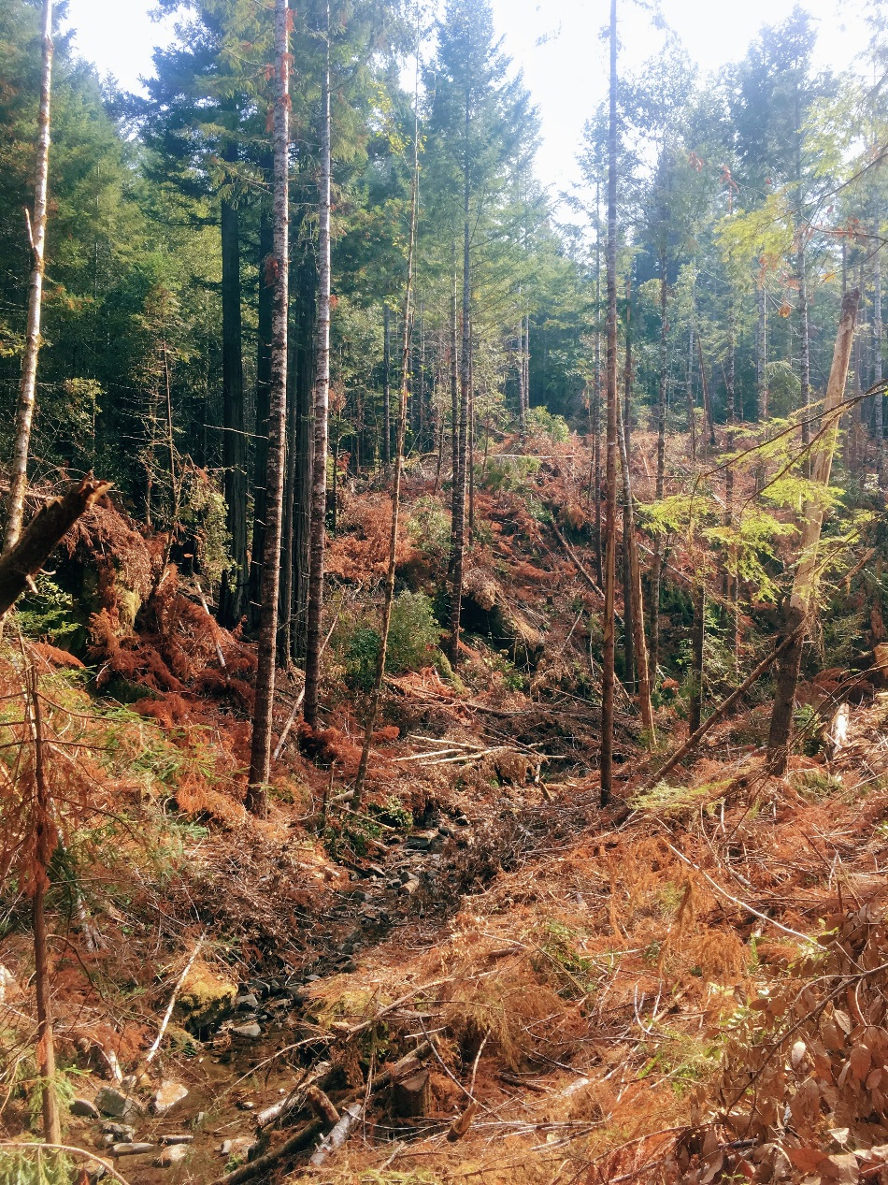
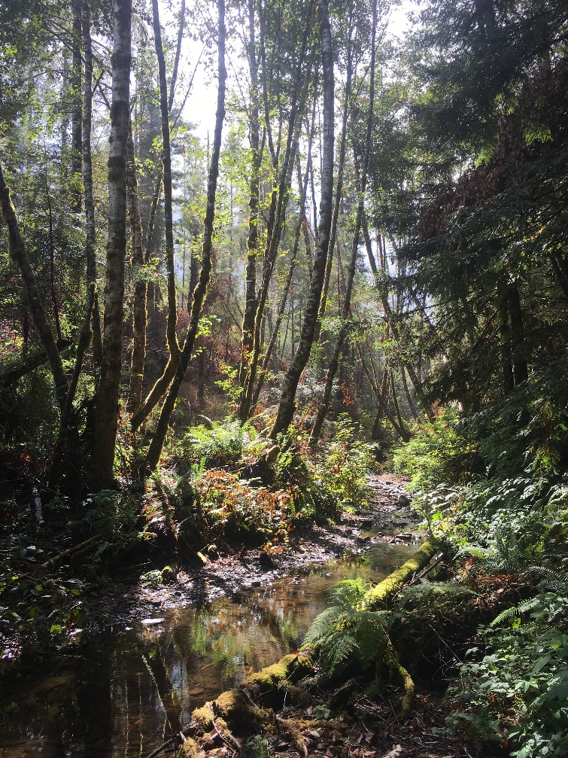
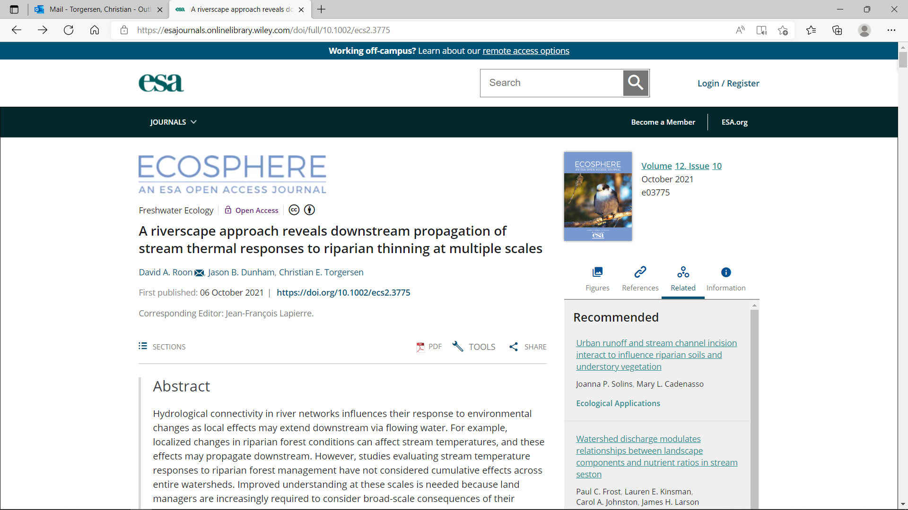
Effects of riparian thinning on stream temperature
(Roon et al. 2021)
Applications
A riverscape approach reveals downstream propagation of stream thermal responses to riparian thinning at multiple scales
Photos by D. Roon (with permission)

Slide 33
Experimental design
BACI design
  Upstream reference, thinned, and downstream reaches
  Before and after thinning
Replicated at 10 locations across 3 watersheds
Data collection occurred seasonally (Spring, Summer, Fall)

Slide 34
Watershed-scale patterns in stream temperature

Slide 35
New frontiers: Spatially continuous patterns over time

Slide 36
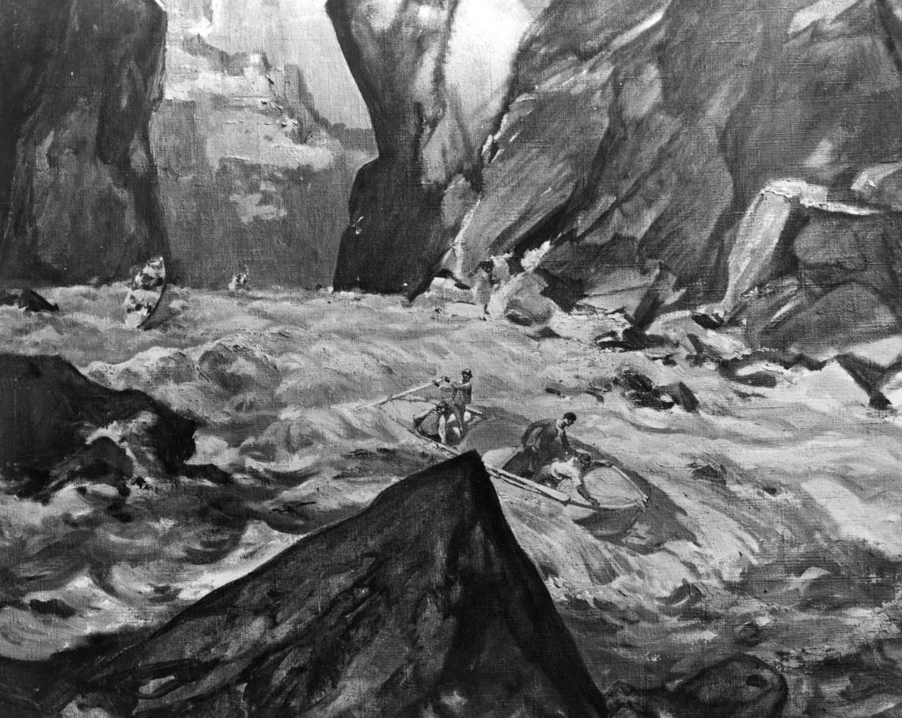
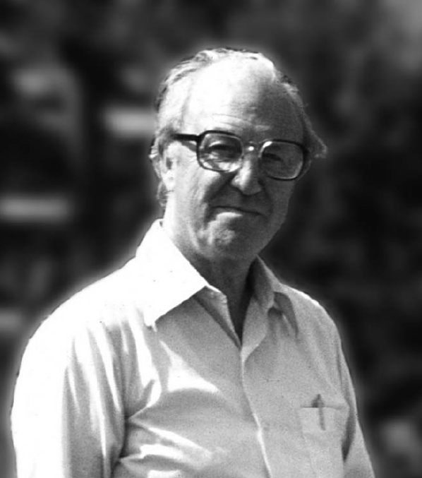
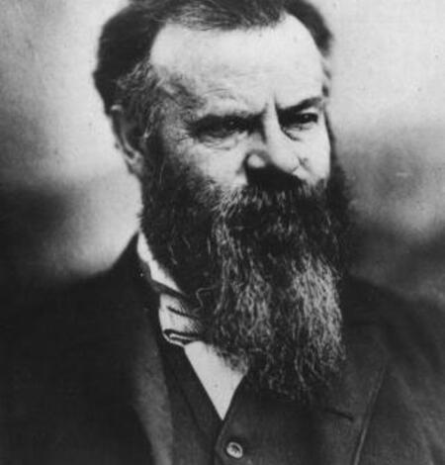
Powell Geographic Expedition of 1869
John Wesley Powell and party in the Grand Canyon | U.S. Geological Survey (usgs.gov)
John Wesley Powell | U.S. Geological Survey (usgs.gov)
H.B. Noel Hynes (1917-2009)
https://www.tandfonline.com/doi/pdf/10.1080/01650420903003763
Harper, P. 2009. Aquatic Insects

Slide 37
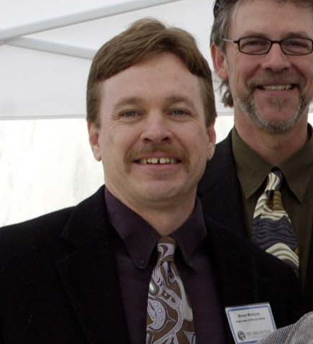


Bruce McIntosh
Jim Sedell (1944-2012)
Gordie Reeves

Slide 38
What’s next?
Investigating communities and ecosystem processes
Food webs, nutrient spiraling, metabolism
Notes:
Here are the same graphs for Chinook salmon. Before dam removal, chinook were limited to areas downstream of the Elwha Dam. After dam removal, adults were detected upstream of each dam, but you can see that densities were highest downstream of the former Glines Canyon dam. Densities in the former lake mills reservoir and geyser valley were generally higher in the second post dam removal survey, but you can see that very few fish were detected upstream of the Grand Canyon of the Elwha.
Summer Steelhead were scarce on the Elwha prior to dam removal, and we didn’t detect any in our surveys. After dam removal, however, we saw a large increase. This is presumably a reawakening of anadromy from upriver populations of resident rainbow, and genetic evidence by Alex Fraik and colleages support this hypothesis. I’m not sure if Elwha Summer Steelhead motivated the theme for this year’s conference, but the notion of the phoenix rising from the ashes in the Elwha was coined by John McMillan a few years ago to describe this remarkable turn around in steelhead. There is a short documentary on our riverscape surveys that you can find on youtube to get some more information about the project, with a focus on steelhead.

Slide 39
Notes:
Here are the same graphs for Chinook salmon. Before dam removal, chinook were limited to areas downstream of the Elwha Dam. After dam removal, adults were detected upstream of each dam, but you can see that densities were highest downstream of the former Glines Canyon dam. Densities in the former lake mills reservoir and geyser valley were generally higher in the second post dam removal survey, but you can see that very few fish were detected upstream of the Grand Canyon of the Elwha.
Summer Steelhead were scarce on the Elwha prior to dam removal, and we didn’t detect any in our surveys. After dam removal, however, we saw a large increase. This is presumably a reawakening of anadromy from upriver populations of resident rainbow, and genetic evidence by Alex Fraik and colleages support this hypothesis. I’m not sure if Elwha Summer Steelhead motivated the theme for this year’s conference, but the notion of the phoenix rising from the ashes in the Elwha was coined by John McMillan a few years ago to describe this remarkable turn around in steelhead. There is a short documentary on our riverscape surveys that you can find on youtube to get some more information about the project, with a focus on steelhead.

Slide 40
Notes:
Here are the same graphs for Chinook salmon. Before dam removal, chinook were limited to areas downstream of the Elwha Dam. After dam removal, adults were detected upstream of each dam, but you can see that densities were highest downstream of the former Glines Canyon dam. Densities in the former lake mills reservoir and geyser valley were generally higher in the second post dam removal survey, but you can see that very few fish were detected upstream of the Grand Canyon of the Elwha.
Summer Steelhead were scarce on the Elwha prior to dam removal, and we didn’t detect any in our surveys. After dam removal, however, we saw a large increase. This is presumably a reawakening of anadromy from upriver populations of resident rainbow, and genetic evidence by Alex Fraik and colleages support this hypothesis. I’m not sure if Elwha Summer Steelhead motivated the theme for this year’s conference, but the notion of the phoenix rising from the ashes in the Elwha was coined by John McMillan a few years ago to describe this remarkable turn around in steelhead. There is a short documentary on our riverscape surveys that you can find on youtube to get some more information about the project, with a focus on steelhead.

Slide 41
Notes:
Here are the same graphs for Chinook salmon. Before dam removal, chinook were limited to areas downstream of the Elwha Dam. After dam removal, adults were detected upstream of each dam, but you can see that densities were highest downstream of the former Glines Canyon dam. Densities in the former lake mills reservoir and geyser valley were generally higher in the second post dam removal survey, but you can see that very few fish were detected upstream of the Grand Canyon of the Elwha.
Summer Steelhead were scarce on the Elwha prior to dam removal, and we didn’t detect any in our surveys. After dam removal, however, we saw a large increase. This is presumably a reawakening of anadromy from upriver populations of resident rainbow, and genetic evidence by Alex Fraik and colleages support this hypothesis. I’m not sure if Elwha Summer Steelhead motivated the theme for this year’s conference, but the notion of the phoenix rising from the ashes in the Elwha was coined by John McMillan a few years ago to describe this remarkable turn around in steelhead. There is a short documentary on our riverscape surveys that you can find on youtube to get some more information about the project, with a focus on steelhead.

Slide 42
Collaborators
Céline Le Pichon², Aimee Fullerton³, Steve Dugdale⁴, Jeff Duda⁵, Floriane Giovannini⁶, Évelyne Tales², Jérôme Belliard², Paulo Branco⁷, Normand Bergeron⁸ , Mathieu Roy⁹, Diego Tonolla¹⁰, Nicolas Lamouroux¹¹, Hervé Capra¹¹, Colden Baxter^{12,} Sam Brenkman¹³, Roger Peters¹⁴, Kathryn Sutton¹⁵, David Roon¹⁶, Jason Dunham¹, ¹⁷Ethan Welty, and many others.
¹U.S. Geological Survey, ²INRAE, HYCAR, Université Paris-Saclay (France), ³NOAA, ⁴ University of Nottingham (UK), ⁷Universidade de Lisboa (Portugal), ⁸INRS (Québec, Canada), ⁹Environment and Climate Change Canada (Québec), ¹⁰Zurich University of Applied Sciences (Switzerland), ¹¹INRAE (France), ¹²Idaho State University, ¹³National Park Service, ¹⁴U.S. Fish and Wildlife Service, ¹⁵WA Dept. of Fish and Wildlife, ¹⁶Oregon State University, ¹⁷University of Zurich

Slide 43
Snorkel Survey Results: “Trout”
‘Trout’ = mostly rainbow, but also cutthroat
Widely distributed before and after dam removal
Higher densities in most reaches after dam removal, except downstream of former Elwha Dam
Shift in higher density reaches upstream
Duda et al. 2021. Front. Ecol. Evol.
Notes:
Because they are difficult to distinguish between Rainbow trout and Cutthroat trout Trout, which again is mostly rainbow trout, were also widely distributed before and after dam removal. The Elwha really is a rainbow trout river these days. There was a large increase in fish density after dam removal in most reaches, and like bull trout a shift in higher density reaches upstream. A commercial and recreational fishing moratorium in place for the last 10 years, and/or marine derived nutrients might be contributing to the increase in trout in the system.

Slide 44


Snorkel Survey Results: Chinook & Steelhead
Chinook
Before dam removal, Chinook limited to downstream of Elwha Dam
Adults detected upstream of each dam, but densities highest in reaches downstream of Glines Canyon
Limited incursion into uppermost reaches upstream of the Grand Canyon
Summer Steelhead
Scarce before dam removal
Large increases, presumed “re-awakening of anadromy” from resident trout populations (Fraik et al. 2021).
Steelhead ‘hotspot’ detected upstream of Grand Canyon.
Duda et al. 2021. Front. Ecol. Evol.
Notes:
Here are the same graphs for Chinook salmon. Before dam removal, chinook were limited to areas downstream of the Elwha Dam. After dam removal, adults were detected upstream of each dam, but you can see that densities were highest downstream of the former Glines Canyon dam. Densities in the former lake mills reservoir and geyser valley were generally higher in the second post dam removal survey, but you can see that very few fish were detected upstream of the Grand Canyon of the Elwha.
Summer Steelhead were scarce on the Elwha prior to dam removal, and we didn’t detect any in our surveys. After dam removal, however, we saw a large increase. This is presumably a reawakening of anadromy from upriver populations of resident rainbow, and genetic evidence by Alex Fraik and colleages support this hypothesis. I’m not sure if Elwha Summer Steelhead motivated the theme for this year’s conference, but the notion of the phoenix rising from the ashes in the Elwha was coined by John McMillan a few years ago to describe this remarkable turn around in steelhead. There is a short documentary on our riverscape surveys that you can find on youtube to get some more information about the project, with a focus on steelhead.

Slide 45

How do local responses propagate downstream?
Waveforms

Slide 46
Downstream propagation of local responses
flow

Slide 47
Snorkel Survey Results: Bull Trout
Widely distributed before and after dam removal
Riverscape patterns between years highly correlated before dam removal, moderately so after.
Before dam removal, two “hot spots” associate with upper dam and reservoir
  Leads to focused “fish rescue and relocation” effort before dam removal
Higher densities in most reaches after dam removal
Upstream shift in higher density reaches
Bull trout ‘hot spots’
National Park Service
Duda et al. 2021. Front. Ecol. Evol.
Notes:
So lets get into the main results of the Elwha Riverscapes. Here is a graph showing the spatial distribution of fish density for bull trout. The width of each bar represents the length of each reach. Warm colors are the pre-dam removal surveys in 2007 and 2008 and the post dam removal surveys are in cool colors.
Bull trout were widely distributed before and after dam removal. The patterns of fish density were fairly consistent between the pairs of surveys, with a high correlation before dam removal and a moderate one after dam removal. This showed that although we were not counting every fish, that there was pretty stable and repeatable spatial patterns between years.
There was a peak, or hot spot of bull trout associated with the Mills reservoir before dam removal. The National Park Service used that information top direct fish rescue efforts prior to dam removal, where as many bull trout as possible were collected from the project area and moved out of harms way to upstream areas. Some of the fish were implanted with radio transmitters and over 90% of them remained in those upstream areas.
After dam removal, there were higher densities in most reaches and an upstream shift in higher density reaches. With the ability to freely migrate the entirety of the Elwha, bull trout seem to be favoring upstream areas with colder water.

Slide 48

Snorkel Survey Results: “Trout”
‘Trout’ = mostly rainbow, but also cutthroat
Widely distributed before and after dam removal
Riverscape patters between years moderately correlated before and after dam removal
Higher densities in most reaches after dam removal, except downstream of former Elwha Dam
Shift in higher density reaches upstream
Duda et al. 2021. Front. Ecol. Evol.
Notes:
Because they are difficult to distinguish between Rainbow trout and Cutthroat trout Trout, which again is mostly rainbow trout, were also widely distributed before and after dam removal. The Elwha really is a rainbow trout river these days. There was a large increase in fish density after dam removal in most reaches, and like bull trout a shift in higher density reaches upstream. A commercial and recreational fishing moratorium in place for the last 10 years, and/or marine derived nutrients might be contributing to the increase in trout in the system.

Slide 49
Snorkel Survey Results: Chinook & Steelhead
Chinook
Before dam removal, Chinook limited to downstream of Elwha Dam
Adults detected upstream of each dam, but densities highest in reaches downstream of Glines Canyon
Limited incursion into uppermost reaches upstream of the Grand Canyon
Summer Steelhead
Scarce before dam removal
Large increases, presumed “re-awakening of anadromy” from resident trout populations (Fraik et al. 2021).
Steelhead ‘hotspot’ detected upstream of Grand Canyon.
Duda et al. 2021. Front. Ecol. Evol.
Notes:
Here are the same graphs for Chinook salmon. Before dam removal, chinook were limited to areas downstream of the Elwha Dam. After dam removal, adults were detected upstream of each dam, but you can see that densities were highest downstream of the former Glines Canyon dam. Densities in the former lake mills reservoir and geyser valley were generally higher in the second post dam removal survey, but you can see that very few fish were detected upstream of the Grand Canyon of the Elwha.
Summer Steelhead were scarce on the Elwha prior to dam removal, and we didn’t detect any in our surveys. After dam removal, however, we saw a large increase. This is presumably a reawakening of anadromy from upriver populations of resident rainbow, and genetic evidence by Alex Fraik and colleages support this hypothesis. I’m not sure if Elwha Summer Steelhead motivated the theme for this year’s conference, but the notion of the phoenix rising from the ashes in the Elwha was coined by John McMillan a few years ago to describe this remarkable turn around in steelhead. There is a short documentary on our riverscape surveys that you can find on youtube to get some more information about the project, with a focus on steelhead.

